Slide 1
Building Touch Apps with UI for WPF
Michael Crump | @mbcrump | michaelcrump.net

Slide 2
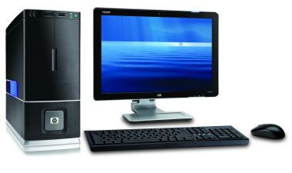
The Desktop

Slide 3
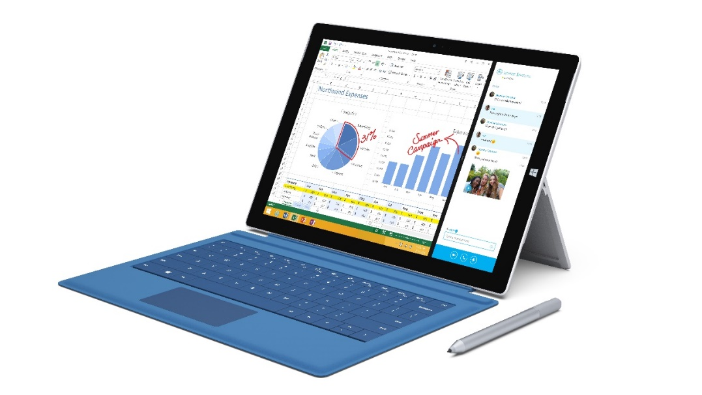
With Windows 8 - Surface Tablets

Slide 4
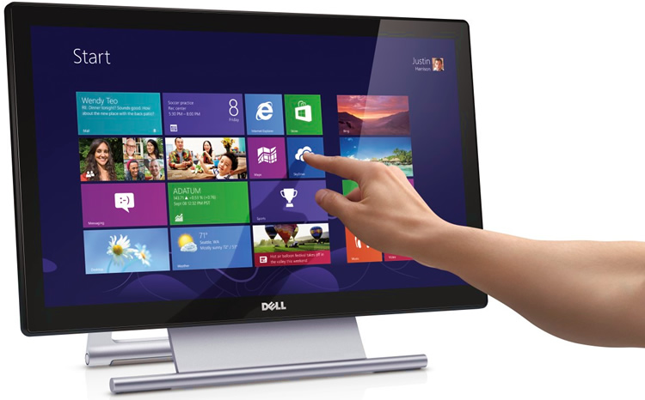
With Windows 8 - Screen

Slide 5
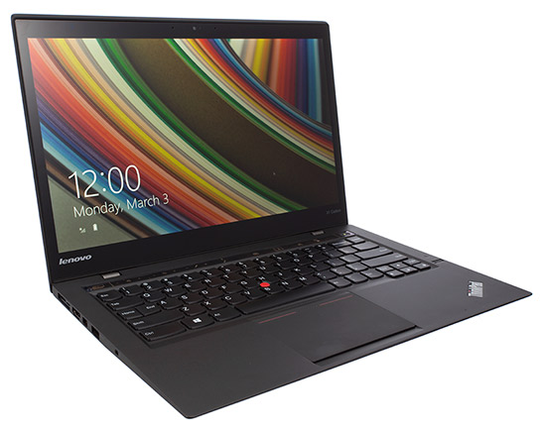
With Windows 8 - Laptop

Slide 6
We heard the Windows 8 message loud and clear…

Slide 7
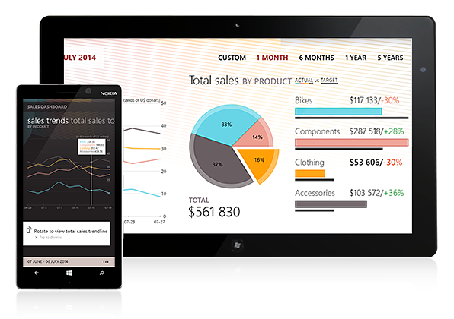
Windows 8 Controls

Slide 8
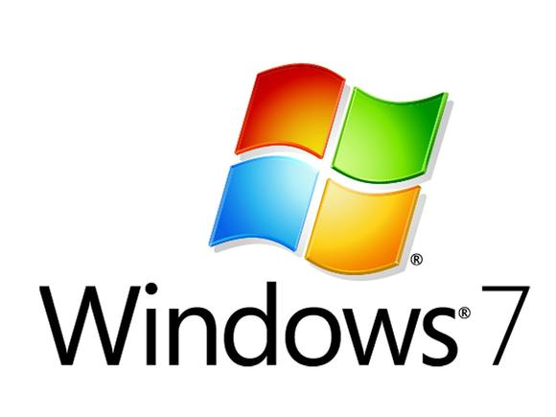

..but what about earlier versions of Windows?

Slide 9
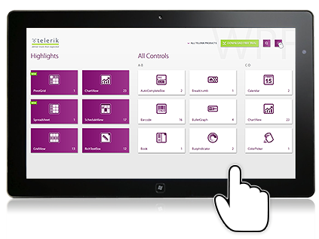
Touch-Enabled Controls for WPF

Slide 10

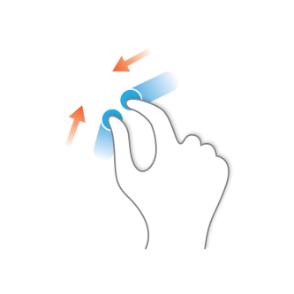
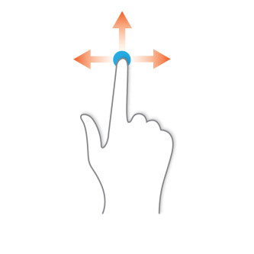
Most commonly used Gestures (Swipe, Pinch, Tap) 1/2

Slide 11
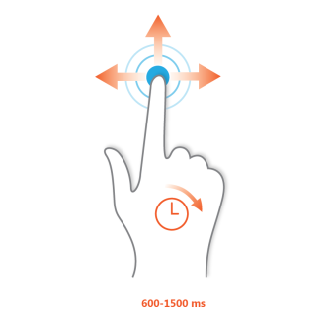
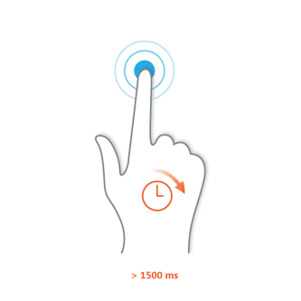
Most commonly used Gestures (Tap & Move, Tap & Hold) 2/2

Slide 12
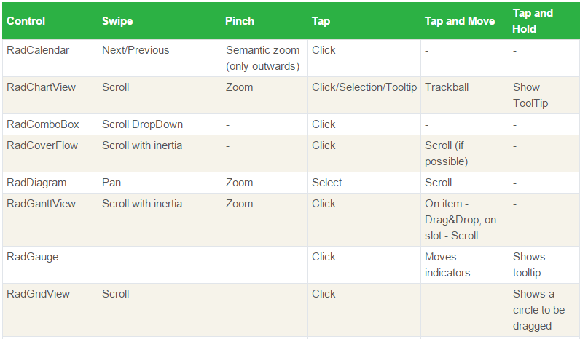
Telerik UI for WPF Controls

Slide 13
Now that the touch interaction was built-in, we needed to style our controls.

Slide 14
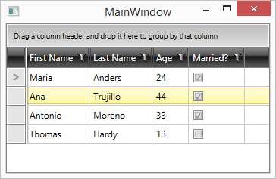
Default RadGridView

Slide 15
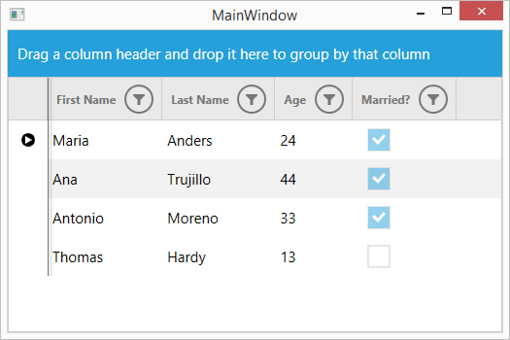
RadGridView with Windows8Touch Theme

Slide 16
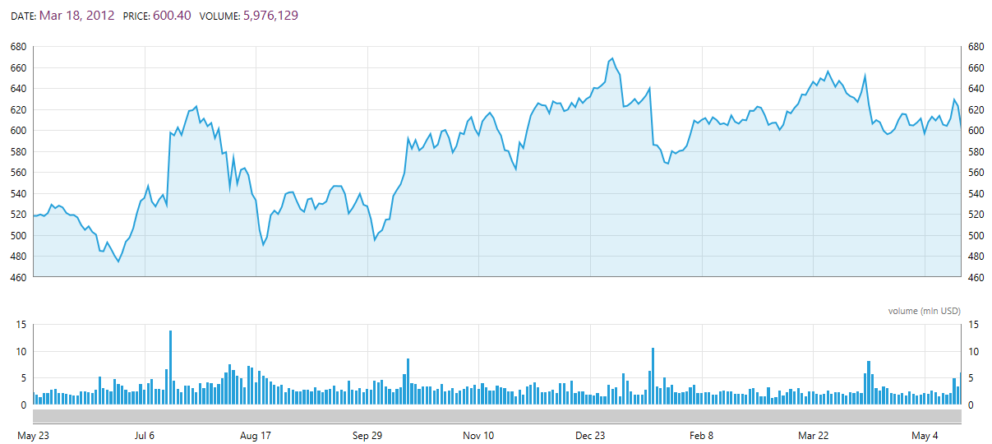
RadChartView

Slide 17
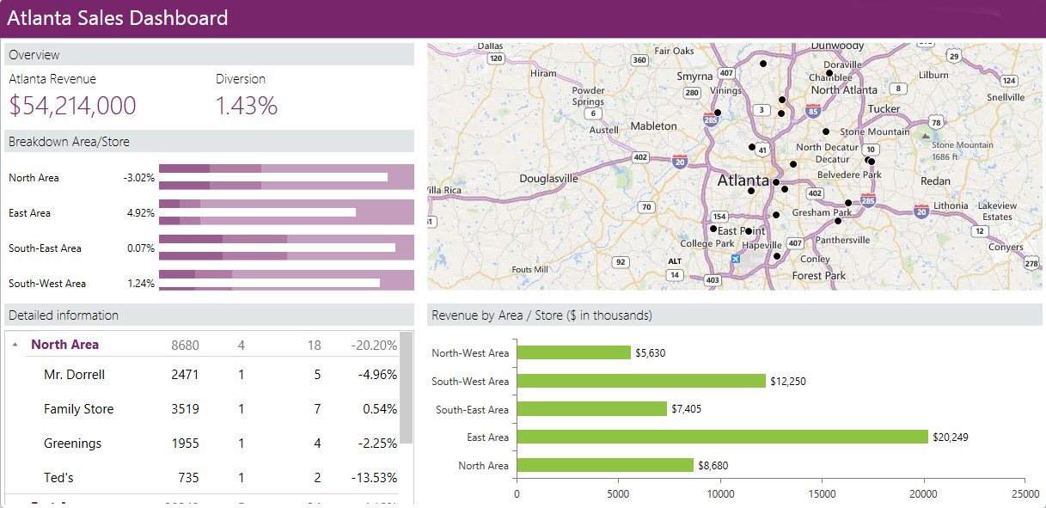
Maps

Slide 18
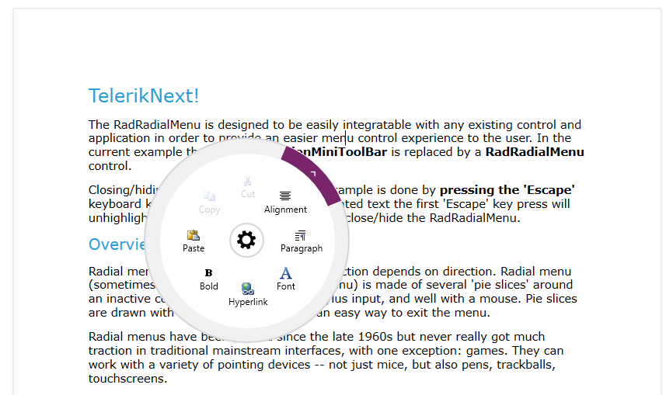
RadRadialMenu

Slide 19
But what if you’re wanting the Windows 8.1 look and feel?

Slide 20
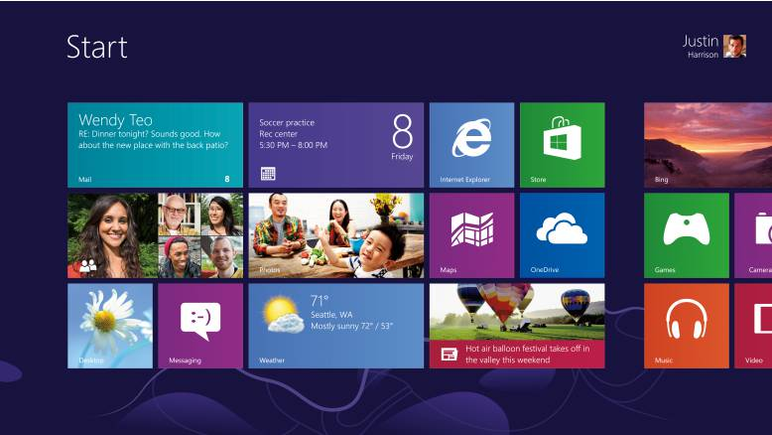

Slide 21
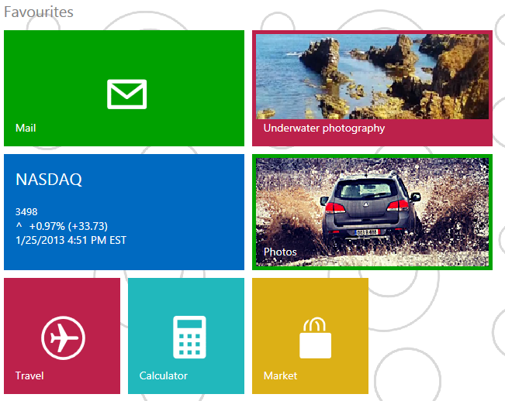
RadTileList

Slide 22
Demos!

Slide 23
Thanks! Q&A Time
Slides/Code: https://github.com/mbcrump/TelerikNextWPF
Session Survey: http://bit.ly/next-crump-1

