Slide 1



Using Kendo UI in Office 365
And/Or SharePoint 2013 On Premise
Ed Musters, SharePoint MVP, Infusion
emusters@infusion.com
@TechEdToronto
Slides available now at:
http://slideshare.net/emusters

Slide 2
Presentation Summary
You can create custom data schema (SharePoint Lists) for SharePoint Online declaratively in Visual Studio (i.e. with tooling VS provides). Kendo UI then makes very short work of creating a powerful user interface. Even if you have never customized SharePoint before, you will be surprised how rapidly you can learn everything you need to do from a programming, packaging, and deployment perspective to start developing with SharePoint Online now! Productivity at a level you did not think possible, guaranteed!
Audience: Developer
Level: 100
Pre-Requisites: Knowledge of Kendo UI, basic SP developer knowledge

Slide 3
Session Evaluation! Win Prizes!
http://bit.ly/next-musters
Or use the TelerikNEXT App

Slide 4
Terminology
Office 365 is an extensive offering
SharePoint Online is part of that offering
We’ll refer to SharePoint Online and Office 365 interchangeably
Everything we do here you can also do with your On Premise version of SharePoint 2013

Slide 5

Look for the .NET Ninja!
This symbol will point you to important tips and insider knowledge that will show you are a pro!

Slide 6





{ About.Me() }
Current SharePoint MVP – 11th year!
Author for two SP development books
SharePoint Architect for Infusion
Speaker at International Conferences on SharePoint, at user groups, and at SharePoint Saturdays
Certified Trainer for the industry leading SharePoint training from Critical Path Training
Harley-Davidson ™ Enthusiast!
https://mvp.support.microsoft.com/profile/Ed.Musters

Slide 7




And, yes, I do really have a Black Belt. ☺

Slide 8
Agenda
The SharePoint Team Site
How To – SP 2013 VS Tools and Features
How To – SharePoint Lists (Schema)
How To – Deploy Kendo UI to SharePoint
How To – Kendo UI Grid in SP 2013
How To – Grid Reading From SP List
Where to go from here?

Slide 9
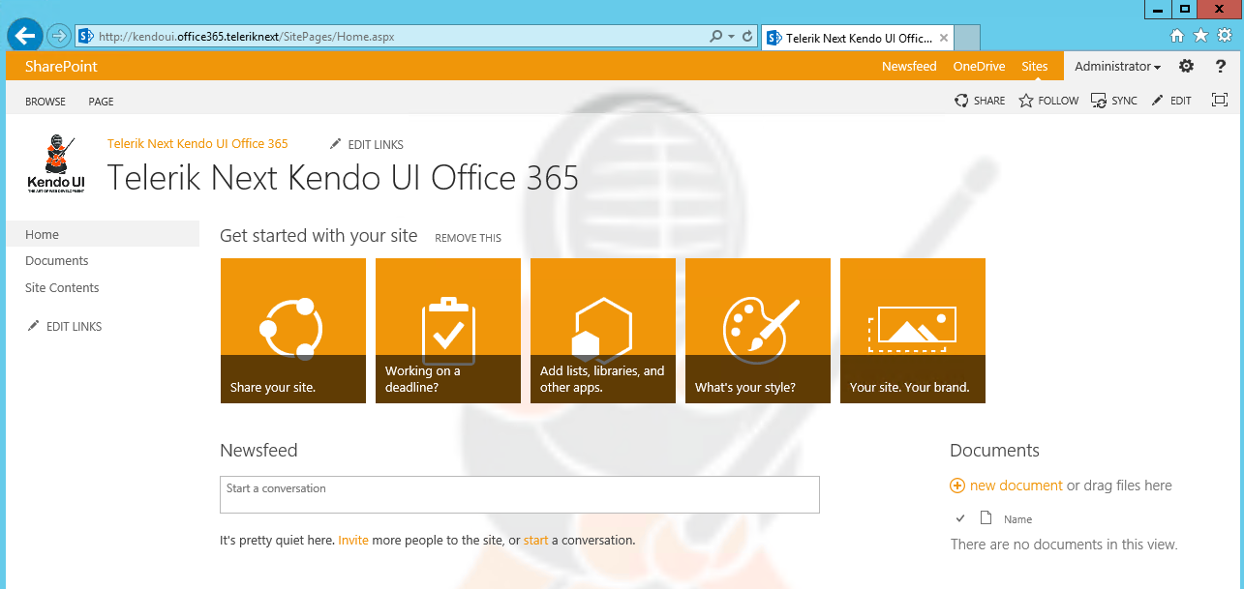
The SharePoint Team Site

Slide 10
Why Kendo UI in SharePoint?
SharePoint is great for browser based customizations, SharePoint designer customizations, and easy no code solutions with Visual Studio
Creating great user experiences (UI) in SharePoint, however, is not so easy!
Presenting… Kendo UI in SharePoint!

Slide 11
Agenda
The SharePoint Team Site
How To – SP 2013 VS Tools and Features
How To – SharePoint Lists (Schema)
How To – Deploy Kendo UI to SharePoint
How To – Kendo UI Grid in SP 2013
How To – Grid Reading From SP List
Where to go from here?

Slide 12
SP2013 Declarative SandBox Solutions
A solution deployment file, with extension of WSP
Deploy your SharePoint customizations
Contains features with elements that (primarily) provisions files to the site collection (e.g. JS and CSS)
Provision schema (site columns, content types, lists) and more!
All done through “declarative” XML, no compiled C# code!
Features scoped only to one specific site collection
Compatible for Office 365 and On Premise

Slide 13
What are we going to deploy?
A Kendo UI Solution for Office 365
Deploy Kendo UI JS and Styles to site collection
Provision custom schema – site column, content type, and list – to store “Telerik Contacts”
Reference Telerik JS and CSS files globally through “custom actions”
Create a page and configure it with Kendo UI script samples that will read SharePoint data

Slide 14
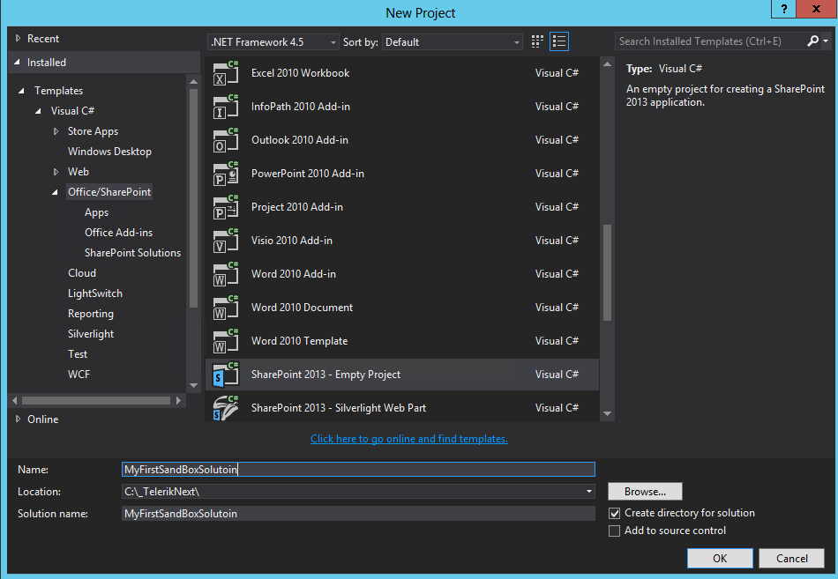
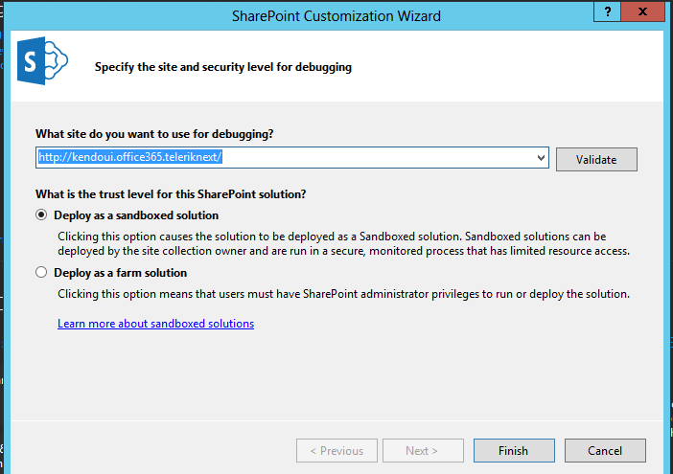
How To – VS SharePoint Tools

Slide 15
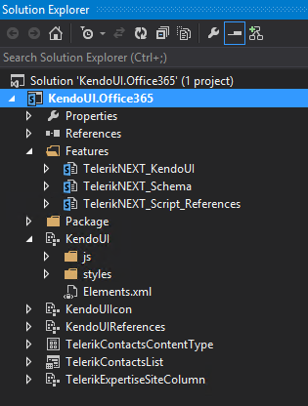
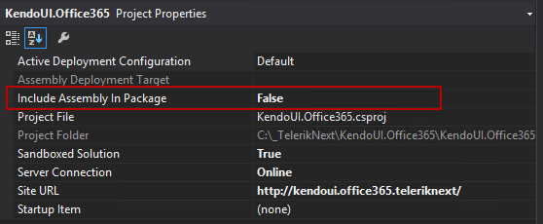
How To – VS SharePoint Tools

Slide 16
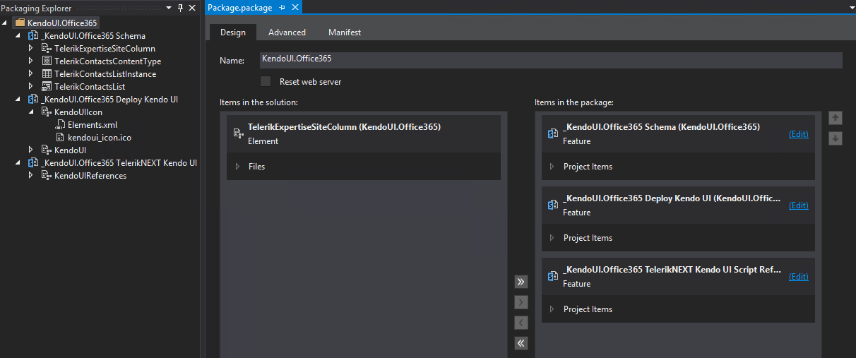
Solution (WSP) Contains 3 Features

Slide 17
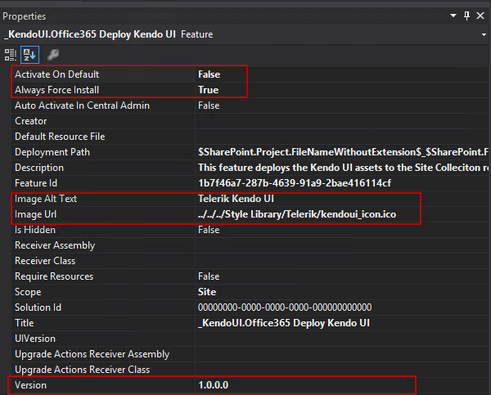
Important Feature Properties

Slide 18
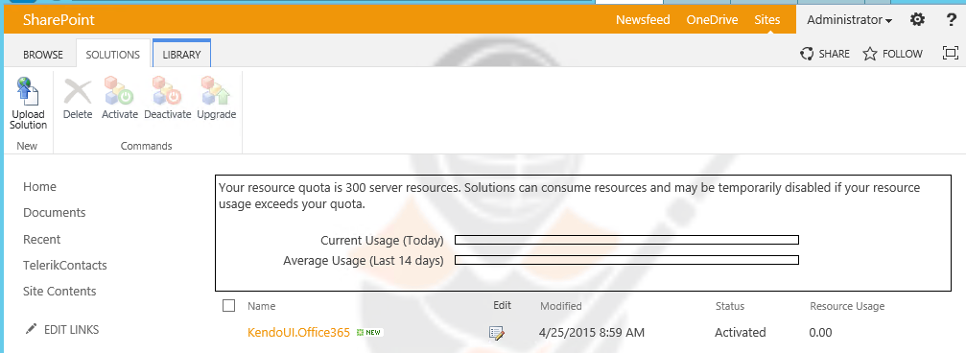
Solution is uploaded to Solution Gallery
Don’t worry, declarative Sandbox Solutions NEVER consume resources!

Slide 19
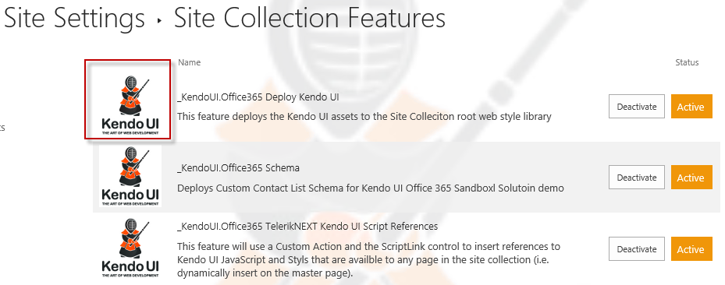
Features are available and activated
Yes! You can get a feature Icon in a Sandbox feature. This is a very pro touch!

Slide 20
Agenda
The SharePoint Team Site
How To – SP 2013 VS Tools and Features
How To – SharePoint Lists (Schema)
How To – Deploy Kendo UI to SharePoint
How To – Kendo UI Grid in SP 2013
How To – Grid Reading From SP List
Where to go from here?

Slide 21
Telerik Contacts List
Goal is to take the OOTB Contacts List
Add a custom choice column of “Telerik Expertise”
Create a custom Content type
Create a custom List Definition and instance

Slide 22
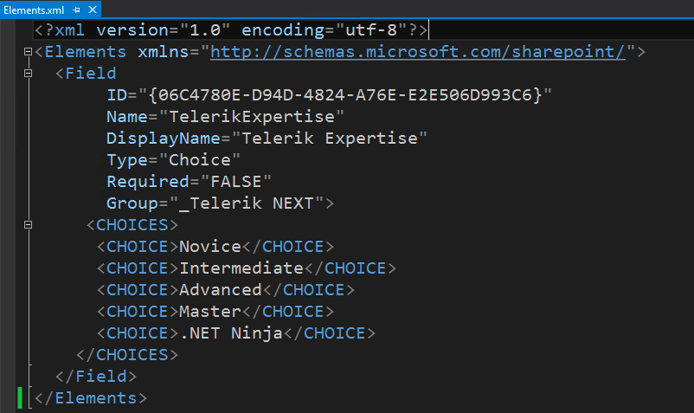
Telerik Expertise Site Column

Slide 23
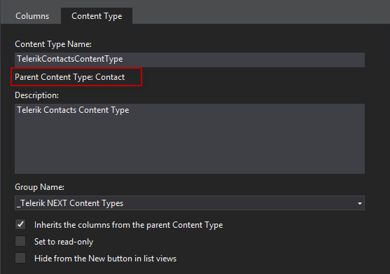
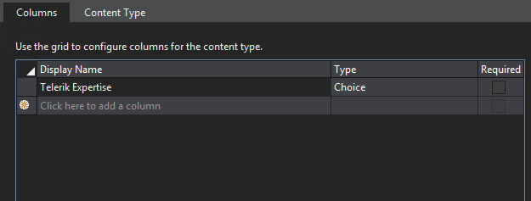
Content Type Telerik Contacts

Slide 24
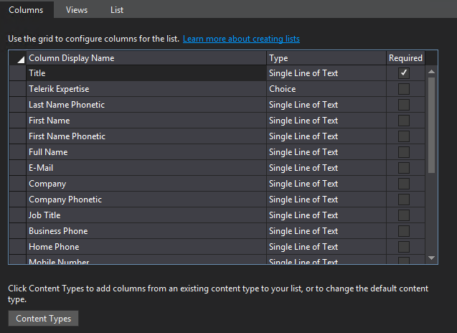
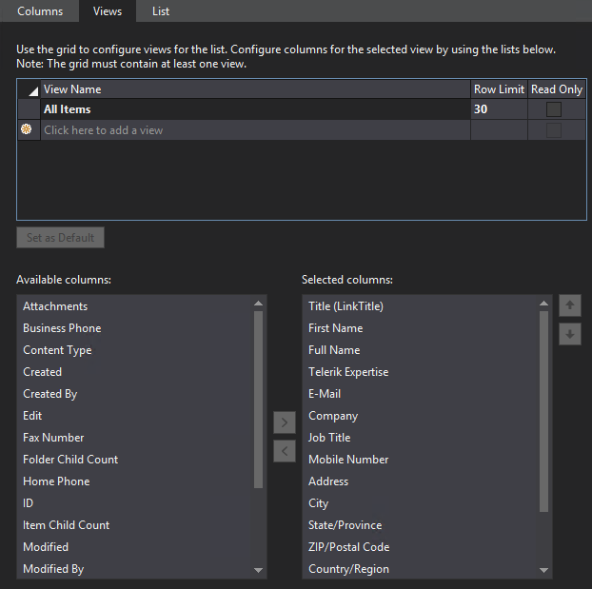
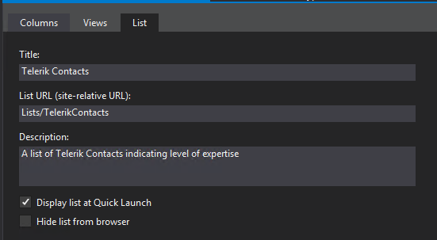
List Definition and Instance

Slide 25
Agenda
The SharePoint Team Site
How To – SP 2013 VS Tools and Features
How To – SharePoint Lists (Schema)
How To – Deploy Kendo UI to SharePoint
How To – Kendo UI Grid in SP 2013
How To – Grid Reading From SP List
Where to go from here?

Slide 26
Deploy Kendo UI to SharePoint
To deploy Kendo UI, deploy JavaScript and Styles directories
Use Module element to deploy files to the Site Collection Style Library
Create module element, simply drag drop files into project folder!

Slide 27
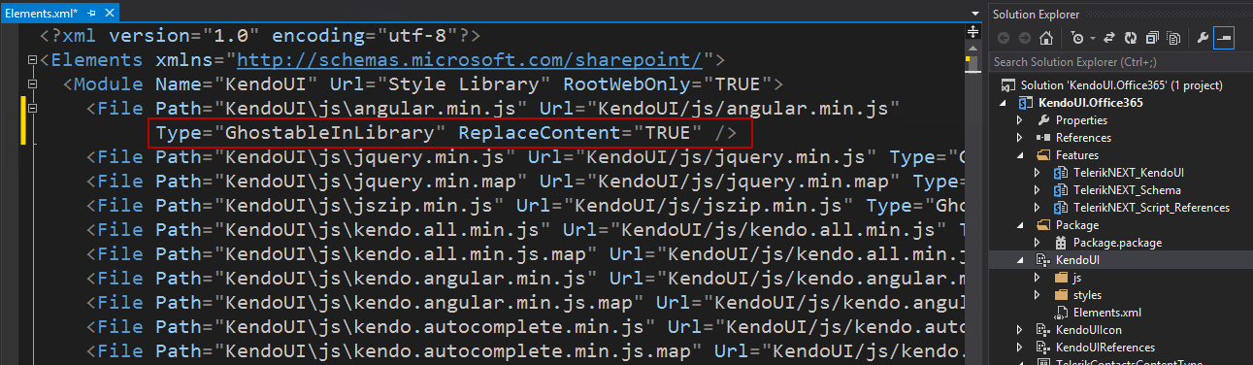
Deploy Kendo UI files
Specify ReplaceContent=“True”, so that updated files when re-deployed will get overwritten

Slide 28
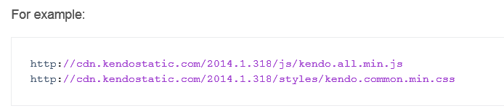
Alternative – use the CDN
http://docs.telerik.com/kendo-ui/install/cdn

Slide 29
Agenda
The SharePoint Team Site
How To – SP 2013 VS Tools and Features
How To – SharePoint Lists (Schema)
How To – Deploy Kendo UI to SharePoint
How To – Kendo UI Grid in SP 2013
How To – Grid Reading From SP List
Where to go from here?

Slide 30
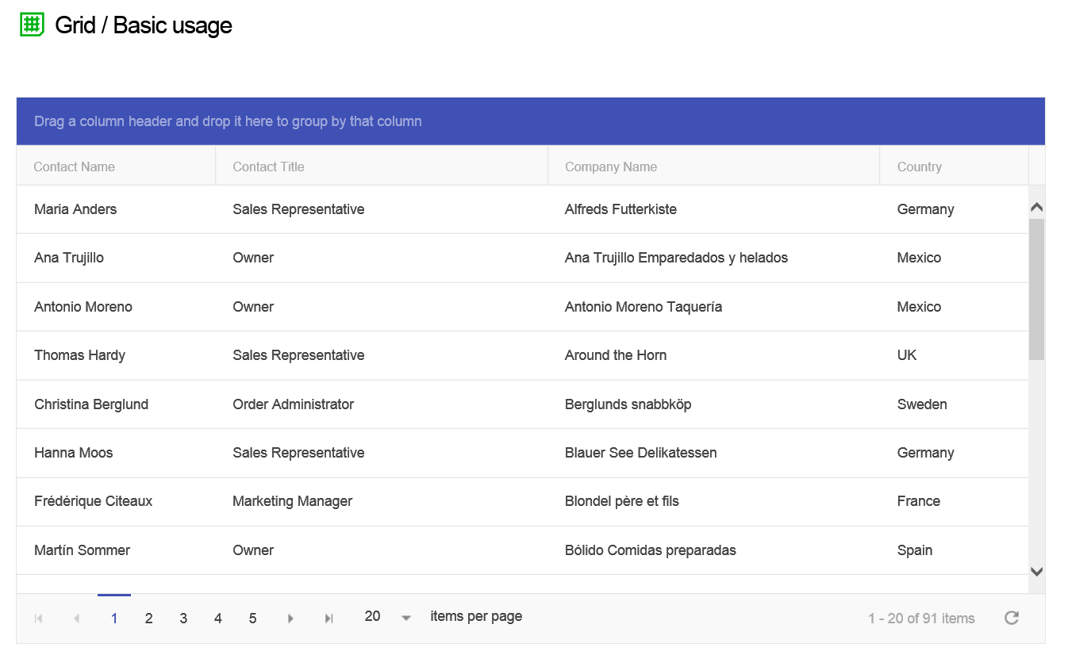
Deploy Basic Grid Demo to SharePoint
Uses “Northwind Customers” service, see:
http://demos.telerik.com/kendo-ui/grid/index

Slide 31
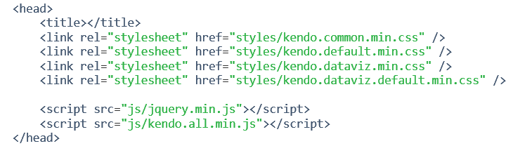
Step 1: Deploy Kendo UI Reference
The demo uses 4 CSS and 2 JS references

Slide 32
SharePoint Master Page
SharePoint has a special ASP.NET Master page called “seattle.master” in the Master Page gallery
A perfectly valid option is to copy this OOTB master page, then modify it to include desired Kendo UI references
Instead we’ll use another method to “inject” references to the site collection without need of custom master pages

Slide 33
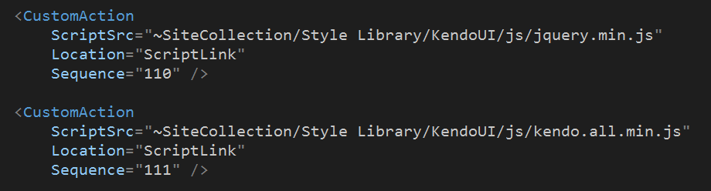
Reference JS in SharePoint Master Page
Use Empty Element and Custom Action to get a “Script Link” into the master page header:

Slide 34
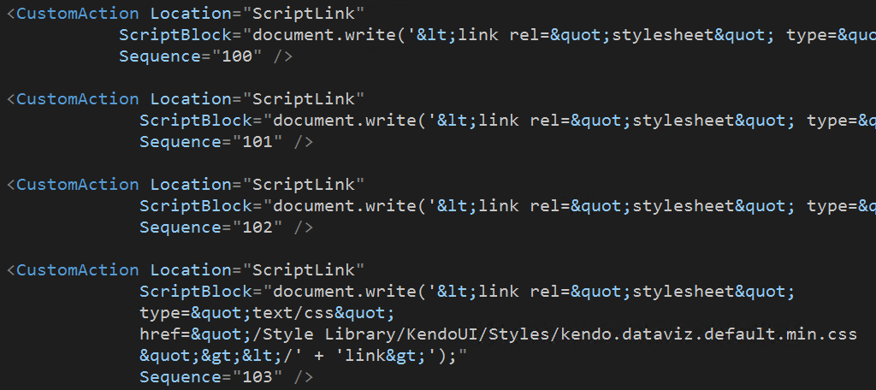
Reference CSS in SharePoint Master Page
Use clever “hack” to inject script reference with Custom Action.
Note this should be all on one line – broken up here for visibility only

Slide 35
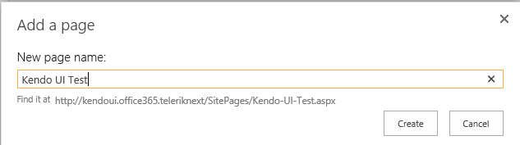
Step 2: Add a New Page
“Add A Page” from the drop down menu

Slide 36
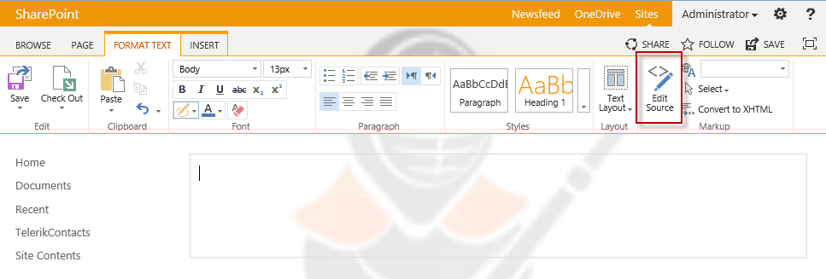
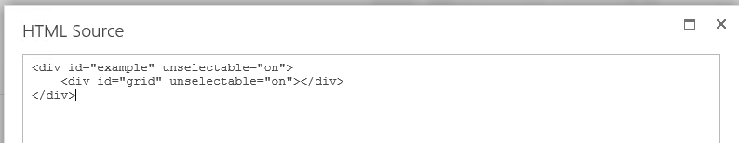
Add HTML for Grid Element

Slide 37
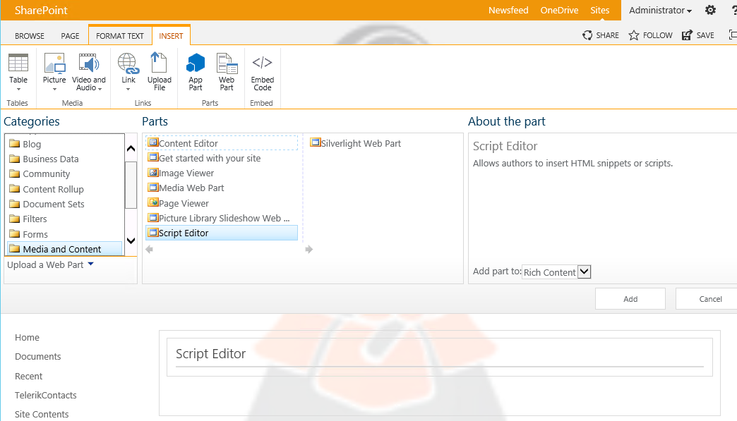
Step 3: Add A Script Editor Web Part

Slide 38
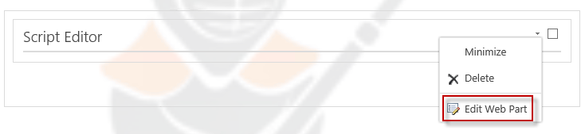
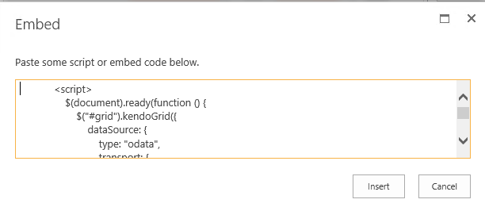
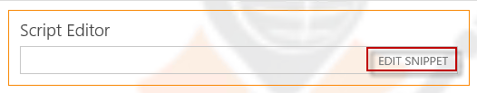
Add Script to Web Part
Edit web part, then click “Edit Snippet”

Slide 39
The full script pasted in was
$(document).ready(function () {
$("#grid").kendoGrid({
dataSource: {
type: "odata",
transport: {
read: "http://demos.telerik.com/kendo-ui/service/Northwind.svc/Customers"
},
pageSize: 20
},
height: 550,
groupable: true, sortable: true, pageable: {
refresh: true, pageSizes: true, buttonCount: 5 },
columns: [{
field: “FullName", title: "Contact Name", width: 200 }, {
field: “JobTitle", title: "Contact Title“ }, {
field: "Company", title: "Company Name" }, {
field: "Country", width: 150 }]
});
});

Slide 40
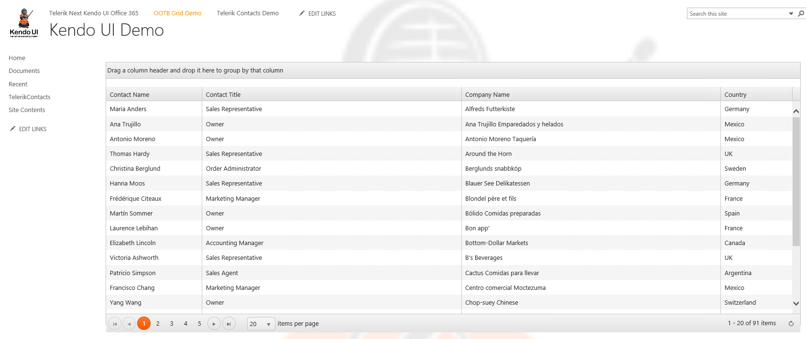
Kendo UI Running in SharePoint!

Slide 41
Agenda
The SharePoint Team Site
How To – SP 2013 VS Tools and Features
How To – SharePoint Lists (Schema)
How To – Deploy Kendo UI to SharePoint
How To – Kendo UI Grid in SP 2013
How To – Grid Reading From SP List
Where to go from here?

Slide 42
Grid Reading From SharePoint List
We will create Kendo UI Grid reading from the Telerik Contacts list
Repeat Step 2 – add a page and add the HTML element for the Grid
Repeat Step 3 with the following Script that uses the SharePoint REST API

Slide 43
The full script (changes highlighted)
$(document).ready(function () {
$("#grid").kendoGrid({
dataSource: {
type: “json",
transport: {
read: "http://kendoui.office365.teleriknext/_api/lists/getbytitle('TelerikContacts')/items"
},
pageSize: 20
},
height: 550,
groupable: true, sortable: true, pageable: {
refresh: true, pageSizes: true, buttonCount: 5 },
columns: [{
field: “FullName", title: "Contact Name", width: 200 }, {
field: “JobTitle", title: "Contact Title“ }, {
field: "Company", title: "Company Name" }, {
field: "TelerikExpertise", title: "Telerik Expertise", width: 150 }]
});
});

Slide 44
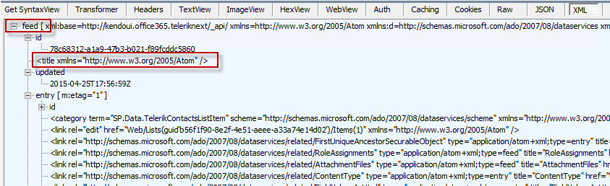
But wait! The Grid did not populate!
What happened? Use Fiddler!
Discover that SharePoint REST by default returns ATOM format, not JSON

Slide 45
How do we fix it?
Two things:
First, must modify Accept Header to ask for JSON format
The JSON will be wrapped in a “Results” block, so must target the data
Note: You can examine a JSON Response to get the proper “internal” SP List field names, which will be different from the “Display Names”.

Slide 46
Configuration of Script Data Source
dataSource: {
type: “json",
transport: {
read: {
url: "http://kendoui.office365.teleriknext/_api/lists/getbytitle('TelerikContacts')/items",
beforeSend: function (xhr) {
xhr.setRequestHeader("Accept", "application/json; odata=verbose")
}
}
},
schema: {
data: function (data) {
return data.d && data.d.results ? data.d.results : [data.d];
}
},

Slide 47
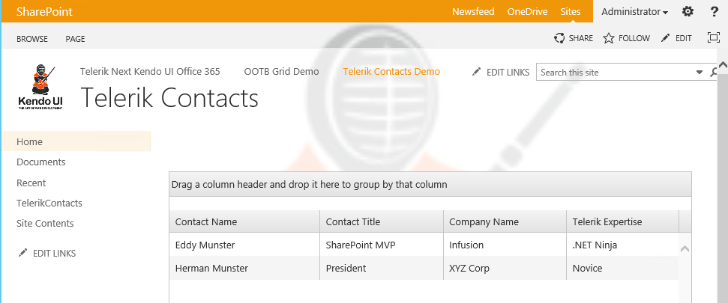
Working Kendo UI with SP List!!

Slide 48
BONUS DEMO
If time permits..
Use SharePoint Designer to download the site page you just created
Include in your Visual Studio solution, and create the related module and feature
So now you have the complete package: Schema, list instance, Kendo UI, and User Interface

Slide 49
Agenda
The SharePoint Team Site
How To – SP 2013 VS Tools and Features
How To – SharePoint Lists (Schema)
How To – Deploy Kendo UI to SharePoint
How To – Kendo UI Grid in SP 2013
How To – Grid Reading From SP List
Where to go from here?

Slide 50
Where to go from here?
See my dedicated slide deck for SharePoint Sandbox Solutions
http://slideshare.net/emusters
Kendo UI Theme available for Office 365
Seamless styling for controls compatible for Office 365
Can I use Kendo UI in SharePoint Apps?
Yes! All the same techniques you have learned here can be applied to bring Kendo UI to your SharePoint App development

Slide 51
Office 365 Developer Announcement!
If you are part of the Office 365 Developer Program, included is a free license of Kendo UI pro!
Office 365 Developer: http://dev.office.com
Claim Kendo UI license: http://telerik.com/o365

Slide 52
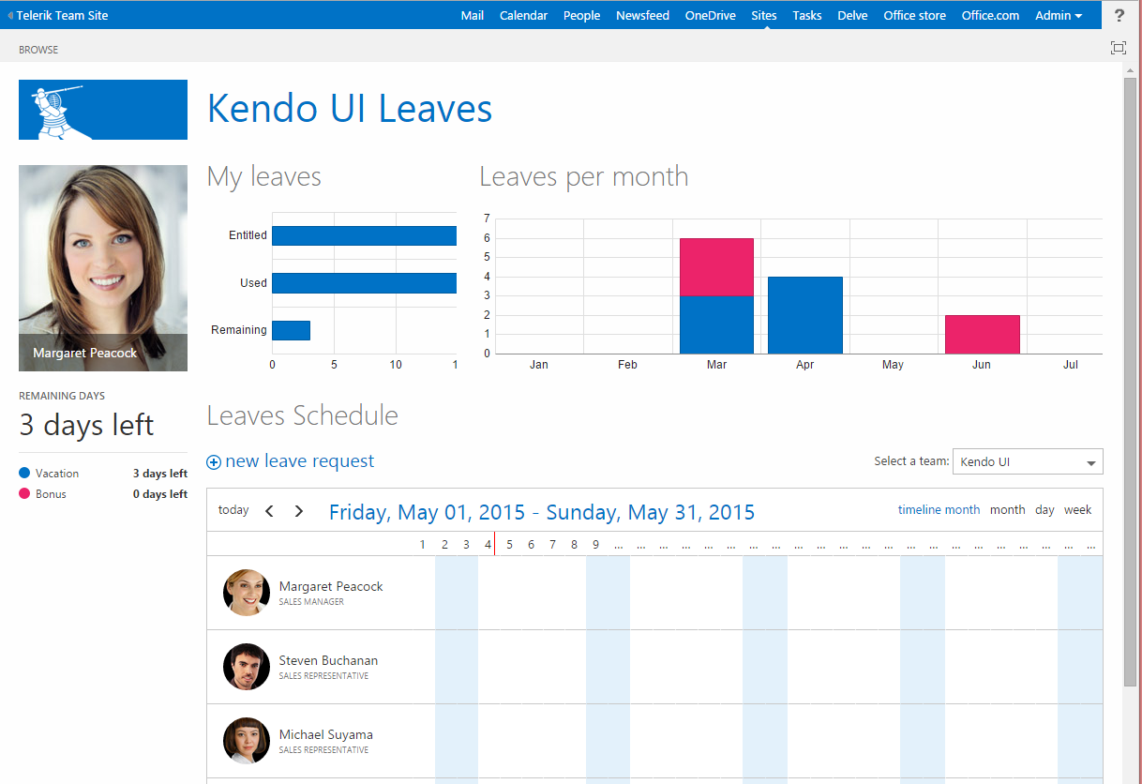
Kendo UI Office 365 App Sample

Slide 53


Question and Answer
Ed Musters
emusters@infusion.com
@TechEdToronto
Session Evaluation!
http://bit.ly/next-musters

