Slide 1
Modern MVC and Front-End Development with Telerik Sitefinity
Bilyana Ivanova

Slide 2
Session Highlights
What is Feather
Why we introduced it
What are its main components
How can you benefit from it

Slide 3
Sitefinity Feather
Build Modern, intuitive, convention based, mobile-first UI for Telerik Sitefinity
MVC Stock Widgets
Front-End of Your Choice
Package Everything
Mobile First
Convention-Based FW
New Designers FW

Slide 4
Some Useful Links
Project Feather main site:
http://projectfeather.sitefinity.com/
Feather GitHub:
https://github.com/Sitefinity/feather/wiki
UI Bootstrap:
http://angular-ui.github.io/bootstrap/
KendoUI:
http://demos.telerik.com/kendo-ui/

Slide 5




Front-End of Your Choice
Bootstrap
Foundation
Semantic UI
Anything...

Slide 6
Frontend Packages
A Package is a complete encapsulation of the look and feel in Sitefinity. It can include everything:
CSS
Sass, LeSS
JS
Images, Icons
Fonts
Layout Files (Master Templates)
Layout Templates
Widget Templates
Widget Designers Templates

Slide 7
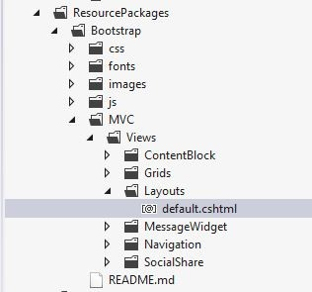
Frontend Packages – Layout files
Pure MVC template generation
~/MVC/View/Layouts
Page template title = Layout name
~/ResourcePackages/PackageName
/Mvc/Views/Layouts
Page template title = PackageName.LayoutName

Slide 8
Frontend Packages – Resource Files
Url.WidgetContent helper
<link rel="stylesheet"
href='@Url.WidgetContent("Mvc/Styles/Css/sitefinity-theme.css")'>
Loading Order
Resource Package (higher)
~/MVC (lower)
Example:
~/Mvc/Styles/Css/sitefinity-theme.css
~/ResourcePackages/My Template/Mvc/Styles/Css/sitefinity-theme.css

Slide 9
Frontend Packages – Resource Files In MVC Views
@Html.Section("main")
@Html.Script(ScriptRef.JQuery, "top")
@Html.Script(Url.WidgetContent("Mvc/Scripts/LoginStatus/login-status.js"),"bottom")
@Html.StyleSheet(Url.WidgetContent("~/ResourcePackages/Bootstrap/assets/dist/css/styles.min.css"), "head", false)
@Html.Script(Url.EmbeddedResource("Telerik.Sitefinity.Resources.Reference", "Telerik.Sitefinity.Resources.Scripts.jquery.ui.map.js"))

Slide 10
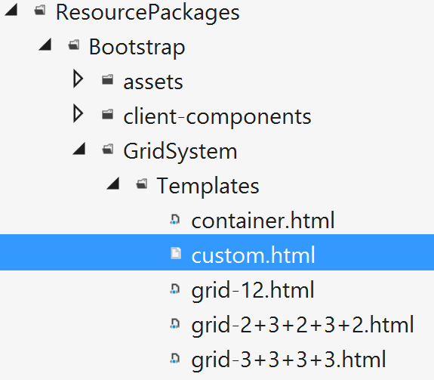
Frontend Packages – Grid templates
<div class="row">
<div class="sf_colsIn col-md-3 customClass">
</div>
<div class="sf_colsIn col-md-6">
</div>
<div class="sf_colsIn col-md-3">
</div>
</div>

Slide 11
Stock widgets
Navigation
Dynamic Content
Content Block
News
Image
Image gallery
Video
Video gallery
Document link
Document list
List
Blogs
Blog posts
Login button
Login form
Registration
Change password
Account activation
Profile
Users list
Social Share
Search
Search Results
(Progress)

Slide 12
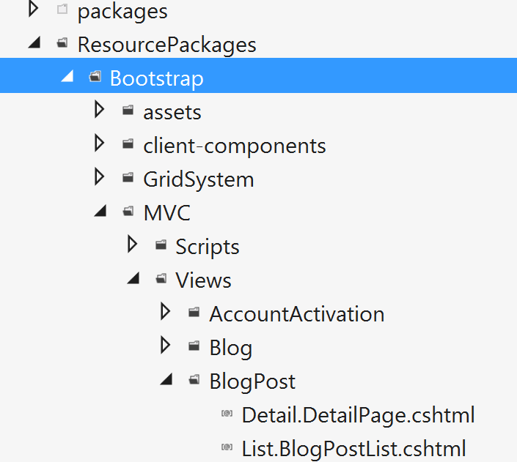
Stock widgets - Widget templates
Located in the ‘ResourcePackages’
Dedicated folder per framework
Bootstrap
Foundation
SemanticUI
Edit -> Save, no build required

Slide 13
Stock widgets - Widget templates
Loading Order
Resource Package (highest)
~/MVC
Design->Widget Templates
Feather (lowest)
Naming conventions
List.[ViewName].cshtml
Detail.[ViewName].cshtml

Slide 14

Stock Widgets – Example: Related Items for News
<div class="sfMultiRelatedItmsWrp">
<h2 class="sfrelatedItmTitle">Related news</h2>
<ul class="sfrelatedList sflist">
@foreach (var relatedItem in Model.Item.Fields.RelatedNews)
{
<li class="sfrelatedListItem sflistitem">
@Html.ActionLink((string)relatedItem.Fields.Title,
(string)relatedItem.Fields.ItemDefaultUrl)
</li>
}
</ul>
</div>

Slide 15
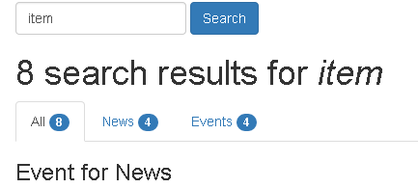
Stock Widgets – Example: Search results by type
<div role="tabpanel">
<!-- Nav tabs -->
<ul class="nav nav-tabs" role="tablist">
<li role="presentation" class="active">
<a href="#all" role="tab" data-toggle="tab">All<span class="badge">@Model.Results.Data.Count</span></a>
</li>
<li role="presentation">
<a href="#news" role="tab" data-toggle="tab">News<span class="badge">@news.Count()</span></a>
</li>
…
</ul>
<!-- Tab panes -->
<div class="tab-content">
<div role="tabpanel" class="tab-pane active" id="all">
@Html.Partial("_SearchResults", Model.Results.Data)
</div>
<div role="tabpanel" class="tab-pane" id="news">
@Html.Partial("_SearchResults", news)
</div>
…
</div>
</div>

Slide 16
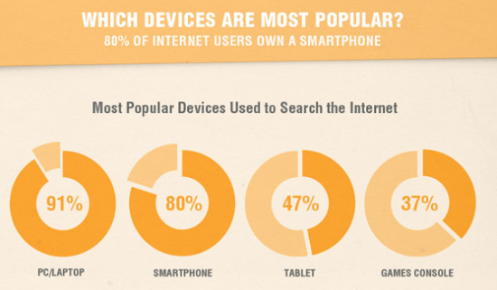
Mobile First

Slide 17
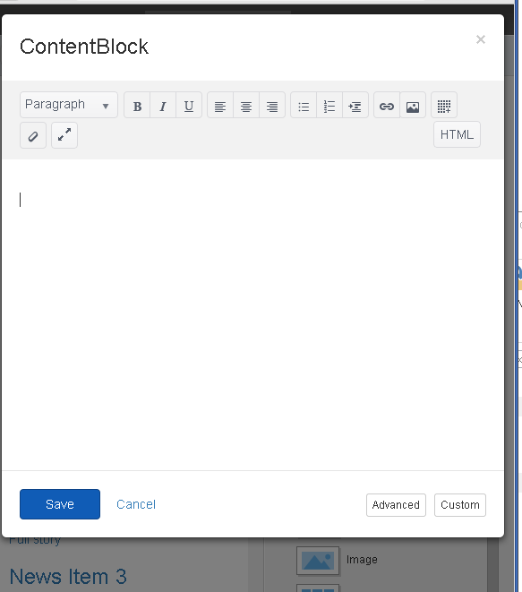
Mobile First
Frontend
Backend

Slide 18
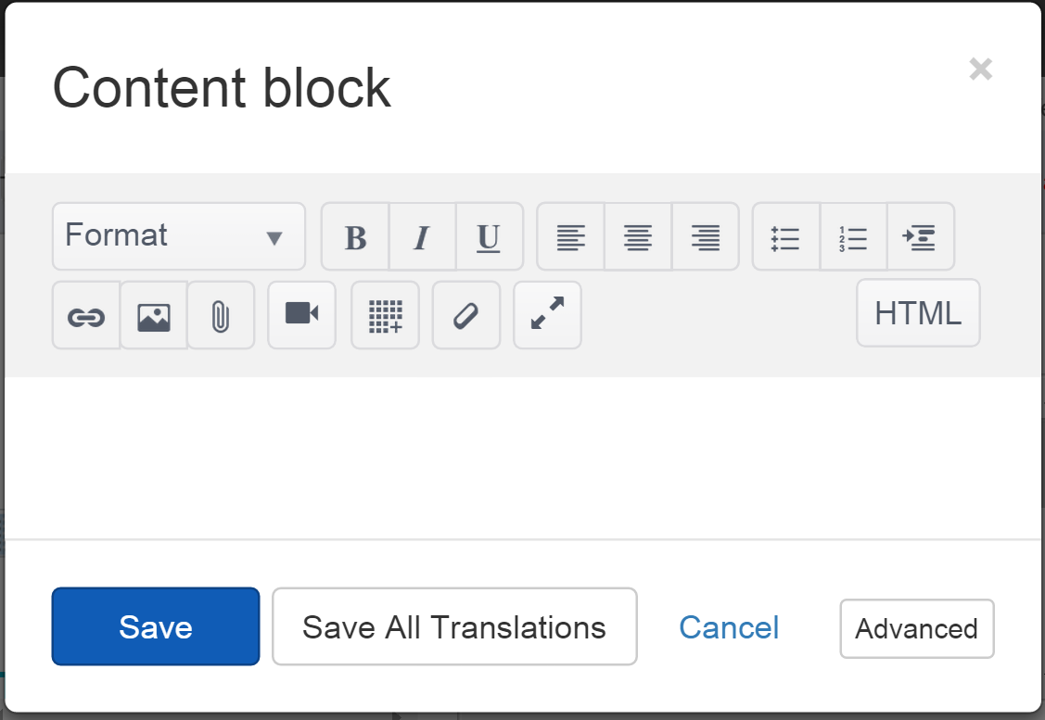
Designers Framework – Stock Widget Designers
Default (Simple.cshtml)
<sf-html-field class="kendo-content-block"
sf-model="properties.Content.PropertyValue">
</sf-html-field>
$scope.properties bound to controller properties
Reuses sf-html-field

Slide 19
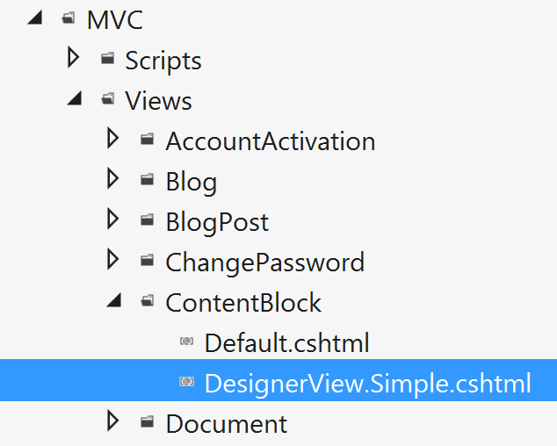
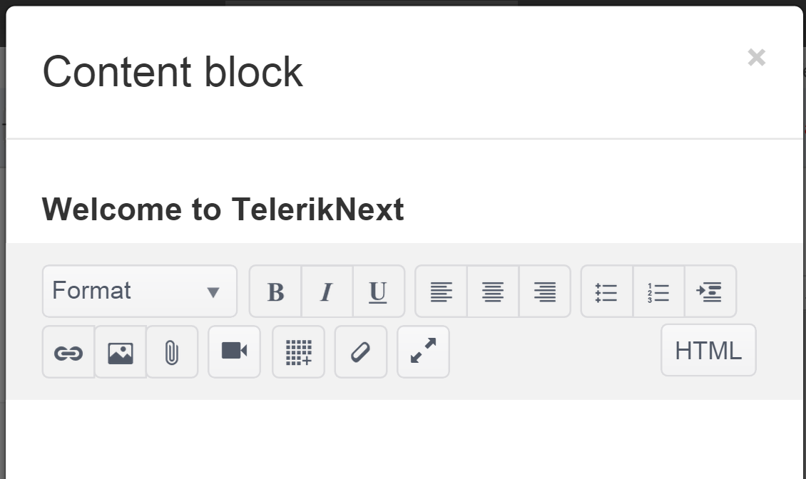
Designers Framework – Stock Widget Designers
~/Mvc/Views/[WidgetName]/DesignerView.[ViewName].[extension]
<h3>Welcome to TelerikNext</h3>
<sf-html-field class="kendo-content-block"
sf-model="properties.Content.PropertyValue"></sf-html-field>

Slide 20
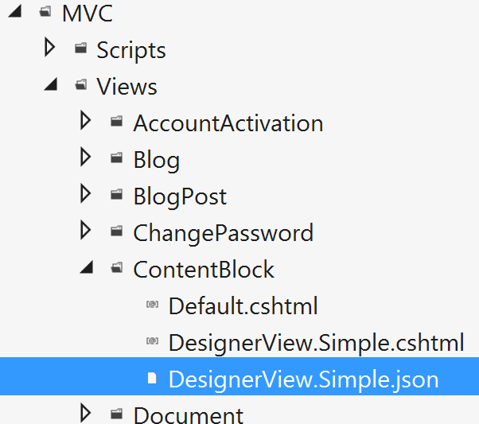
Designers Framework – Designers configuration
~/Mvc/Views/[WidgetName]/DesignerView.[ViewName].json
{
"priority": 1,
"scripts": [
"Mvc/Scripts/ContentBlock/shared-content-services.js",
"Mvc/Scripts/MyAdditionalScript.js"
]
}

Slide 21
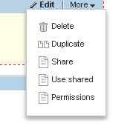
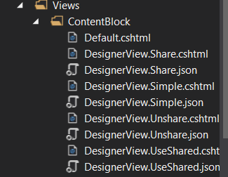
Designers Framework – Custom Commands
public class ContentBlockController : Controller,
IHasEditCommands
....
this.CommandsList.Add(new WidgetMenuItem()
{
Text = "Use Shared",
ActionUrl = "UseShared",
NeedsModal = true
});

Slide 22
Convention-Based Framework
Stock Widget templates
List.[ViewName].cshtml or Detail.[ViewName].cshtml
Page templates based on layout files
MVC\View\Layouts or ResourcePackages\YourPackageName\Mvc\Views\Layouts

Slide 23
Convention-Based Framework
Designer template name & location
\Mvc\Views\[WidgetName]\DesignerView.[ViewName].[extension]
Needed scripts and modules
Mvc\[WidgetName]\DesignerView.[ViewName].json
Designer module
Mvc\Scripts\[WidgetName]\designerview-[viewname].js

Slide 24
Framework goodness
Native support for DI (Ninject)
public IssueController(IIssueModel issuesModel)
{
this.model = issuesModel;
}
Support for class libraries (full encapsulation)

Slide 25
Framework goodness
Support for Locations Service
public class NewsController : Controller, IContentLocatableView
{
}
Localization resources for both front and backend
[Localization(typeof(NewsWidgetResources))]
And more...

Slide 26
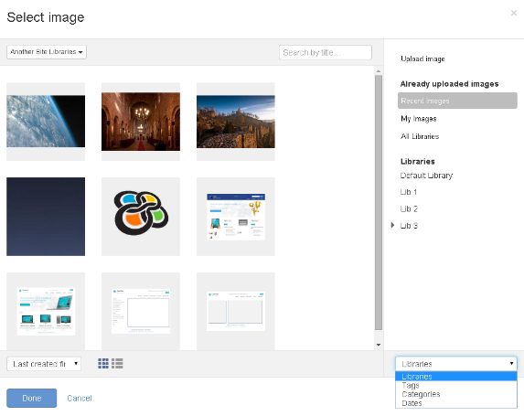
Designers Framework
The designer module (designerview-yourView.js):
angular.module('designer').requires.push('sfImageField');
Designer View (DesignerView.YourView.cshtml):
<sf-image-field
sf-auto-open-selector
sf-model="selectedImageId"
sf-image="selectedImage"
sf-provider="imageProvider"/>

Slide 27
Q&A

