Slide 1
Making the most out of Sitefinity Personalization
Bilyana Ivanova

Slide 2
Agenda
What is personalization
Personalization & Sitefinity
How it works
Making the most out of it

Slide 3
Agenda
What is personalization
Personalization in Sitefinity
How it works
Making the most out of it

Slide 4
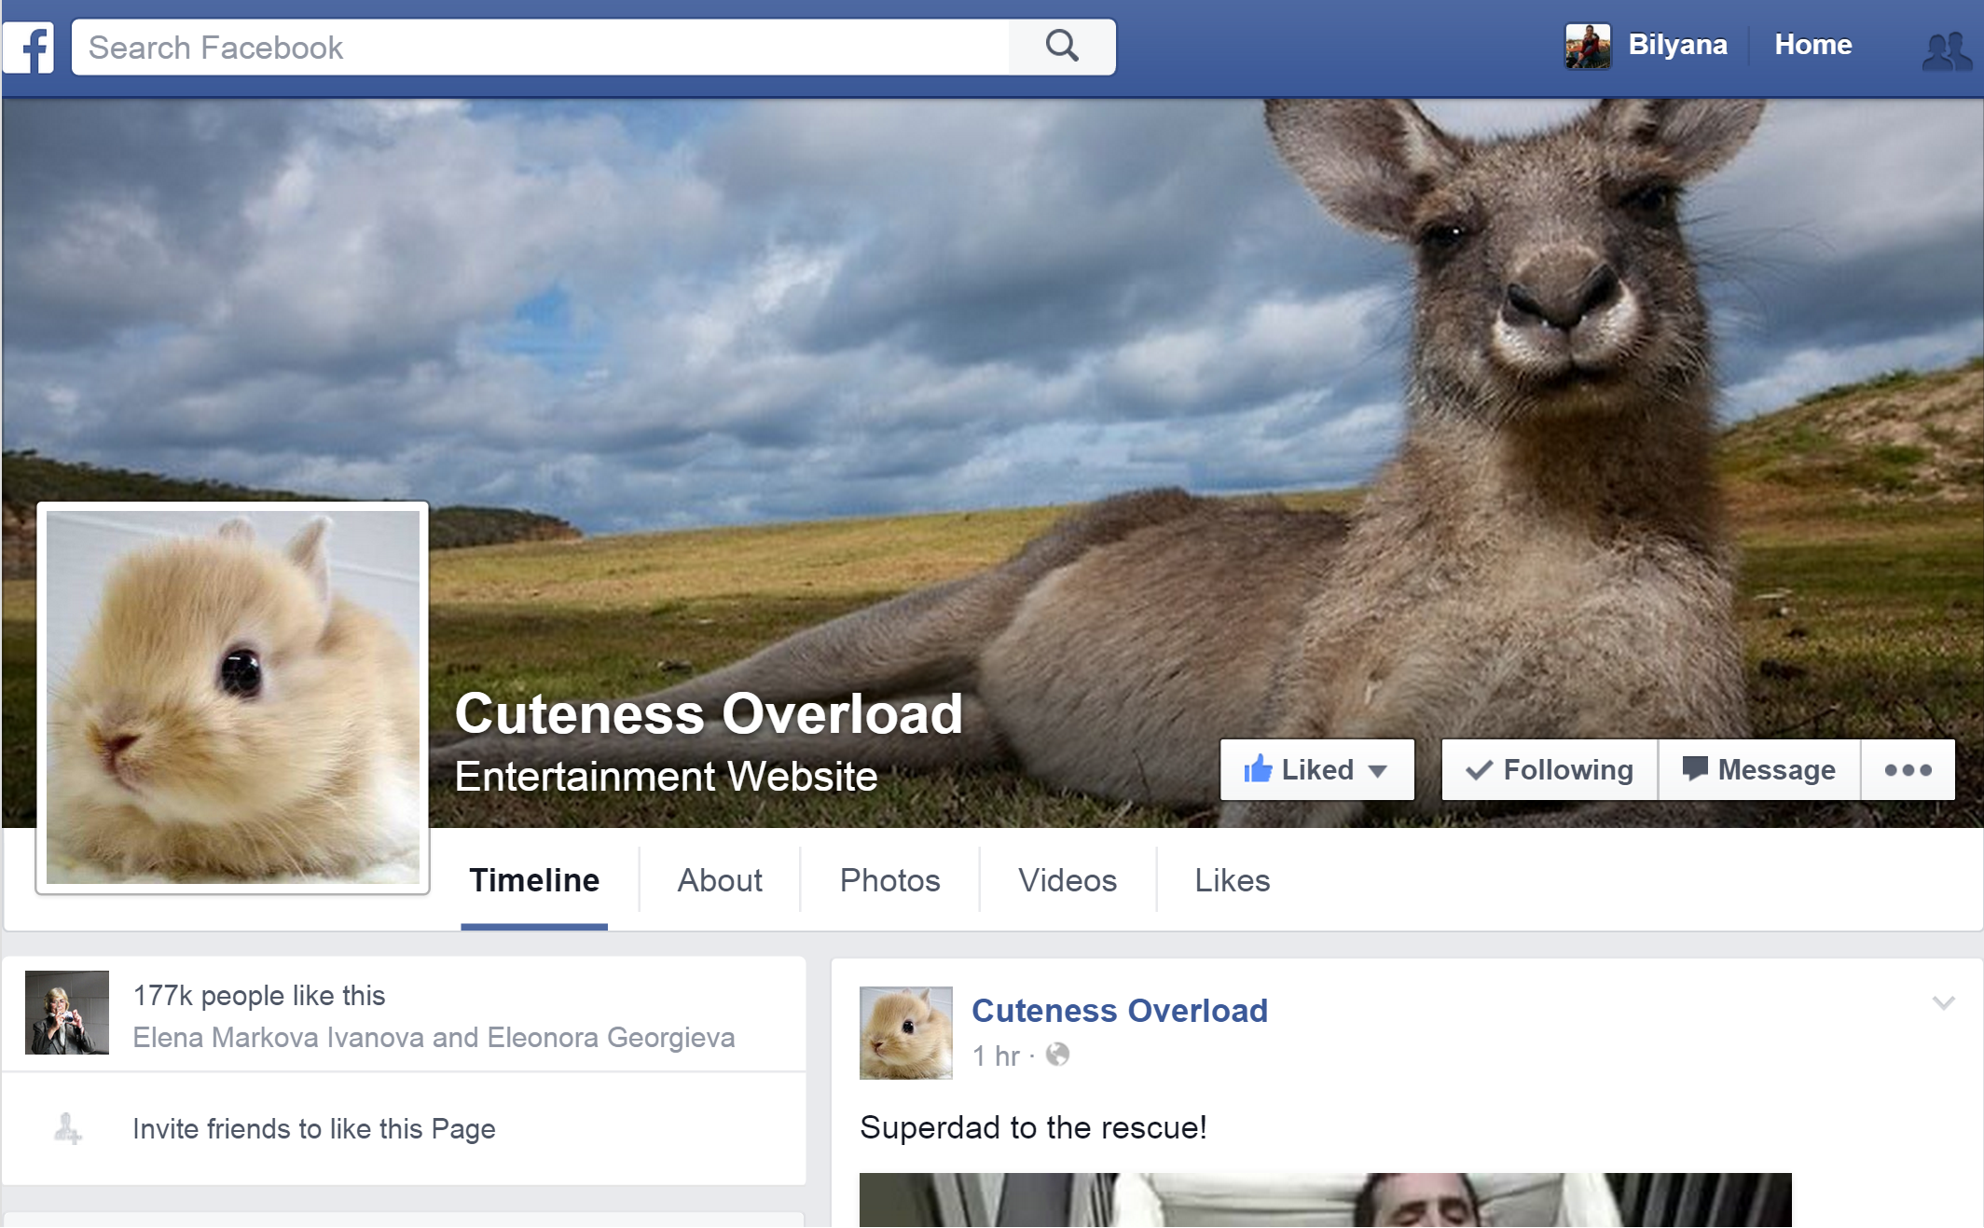
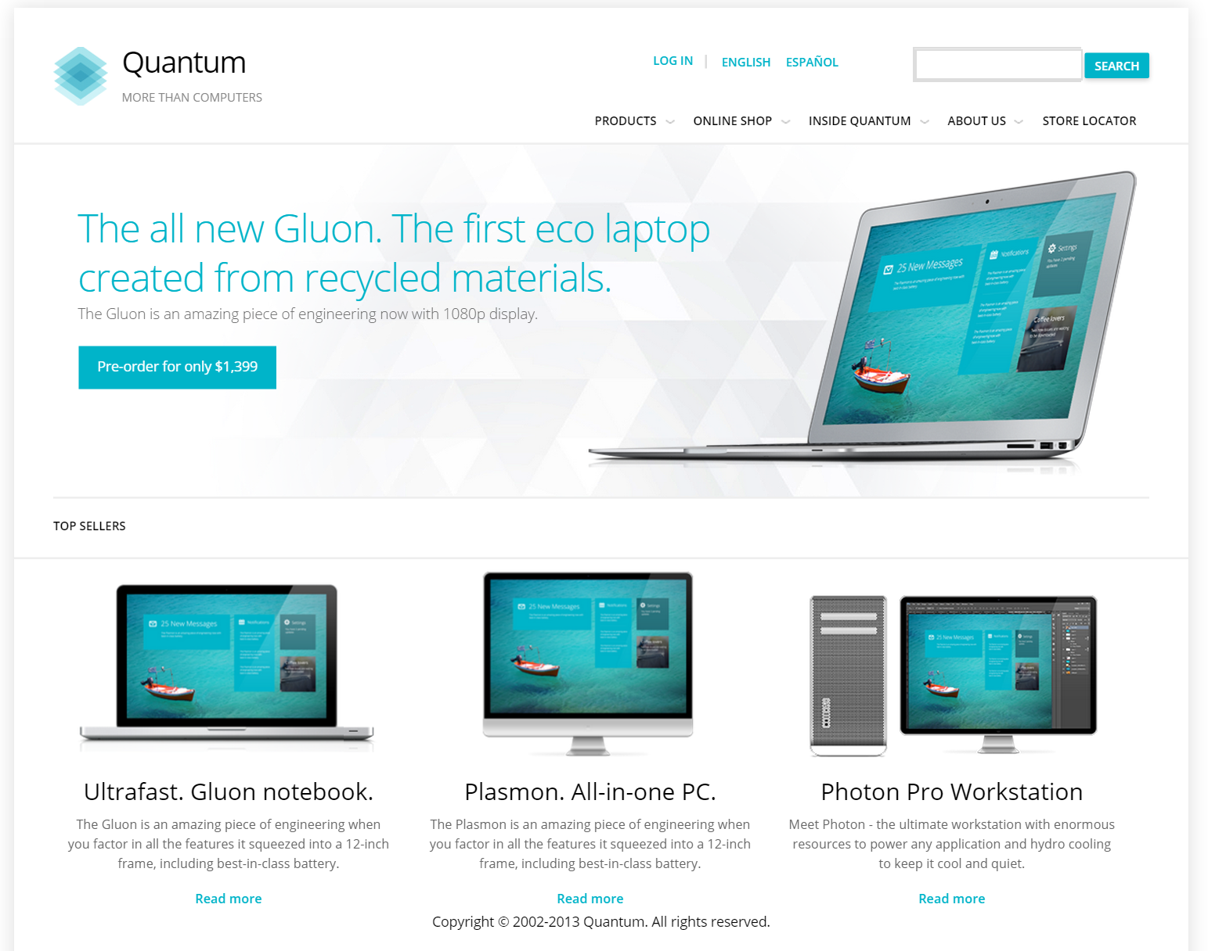

Slide 5



Targeting mixed audience – Developers vs Business Users
Notes:
Developers vs. Business Users

Slide 6


Targeting visitors at a different stage
Notes:
New visitors vs hot leads

Slide 7
Agenda
What is personalization
Personalization in Sitefinity
How it works
Making the most out of it

Slide 8
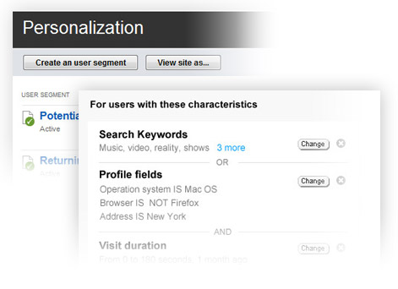
Step 1 - Segment Your Visitors
Business Users
vs Developers
Visitors from US
vs International visitors
…

Slide 9
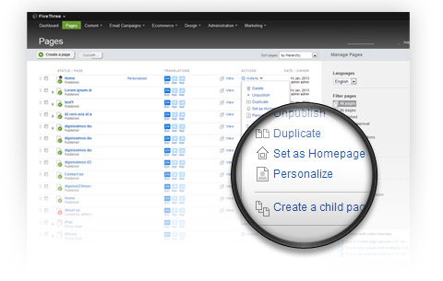
Step 2 – Personalize the Presentation
Home page
Business Users vs Developers
Products Page
Existing customers vs New customers

Slide 10
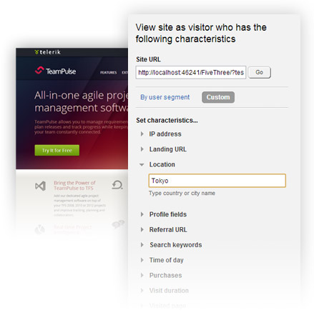
Step 3 – Impersonate to Test the Experience
View as:
Business User
Developer
Existing customer
Boston visitor &&
Existing customer &&
Visited Events page

Slide 11
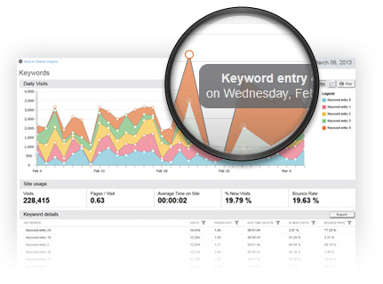
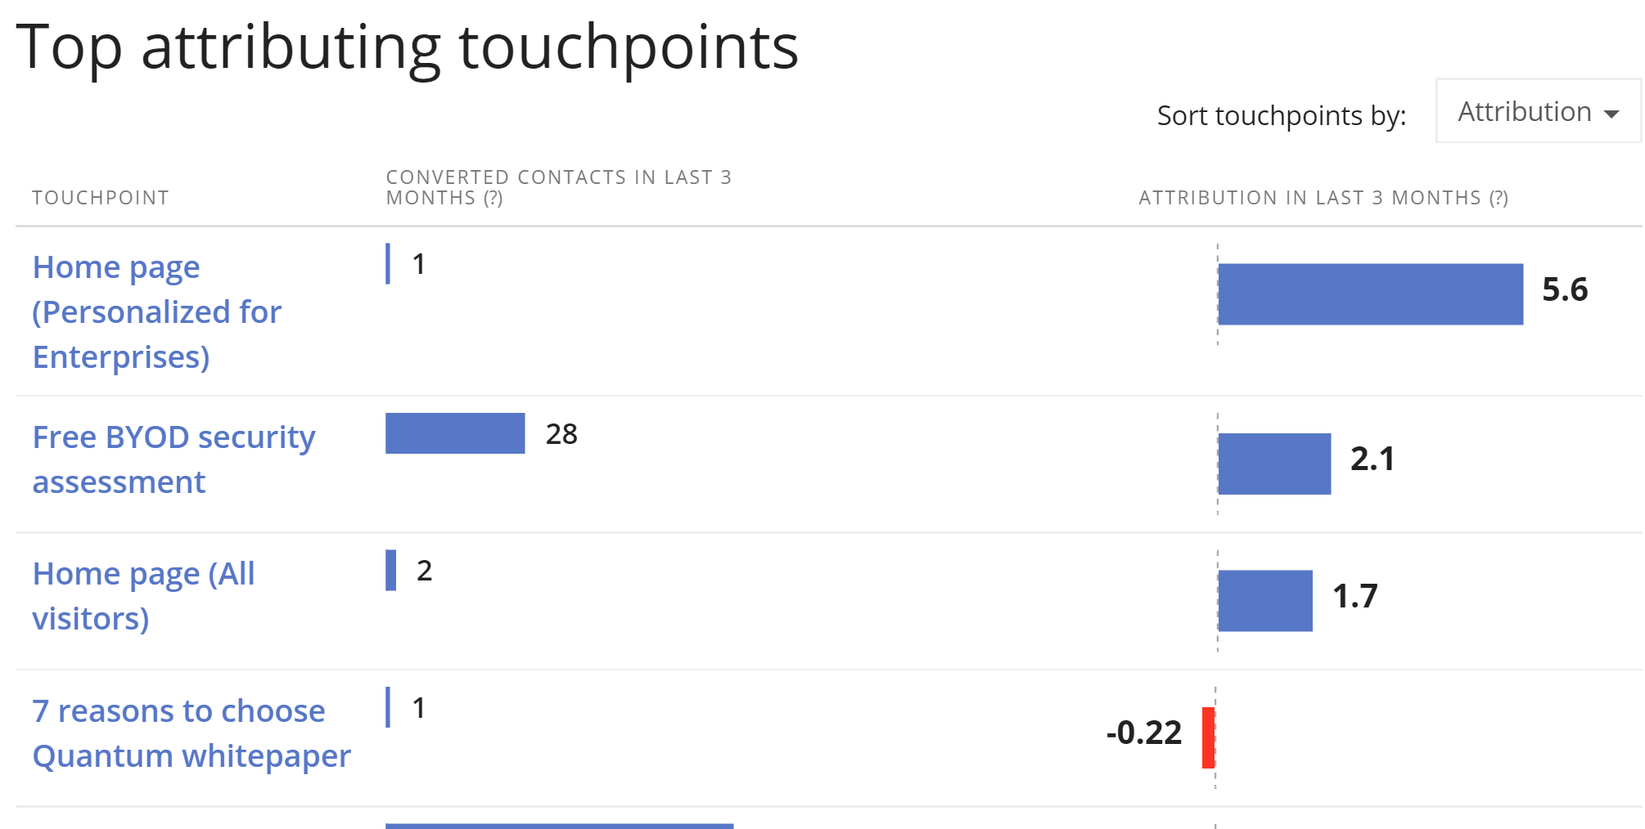
Step 4 – Measure the Results

Slide 12
Demo

Slide 13
Agenda
What is personalization
Personalization in Sitefinity
How it works
Making the most out of it

Slide 14


How it works - Collecting data
Statistics
Service
StatsClient
Log HasVisited
Referral Url
Landing Url
Start Visit Duration
1st Request
Issue cookie
Statistics
Service
2nd Request
StatsClient
Log HasVisited
Cookie
Statistics
Service
PreProcessOrder
Log HasBought
Log HasBoughtFromDepartment
Log HasBoughtProductTaggedBy
Purchase

Slide 15
How it works - Collecting data
2015-05-01: Arrived from Facebook
2015-05-01: Visited Products Page
2015-05-03: Purchased Notebook
2015-05-05: Visited Login Page
2015-05-05: Name: Bill
2015-04-12: Visited Home Page
2015-04-23: Purchased a backpack

Slide 16
How it works – User characteristics
Anonymous Users
Referral URL
Landing URL
Visited page
Visit duration
Purchases
Search keywords
IP address
Location
Time of day
Require Authentication
Profile fields
Roles
Require Marketo Connector
Marketo lead score
Marketo field
Requires Digital Experience Cloud Connector
Persona

Slide 17
How it works – User characteristics evaluators
IP Address | IPAddressEvaluator | TimeOfDay | TimeOfTheDayEvaluator
Landing URL | LandingUrlEvaluator | Purchases | PurchasesEvaluator
Location | LocationEvaluator | VisitDuration | VisitDurationEvaluator
ProfileFields | ProfileFieldsEvaluator | VisitedPage | VisitedPageEvaluator
ReferralUrl | ReferralUrlEvaluator | Roles | UserRolesEvaluator
SearchKeywords | SearchKeywordsEvaluator | <Custom Criteria> | <Custom Evaluator>

Slide 18
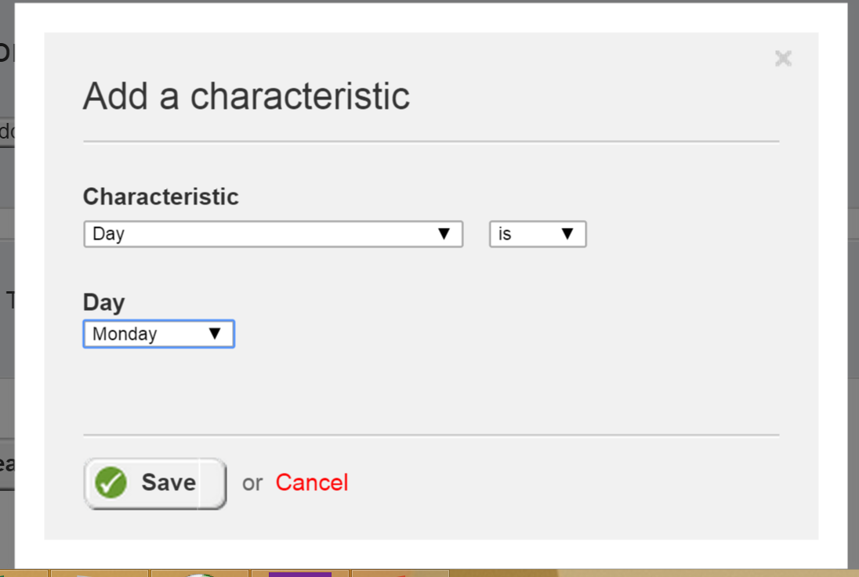
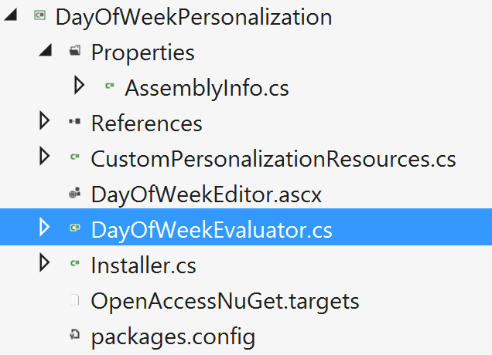
Custom characteristics
DayOfWeekEvaluator : ICriterionEvaluator

Slide 19
Which version to show?
Home Page Versions
Default
Existing Customers
Referred by Facebook
UK Visitors
Request Home Page

Slide 20
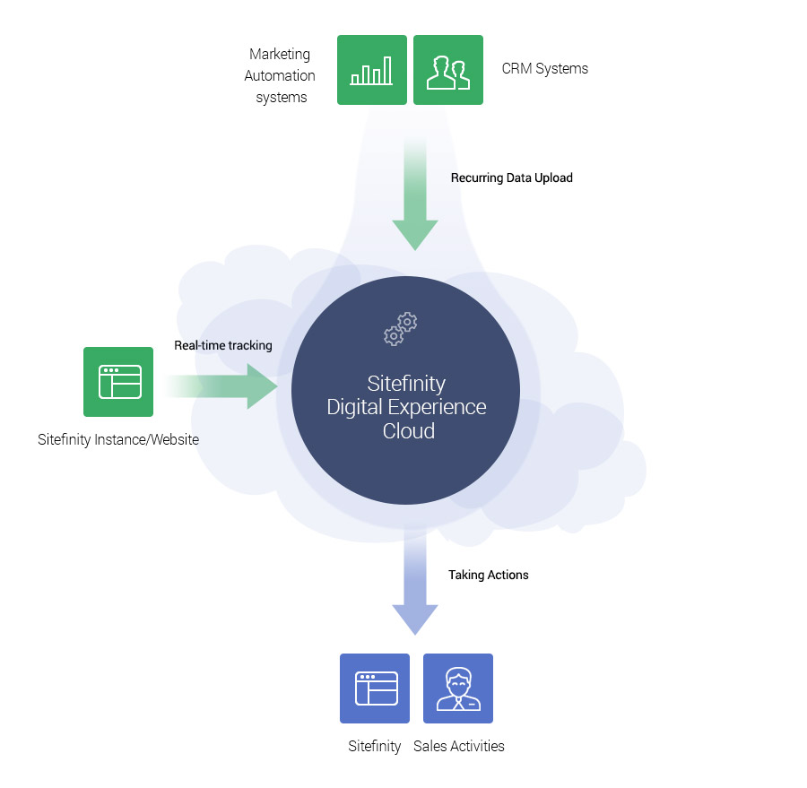
Beyond Personalization
Scoring user behavior
360° profile
Measuring personalization against business goals

Slide 21
Q&A

