Slide 1
Improving Applications with Telerik Analytics
Brian Busby
Clark Sell
Enterprise Customer Team – Telerik Platform
brian.busby@telerik.com

Slide 2
Agenda
The What, Why and Who of Application Analytics
The How of Analytics
Demo
Q & A

Slide 3
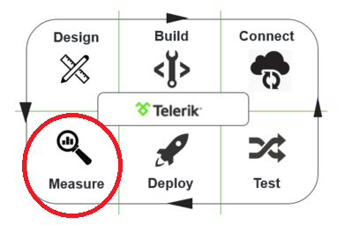
What is Application Analytics?
"Analytics leverage data in a particular functional process (or application) to enable context-specific insight that is actionable.“
- Gartner
Notes:
Analytics is the process of adding small pieces of code to your application (called instrumentation) that allow meta-data about how a user interacts with your application to be sent to a data repository for viewing through a graphical interface

Slide 4
3 Main Types of Information
Information about your User’s Environment
What are the characteristics of the device/environment they are using
Information about your User’s Behavior
When are they using your application – and for how long
Where are your users from
What features of your application are they (not) using
Information about your User’s Problems
Are your users discovering issues w/ your application that are not being reported

Slide 5
Telerik Analytics Mapping
Environmental Metrics
What are the characteristics of the device they are using
When are they using your application – and for how long
Where are your users from
Feature Tracking
What features of your application are they (not) using
How are your features performing
Exception Handling
Are your users discovering issues w/ your application that are not being reported

Slide 6
Why Application Analytics
The price of light is less than the cost of darkness.
- Arthur C. Nielsen, Founder of ACNielsen
I never guess. It is a capital mistake to theorize before one has data.
- Sir Arthur Conan Doyle

Slide 7
Why Application Analytics
Prioritize work based on actual usage patterns
Target popular users/environments
Manage support expectations
Test based on actual use
Identify, triage and resolve problems before your customers are seriously impacted
Enhance/re-work/remove features

Slide 8
Who Benefits From Analytics
Sales
Marketing
Executives
Product Managers
Designers
Developers
Test Team
User-Centric
Segmentation
Funnels
Churn
Strategy
Promotions
Product-Centric
Product Improvement
Prioritization
Support

Slide 9
Design: Improving Your Application
Environmental Metrics
“Am I designing my application based on the devices it’s being used on (OS, Screen)?
“Am I designing my application based on the location of my users?
“Do I need to keep designing for particular environments?
Feature Tracking
“Am I designing my features so they’re easy to find?
“What are the preferred access points to my features?
“Are users completing multi-step features?
Exception Handling
“Is my design causing problems in certain environments?
“Am I “designing out” the biggest issues?

Slide 10
Develop/Build: Improving Your Application
Environmental Metrics
“Am I developing my apps with popular environments in mind?
“Am I optimizing my app for a particular environment?
“Do I need to keep developing for particular environments?
Feature Tracking
“Am I prioritizing my development based on the most used features?
“Am I prioritizing new features based on current use of the app?
“Am I enhancing my features appropriately?
“Am I getting the appropriate performance out of my features?
Exception Handling
“Am I “developing out” problems?
“Do I need to be concerned about certain problems during the development phase?

Slide 11
Connect: Improving Your Application
Environmental Metrics
“Are there off-line situations that I need to be aware of?
Feature Tracking
“How will my features work in an off-line scenario?
“Are my backend services performing well?
Exception Handling
“Are my backend services causing runtime issues?

Slide 12
Test: Improving Your Application
Environmental Metrics
“Am I focusing my testing on the appropriate environments?
“Are there particular loads that I should test for?
“Do I need to keep testing for particular environments?
Feature Tracking
“Do I need to test my features under a particular load?
“Do I need to test my feature given a certain number of objects?
“Am I focusing my testing on the most popular features?
Exception Handling
“Do I need to modify my test plans based on exceptions?

Slide 13
Deploy: Improving Your Application
Environmental Metrics
“Is my app being deployed to the right people?
“What versions of my app are actively being used?
“What types of deployment mechanisms do I need to use for my app?
“What are my support requirements for the app?
Feature Tracking
“Will feature sets lead to different deployment needs?
Exception Handling
“How is my release schedule impacted by fixing exceptions?

Slide 14
HOW

Slide 15
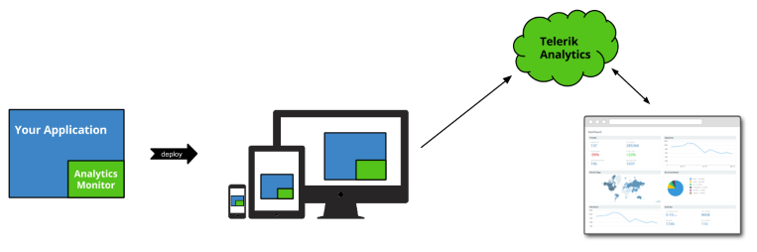
Analytics Architecture

Slide 16
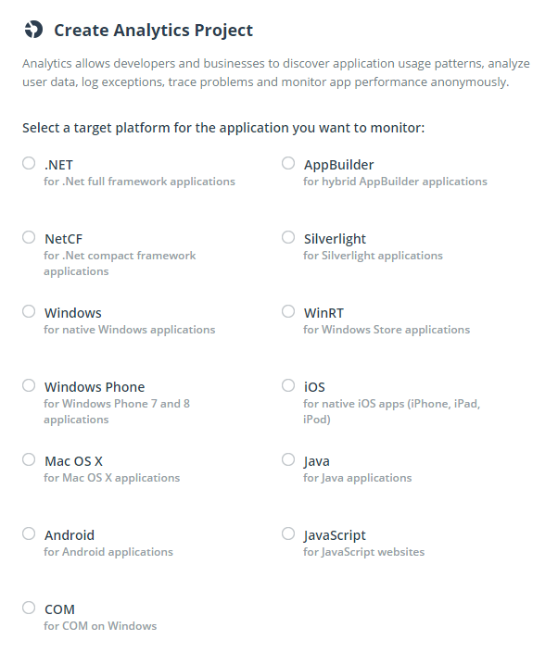
Development Platforms Supported - Monitors
Application types:
Mobile (native, hybrid, web)
Desktop
Web
Implementations:
C++
C#
Java
JavaScript

Slide 17
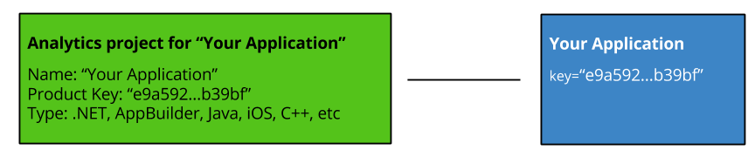
Analytics Architecture

Slide 18
3 Main Types of Information
Environmental Metrics
Initiated w/ 2 lines of code (‘start’,’stop’)
Monitor sends payloads based on client environment
Payloads are cached for off-line situations
Feature Tracking
TrackFeature
TrackFeatureTiming
TrackFeatureValue
Exception Handling
Supplement to existing logging
Used to capture Unusual events
Tallies “popular” exceptions
Best if context is provided
Allows for Alerting

Slide 19
Additional Considerations
Anonymous vs. Non-
Aggregate vs. Individual
Performance Implications
Integration
Customizations/Access Control
Licensing/Deployment Options

Slide 20
DEMO

Slide 21
http://bit.ly/next-busby

