Slide 1
Telerik Native Mobile UI for iOS and Android
Mehfuz Hossain, Enterprise Cloud and Platform

Slide 2
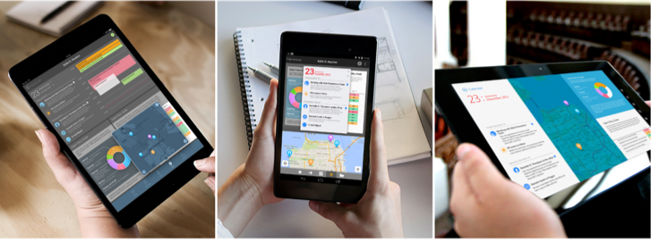
Building Awesome Mobile experience is hard

Slide 3



Tons to choose from
There are tons of open source and third party components out there
Maintained by single developer and mostly outdated
Not much support for mission critical projects.
Only available in specific platform or version

Slide 4
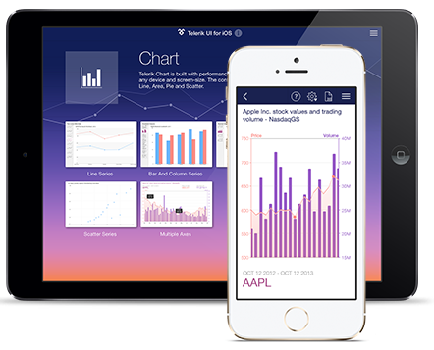
UI for iOS
Rich customizable UI controls for iOS
Rich data visualization controls
Easy to use API
Rich animations
Support and Maintenance

Slide 5
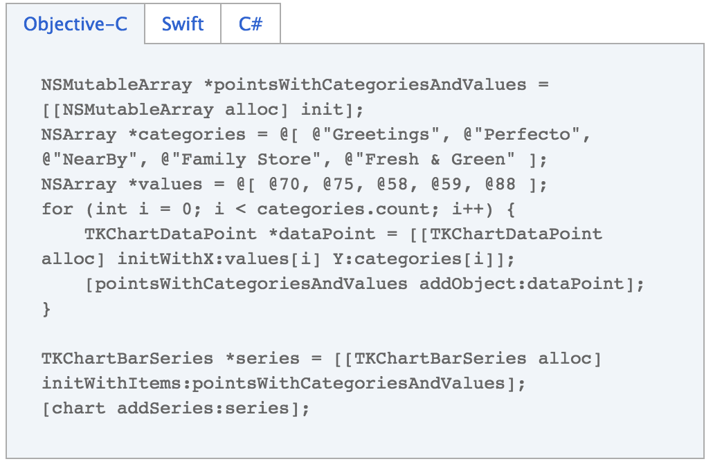
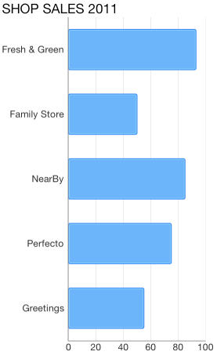
Easy DataBinding
Model-View-Controller Design pattern

Slide 6
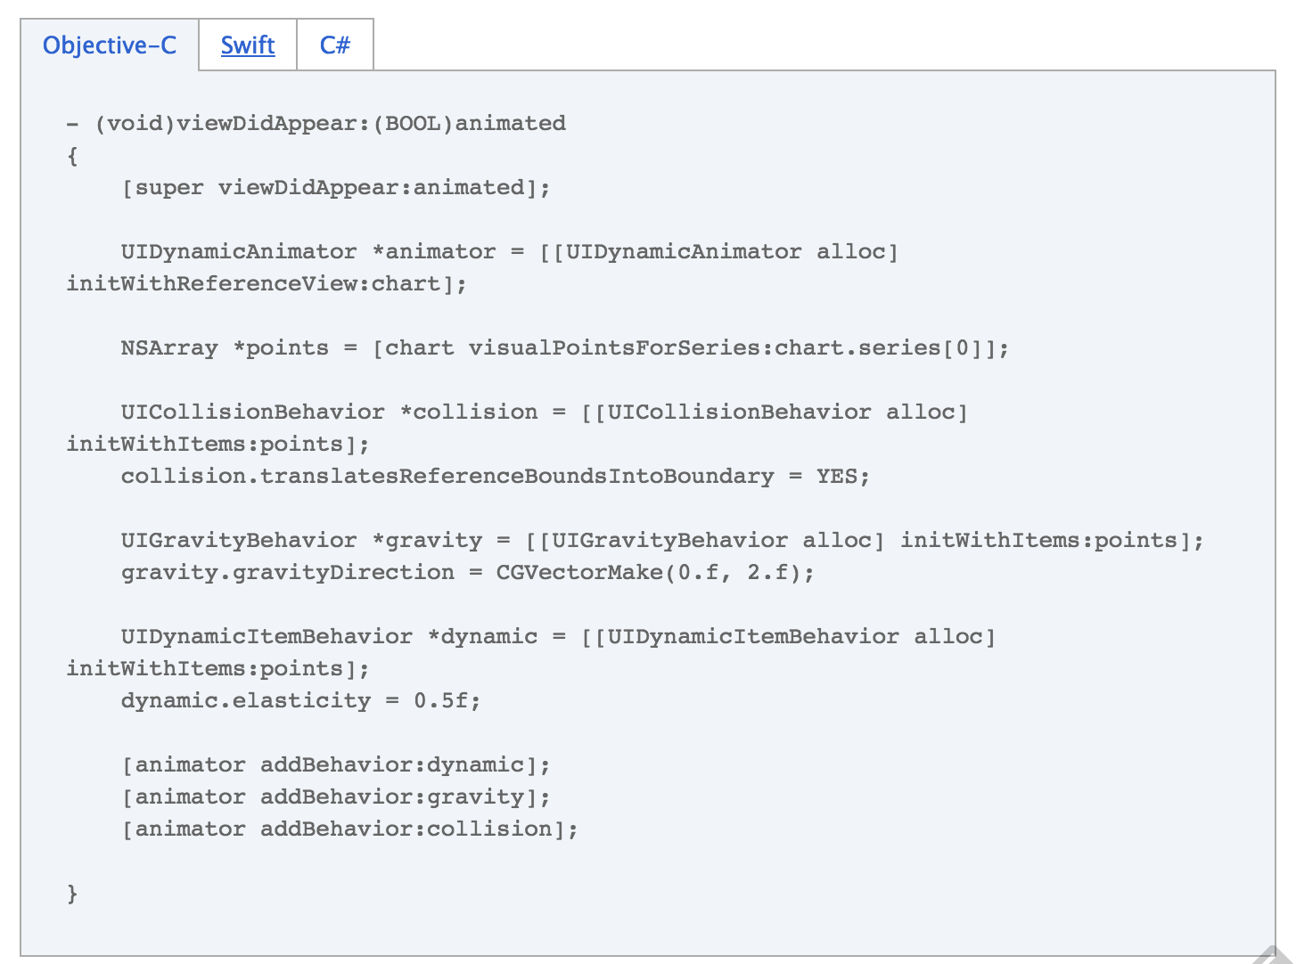
UIKit Dynamics Animations
TKChart uses the UIKit Dynamics Physics Engine in iOS 7.0

Slide 7
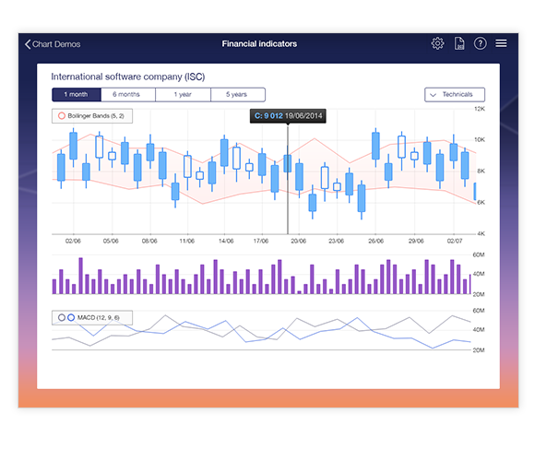
Filling Gaps in the UIKit Framework
Charting Library with 10+ rich charts
Annotation support
Trackball support
Pre-Built animations

Slide 8
Demo

Slide 9
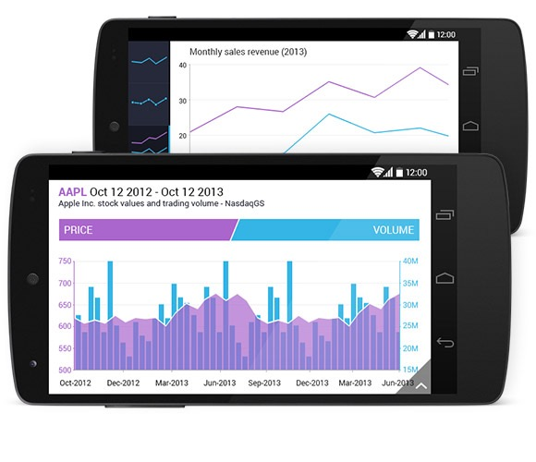
UI for Android
Native and responsive UI controls for Android apps
Fill the Gaps in Android UI framework
Support for you favorite IDE
Predefined Styles and Palettes
Fast and Precise Pan and Zoom
Ultimate Performance

Slide 10
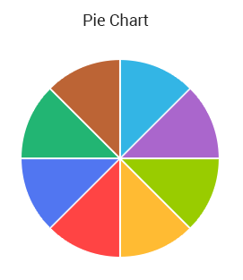
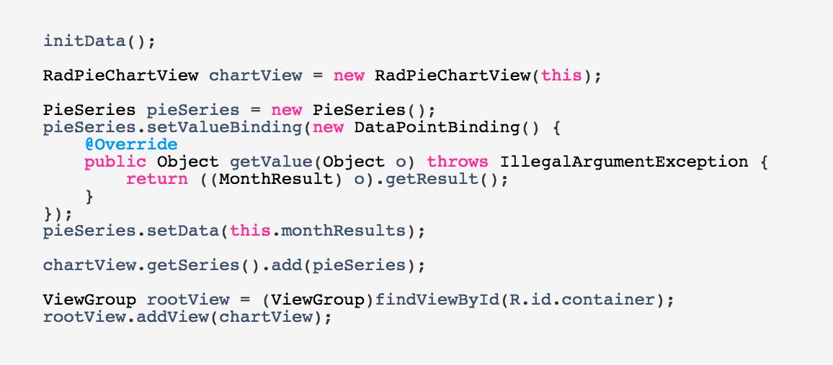
Fill the Gaps in Android UI Framework
Rich data visualization to make your app look gorgeous

Slide 11
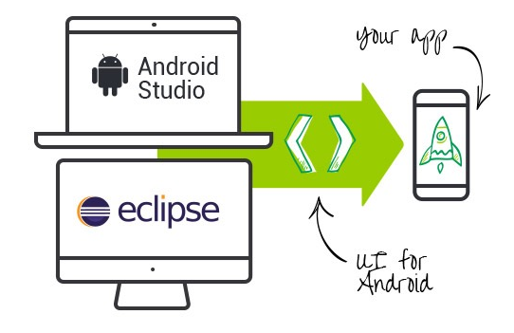
Support for your Favorite IDE
UI for Android covers your favorite IDE of choice
UI for Android with Android Studio
UI for Android with Eclipse
The API level support starts from Android Gingerbread (API level 9)

Slide 12
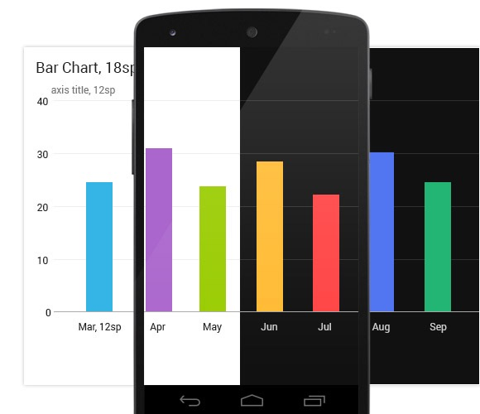
Predefined Styles and Palettes
Built-in predefined styles compliant with Google’s design guidelines
UI for Android offers various predefined styles and palettes which are compliant with Google’s design guidelines. They help you achieve beautiful color combinations in your app. Furthermore, the controls support the Holo system themes, making it easy to implement your own visual styles.

Slide 13
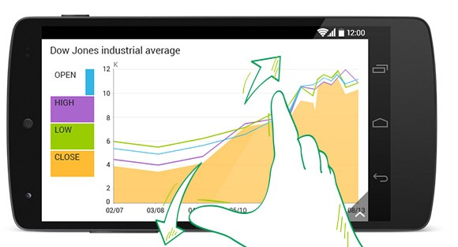
Fast and Precise Pan and Zoom
Provides smooth pinch/pan and drag/zoom
The pinch/pan and drag/zoom gestures deliver smooth and fluid experience when using UI for Android. Thanks to the highly optimized UI virtualization mechanism, the data points are drawn on demand, contributing to highly efficient performance on the mobile device.

Slide 14
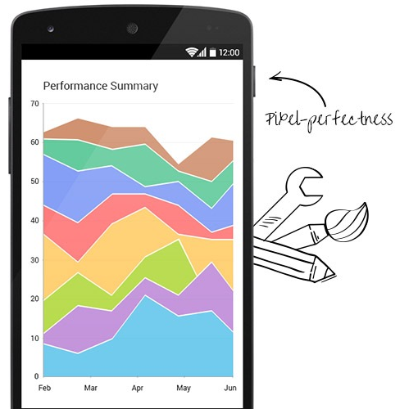
Ultimate Performance
Smooth experience any device or form factor
UI for Android provides the same smooth experience on any device and screen-size running Android. The controls deliver fast loading, excellent drawing capabilities and pixel-perfectness. Thanks to UI virtualization the charts rendering is optimized to the maximum.

Slide 15
Demo

Slide 16
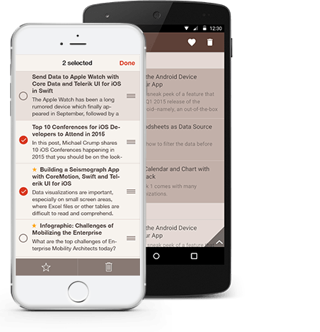

Bindings for Xamarin
Provides C# bindings (a.k.a. Wrappers) for Xamarin to make developers productive while using Xamarin platform.
Available as UI for Xamarin

Slide 17
Q & A
Resources
http://www.telerik.com/ios-ui
http://www.telerik.com/android-ui
Feedback
http://bit.ly/next-hossain
@mehfuzh

