Slide 1
Simplifying Global Economics, Business, and Finance
EDUNOMICS
edunomics.club
edunomicsclub@gmail.com

Slide 2
Game Plan
Review what we learned last class
Talk about the Great Depression
Mr. Bigshot

Slide 3
Last Class
Money Markets

Slide 4
Review- Money Markets
Asset- an owned claim (i.e. your house)
Liability- requirement to pay money in the future (i.e. a loan)
Liquid vs illiquid
Bank- provides liquid cash

Slide 5
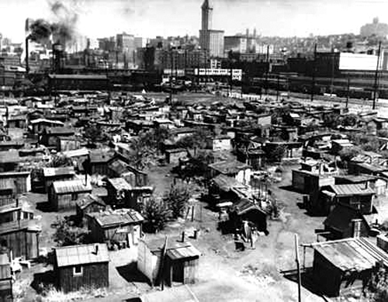
Great Depression
Roaring 20’s
Low prices
Loss of money
Hoovervilles

Slide 6
Crash of 1929
“What goes up must come down”
Investing in anticipation of rising prices
Oversupply -> dump products at loss
Share prices dropped

Slide 7
Bank failures
People pulling savings
Banks stopped loaning
Drop in consumption

Slide 8
FDR’s New Deal
Keynesian economics- active role in government
Public projects

Slide 9
Crash Course
https://www.youtube.com/watch?v=GCQfMWAikyU

Slide 10
Mr. Bigshot
http://www.mrbigshot.com/#

Slide 11
Next Class
Review what we learned today
Talk about Foreign Exchange Market

Slide 12
Contact
Email: edunomicsclub@gmail.com
Website: edunomics.club

