Slide 1
Simplifying Global Economics, Business, and Finance
EDUNOMICS
edunomics.club
edunomicsclub@gmail.com

Slide 2
Game Plan
Review what we learned last class
Simulation
Talk about Prisoner’s Dilemma

Slide 3
Last Class
Stock comparison

Slide 4
Review- Stock Comparisons
P/E
Beta
EPS

Slide 5
Game Theory
Study of behavior in situations of interdependence
Dominant strategy- player’s best action regardless of actions by other players
http://www.investopedia.com/terms/p/prisoners-dilemma.asp

Slide 6
Simulation

Slide 7
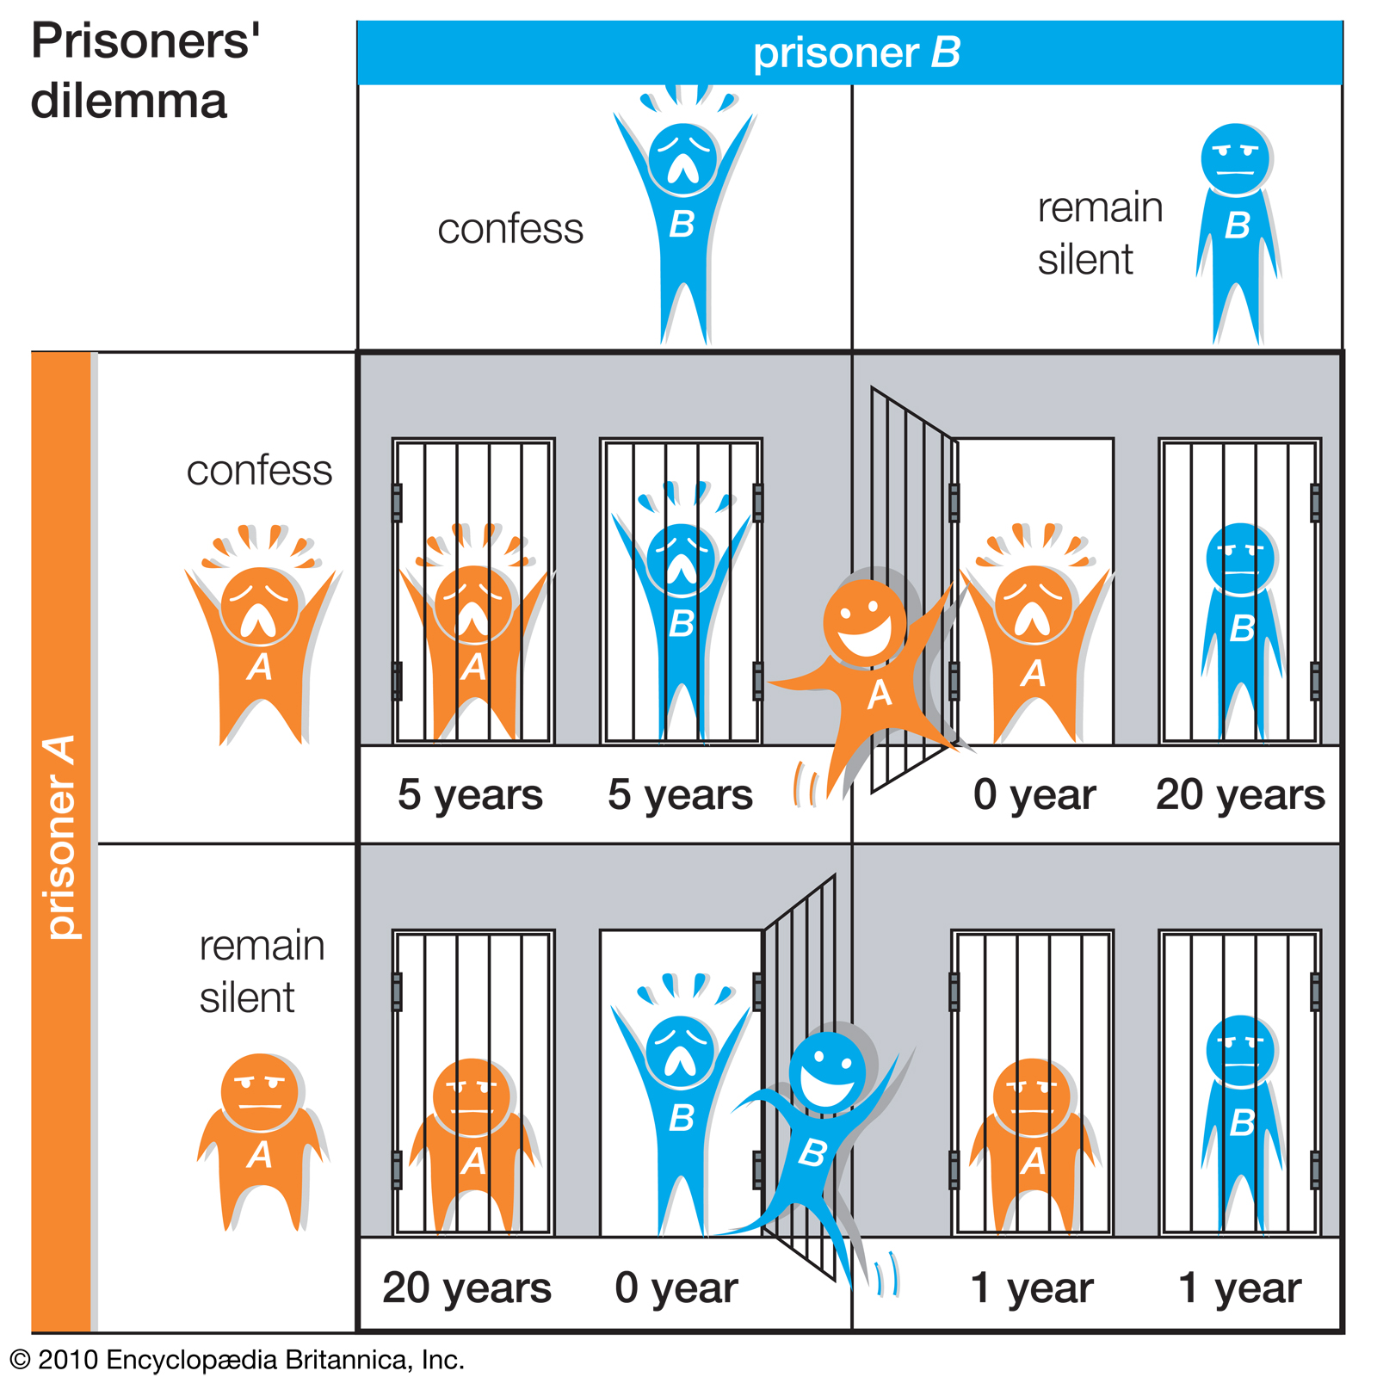
Prisoner’s Dilemma

Slide 8
Strategies
Nash equilibrium- when all players choose dominant strategy
Tit for tat- players cooperate at first
Collusion

Slide 9
Next Class
Party!!!
Quiz

Slide 10
Contact
Email: edunomicsclub@gmail.com
Website: edunomics.club

