Slide 1
Simplifying Global Economics, Business, and Finance
EDUNOMICS
edunomics.club
edunomicsclub@gmail.com

Slide 2
Game Plan
Review what we learned last class
Talk about GDP and Unemployment
GDP Trivia

Slide 3
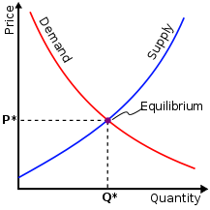
Last Class
Economics
Business
Finance
Supply and Demand

Slide 4
Review- Supply and Demand
Changes in Supply and Demand
Complements and Substitutes

Slide 5
GDP
Gross Domestic Product (GDP) is the measure of all finished goods and services in a country
How much is it worth?
http://www.investopedia.com/video/play/what-is-gdp/

Slide 6
How is GDP Calculated?
Y = C + I + G +(X - M)
C = Consumption
I = Investment
G = Government Spending
(X-M) = Net Exports

Slide 7
Consumption
Consumption is spending on goods and services
Household level
There are three subcategories of consumption: Durable goods, non-durable good, and services
Examples of consumption include rent, food, and medicine

Slide 8
Investment
Lending money to make profits
Examples of investment include real estate, tech. companies

Slide 9
Government spending
Similar to consumption only on the national level
Examples of things the government may spend money on are salaries, military equipment, etc.

Slide 10
Net exports
Products a country gives to another in return for other products or money

Slide 11
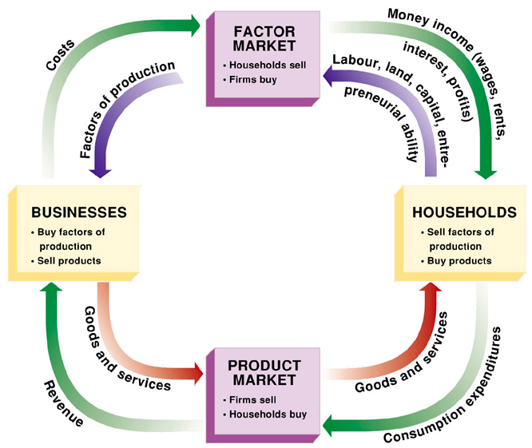
Circular Flow

Slide 12
Top 5 GDP
United States of America
China
Japan
Germany
United Kingdom

Slide 13
Unemployment
People in the workforce without a job
3 Types:
Frictional- searching for a job
Structural- replaced by technology
Cyclical- recessions
http://www.investopedia.com/video/play/how-unemployment-defined/

Slide 14
GDP Trivia
http://www.sporcle.com/games/g/biggest_economies

Slide 15
Next Class
Review what we learned today
Talk about Money

Slide 16
Contact
Email: edunomicsclub@gmail.com
Website: edunomics.club
Email list: http://bit.ly/1FxWCnS

