Slide 1
Simplifying Global Economics, Business, and Finance
EDUNOMICS
edunomics.club
edunomicsclub@gmail.com

Slide 2
Game Plan
Review what we learned last class
Talk about Money Markets
Mr. Bigshot

Slide 3
Last Class
Money

Slide 4
Review- Money
Payment for goods and services
Medium of exchange
Store of value
Unit of account
Value of American dollar decreasing

Slide 5
Money Markets
Asset- an owned claim (i.e. your house)
Liability- requirement to pay money in the future (i.e. a loan)

Slide 6
Liquid vs illiquid
Liquid- converted to cash easily (i.e. stocks)
Illiquid- difficult to convert to cash (i.e. land)

Slide 7
Banks
Provides liquid assets to borrowers
A loan is a bank’s asset and a borrower’s liability
Federal Reserve- America’s national bank
Video on banks

Slide 8
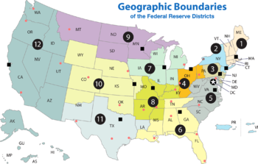
Federal Reserve
12 regional banks
Headquarters in DC
Control money supply

Slide 9
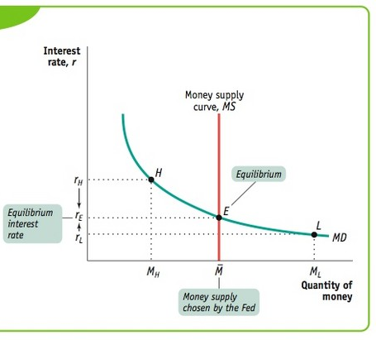
Money Curve

Slide 10
Interest Rates
Sum of money borrower owes to lender
Lower interest rates -> higher output

Slide 11
Mr. Bigshot
http://www.mrbigshot.com/#

Slide 12
Next Class
Review what we learned today
Talk about Great Depression and Great Recession

Slide 13
Contact
Email: edunomicsclub@gmail.com
Website: edunomics.club
Email list: http://bit.ly/1FxWCnS

