Slide 1
Simplifying Global Economics, Business, and Finance
EDUNOMICS
edunomics.club
edunomicsclub@gmail.com

Slide 2
Game Plan
Review what we learned last class
Talk about the Foreign Exchange Market
Walk the Plank game

Slide 3
Last Class
Great Depression

Slide 4
Review- Great Depression
“What goes up must come down”
Investing in anticipation of rising prices
Oversupply -> dump products at loss
Share prices dropped

Slide 5
Foreign Exchange Market
Market of international currencies
Exchange rates- prices at which currencies trade
Forex Market Basics

Slide 6
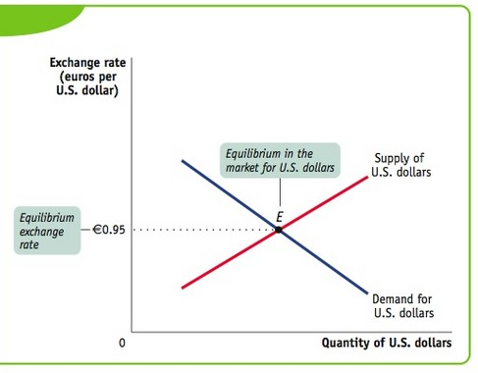
US Dollars v. Euro

Slide 7
Vocabulary
When a currency becomes more valuable in terms of other currencies, it appreciates
When a currency becomes less valuable in terms of other currencies, it depreciates

Slide 8
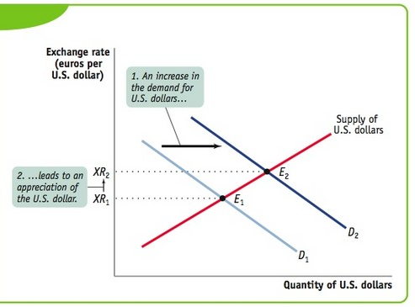
US Dollar Appreciation

Slide 9
Inflation
General level of prices of goods and services rising
Inflation

Slide 10
Walk the Plank- Great Depression
http://www.schoolhistory.co.uk/games/walk/walk_depression.html

Slide 11
Next Class
Review what we learned today
Talk about Stock Market

Slide 12
Contact
Email: edunomicsclub@gmail.com
Website: edunomics.club

