Slide 1
Simplifying Global Economics, Business, and Finance
EDUNOMICS
edunomics.club
edunomicsclub@gmail.com

Slide 2
About Us
Two high school students who have an interest in business
Teach economics, business, and finance to middle school students

Slide 3
Sahith Malyala
Senior
Goes to Thomas Jefferson (TJ)
Interested in quantitative finance and venture capital
Enjoys swimming and working out

Slide 4
Sahil Yedulla
Senior
Goes to Broad Run
Interested in financial engineering
Plays golf and basketball

Slide 5
Game Plan
Briefly explain economics, business, and finance
Week 1- Supply and Demand
Village Game

Slide 6
Economics
Economics is the concept of people, businesses, and nations making choices to satisfy wants and needs
Has two major subcategories: Macro and Micro economics
Macroeconomics- Refers to large scale economic factors often relating to GDP, money market, and foreign exchange market
Microeconomics- Study of how individuals and companies make financial decisions

Slide 7
Business
Interactions between consumers, producers, and government
Business basics
Communicating to convince others to buy/sell a product
Number trick
Pitching: Shark Tank Video
We will do mock pitches later on in the year

Slide 8
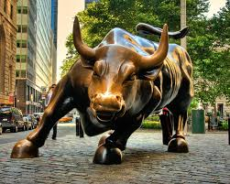
Finance
Refers to how one manages money and acquires money via loans, investing, etc
Many aspects: corporate, personal, etc
Includes money, the history of it and the value of it
Stock market game with prizes!

Slide 9
Supply And Demand
Major part of economics
Refers to the relationship between how much of a product there is (supply) and how many people/things require the product (demand)

Slide 10
Changes in Demand
Changes in the prices of related goods or services
Changes in income
Changes in tastes
Changes in the number of consumers

Slide 11
Changes in Supply
Changes in the prices of related goods or services
Changes in input prices
Changes in technology
Changes in the number of producers

Slide 12
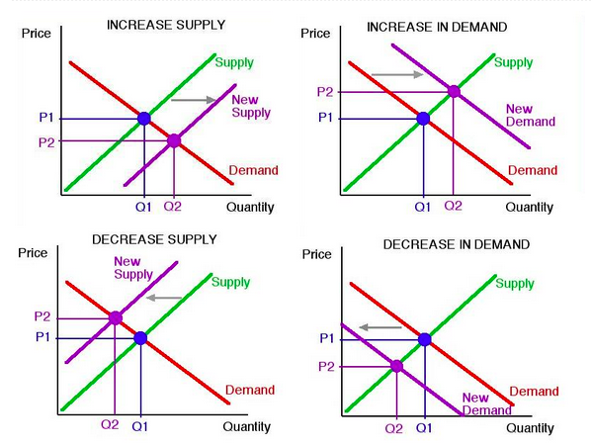
Graphs

Slide 13
The Goal
The goal is to find an equilibrium point between supply and demand by doing so prices will be stable.

Slide 14
Village Game
Illustrates Supply and Demand
Teams of 2-3
Goal: 3 of each item

Slide 15
Next Class
Review what we learned today
Talk about GDP and Unemployment

Slide 16
Contact
Email: edunomicsclub@gmail.com
Website: edunomics.club
Email list: http://bit.ly/1FxWCnS

