Slide 1
School is…

Slide 2
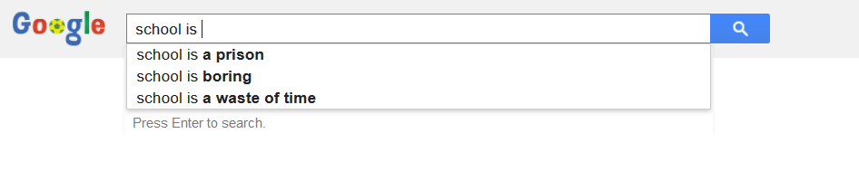
School is…

Slide 3
…but education is adventure
edventure
Show the world your feats

Slide 4

Gamification
Gamification makes boring processes interesting

Slide 5
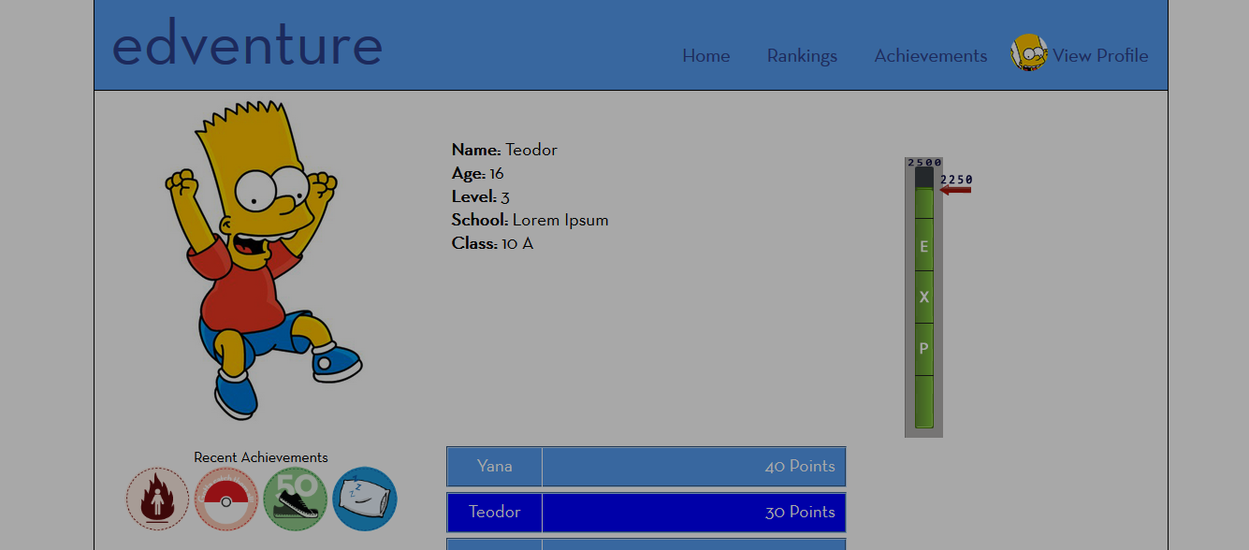

Slide 6
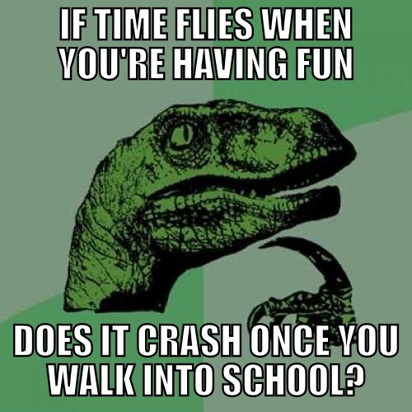
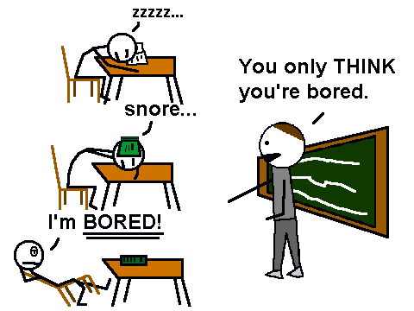

Slide 7

Motivation

Slide 8
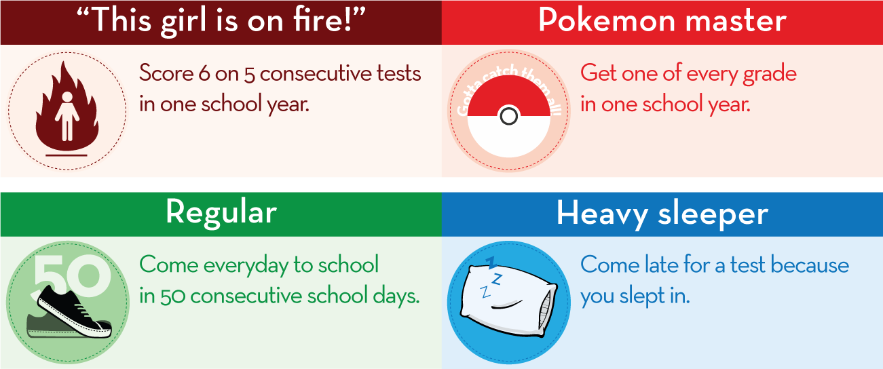

Slide 9
edventure
Show the world your feats
Thanks

