Slide 1

NCCS - 2
Bashini Weerasinghe : CB010292 Shammika Karunarathne : CB010624 Sulakshi Ilangeshwaran : CB010434

Slide 2
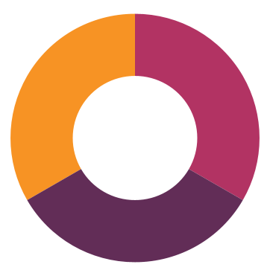
TEAM CONTRIBUTION
BASHINI
SHAMMIKA
SULAKSHI

Slide 3
EXECUTIVE SUMMARY
We selected Kongcepts as the organization to do this cyber security assessment.
The measures we used for this security evaluation are as follows:
Company visit
Meetings (online and physical) with the staff in different departments
Review of critical IT infrastructure and systems
Review of current IT policies and procedures
Review of special security concerns revealed during visits and meetings.

Slide 4

ORGANIZATIONAL PROFILE
Kongcepts is a software engineering firm as well as a digital marketing and branding agency based in Peradeniya, with a second branch in Malabe. They currently serve many clients all around the world, including those from Germany, the United States, Singapore, Australia, and Sri Lanka.

Slide 5
OBJECTIVES
1
2
Listing the hardware, software and data assets available in the company.
Identifying vulnerabilities, risks and threats for each asset.
Identifying the consequences of each threat.
Deciding on which threats to mitigate, defer, accept and transfer.
3
4
5
6
7
8
Discovering the company's minimal tolerance limit to being vulnerable.
Determining the administrative, technical, and physical controls applied on the assets whose threats are to be mitigated.
Organizing the list based on several assessment criteria like asset worth and importance of the data in it.
Prioritizing vulnerabilities, risks and threats depending on severity of threats and how vital the assets are.

Slide 6
Asset ID | Rationale for Selection | Most Important Security Requirement
BSS-0001: Antivirus Software | Antivirus protection is crucial to prevent the corruption of data and to protect computer systems from cyber threats. | Availability
BSS-0002: Cloud Backup System | Data backups guarantee that the company has a restorable copy of all the data of the company. | Integrity
BSS-0003: Employee Data | Employee data offers a non-biased view of an employee’s work history. | Confidentiality
BSS-0004: Fingerprint Scanner | Fingerprint scanners identify and authenticate an employee. | Availability
BSS-0005: IDE | IDE streamlines and maintains the development/creation process. | Integrity
BSS-0006: NoSQL Database | NoSQL databases are essential because they provide a centralized system to store all the information in documents rather than relational tables. | Availability
BSS-0007: Operating System | Operating System provides the interface for handling all the computerized company activities. | Confidentiality
BSS-0008: Router Configurations | The router helps connect the company networks in geographically separate sites, as well as multiple devices to the Internet. | Integrity
BSS-0009: Switches | It allows connected devices to share information and communicate with one another. | Integrity

Slide 7
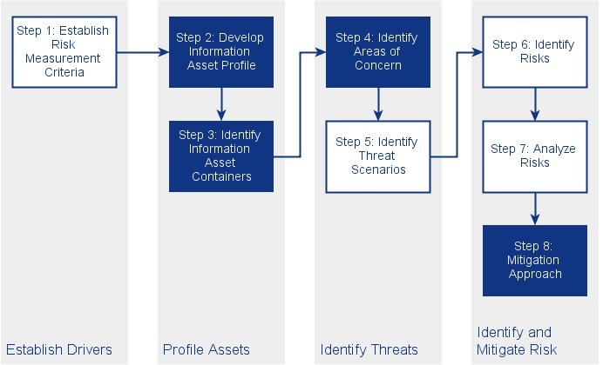
RISK ASSESSMENT FRAMEWORK
OCTAVE ALLEGRO
The most important factor to consider when choosing a framework is that it is ‘fit for purpose’ and best suited for the intended objectives.
Notes:
A paradigm for assessing and mitigating information security risks is called the Operationally Critical Threat, Asset, and Vulnerability Evaluation (OCTAVE). • It outlines a thorough review process that enables an organization to determine which information assets are crucial to achieving its goals, as well as the risks that may affect those assets and the vulnerabilities that might make them vulnerable. ⚫ The company may start to comprehend what data is at danger by combining the information assets, risks, and vulnerabilities. Considering this knowledge, the company may develop and put into action a protection strategy to lessen the total risk exposure of its information assets.

Slide 8
ASSETS + THREATS + VULNERABILITIES

Slide 9




Asset | Vulnerability | Threat | Risk Mitigation
BSS-0001: Antivirus Software | Carelessness of employees | USB infection | Enforce a USB drive usage policies
 | Lack of verification of email addresses | File-less malware attacks | Continuous network monitoring
 | Zero-day vulnerabilities | Zero-day attacks | Keeping all software applications up to date

Slide 10
Asset | Vulnerability | Threat | Risk Mitigation
BSS-0002: Cloud Backup System | Misconfigured security settings | Cyber attacker | Keep your sensitive information off their servers.
 | Careless employees | Virus on public device used to access the cloud | Backing up the backup
 | Lack of verification of email sources | Ransomware | Implement cloud-based anti-phishing

Slide 11
Asset | Vulnerability | Threat | Risk Mitigation
BSS-0003: Employee Data | Employee corruption | Data theft | Use data encryption solutions
 | Careless service provider | Equipment malfunction | Use updated equipment with new technology
 | Lack of antivirus measures | Ransomware | Using professional anti malware software

Slide 12
Asset | Vulnerability | Threat | Risk Mitigation
BSS-0004: Fingerprint Scanner | Weak security measures | Presentation Attack | Keep track on database and detect any unusual behavior
 | Careless employee | Weak passwords | Only store hashed fingerprint templates
 | Contact surfaces that can contain germs | Infectious disease | Using disinfectants regularly on scanners

Slide 13
Asset | Vulnerability | Threat | Risk Mitigation
BSS-0005: IDE | Lack of adequate authentication mechanisms | Hacker from a competitor software firm | IAM, MFA and SSO
 | Automated Running of Scripts without Malware/Virus Checks | Malware | Install anti-scripting software to prevent unauthorized execution
 | Allowing unauthorized devices to interact with services | Hacked device | Control the network architecture

Slide 14
Asset | Vulnerability | Threat | Risk Mitigation
BSS-0006: NoSQL Database | NoSQL injection vulnerability | NoSQL injection attacks | Use separate databases for each application
 | Weak passwords | Unauthorized access | Encrypt information stored in databases
 | Limited bandwidth | DDoS/ DoS attacks | Deploy anti-DDoS hardware and software modules

Slide 15
Asset | Vulnerability | Threat | Risk Mitigation
BSS-0007: Operating System | Careless employee | Malware / Virus present in the public network | Using effective antivirus software
 | Fault in computer administration | Bug in cracked OS | Use original operating systems acquired by a verified dealer
 | Fault in computer administration | Weak functioning | Keeping OS up to date

Slide 16
Asset | Vulnerability | Threat | Risk Mitigation
BSS-0008: Router Configurations | Lack of confidentiality of router credentials | Malware | Enforce a password policy
 | Unmonitored hard disk software | DDoS attack | Use an anti-DDoS solution
 | Capability of installing network devices without proper authorization | Router poisoning | Using routing protocol authentication

Slide 17
Asset | Vulnerability | Threat | Risk Mitigation
BSS-0009: Switches | Limited MAC table size | MAC Flooding | The obtained MAC addresses are validated against an AAA server
 | Switch configured with ‘dynamic desirable’, ‘dynamic auto’ or ‘trunk’ modes | VLAN Hopping attack | Never leave an access port in "dynamic desirable", "dynamic auto" or "trunk" mode
 | Lack of authentication of source addresses | ARP spoofing | Devices can connect to the internet via a VPN

Slide 18
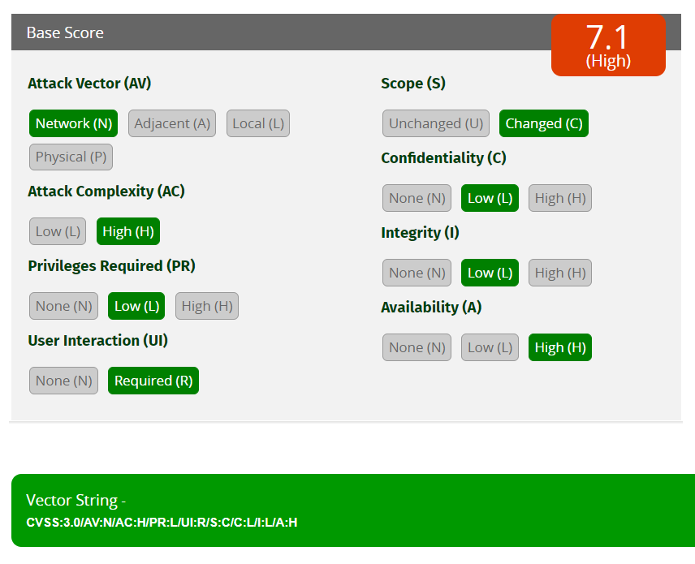
RISK ANALYSIS
Does a successful attack impact the other components?
OVERALL CVSS SCORE
How does the vulnerability exploitation happen?
How much does the attack impact the confidentiality of the asset?
How does the vulnerability exploitation happen?
How much does the attack impact the integrity of the asset?
How much privilege an attacker must have to exploit a vulnerability?
How much does the attack impact the availability of the asset?
Does the attack require user interaction for it to be successful?

Slide 19
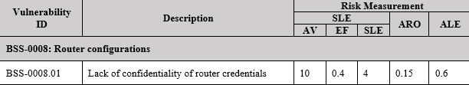
HEAT MAP
DREAD MODEL
Critical 1 | High 14 | Medium 12
Low 0 | Info 0 | Total 27
AV - Asset Value (scale 0 - 10)
EF - Exposure Factor (scale 0 - 1)
SLE - Single Loss Expectancy (AV * EF)
ARO – Annual Rate of Occurrence (scale 0 - 0.1)
ALE – Annualized Loss Expectancy (SLE * ARO)
Example:

Slide 20
RISK MITIGATION STRATEGIES
1
Implement multi-factor authentication
2
Secure accounts and privileges
3
Continuously monitor network traffic
4
Utilize system recovery plan
5
Administer systems and configurations actively
6
Keeping software applications up to date
7
Backup/Recovery solutions
8
CCTV
9
Company infrastructure check

Slide 21
SECURITY POLICIES
Network monitoring and remote access policy
Employee onboarding and offboarding policy
Privilege account creation policy

Slide 22
CONCLUSION
By the end of this assessment, we understood that cybersecurity is a never-ending battle. The intricacy of Information Technology Systems and human error in concluding whether the mitigating actions are secure or unsecure from a cybersecurity perspective is the root source of most cybersecurity issues. In addition, as cybersecurity evolves, cybersecurity threats also evolve, therefore, there is no such thing as a lasting fix for any issue.
Thus, improving the cybersecurity posture of a system must be seen as a recurring process rather than a one-time event.

Slide 23
THANK YOU!
Any questions?

