Slide 1
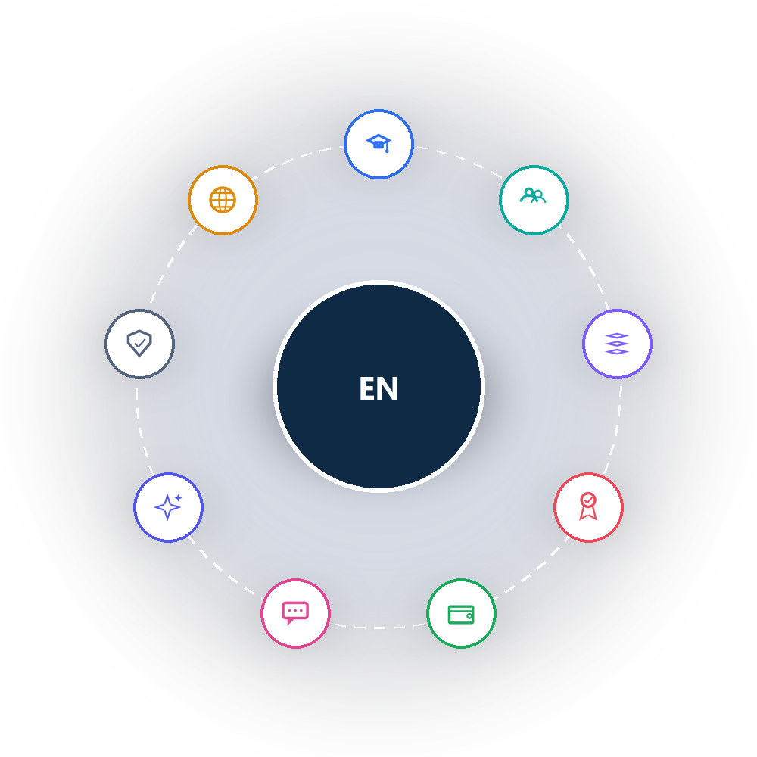
EDUNEXUSTECH PRESENTS
EduNexus
School Management, Reimagined
A Live Demo for Your School
EduNexusTech • https://edunexustech.com

Slide 2








AGENDA
What We'll Cover Today
01
05
About EduNexusTech
Live Demo — Every Module
02
06
The Challenge Schools Face
Security & Trust
03
07
Introducing EduNexus
Getting Started
04
08
Why Schools Choose Us
Let's Talk
EduNexusTech • School Demo
2

Slide 3
ABOUT US
We Build Technology for Schools
EduNexusTech is focused on one mission: giving schools a single, modern platform to run every part of their operation — so educators can spend less time on admin and more time teaching.
Purpose-Built
Modern & AI-Ready
Security First
Designed specifically for K-12 schools and education groups — not a generic business tool bolted on.
Built on a modern platform with an integrated AI assistant, not a legacy system playing catch-up.
Role-based access, full audit trails, and data protection built in from day one.
EduNexusTech • School Demo
3

Slide 4





THE CHALLENGE
Sound Familiar?
Admissions tracked across scattered spreadsheets and paper forms
Parents left guessing — no single channel for updates
Attendance registers filled by hand, every single day
School leadership flying blind with no real-time data
Fee collection spread across cash books, SMS reminders, and phone calls
Student records scattered across disconnected systems
EduNexusTech • School Demo
4

Slide 5
THE SOLUTION
One Platform. Every School Need.
Admissions, academics, exams, fees, communication, and AI — unified in one secure platform, so nothing falls through the cracks.
EduNexusTech • School Demo
5

Slide 6
WHY SCHOOLS CHOOSE US
Built Around Your Outcomes
Save Staff Time
Increase Enrollment
Delight Parents
Decide with Data
Stay Secure
Automate the repetitive admin work — admissions, invoicing, report cards — so your team focuses on students.
A faster, friendlier admissions journey converts more enquiries into confirmed admissions.
Timely, multi-channel updates build the trust that keeps families engaged and loyal.
Real-time dashboards give leadership visibility the moment they need it — not at term-end.
Role-based access and full audit trails protect student and financial data at every level.
EduNexusTech • School Demo
6

Slide 7
PLATFORM AT A GLANCE
Depth You Can Rely On
3-Tier
9
200+
5
Architecture built for single schools or entire education groups
Core suites covering the full school lifecycle
Screens — nothing bolted on, everything built in
Ways to reach parents: Email, SMS, WhatsApp, Push, In-App
Everything you see today runs on the same platform — no plug-ins, no separate logins, no data stuck in silos.
EduNexusTech • School Demo
7

Slide 8
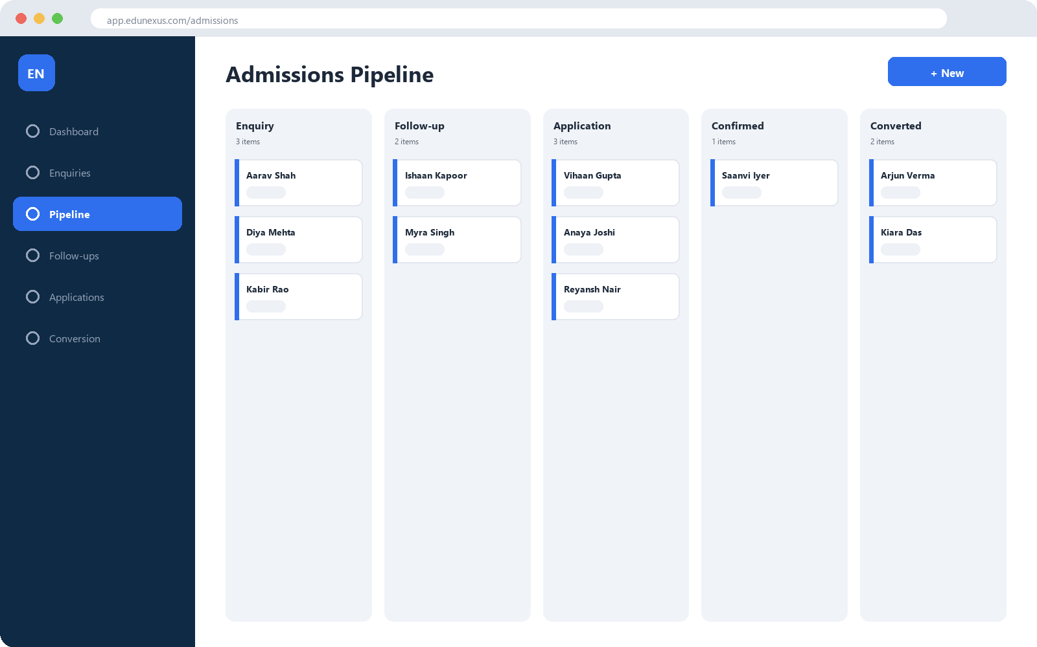

LIVE DEMO — ADMISSIONS
Turn Every Enquiry Into an Enrolled Student
Track every lead from first enquiry to confirmed admission — nothing falls through the cracks
A visual pipeline your team can manage in minutes, not spreadsheets
Online application forms parents can fill out from their phone, anytime
EduNexusTech • School Demo
8

Slide 9
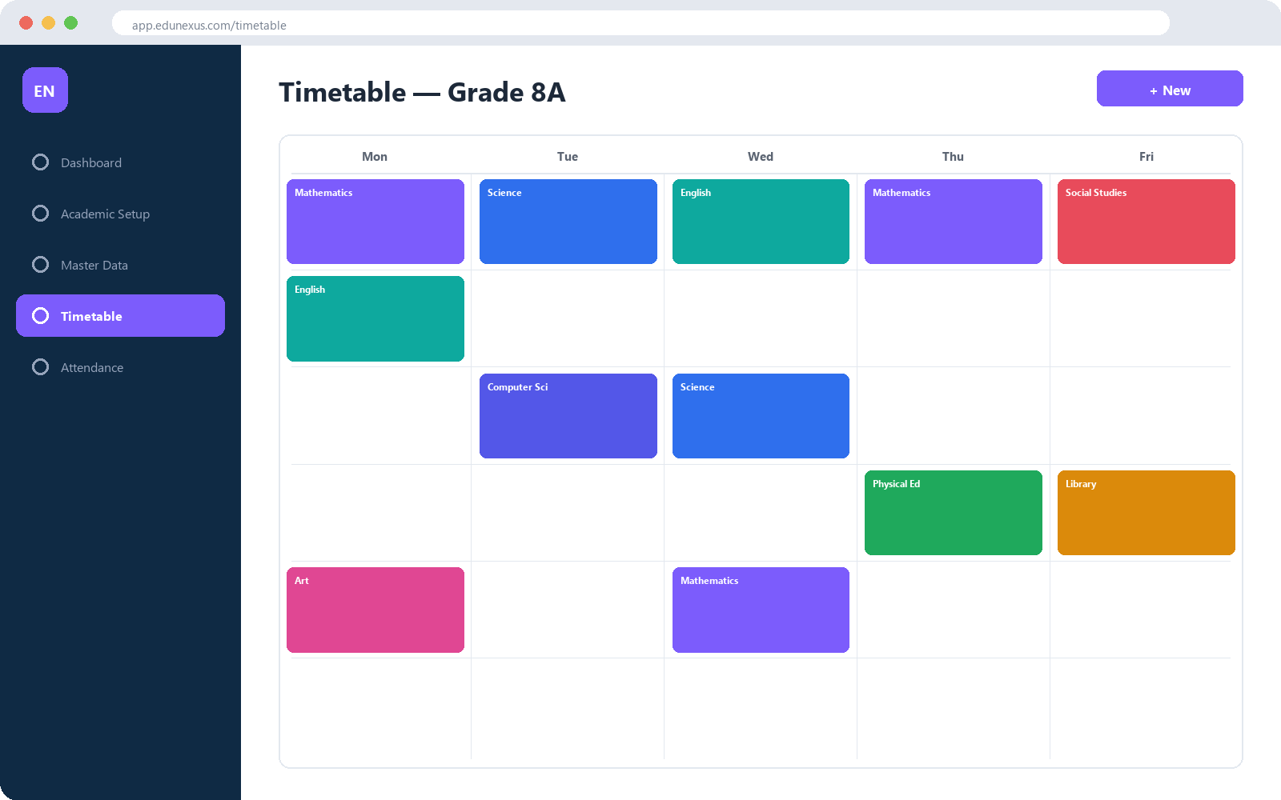

LIVE DEMO — ACADEMICS & ATTENDANCE
Timetables & Attendance, Without the Headache
Build conflict-free class schedules in a fraction of the time
Mark attendance for students, teachers, and staff from one screen
Real-time visibility into attendance trends for school leadership
EduNexusTech • School Demo
9

Slide 10
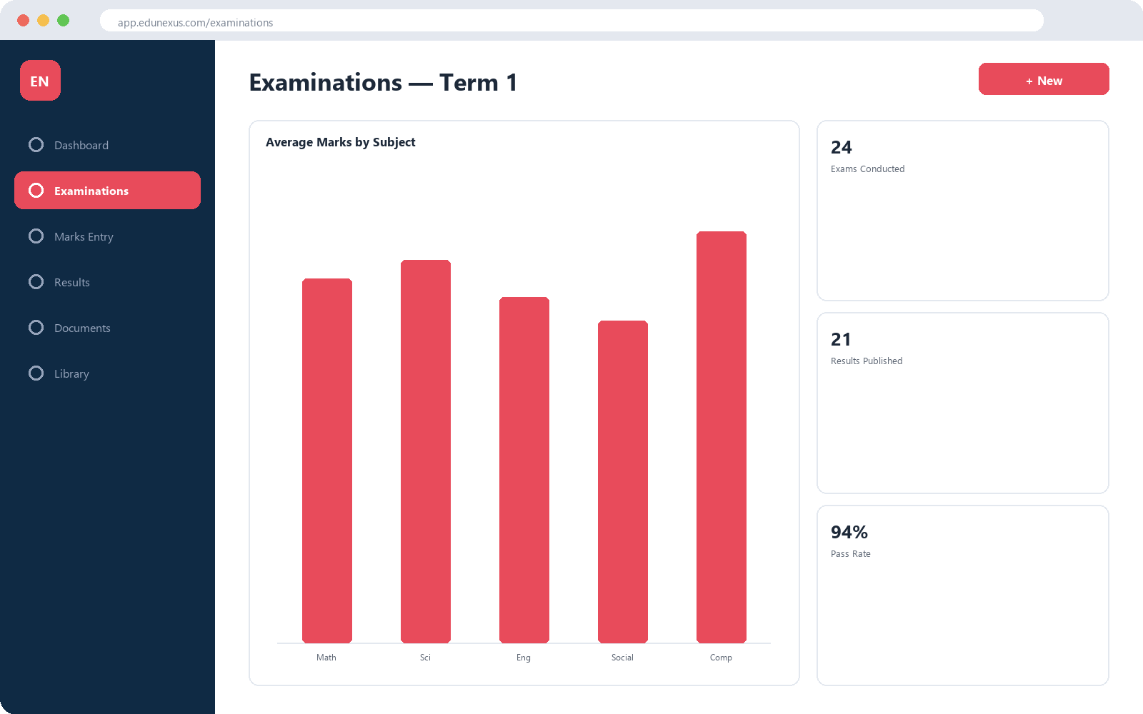

LIVE DEMO — EXAMINATIONS
From Exam to Report Card, Fully Automated
Enter marks once — results, analytics, and report cards generate themselves
Beautifully designed, QR-verifiable report cards and certificates
Give parents instant, transparent visibility into performance
EduNexusTech • School Demo
10

Slide 11
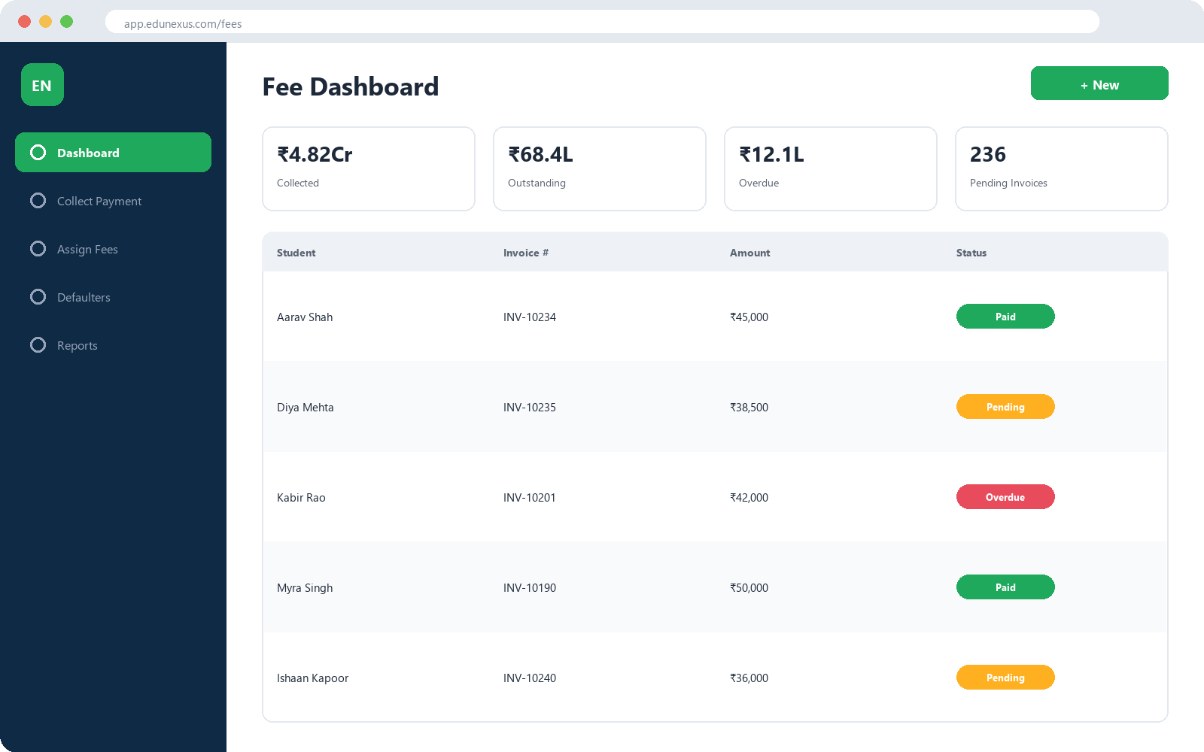
LIVE DEMO — FEES & FINANCE
Fee Collection That Runs Itself
Automatic invoicing, online payments, and instant digital receipts
Real-time visibility into collections, dues, and defaulters
Fewer manual errors, faster reconciliation, happier accounts team
EduNexusTech • School Demo
11

Slide 12
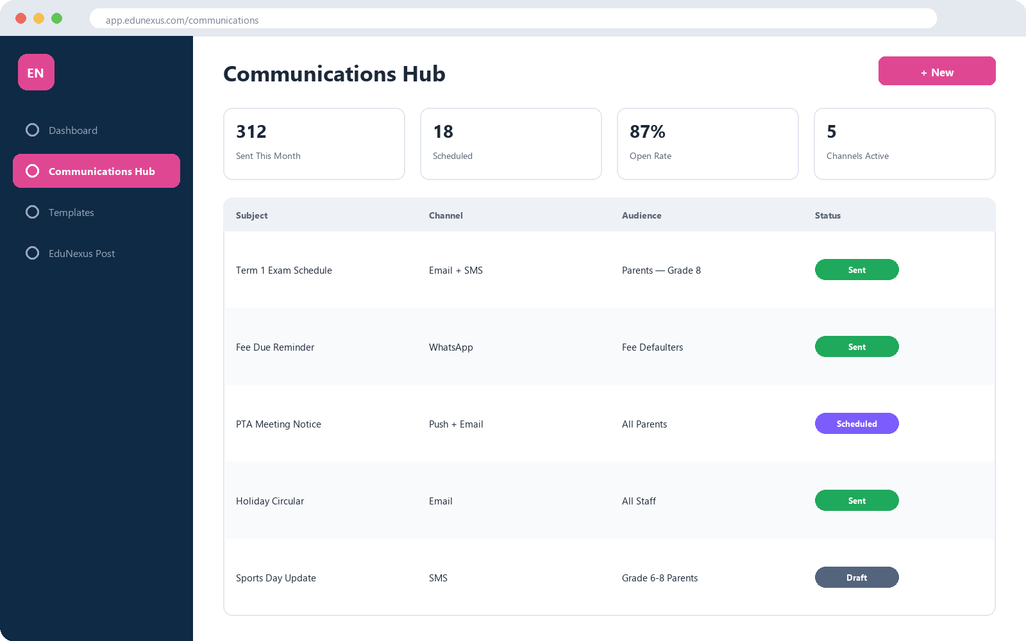
LIVE DEMO — COMMUNICATION
Never Miss Reaching a Parent Again
Reach every parent by Email, SMS, WhatsApp, or push — from one place
Announcements, circulars, and fee reminders sent in seconds
Build trust with parents through consistent, timely updates
EduNexusTech • School Demo
12

Slide 13
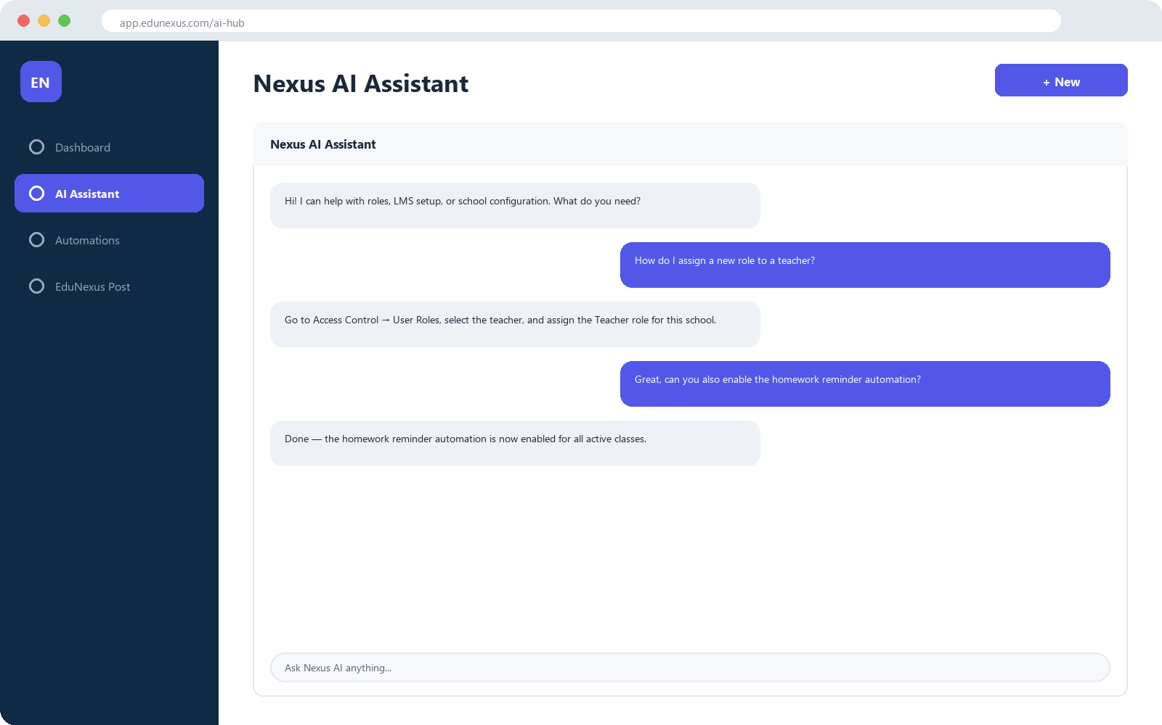

LIVE DEMO — AI ASSISTANT
Your School's Always-On Digital Assistant
Instant answers for staff on roles, setup, and daily tasks
Automations that handle reminders and routine follow-ups for you
Less time on admin, more time on students
EduNexusTech • School Demo
13

Slide 14


SECURITY & TRUST
Your Data, Protected at Every Level
Role-based access control ensures every user only sees what they're meant to
A full audit trail records who changed what, when, and from where
Data is encrypted and regularly backed up
QR-verifiable certificates and report cards prevent forgery
EduNexusTech • School Demo
14

Slide 15
BUILT TO SCALE WITH YOU
One School Today, a Whole Group Tomorrow
EduNexus is architected as Platform → Organization → School, so whether you run one campus or a growing group of schools, the same platform scales with you — with each school keeping its own structure, staff, and settings.
And we keep building — transport management, payroll, and deeper analytics are already on our roadmap.
Without EduNexus | With EduNexus
✗ Multiple disconnected tools | ✓ One unified platform
✗ Manual data entry & errors | ✓ Automated workflows
✗ Delayed, one-way communication | ✓ Instant, multi-channel outreach
✗ Limited visibility for leadership | ✓ Real-time dashboards
EduNexusTech • School Demo
15

Slide 16
GETTING STARTED
From Decision to Go-Live
Discovery Call
Team Training
Ongoing Support
Understand your school's specific needs
Hands-on onboarding for your staff
We're with you long after launch
1
2
3
4
5
Setup & Migration
Go Live
We configure the platform and migrate your data
Launch with our team supporting you closely
EduNexusTech • School Demo
16

Slide 17

Ready to See EduNexus
in Your School?
Let's schedule a personalized walkthrough for your team.
EduNexusTech
edunexuxtech@gmail.com
+91 99014 14072
https://edunexustech.com
EduNexusTech • School Demo
17

Slide 18
Thank You
We look forward to partnering with you
EduNexusTech • School Demo
18

