Slide 1
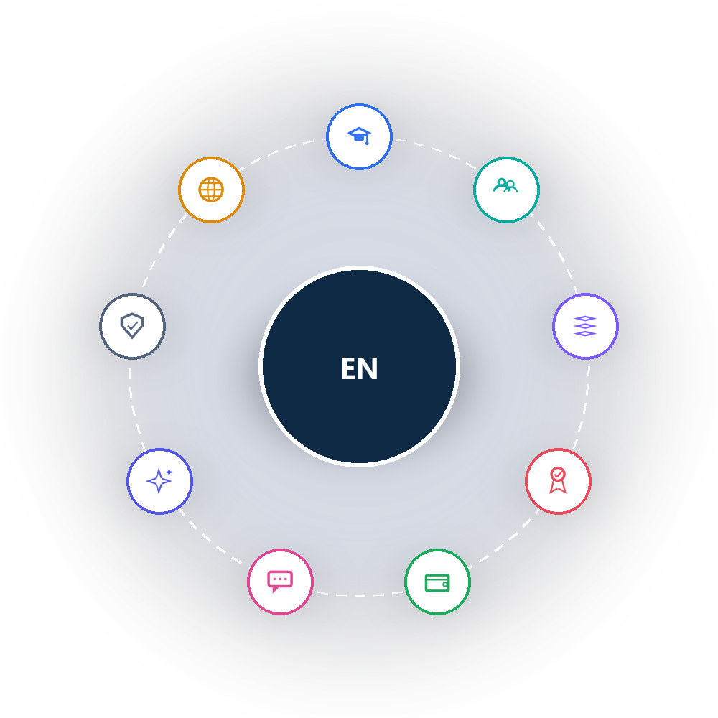
EduNexus
Complete Page & Menu Directory
Every menu. Every page. No exceptions.
207 pages • 13 menus
Prepared July 2026 • Confidential

Slide 2

DIRECTORY INDEX
Menu-by-Menu Coverage
207 pages across 13 menus — nothing left out
01
6 pgs
08
3 pgs
Dashboard & Account
AI & Automation
02
20 pgs
09
21 pgs
Admissions & Enrollment
Platform & Tenant Administration
03
21 pgs
10
17 pgs
Student, Staff & Family Records
Access Control & Navigation Config
04
26 pgs
11
35 pgs
Core Academic Operations
Master Data
05
16 pgs
12
25 pgs
Teaching, Learning & Assessment
Configuration & Compliance
06
4 pgs
13
3 pgs
Finance
Public Website
07
10 pgs
Communication & Engagement
EduNexus • Complete Page & Menu Directory
2

Slide 3
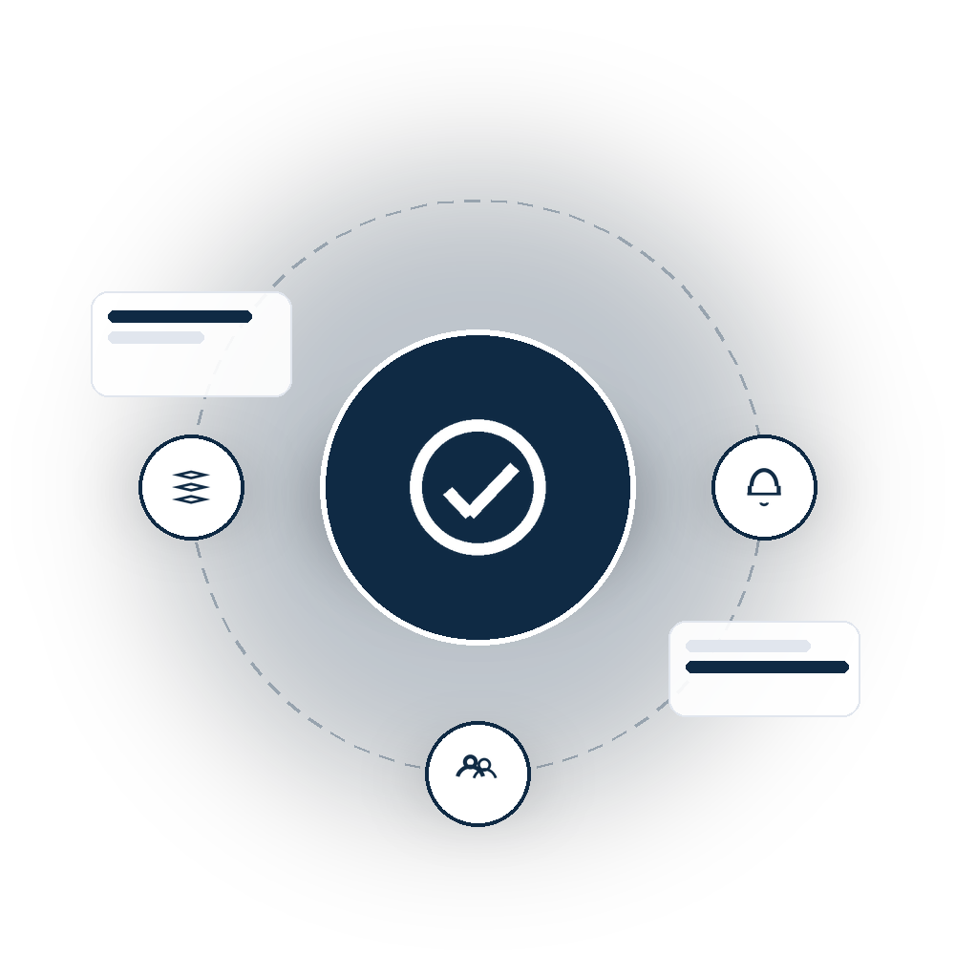
01
Dashboard & Account
The landing dashboard and every user's personal account pages
6 pages in this menu
EduNexus • Complete Page & Menu Directory
3

Slide 4
DASHBOARD & ACCOUNT
Page Directory
6 pages total
Page / Screen | Route | Type
Dashboard | /dashboard | Dashboard
Login | /login | Public
Forgot Password | /forgot-password | Public
Change Password | /change-password | Form
My Profile | /profile | Form
Notifications | /notifications | List
EduNexus • Complete Page & Menu Directory
4

Slide 5

02
Admissions & Enrollment
Enquiry capture, pipeline, applications, conversion, and the form builder
20 pages in this menu
EduNexus • Complete Page & Menu Directory
5

Slide 6
ADMISSIONS & ENROLLMENT
Page Directory
Part 1 of 2 — 20 pages total
Page / Screen | Route | Type
Admissions Overview | /admissions | Hub
Academic Year Setup | /admissions/setup | Setup
Enquiries | /admissions/enquiries | List
Pipeline (Kanban) | /admissions/pipeline | Board
Follow-ups | /admissions/follow-ups | List
Internal Applications | /admissions/applications/internal | List
External Applications | /admissions/applications/external | List
Confirmed Applications | /admissions/confirmed | List
Conversion | /admissions/conversion | Action
New Enquiry / Lead | /admissions/leads/new | Form
Edit Enquiry / Lead | /admissions/leads/:id/edit | Form
New Application | /admissions/applications/new | Form
Application Detail | /admissions/applications/:id | Detail
EduNexus • Complete Page & Menu Directory
6

Slide 7
ADMISSIONS & ENROLLMENT
Page Directory
Part 2 of 2 — 20 pages total
Page / Screen | Route | Type
Edit Application | /admissions/applications/:id/edit | Form
Form Builder — List | /form-builder | List
Form Builder — New Form | /form-builder/new | Form
Form Builder — Designer | /form-builder/:id/edit | Builder
Form Builder — Preview | /form-builder/:id/preview | Preview
Form Builder — Responses | /form-builder/:id/responses | Analytics
Public Form (Fill) | /f/:slug | Public
EduNexus • Complete Page & Menu Directory
7

Slide 8
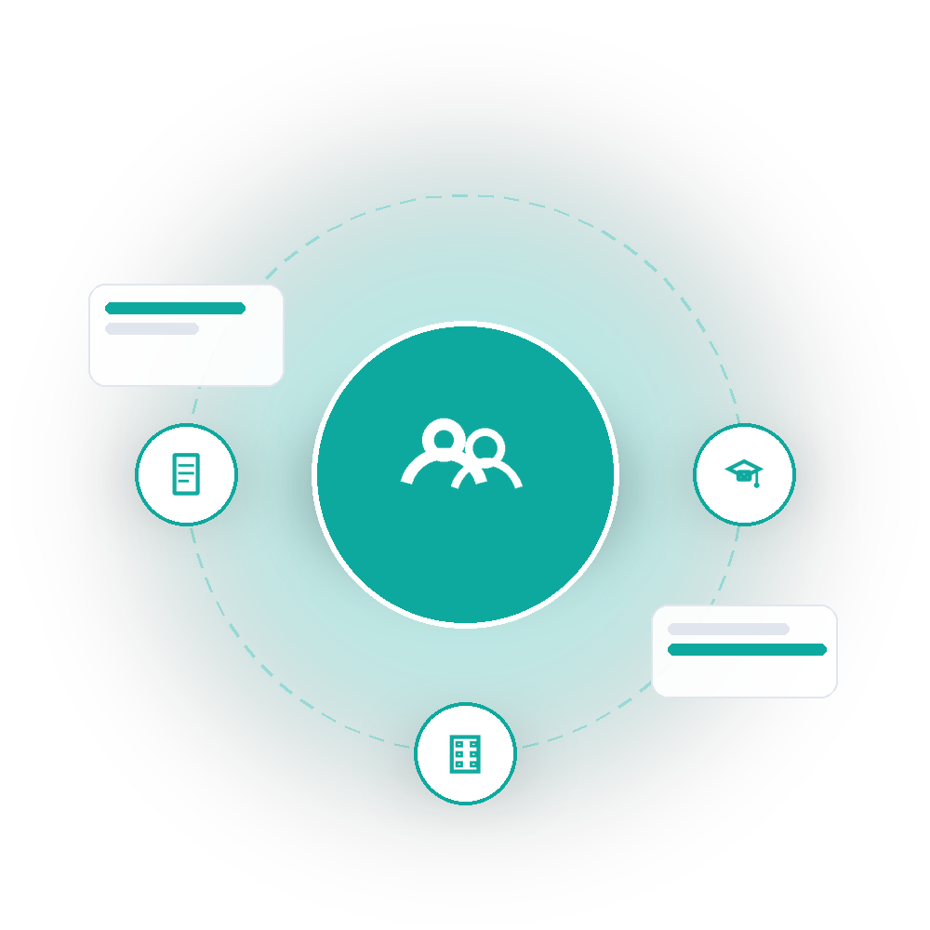
03
Student, Staff & Family Records
Students, teachers, parents & guardians, and HRMS staff records
21 pages in this menu
EduNexus • Complete Page & Menu Directory
8

Slide 9
STUDENT, STAFF & FAMILY RECORDS
Page Directory
Part 1 of 2 — 21 pages total
Page / Screen | Route | Type
Students Hub | /students | Hub
Students Roster | /students/roster | List
Add Student | /students/new | Form
Student Detail | /students/:id | Detail
Edit Student | /students/:id/edit | Form
Teachers Hub | /teachers | Hub
Teachers Roster | /teachers/roster | List
Add Teacher | /teachers/new | Form
Teacher Detail | /teachers/:id | Detail
Edit Teacher | /teachers/:id/edit | Form
Parents Hub | /parents | Hub
Parents Roster | /parents/roster | List
Households | /parents/households | List
EduNexus • Complete Page & Menu Directory
9

Slide 10
STUDENT, STAFF & FAMILY RECORDS
Page Directory
Part 2 of 2 — 21 pages total
Page / Screen | Route | Type
Add Parent / Guardian | /parents/new | Form
Parent Detail | /parents/:id | Detail
Edit Parent / Guardian | /parents/:id/edit | Form
Staff Hub (HRMS) | /staff | Hub
Staff Roster | /staff/roster | List
Add Staff | /staff/new | Form
Staff Detail | /staff/:id | Detail
Edit Staff | /staff/:id/edit | Form
EduNexus • Complete Page & Menu Directory
10

Slide 11
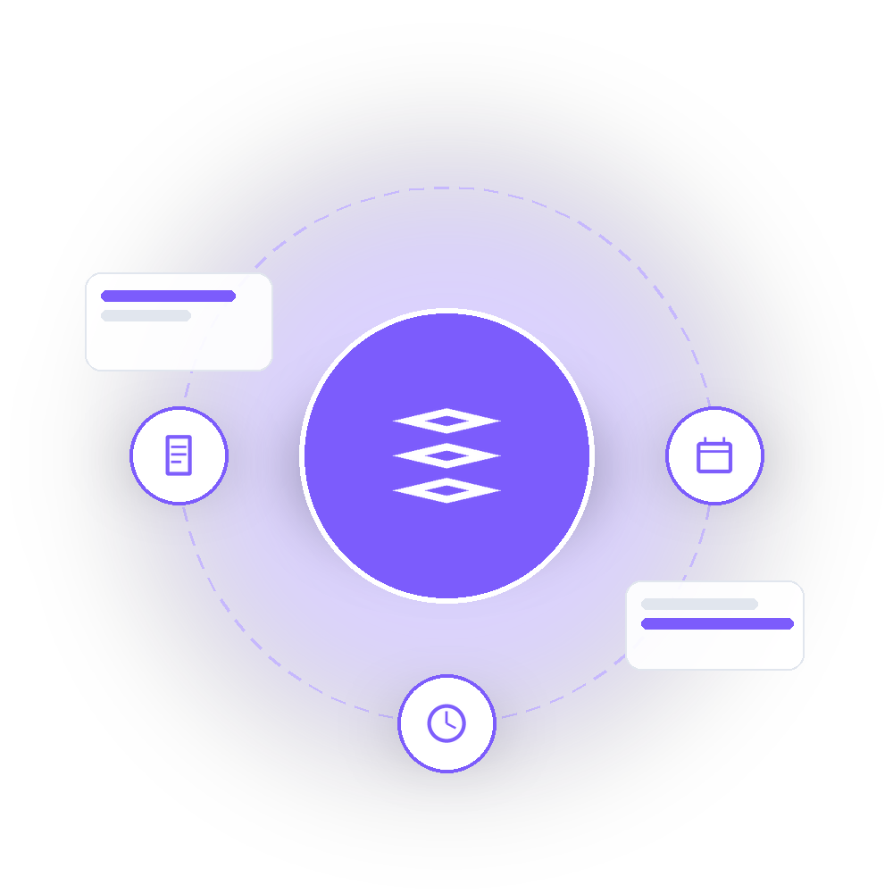
04
Core Academic Operations
Academic foundation, MDM, timetable, and attendance
26 pages in this menu
EduNexus • Complete Page & Menu Directory
11

Slide 12
CORE ACADEMIC OPERATIONS
Page Directory
Part 1 of 2 — 26 pages total
Page / Screen | Route | Type
Academic Foundation Hub | /academics | Hub
Academic Years | /academics/academic-years | List
Terms / Semesters | /academics/terms | List
Curriculum | /academics/curriculums | List
Curriculum Subjects | /academics/curriculum-subjects | List
Elective Subjects | /academics/elective-subjects | List
Active / Inactive Classes | /academics/class-sections | List
Class Teachers | /academics/class-teachers | List
Class Subjects | /academics/class-section-subjects | List
Rooms | /academics/rooms | List
Academic Calendar | /academics/calendar-events | List
Working Days | /academics/working-days | List
Holiday Calendar | /academics/holidays | List
EduNexus • Complete Page & Menu Directory
12

Slide 13
CORE ACADEMIC OPERATIONS
Page Directory
Part 2 of 2 — 26 pages total
Page / Screen | Route | Type
Class Timings | /academics/class-timings | List
Periods | /academics/periods | List
Grading Schemes | /academics/grading-schemes | List
Assessment Categories | /academics/assessment-categories | List
Exam Types | /academics/exam-types | List
Academic Policies | /academics/policies | List
MDM Catalog & Adopt | /mdm | Hub
Timetable Hub | /timetable | Hub
Timetable Builder | /timetable/builder | Builder
Substitutions | /timetable/substitutions | List
Attendance Hub | /attendance | Hub
Mark Attendance | /attendance/mark | Form
Attendance Reports | /attendance/reports | Report
EduNexus • Complete Page & Menu Directory
13

Slide 14
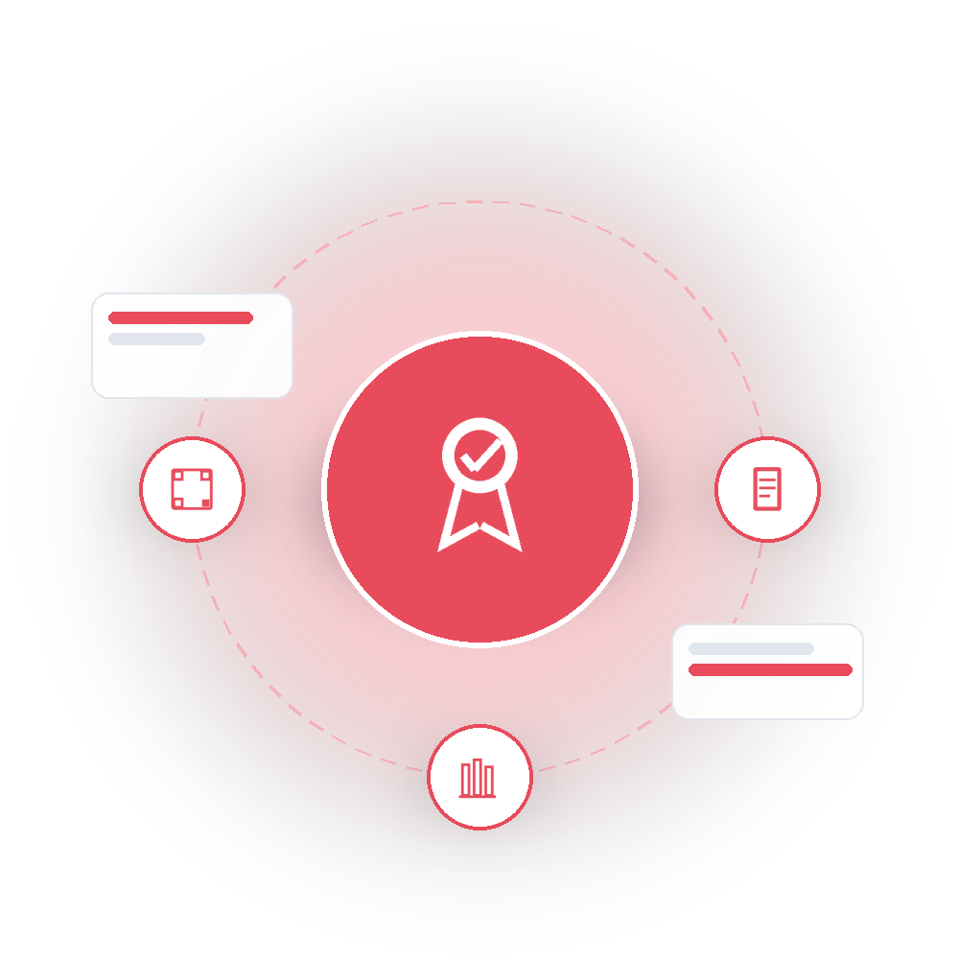
05
Teaching, Learning & Assessment
LMS, examinations, documents & report cards, and library
16 pages in this menu
EduNexus • Complete Page & Menu Directory
14

Slide 15
TEACHING, LEARNING & ASSESSMENT
Page Directory
Part 1 of 2 — 16 pages total
Page / Screen | Route | Type
LMS Hub | /lms | Hub
Courses (Course Studio) | /lms/courses | List
Assignments & Homework | /lms/assignments | List
Lesson Plans | /lms/lesson-plans | List
Quizzes | /lms/quizzes | List
Examinations Hub | /examinations | Hub
Marks Entry | /examinations/marks | Form
Results & Publishing | /examinations/results | Report
Documents Hub | /documents | Hub
Template Designer | /documents/designer | Builder
Generate Report Cards | /documents/generate | Action
Certificates | /documents/certificates | List
QR Verify (Public) | /documents/verify | Public
EduNexus • Complete Page & Menu Directory
15

Slide 16
TEACHING, LEARNING & ASSESSMENT
Page Directory
Part 2 of 2 — 16 pages total
Page / Screen | Route | Type
Library Catalog | /library | List
Add Library Book | /library/new | Form
Edit Library Book | /library/:id/edit | Form
EduNexus • Complete Page & Menu Directory
16

Slide 17
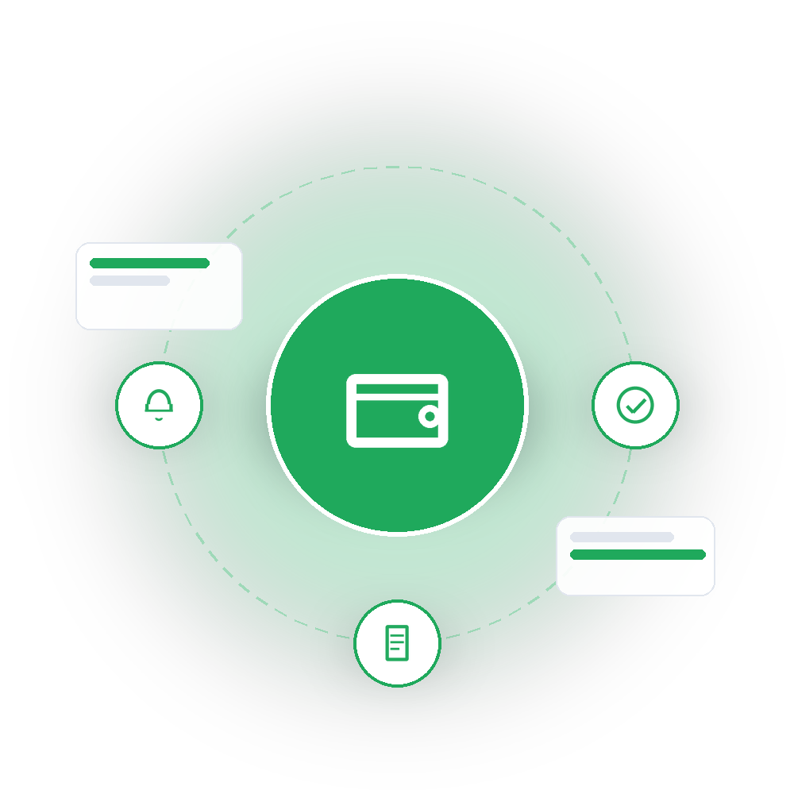
06
Finance
Fee dashboard, collection, assignment, and defaulter tracking
4 pages in this menu
EduNexus • Complete Page & Menu Directory
17

Slide 18
FINANCE
Page Directory
4 pages total
Page / Screen | Route | Type
Fees Hub / Dashboard | /fees | Hub
Collect Payment | /fees/collect | Form
Assign Fees | /fees/assign | Form
Defaulters Report | /fees/defaulters | Report
EduNexus • Complete Page & Menu Directory
18

Slide 19

07
Communication & Engagement
Communications hub, announcements, and the built-in webmail client
10 pages in this menu
EduNexus • Complete Page & Menu Directory
19

Slide 20
COMMUNICATION & ENGAGEMENT
Page Directory
10 pages total
Page / Screen | Route | Type
Communications Hub | /communications | Hub
Message Templates | /communications/templates | List
New Template | /communications/templates/new | Form
Edit Template | /communications/templates/:id/edit | Form
Messages | /communications/messages | List
Compose Message | /communications/messages/new | Form
Message Detail | /communications/messages/:id | Detail
Edit Message | /communications/messages/:id/edit | Form
Announcements | /announcements | List
EduNexus Post (Webmail) | /edu-nexus-post | App
EduNexus • Complete Page & Menu Directory
20

Slide 21

08
AI & Automation
The Nexus AI Assistant and configurable automations
3 pages in this menu
EduNexus • Complete Page & Menu Directory
21

Slide 22
AI & AUTOMATION
Page Directory
3 pages total
Page / Screen | Route | Type
AI Hub | /ai-hub | Hub
Nexus AI Assistant | /ai-hub/assistant | Chat
Automations | /ai-hub/automations | List
EduNexus • Complete Page & Menu Directory
22

Slide 23

09
Platform & Tenant Administration
Organizations, schools, platform users, school users, and memberships
21 pages in this menu
EduNexus • Complete Page & Menu Directory
23

Slide 24
PLATFORM & TENANT ADMINISTRATION
Page Directory
Part 1 of 2 — 21 pages total
Page / Screen | Route | Type
Organizations | /organizations | List
Add Organization | /organizations/new | Form
Organization Detail | /organizations/:id | Detail
Edit Organization | /organizations/:id/edit | Form
Schools | /schools | List
Add School | /schools/new | Form
School Detail | /schools/:id | Detail
Edit School | /schools/:id/edit | Form
School Profile (Admin View) | /schools/:id/profile | Detail
My School Profile | /school-profile | Detail
Platform Users | /users | List
Add User | /users/new | Form
User Detail | /users/:id | Detail
EduNexus • Complete Page & Menu Directory
24

Slide 25
PLATFORM & TENANT ADMINISTRATION
Page Directory
Part 2 of 2 — 21 pages total
Page / Screen | Route | Type
Edit User | /users/:id/edit | Form
School Users | /school-users | List
Add School User | /school-users/new | Form
School User Detail | /school-users/:id | Detail
Edit School User | /school-users/:id/edit | Form
Memberships | /memberships | List
Add Membership | /memberships/new | Form
Edit Membership | /memberships/:id/edit | Form
EduNexus • Complete Page & Menu Directory
25

Slide 26
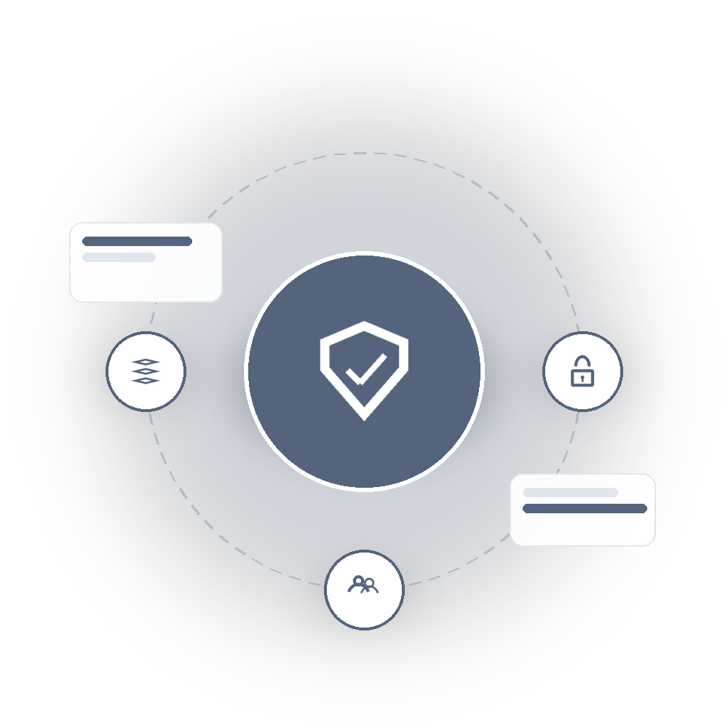
10
Access Control & Navigation Config
Roles, permissions, user-role assignment, modules, and menus
17 pages in this menu
EduNexus • Complete Page & Menu Directory
26

Slide 27
ACCESS CONTROL & NAVIGATION CONFIG
Page Directory
Part 1 of 2 — 17 pages total
Page / Screen | Route | Type
Roles | /roles | List
Add Role | /roles/new | Form
Edit Role | /roles/:id/edit | Form
Role Permissions | /roles/:id/permissions | Matrix
Permissions | /permissions | List
Add Permission | /permissions/new | Form
Edit Permission | /permissions/:id/edit | Form
Permission Matrix | /permissions/matrix | Matrix
User Roles | /user-roles | List
Assign User Role | /user-roles/new | Form
Edit User Role | /user-roles/:id/edit | Form
Modules | /modules | List
Add Module | /modules/new | Form
EduNexus • Complete Page & Menu Directory
27

Slide 28
ACCESS CONTROL & NAVIGATION CONFIG
Page Directory
Part 2 of 2 — 17 pages total
Page / Screen | Route | Type
Edit Module | /modules/:id/edit | Form
Menus | /menus | List
Add Menu Item | /menus/new | Form
Edit Menu Item | /menus/:id/edit | Form
EduNexus • Complete Page & Menu Directory
28

Slide 29

11
Master Data
Organization-level masters and school-scoped master lists
35 pages in this menu
EduNexus • Complete Page & Menu Directory
29

Slide 30
MASTER DATA
Page Directory
Part 1 of 3 — 35 pages total
Page / Screen | Route | Type
Masters Hub | /masters | Hub
Countries | /masters/countries | List
States | /masters/states | List
Cities | /masters/cities | List
Boards | /masters/boards | List
Streams | /masters/streams | List
Subjects | /masters/subjects | List
Subject Groups | /masters/subject-groups | List
Departments | /masters/departments | List
Designations | /masters/designations | List
Categories | /masters/categories | List
Setup — Standards | /masters/setup/standards | Setup
Setup — Sections | /masters/setup/sections | Setup
EduNexus • Complete Page & Menu Directory
30

Slide 31
MASTER DATA
Page Directory
Part 2 of 3 — 35 pages total
Page / Screen | Route | Type
Setup — Class Map | /masters/setup/map | Setup
School Masters Hub | /school-masters | Hub
Religion | /school-masters/religion | List
Caste | /school-masters/caste | List
Category | /school-masters/category | List
Gender | /school-masters/gender | List
Blood Group | /school-masters/blood_group | List
Nationality | /school-masters/nationality | List
Mother Tongue | /school-masters/mother_tongue | List
Disability | /school-masters/disability | List
Occupation | /school-masters/occupation | List
Relationship | /school-masters/relationship | List
Department | /school-masters/department | List
EduNexus • Complete Page & Menu Directory
31

Slide 32
MASTER DATA
Page Directory
Part 3 of 3 — 35 pages total
Page / Screen | Route | Type
Designation | /school-masters/designation | List
House | /school-masters/house | List
Club | /school-masters/club | List
Skill | /school-masters/skill | List
Achievement | /school-masters/achievement | List
Transport Route | /school-masters/transport_route | List
Pickup Point | /school-masters/pickup_point | List
Vehicle Type | /school-masters/vehicle_type | List
Medical Condition | /school-masters/medical_condition | List
EduNexus • Complete Page & Menu Directory
32

Slide 33
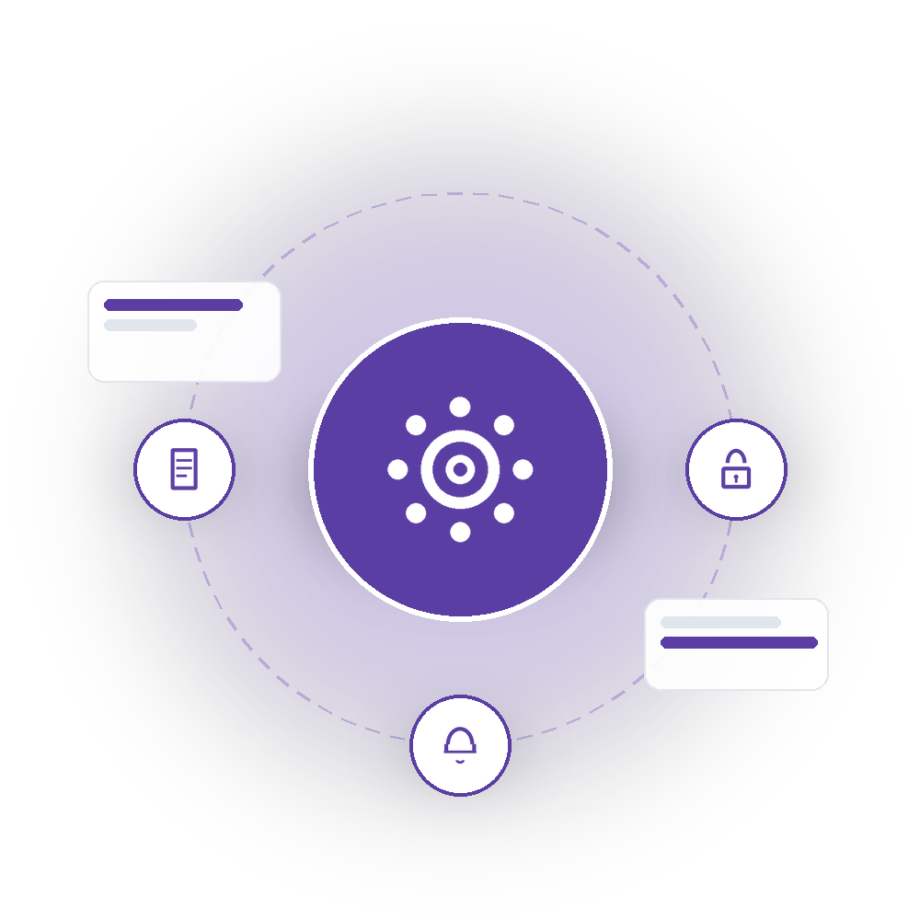
12
Configuration & Compliance
System settings, school settings, audit logs, and transport
25 pages in this menu
EduNexus • Complete Page & Menu Directory
33

Slide 34
CONFIGURATION & COMPLIANCE
Page Directory
Part 1 of 2 — 25 pages total
Page / Screen | Route | Type
System Settings Hub | /settings | Hub
Settings — General | /settings/general | Setup
Settings — Email | /settings/email | Setup
Settings — SMS | /settings/sms | Setup
Settings — Storage | /settings/storage | Setup
Settings — JWT | /settings/jwt | Setup
Settings — Security | /settings/security | Setup
Settings — Theme | /settings/theme | Setup
Settings — Notifications | /settings/notifications | Setup
School Settings Hub | /school-settings | Hub
School Settings — Number Formats | /school-settings/number_formats | Setup
School Settings — Academic Year & Session | /school-settings/academic | Setup
School Settings — School Timing | /school-settings/school_timing | Setup
EduNexus • Complete Page & Menu Directory
34

Slide 35
CONFIGURATION & COMPLIANCE
Page Directory
Part 2 of 2 — 25 pages total
Page / Screen | Route | Type
School Settings — Attendance Rules | /school-settings/attendance_rules | Setup
School Settings — Grading Rules | /school-settings/grading_rules | Setup
School Settings — Promotion Rules | /school-settings/promotion_rules | Setup
School Settings — Fee Settings | /school-settings/fee_settings | Setup
School Settings — Notification Settings | /school-settings/notification_settings | Setup
School Settings — Email Settings | /school-settings/email_settings | Setup
School Settings — SMS Settings | /school-settings/sms_settings | Setup
School Settings — WhatsApp Settings | /school-settings/whatsapp_settings | Setup
School Settings — Document Settings | /school-settings/document_settings | Setup
Audit Logs | /audit-logs | List
Audit Log Detail | /audit-logs/:id | Detail
Transport | /transport | Placeholder
EduNexus • Complete Page & Menu Directory
35

Slide 36

13
Public Website
The only pages that don't require a login
3 pages in this menu
EduNexus • Complete Page & Menu Directory
36

Slide 37
PUBLIC WEBSITE
Page Directory
3 pages total
Page / Screen | Route | Type
Marketing Landing Page | / | Public
Public Form (Fill) | /f/:slug | Public
QR Verify (Certificates) | /documents/verify | Public
EduNexus • Complete Page & Menu Directory
37

Slide 38
COVERAGE SUMMARY
Every Menu, Fully Accounted For
Dashboard & Account
6 pages
Admissions & Enrollment
20 pages
Student, Staff & Family Records
21 pages
Core Academic Operations
26 pages
Teaching, Learning & Assessment
16 pages
Finance
4 pages
Communication & Engagement
10 pages
AI & Automation
3 pages
Platform & Tenant Administration
21 pages
Access Control & Navigation Config
17 pages
Master Data
35 pages
Configuration & Compliance
25 pages
Public Website
3 pages
TOTAL: 207 pages across 13 menus
EduNexus • Complete Page & Menu Directory
38

Slide 39
Methodology & Notes
Every entry above is a real, routed page in the application — extracted directly from the app's route configuration, not summarized from memory.
List / Create / Detail / Edit views of the same record type are listed as separate rows since each is a distinct screen a user navigates to.
Dynamic pages that share one route template (e.g. Masters, School Masters, Settings) are expanded to show every underlying type or section individually.
Excluded from the count: in-page modals that aren't their own route, pure redirect routes, and the generic 404 error page.
EduNexus • Complete Page & Menu Directory
39

Slide 40
Thank You
Questions & Discussion
EduNexus • Complete Page & Menu Directory
40

