Slide 1
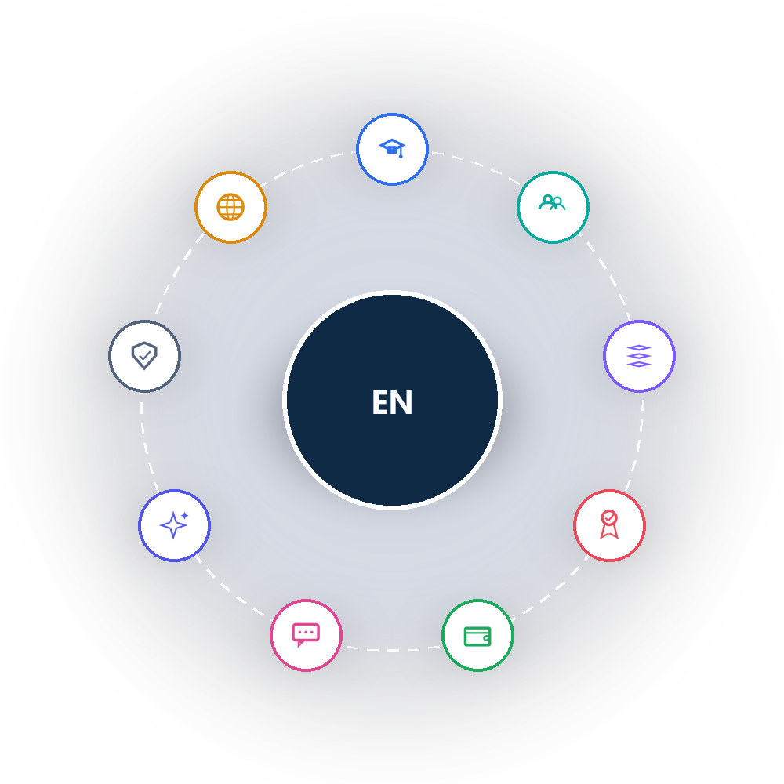
EduNexus
Unified School Management & Learning Platform
Visual Platform & Module Walkthrough
Prepared July 2026 • Confidential

Slide 2











AGENDA
What We'll Cover
01
07
Executive Summary
Teaching, Learning & Assessment
02
08
Platform Architecture
Finance
03
09
User Personas
Communication & Engagement
04
10
Admissions & Enrollment
AI & Automation
05
11
Student, Staff & Family
Administration & Security
06
12
Core Academic Operations
Public Website & Roadmap
EduNexus • Visual Platform Overview
2

Slide 3


EXECUTIVE SUMMARY
Platform at a Glance
3-Tier
9
40
5
Multi-tenant architecture: Platform → Organization → School
Core suites covering the full institution lifecycle
Modules & sub-modules across the platform
Communication channels: Email, SMS, WhatsApp, Push, In-App
EduNexus consolidates admissions, academics, assessments, finance, HR, and communication into one secure platform — so a single deployment can serve an entire group of schools, each governed by its own role-based access model.
EduNexus • Visual Platform Overview
3

Slide 4
PLATFORM ARCHITECTURE
One Platform, Many Schools
Platform
Organization
School
Users
Single deployment
Education group
Individual school
Role-based access
Super Admin
Full platform control across all organizations and schools.
Organization Admin
Manages multiple schools within their group.
School Admin & Staff
Runs daily school operations end to end.
Teachers, Parents & Students
Role-specific portal access to classes, records, and updates.
EduNexus • Visual Platform Overview
4

Slide 5
PLATFORM MAP
Admissions
Nine Suites, One Platform
Public & Roadmap
Students & Family
EduNexus
Admin & Security
Academics
AI & Automation
Teaching & Exams
EduNexus • Visual Platform Overview
5
Communication
Finance

Slide 6
USER PERSONAS
Who Uses EduNexus
Super Admin
Organization Admin
School Admin
Full control across every organization and school on the platform.
Oversees multiple schools within one education group.
Runs day-to-day operations for a single school.
Teacher
Parent
Student
Manages classes, attendance, homework, lesson plans, and marks.
Portal access to a child's academics, attendance, fees, and updates.
Access to courses, assignments, results, and notices.
EduNexus • Visual Platform Overview
6

Slide 7

01
Admissions & Enrollment
From first enquiry to enrolled student
EduNexus • Visual Platform Overview
7

Slide 8
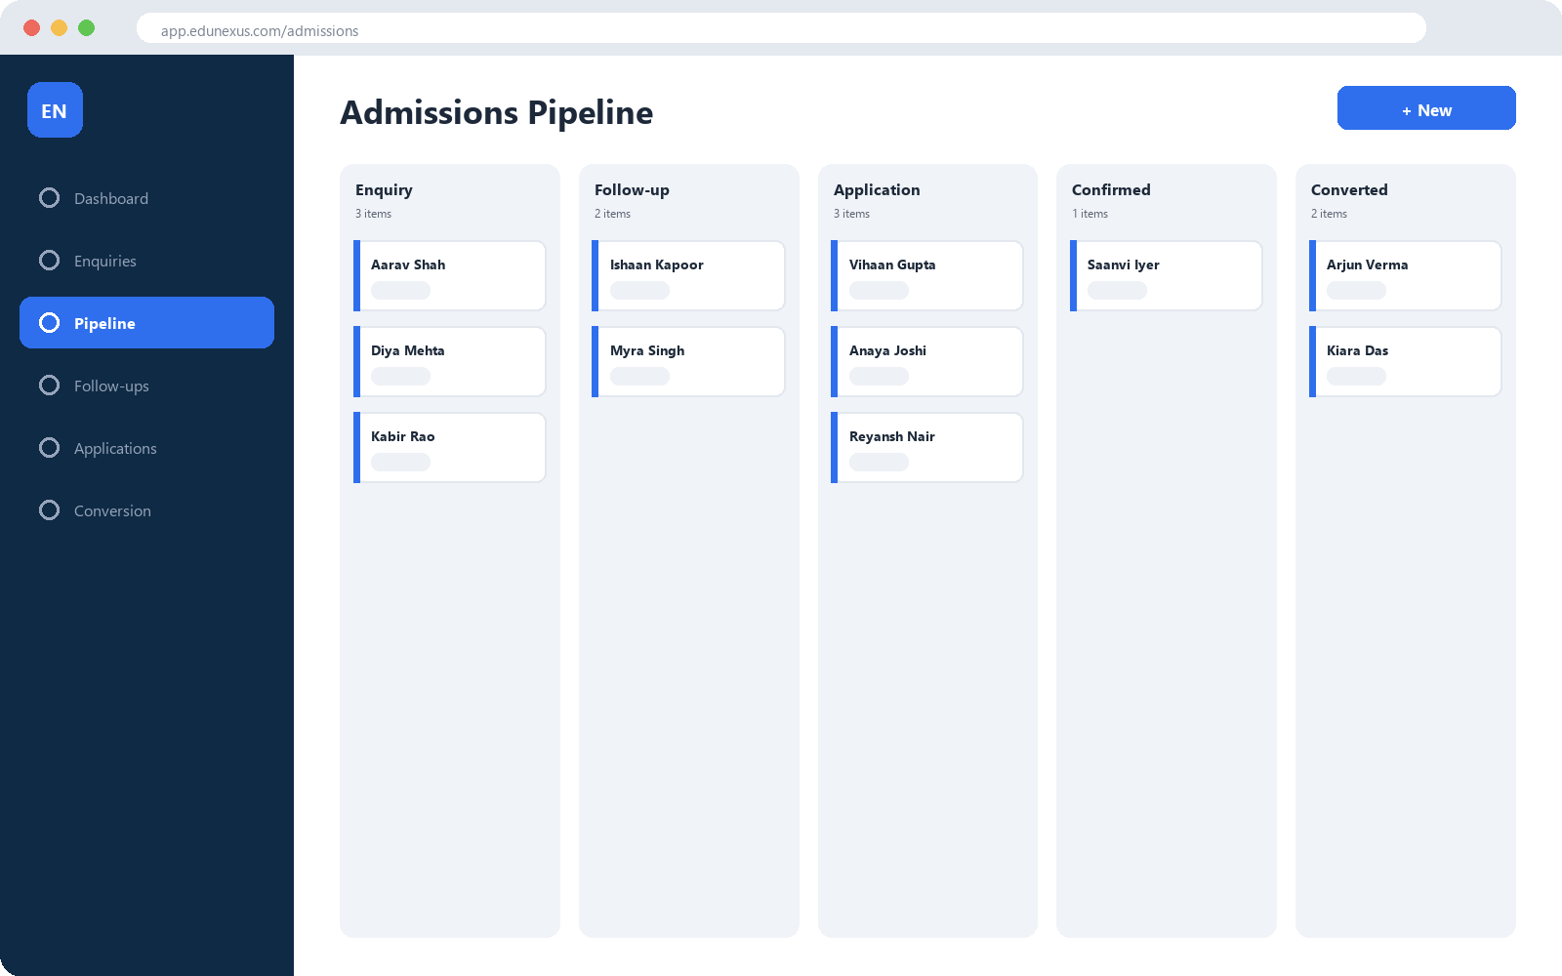
ADMISSIONS & ENROLLMENT
The Enrollment Journey, Visualized
Admissions Hub
A visual pipeline moves every enquiry through follow-up, application, and confirmation.
Live Dashboard
Real-time leads, conversion rate, seat occupancy, and waitlists.
Conversion
Admitted applicants become official student records automatically.
Form Builder
Drag-and-drop public forms with shareable links and response analytics.
EduNexus • Visual Platform Overview
8

Slide 9
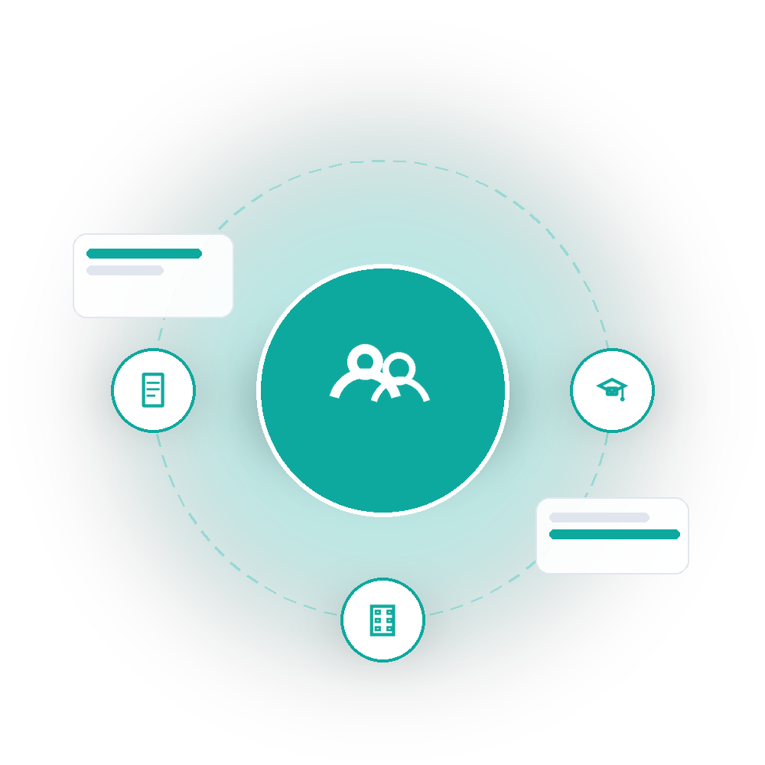
02
Student, Staff & Family Records
A single source of truth for people
EduNexus • Visual Platform Overview
9

Slide 10
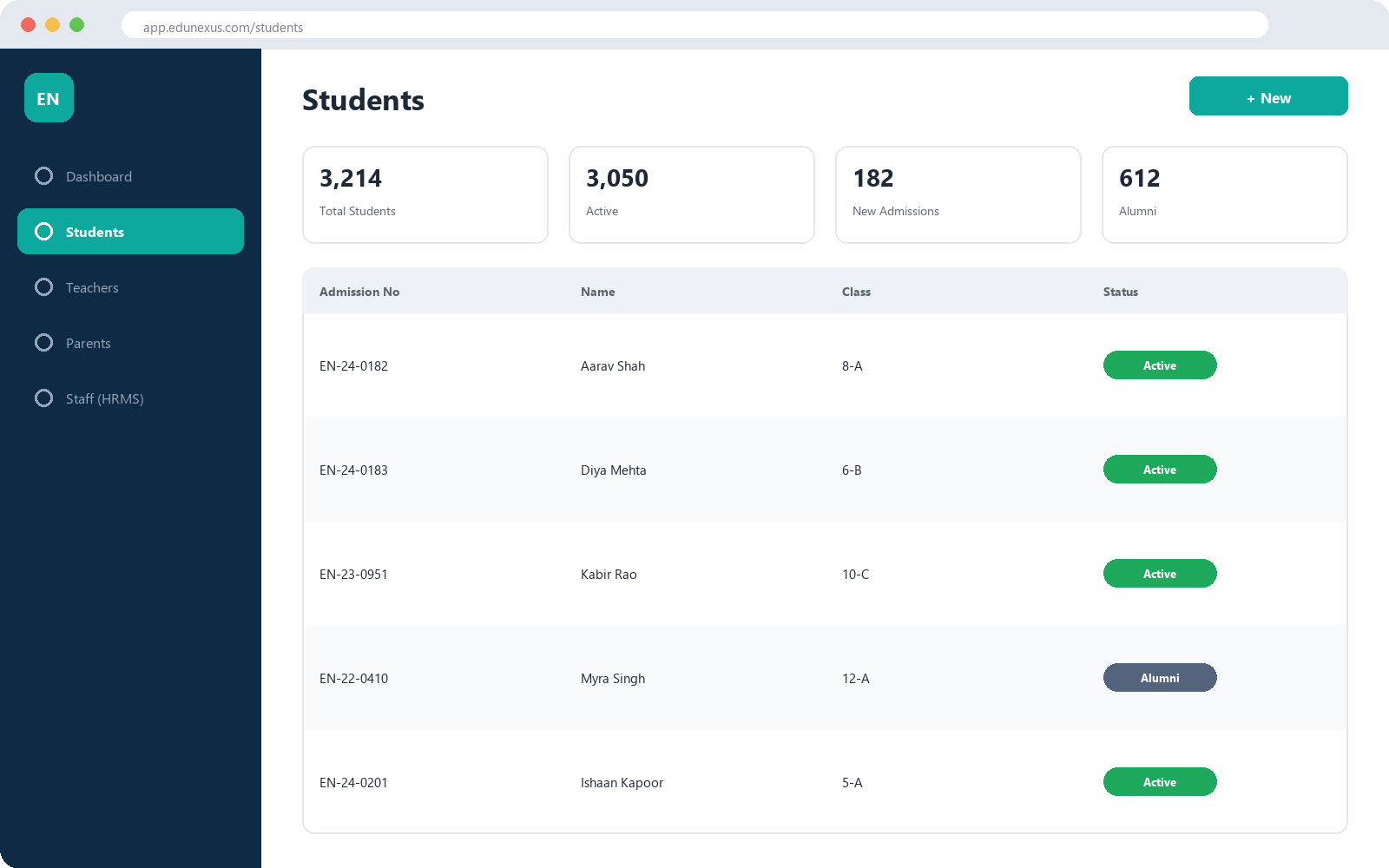
STUDENT, STAFF & FAMILY RECORDS
A Single Source of Truth for People
Students
Core student information system with lifecycle status and fast search.
Teachers
Academic staff roster linked to HR employee records.
Parents & Guardians
Household and guardian management with parent-portal access.
Staff (HRMS)
Employee roster, onboarding, and department structure.
EduNexus • Visual Platform Overview
10

Slide 11
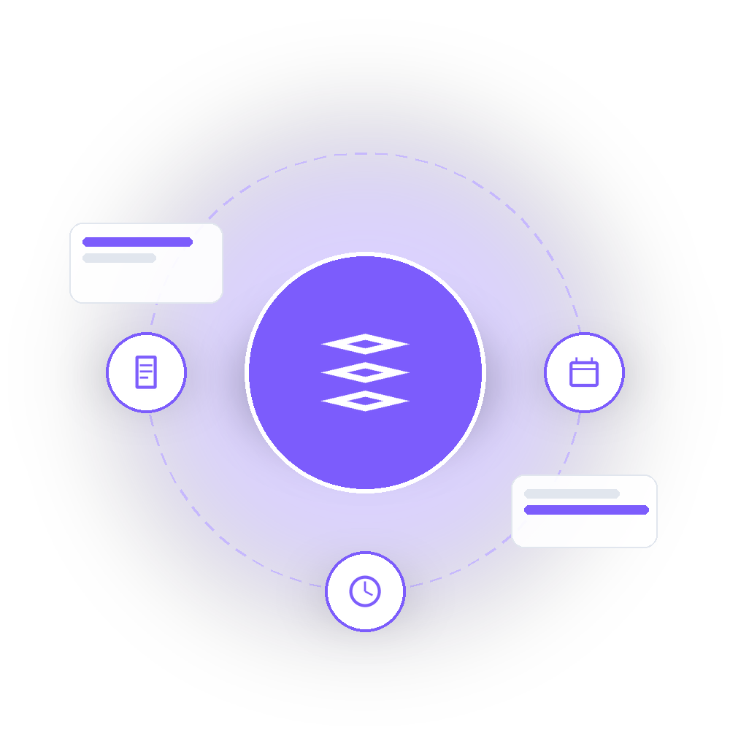
03
Core Academic Operations
Setting up and running the academic year
EduNexus • Visual Platform Overview
11

Slide 12
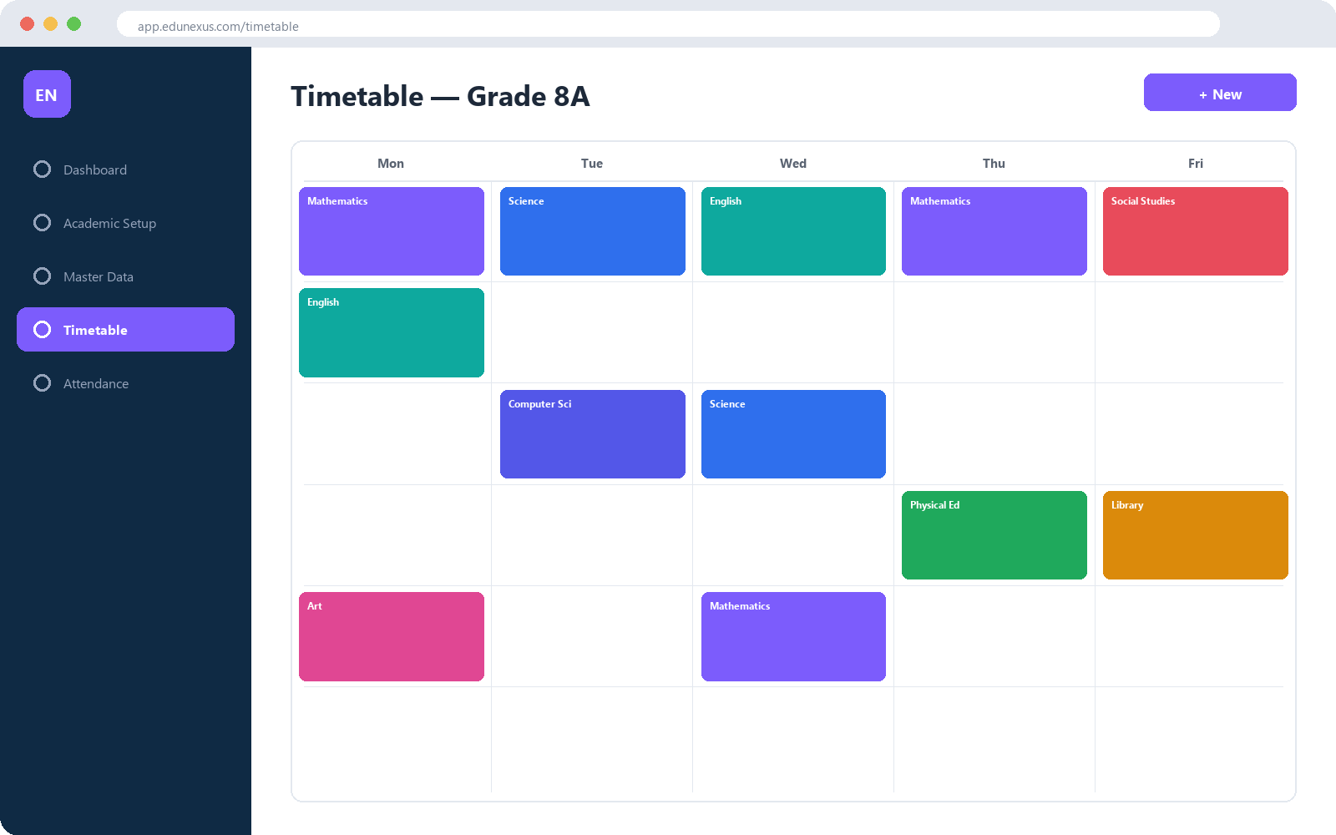
CORE ACADEMIC OPERATIONS
Scheduling Without the Spreadsheets
Academic Foundation
Activates classes and sections each year; manages curriculum and calendar.
Master Data & MDM
Centralized boards, subjects, and grading schemes shared across schools.
Timetable
Period-by-period scheduling with automatic conflict detection.
Attendance
Student, Teacher & Employee attendance in one engine.
EduNexus • Visual Platform Overview
12

Slide 13
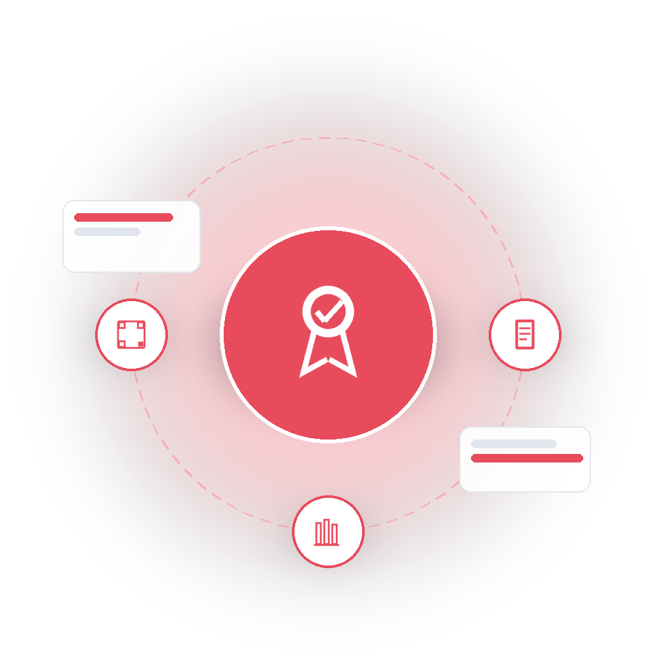
04
Teaching, Learning & Assessment
Course delivery, exams, and results
EduNexus • Visual Platform Overview
13

Slide 14
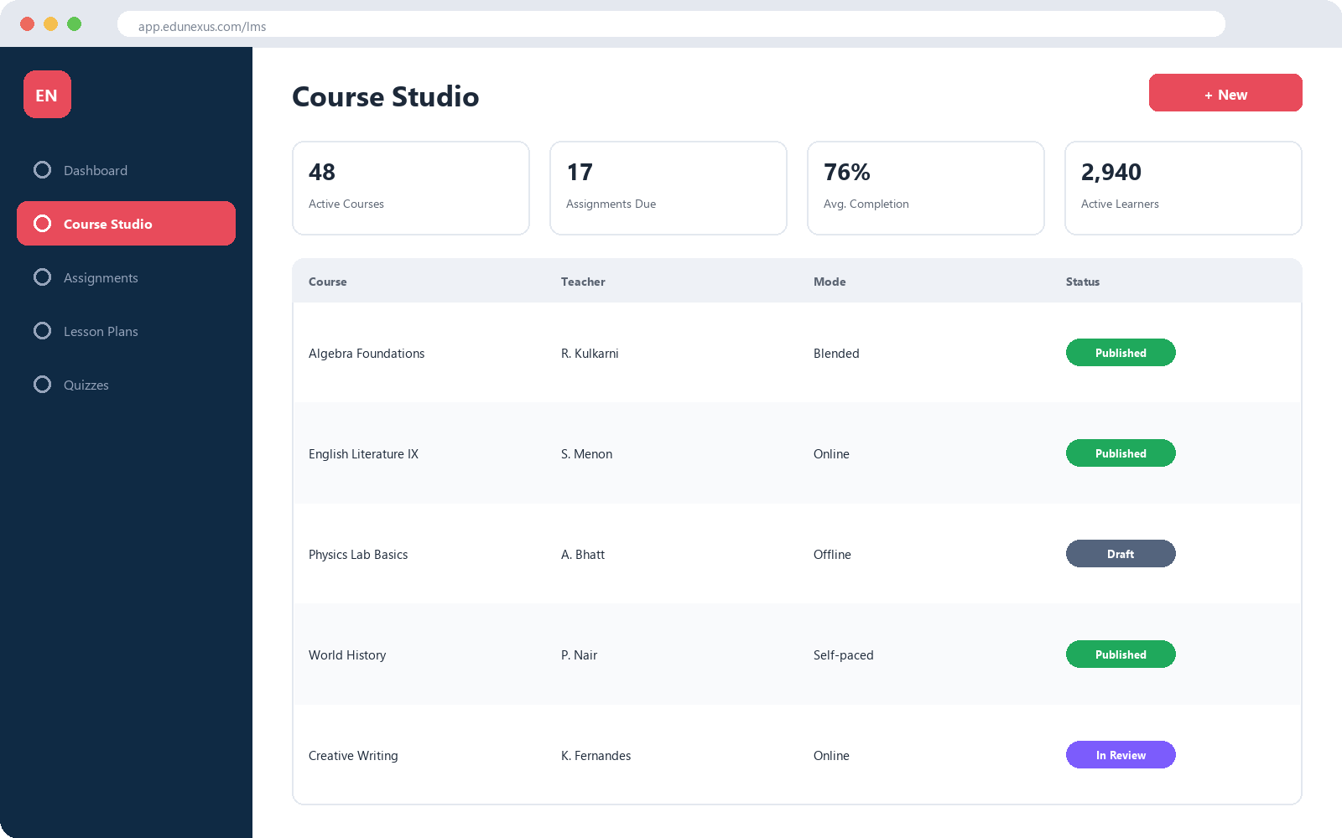
TEACHING, LEARNING & ASSESSMENT
From Course Studio to the Classroom
Course Studio
Modules and lessons across offline, online, blended, and self-paced modes.
Assignments & Homework
A shared draft-to-review workflow for teachers and students.
Lesson Plans
Teacher planning with a built-in approval workflow.
Quizzes & Live Classes
Inline quizzes plus hooks into live-class tools.
EduNexus • Visual Platform Overview
14

Slide 15
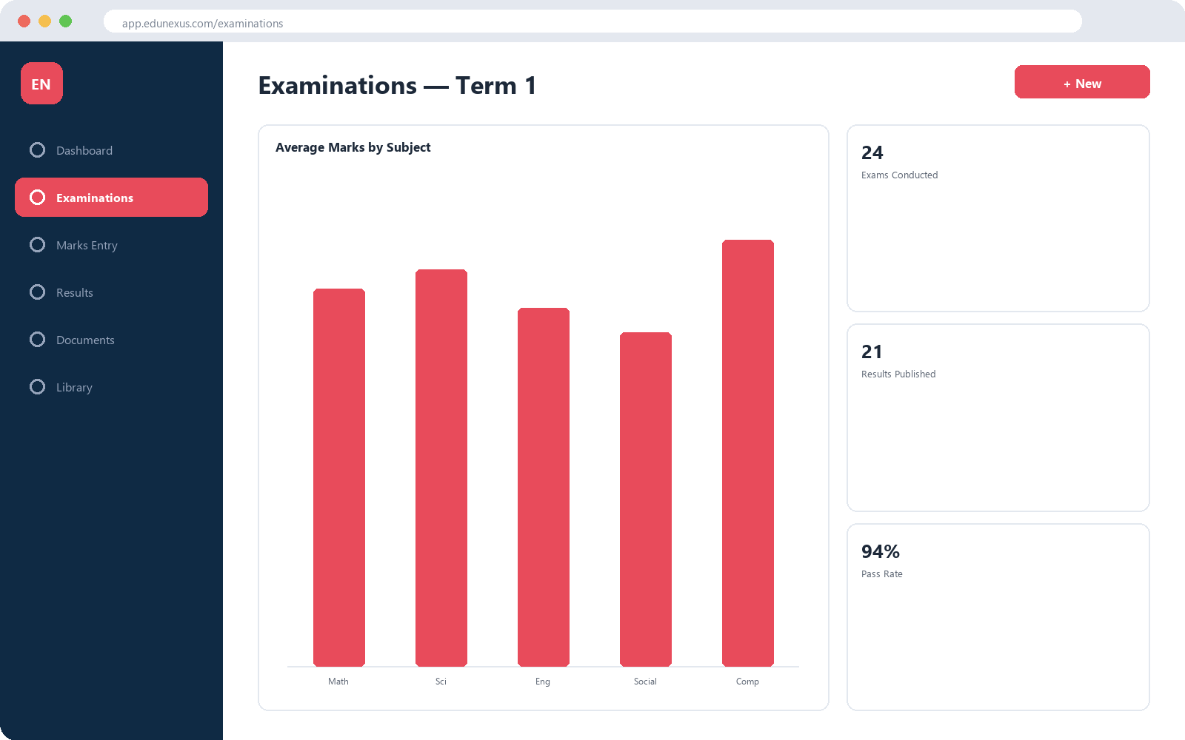
TEACHING, LEARNING & ASSESSMENT
From Exam to Verified Report Card
Examinations
Exam creation, marks entry with approval, and result publishing.
Documents & Report Cards
Drag-and-drop templates generate report cards and certificates.
Library
Book catalog with issue/return tracking linked to student accounts.
EduNexus • Visual Platform Overview
15

Slide 16
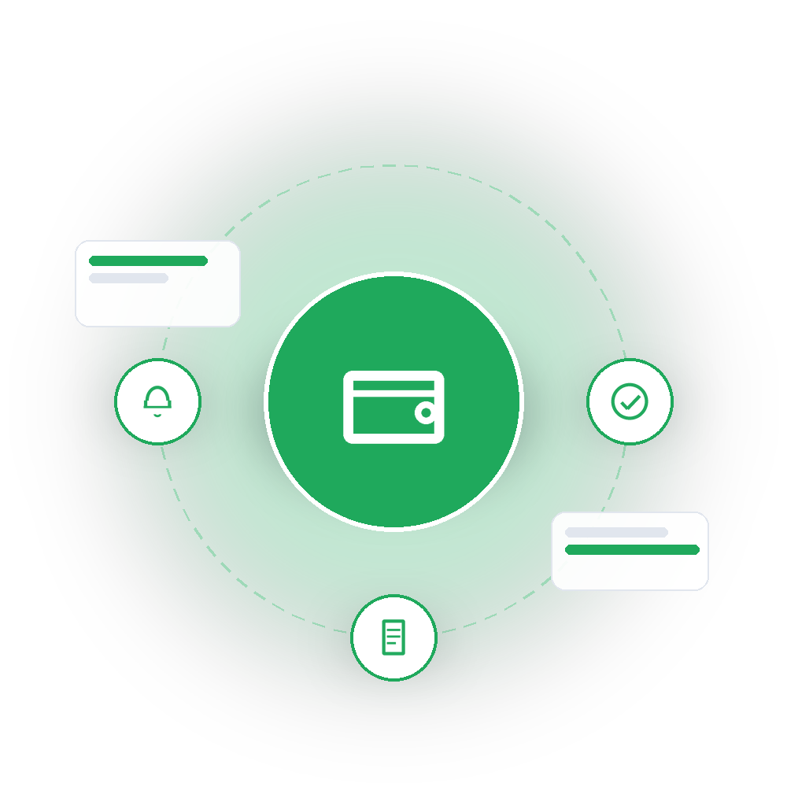
05
Finance
Fee collection and billing, end to end
EduNexus • Visual Platform Overview
16

Slide 17
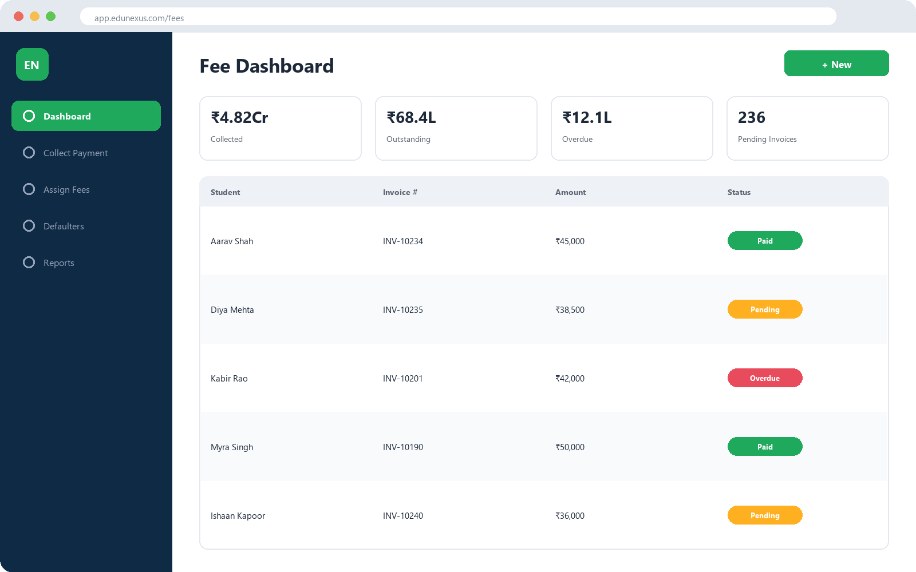
FINANCE
The Fee Lifecycle at a Glance
Live Dashboard
Fees collected, outstanding, overdue, and pending invoices.
Collect Payment
Cash, UPI, card, and online gateway payments with instant receipts.
Assign Fees
Fee-head assignment by academic year with automatic invoicing.
Defaulters
Overdue-balance reporting for timely follow-up.
EduNexus • Visual Platform Overview
17

Slide 18

06
Communication & Engagement
Reaching students, staff and parents
EduNexus • Visual Platform Overview
18

Slide 19
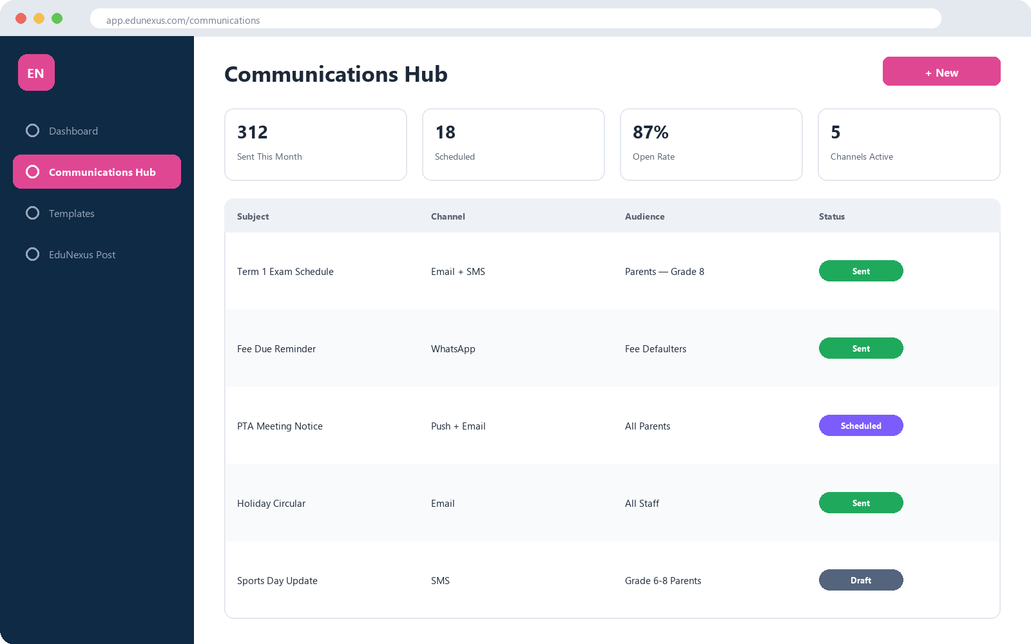
COMMUNICATION & ENGAGEMENT
One Inbox for the Whole School
Communications Hub
Announcements & notifications across Email, SMS, WhatsApp & push.
Reusable Templates
Standardized, on-brand messaging composed in one place.
EduNexus Post
A built-in, Gmail-style webmail client for staff.
EduNexus • Visual Platform Overview
19

Slide 20

07
AI & Automation
The Nexus AI Assistant
EduNexus • Visual Platform Overview
20

Slide 21
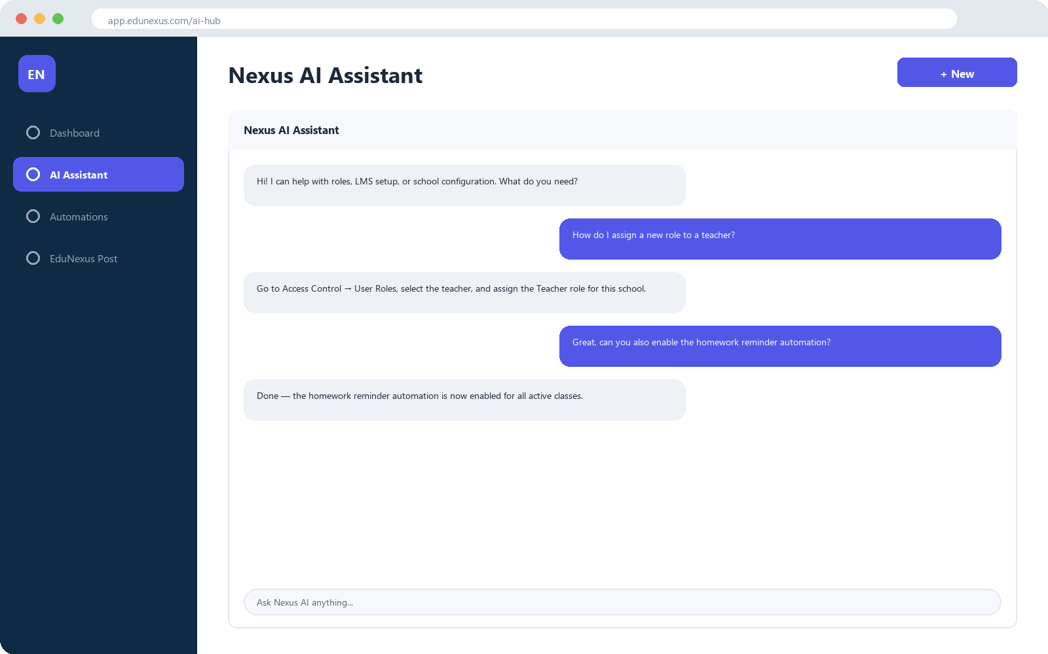
AI & AUTOMATION
Ask Nexus Anything
AI Assistant
Chat-based help for org, school, role, and LMS questions.
Automations
Configurable workflows for onboarding, reminders & tips.
Built for Efficiency
Saves staff time on repetitive guidance and follow-up.
EduNexus • Visual Platform Overview
21

Slide 22
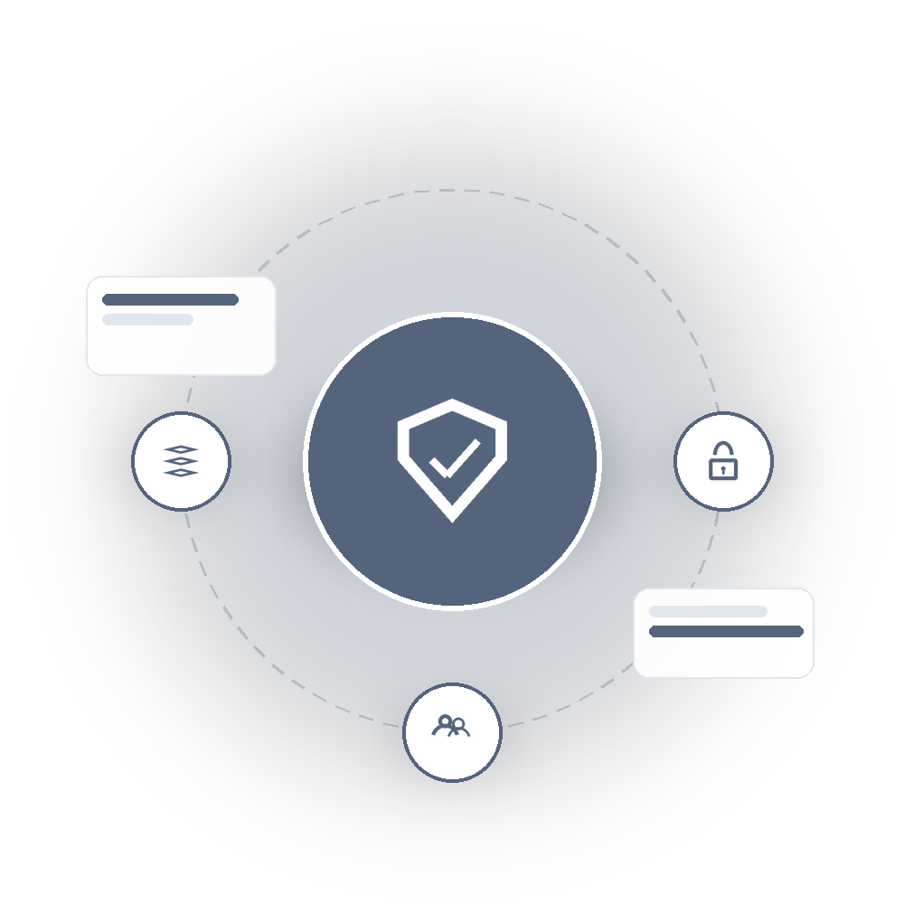
08
Platform Administration & Security
Governing the whole platform
EduNexus • Visual Platform Overview
22

Slide 23
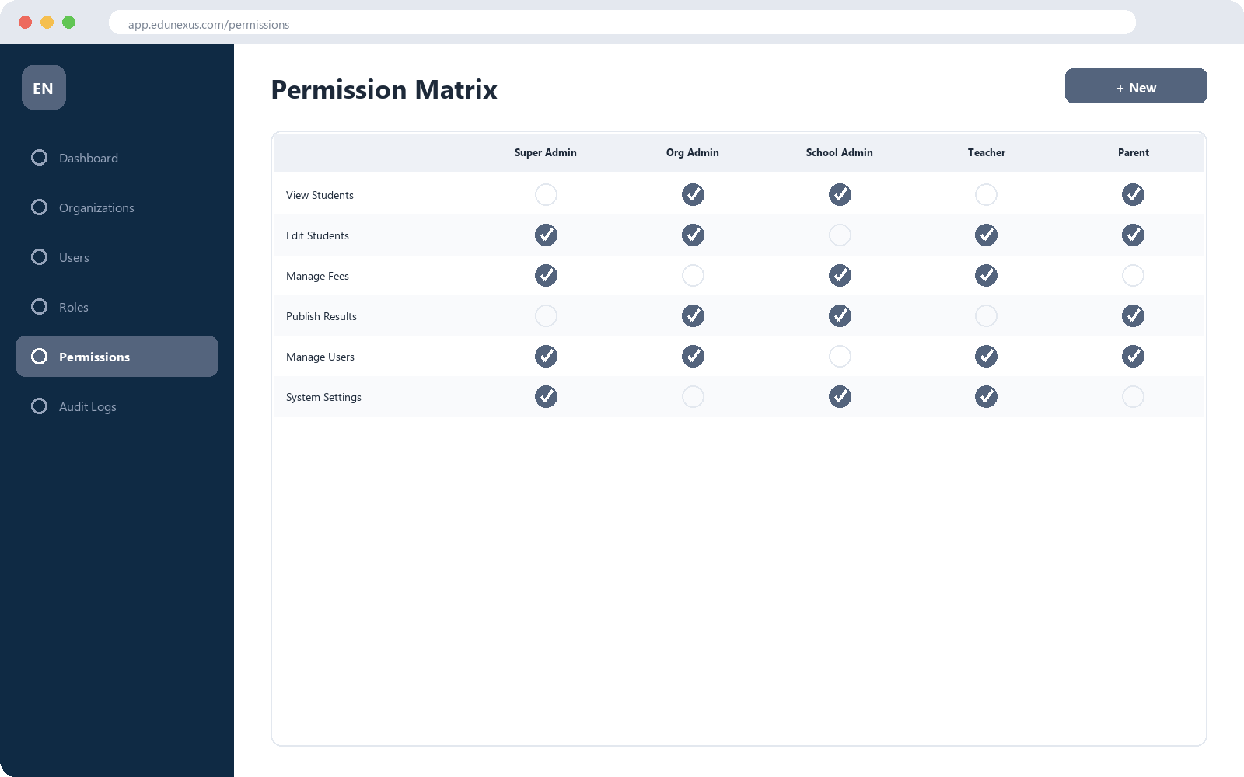
ADMINISTRATION & SECURITY
Every Role, Precisely Scoped
Roles & Permissions
Define roles and review them in a full permission matrix.
Organizations & Schools
Manage the full tenant hierarchy end to end.
Users & Memberships
Manage accounts and organizational memberships.
Audit Logs
A searchable history of who changed what, when, and from where.
EduNexus • Visual Platform Overview
23

Slide 24

09
Public Website & Roadmap
Our public face, and what's next
EduNexus • Visual Platform Overview
24

Slide 25
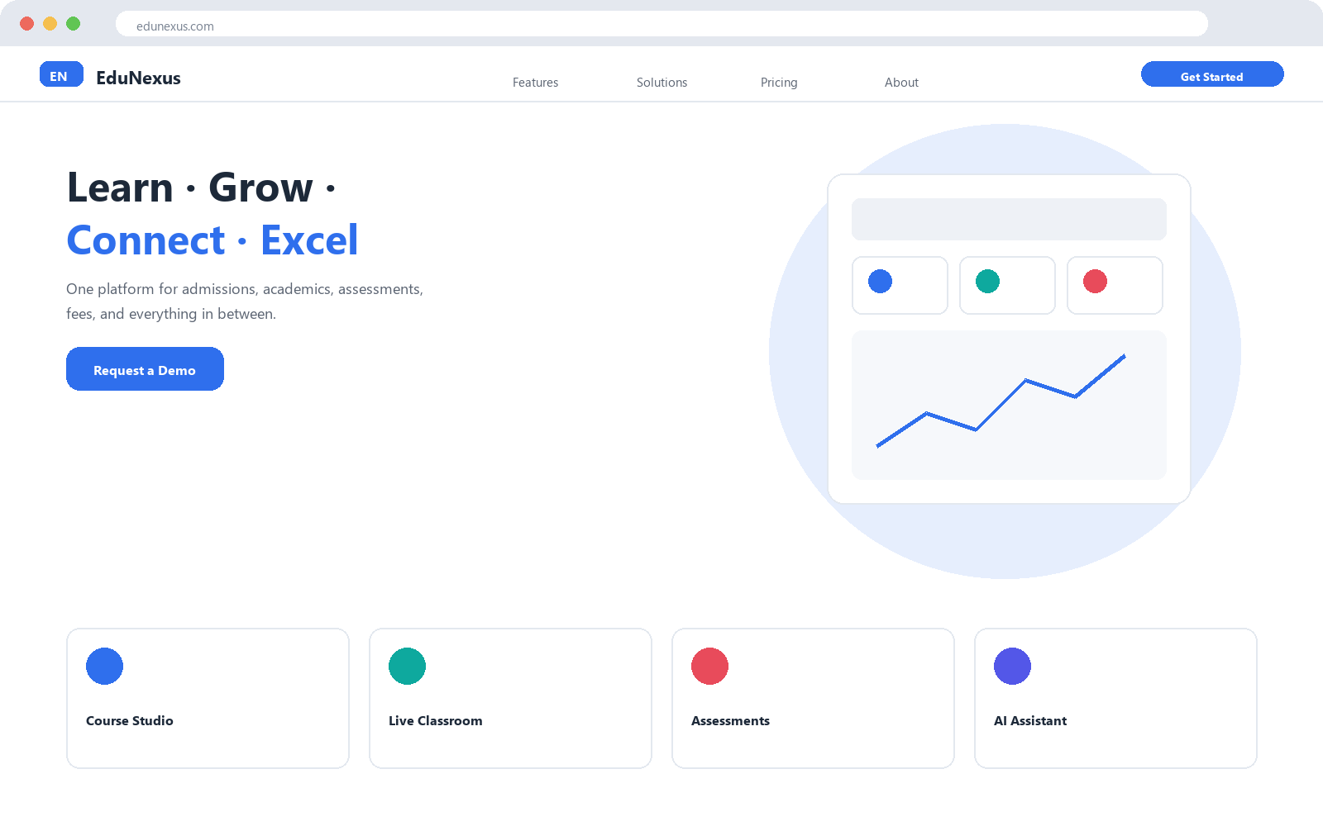
PUBLIC WEBSITE
The First Impression
Marketing Website
A public landing page for prospective learners & educators.
Public Form Links
Admission forms filled out without a login.
Document Verification
Anyone can verify a certificate via QR code.
EduNexus • Visual Platform Overview
25

Slide 26

LOOKING AHEAD
Roadmap
Now
Later
Transport management — routes, vehicles & pickups
Question bank for faster exam creation
Next
Future
Payroll & leave management for HRMS
Advanced reporting & analytics
Roadmap items reflect current development priorities and are subject to change.
EduNexus • Visual Platform Overview
26

Slide 27
PLATFORM AT A GLANCE
Modules by Suite
EduNexus • Visual Platform Overview
27

Slide 28
SUMMARY
Why EduNexus
One Platform, Fewer Tools
Built to Scale
Secure by Design
Ready to Grow
Replaces disconnected tools for admissions, academics, exams, fees, HR & communication.
One deployment serves an entire group of schools with clean tenant-level isolation.
Every action is governed by role-based permissions and logged for audit.
AI assistance and automation today, with transport, payroll & analytics on the roadmap.
EduNexus • Visual Platform Overview
28

Slide 29
Thank You
Questions & Discussion
EduNexus • Visual Platform Overview
29

