Slide 1

HEALTHCARE ANALYSIS
Prepared by : Anuja Mahajan
Guided by : Vishal sir

Slide 2
CONTENTS:
INTRODUCTION
KEY FINDINGS
CONCLUSION
RECOMMADATION

Slide 3
INTRODUCTION
In this dataset consist of 55,500 rows & 15 column in this dataset.
Related to the healthcare including patient like age, gender , medical condition, admission & discharge biling & test result .
Patient Demographics
Includes age, gender, and blood type.
These variables help analyze the distribution of medical conditions and treatments across different patient groups.
Age : Teen age = 18-30, Middle age =31-50, Senior age =51-89
Gender : Male:27774, Female:27727
Blood Type: A+ A-,AB+ AB-,B+B-, O+O-
Medical condition: Arthritis, Asthma, Cancer, Diabetes, Hypertension, Obesity
Insurance Provider: Aetna, Blue cross,, Cigna,
Medicare, UnitedHealthcare
Admission Type: Urgent, Emergency, Elective
Medication : Aspirin, Lipitor , paracetomol, Penicillin , Ibuprofen etc

Slide 4
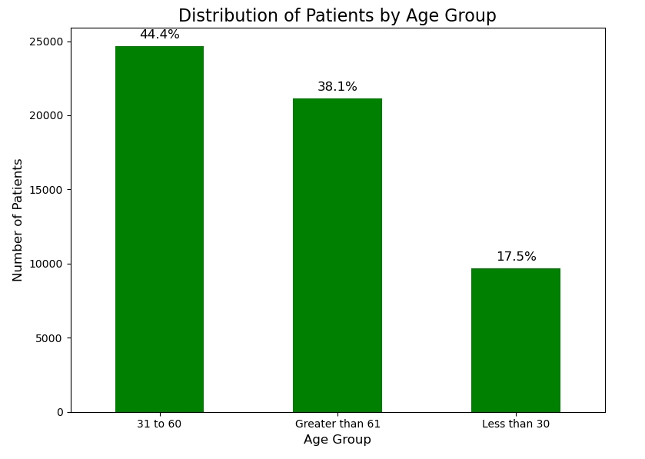
Distribution by age group:
31 to 60 Age Group:
This is the largest group, representing 44.4% of the total patient population.
About 25,000 patients fall into this age range.
2. Greater than 61 Age Group:
The second largest group, making up 38.1% of the patients.
Close to 21,000 patients are in this group.
3. Less than 30 Age Group:
This is the smallest group, comprising 17.5% of the patients.
Around 9,000 patients belong to this category.

Slide 5
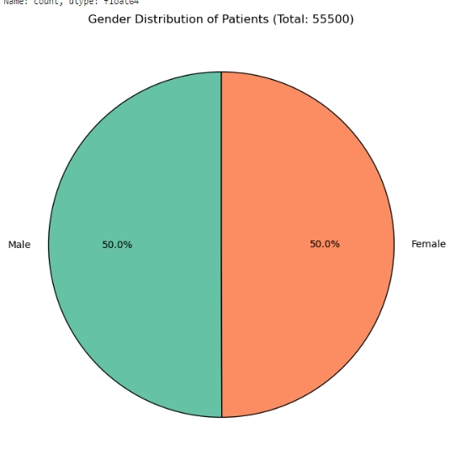
Gender Distribution of patients
Male : 27774
Female: 27726

Slide 6
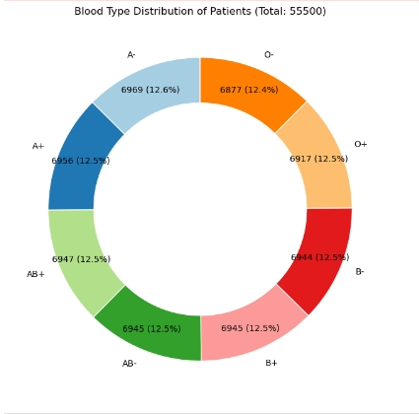
Blood Type Distribustion of patients
The blood type distribution is relatively uniform
with each blood type making up around 12-
13% of the total patient population.
No single blood type significantly dominates, ensuring a fairly balanced distribution across the population in terms of blood type.

Slide 7
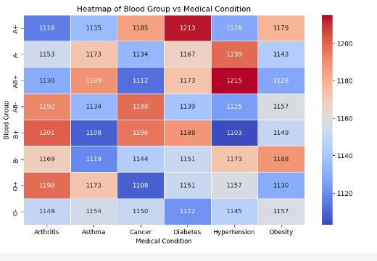
Blood Group vs Medical Condition
Key Findings:
A+ and AB+:
The highest patient count is observed for the A+ and AB+ blood types, particularly for conditions like Diabetes and Hypertension
2.Most blood groups show similar distributions across
medical condtions, with counts typically ranging between 1100 and 1200 for each condition.
3. Diabetes and Hypertension tend to have slightly higher counts across most blood groups, indicating a larger number of patients in these categories.

Slide 8
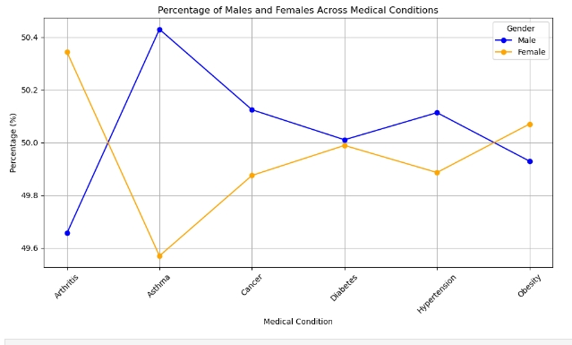
Percentage of Males and Females Across Medical condition
Asthma:
The most significant gender difference is seen in Asthma, where males account for about 50.4%, while females make up around 49.6%.
Arthritis and Obesity:
For conditions like Arthritis and Obesity, the female percentage is higher, though the difference is slight (around 50.4% for females).
Cancer, Diabetes, Hypertension:
These conditions show near-equal gender representation, with both genders hovering close to 50%.

Slide 9
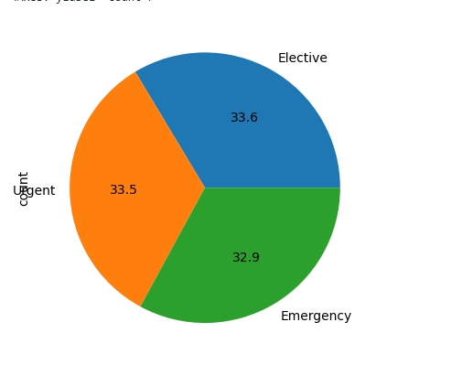
Admission type
This pie chart shows the distribution of different types of medical procedures. The three categories are:
Elective procedures make up the largest portion at 33.6%.
Urgent procedures follow closely with 33.5%.
Emergency procedures account for 32.9%.
Key Finding: The distribution is relatively balanced across all three types of procedures, with only a slight difference in percentages, indicating a fairly equal need for elective, urgent, and emergency medical services.

Slide 10
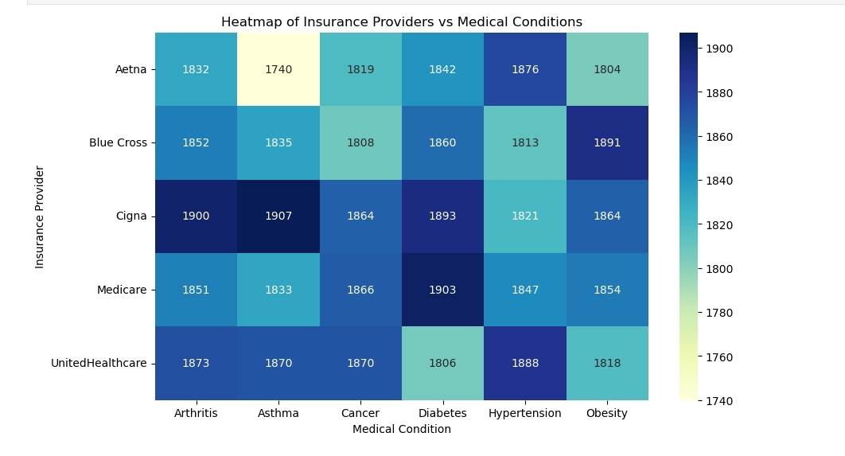
Insures providers vs medical condition
Key findings
Cigna and UnitedHealthcare seem to cater to slightly higher numbers of patients across most medical conditions, as indicated by the darker shades.
Aetna shows lower patient numbers for asthma, which is visually represented by a lighter color compared to other providers.
Medicare has the highest number of patients dealing with diabetes (darker shade in the diabetes column).
The distribution across medical conditions is relatively consistent across most insurance providers, with some variations seen in specific conditions like diabetes and hypertension.

Slide 11
Conclusion:
The dataset reveals important trends in patient demographics, medical conditions, and insurance coverage.
Middle-aged patients (31-60) have the highest medical condition prevalence.
Different insurance providers tend to cover a wide range of conditions, but some focus more on specific health issues.
Blood type shows some correlation with certain conditions, and there's a slight difference in condition prevalence between males and females.
These insights can help tailor healthcare programs, insurance plans, and medication distribution to better meet patient needs.

Slide 12
Recommendations:
Targeted Health: The analysis to design healthcare programs that focus on age groups and medical conditions with higher prevalence, such as patients aged 31-60 facing conditions like hypertension or diabetes.
Blood Type Awareness Campaigns: Promote awareness about the potential correlation between specific blood types and medical conditions to encourage early screening for high-risk patients.
Gender-Specific Healthcare :Focus on gender-based health programs,
conditions like asthma or arthritis, where there may be slight differences in prevalence between males and females.

