Slide 1

How many weeks out do you look?
Literature search for estimating contest readiness from physique photos with pairwise ranking
Notes:
My paper estimates how many weeks out from a show a Classic Physique competitor looks, from photos, using pairwise ranking. This assignment is the literature search behind it.

Slide 2
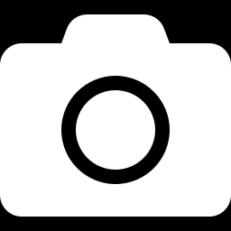
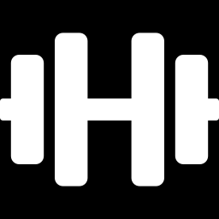
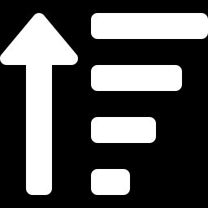
One question, three angles
How has progress toward contest leanness, or body composition in general, been estimated from ordinary photographs?
Q1 · Body fat from photos
Q2 · Contest preparation
Q3 · Learning an order
Which models estimate body fat, composition or shape from 2D images, and how accurate are they?
How does body composition change through prep, and how well do methods work at very low body fat?
Which methods learn a ranking or progression stage from images without absolute labels?
Notes:
The search question splits into three sub-questions: body fat from images, body-composition tracking during contest prep, and methods that learn an order or progression from images. A fourth block covers AI applied to bodybuilding.

Slide 3
From vocabulary to a filtered database search
1
2
3
4
Scholar Labs
OpenAlex
Filters
Four queries
Asked each sub-question in plain language to collect terms and seed papers
Web of Science login failed, Scopus access pending; Scholar has no filters or export
2016–2025 · English · articles, reviews, conference papers, book chapters
Boolean title + abstract search, one block per sub-question plus AI in bodybuilding
Filter string publication_year:2016-2025, language:en, type:article|review|conference-paper|book-chapter
Notes:
I started in Google Scholar Labs to collect vocabulary and a handful of key seed papers. Web of Science would not log in and my Scopus access is pending, so the searches ran in OpenAlex, an open index that covers what Scholar finds but can filter by year, language and type and export results. The same filters were applied to every query.

Slide 4
Four final queries, refined by trial and error
Block | Searches for | Hits
b1v3 · Q1 | body fat / shape AND photo / smartphone AND ML / automated | 804
b2 · Q2 | bodybuilder / physique athlete / contest prep AND body composition | 294
b3v4 · Q3 | ordinal regression / ranking / siamese AND progression AND image | 138
b4 | bodybuilding AND computer vision / deep learning / AI | 18
Union | unique records across all four | 1,251
Changes: conference papers added to the filter · Q1 widened after missing key papers (dropping a concept gave 3,991) · Q3 rebuilt four times (chart)
Original matched “Siam”/Thailand and cancer progression · v2 required a network term: too few · v3 had no image term: off-topic
Notes:
Four final queries, one per sub-question plus AI in bodybuilding, found 1,251 unique records. The first run had no conference papers, where most ML work is published. The body-fat query missed key papers, so I widened it; removing that part entirely gave 3,991 hits, too many. The ranking query went through four versions: the original matched Siam/Thailand studies and cancer progression, requiring a neural-network term cut it to 46, removing the image term gave 703 mostly irrelevant hits, and the final version requires an image term: 138.

Slide 5
1,251 hits became 1,171 broad and 50 relevant papers
1,251
union of the four queries
−84
spam, retractions, abstract books, preprints, non-English, duplicates
+4
seed papers the queries missed (snowballing)
1,171
Dataset 1 · broad, under the 1,500 limit
50
Dataset 2 · screened, each with a theme and reason
Notes:
Cleaning removed 84 records: spam ads, retractions, abstract books, preprints, non-English titles and duplicates. Four known seed papers the queries missed were added by hand. Dataset 1 has 1,171 papers, under the 1,500 limit. Dataset 2 has 50 screened papers, each with a theme and a reason: 15 on body fat from photos, 13 on contest prep, 11 on ranking methods, 9 on shape or weight from images and 2 on AI in bodybuilding.

Slide 6

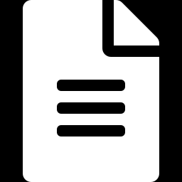



The gap: almost no work ranks physique photos by contest readiness
Body fat from photos (Q1), contest-prep body composition (Q2) and image ranking (Q3) are each well studied; none of the 50 papers combines them to judge contest readiness.
NEXT STEPS
1 Idea map
2 Introduction draft
3 TikZ figure
4 Objectives & highlights
5 Scopus re-run
Mind-map the 50 papers by theme and talk the idea through with 2–3 colleagues
Rewrite the idea as an introduction in LaTeX (KOMA-Script scrartcl), citing dataset 2
Pipeline: two physique photos → pairwise ranker → apparent weeks out
3–4 research objectives and prospective highlights drawn from the gap
Same four queries in Scopus / WoS once access is approved; merge by DOI, re-screen
This week
Next assignment
Next assignment
Next assignment
When access arrives
Notes:
The 50 papers show that photo-based body-fat estimation and image ranking are each well studied, but nothing combines them for physique athletes. That is the gap my paper targets. Next steps, in order: first, map the 50 papers by theme and talk the idea through with two or three colleagues. Then, for the next assignment, turn the idea into a proper introduction in LaTeX using KOMA-Script, draw the method as a TikZ figure — two photos into a pairwise ranker that outputs apparent weeks out — and write three or four research objectives and prospective highlights. Finally, once my Scopus access is approved, I will re-run the same four queries there and merge the results by DOI.

