Slide 1

iMasina Software Plan
Everywhere. Everytime. Easy renting solution.
Team 6
Catana David-Andrei
Samachis Eduard-Iulian

Slide 2
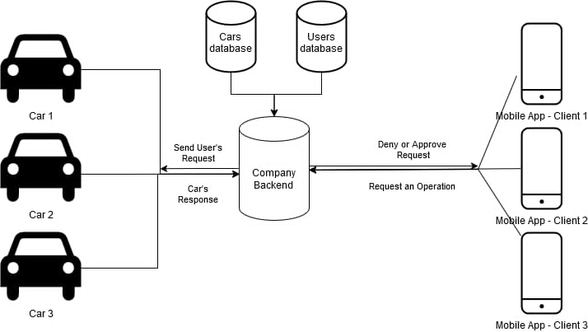
Software Architecture: Entities

Slide 3
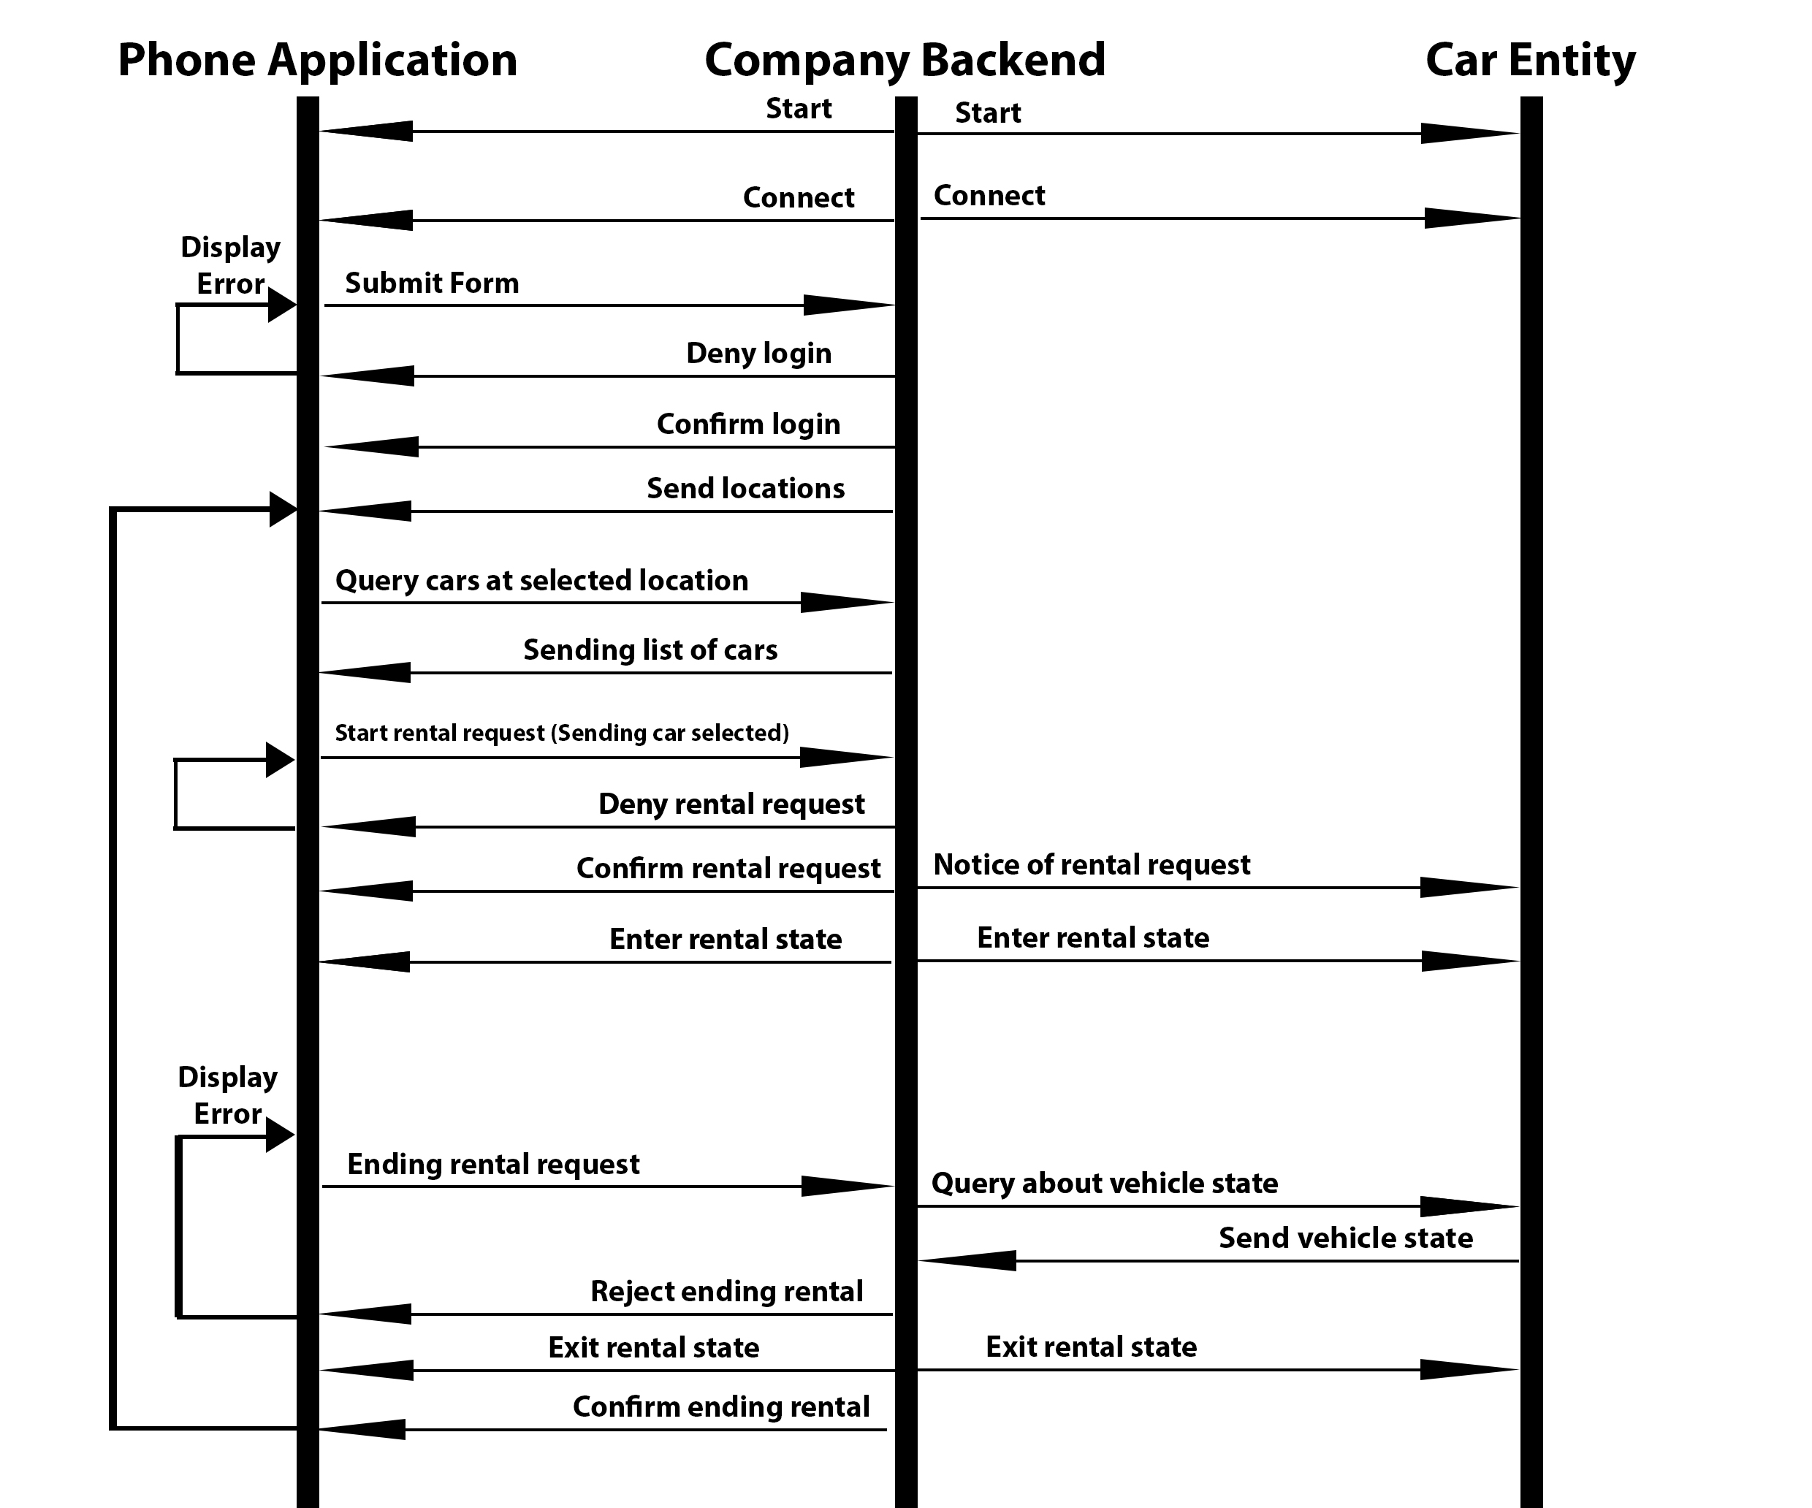
Software Architecture: Flows

Slide 4
Technologies used
Programming Language | Python
Development | PyCharm
Graphic User Interface | PyQT
Communication | Socket.py
Versioning | Git

