Slide 1

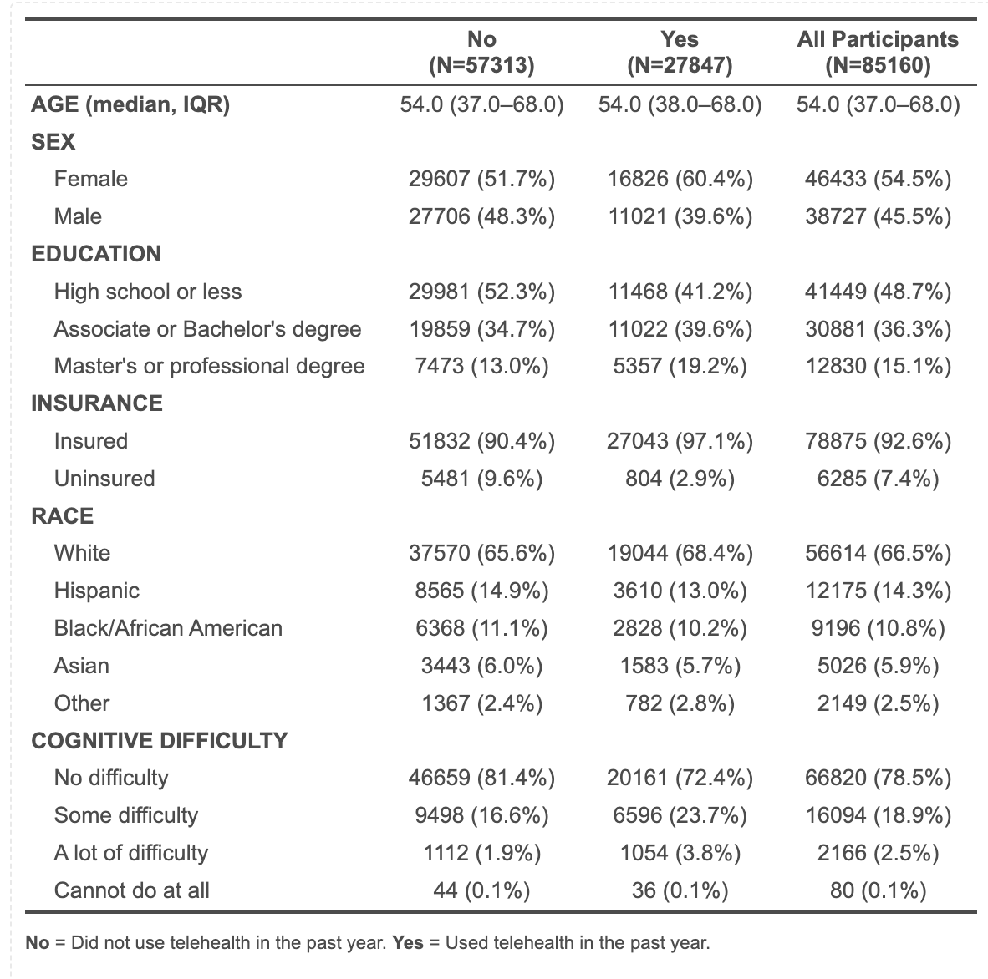
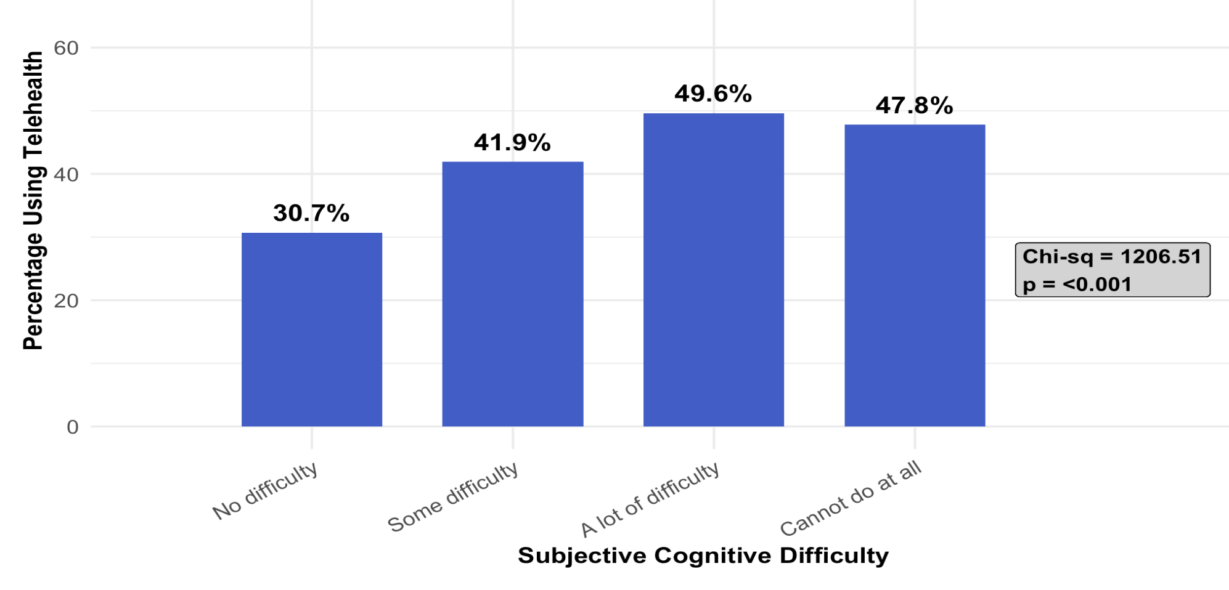
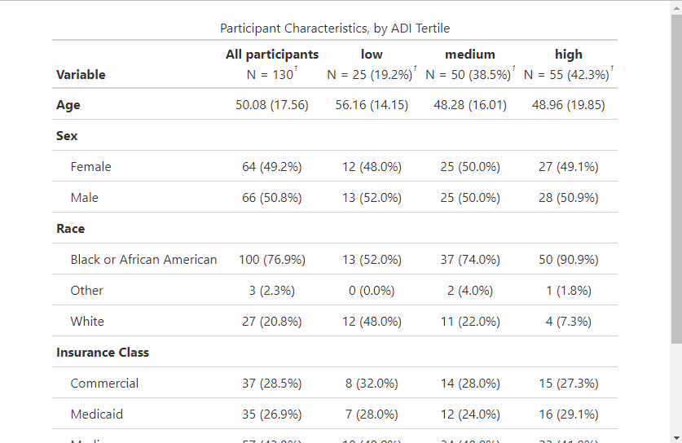
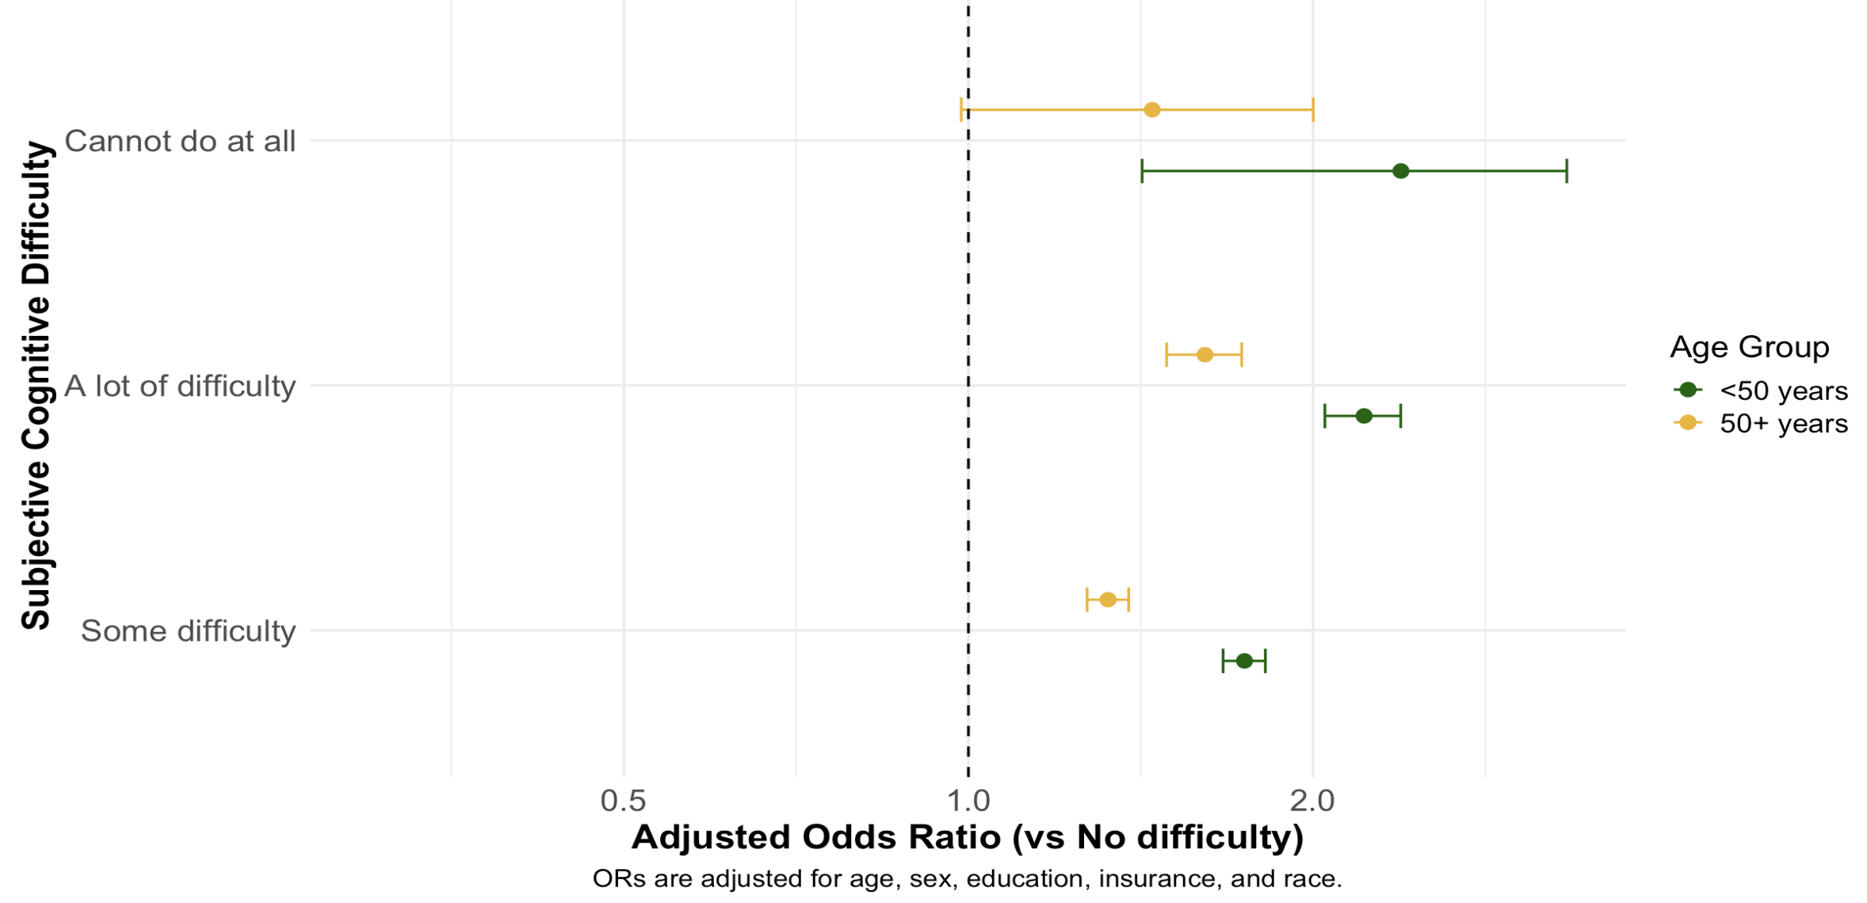
Bridging the Cognitive Divide: Telehealth Utilization
Among Adults with Cognitive Difficulties
Eduardo Gonzalez Villarreal¹; Young-Rock Hong, PhD²; Andrew Breithaupt, MD³; Abha Namjoshi¹; Andrew Kiselica, PhD⁴; Ambar Kulshreshtha, MD, PhD²
¹Department of Epidemiology, Emory University Rollins School of Public Health; ²Department of Family and Preventative Medicine, Emory University School of Medicine;
³Department of Neurology, Emory University School of Medicine; ⁴Institute of Gerontology, University of Georgia
Introduction
Telehealth has become integral to healthcare delivery since the pandemic. It has become a core component of care, with roughly a third of US adults using telehealth services each year. Cognitive function plays a major role in operating digital devices; cognitive difficulties may limit access and uptake of telehealth.
Results
Results/Discussion
Participants with a lot of cognitive difficulty had 2.2 times the odds of using telehealth in the preceding year compared to those with no difficulty (adjusted OR = 2.4, 95% CI: 2.2-2.6). There was a statistically significant interaction between age group and cognitive difficulty (p < 0.001). Participants with a lot of cognitive difficulty were about twice as likely to use telehealth if under 50 (OR = 2.22) and about 1.6 times as likely if 50 or older (OR = 1.61). Those with subjective cognitive difficulty may rely more on telehealth, potentially due to barriers to in-person visits (i.e., driving, navigation).
Table 1. Demographics Stratified by Telehealth Usage
Figure 1. Use of Telehealth by Cognitive Status
Objectives
Evaluate the association between telehealth usage and cognitive difficulty. Determine whether age modifies the association between telehealth and cognitive difficulty.
Conclusions
Individuals with greater cognitive difficulty had consistently higher odds of telehealth usage, a trend that held in both age categories. Telehealth may enhance healthcare accessibility for individuals with cognitive difficulties. Limitations: Cross-sectional design, self-reported data
Methods
We examined nationally representative data from the National Health Interview Survey (NHIS) collected between 2020 and 2023. A multivariable logistic regression model was fit to assess the association between subjective cognitive difficulty and telehealth usage, adjusting for covariates. Assessed statistical interaction by age.
Figure 2. Adjusted Odds Ratios for Telehealth Use, Stratified by Age Group
References
1. Mechanic OJ, Persaud Y, Kimball AB. Telehealth systems [Internet]. Treasure Island (FL): StatPearls Publishing; 2025 Jan– [updated 2022 Sep 12; cited 2025 Nov 2]. Available from: https://www.ncbi.nlm.nih.gov/books/NBK459384/ 2. Lucas JW, Villarroel MA. Telemedicine use among adults: United States, 2021 [Internet]. Hyattsville (MD): National Center for Health Statistics; 2022 Oct [cited 2025 Nov 2]. Available from: https://www.cdc.gov/nchs/products/databriefs/db445.htm. 3. Yi JS, Pittman CA, Price CL, Nieman CL, Oh ES. Telemedicine and dementia care: a systematic review of barriers and facilitators. J Am Med Dir Assoc. 2021;22(7):1396–1402.e18. doi:10.1016/j.jamda.2021.03.015. 4. National Center for Health Statistics. NHIS Questionnaires, Datasets, and Documentation [Internet]. Hyattsville (MD): Centers for Disease Control and Prevention; 2024 [cited 2025 Nov 2]. Available from: https://www.cdc.gov/nchs/nhis/documentation/index.html

