Slide 1

Scheduler Collision
Brief Explanation of USLP10
Group 121
André Pinho
Bianca Almeida
Carlota Lemos
Eduardo Almeida
Marcelo Carvalho
Professores
João Miguel Carneiro
Alberto Gomes Mendes
Jorge Santos

Slide 2

Table of contents
01
02
03
04
Schedule Explanation
Single Track Collision
Two Single Track Collision
Siding Collision

Slide 3
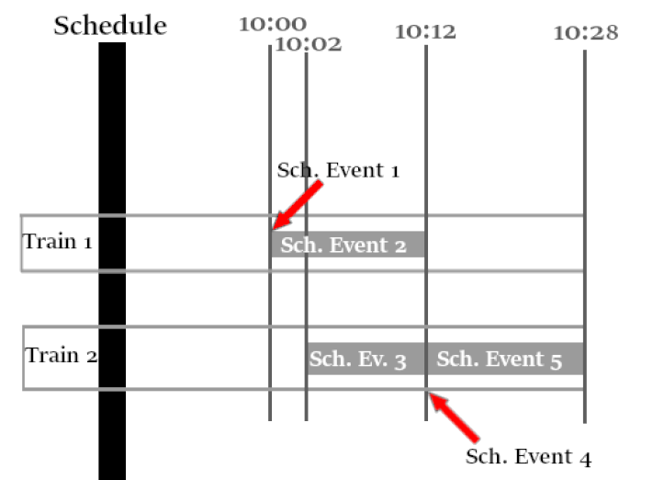
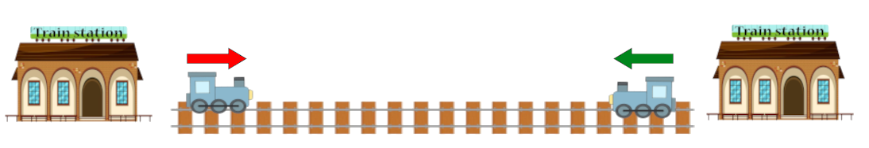
1- Schedule Explanation
Creation: Each time we add a complete train, the schedule generates all events again. It generates them in order of event date.
Events: For each event, check whether it is possible to create the event or generate a waiting event, placing it at the top of the event list.
Schedule Details
Schedule Event 1:
Schedule Event 3:
Verify Collision on Segment 1 - False
Create Movement To Segment Event
Initial Pos. – Station A 10:00
Final Pos. – Segment 1 10:00
Verify Collision on Segment 1 - True
Create Waiting Event
Initial Pos. – Station A 10:02
Final Pos. – Segment 1 10:12
Schedule Event 2:
Schedule Event 4:
Create Movement On Segment Event
Initial Pos. – Segment 1 10:00
Final Pos. – Station B 10:12
Verify Collision on Segment 1 - False
Create Movement To Segment Event
Initial Pos. – Station A 10:12
Final Pos. – Segment 1 10:12
Fig.1 - Schedule Graphical Display
Schedule Event 5:
Create Movement On Segment Event
Initial Pos. – Segment 1 10:12
Final Pos. – Station A 10:28
Fig.2 – Schedule Case

Slide 4
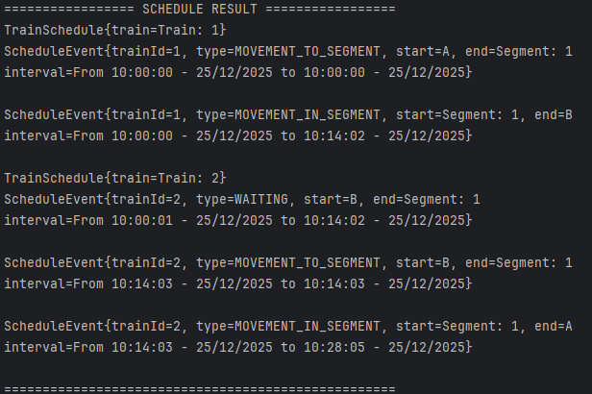
2- Single Track Collision
Context
Two trains travel at the same time on a line connecting Station A to Station B. These stations are connected by a line consisting of a single segment with only one track.
Fig.3 – Collision Case 1
To prevent head-on collisions on single-track railway segments, occupancy is centrally managed by the ScheduleGenerator. Each Segment with 1 track doesn’t allow trains with different direction at the same time, and conflicts are resolved by delaying the train that found the collision and inserting waiting events into its schedule.
Fig.4 - Test Result In App

Slide 5
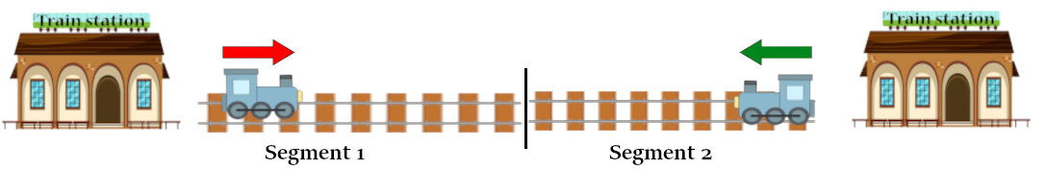
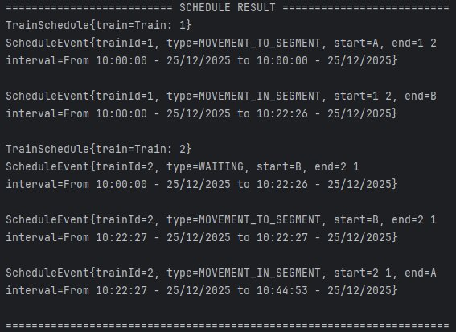
3- Two Single Track Collision
Context
Two trains travel at the same time on a line connecting Station A to Station B. These stations are connected by a line consisting of Two segment with only one track each.
Fig.5 – Collision Case 2
Since the system predicts collisions segment by segment, there may be cases where it is necessary to reverse certain movements. For this reason, the Generator has the ability to aggregate line segments that have only one track and are consecutive. This makes the problem the same as that seen in (1 - Single Track Collision) .
Fig.6 - Test Result In App

Slide 6
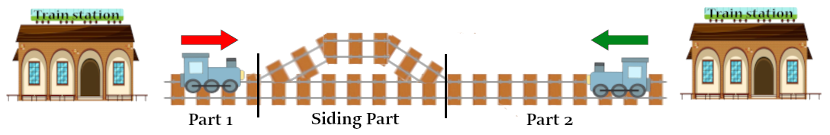
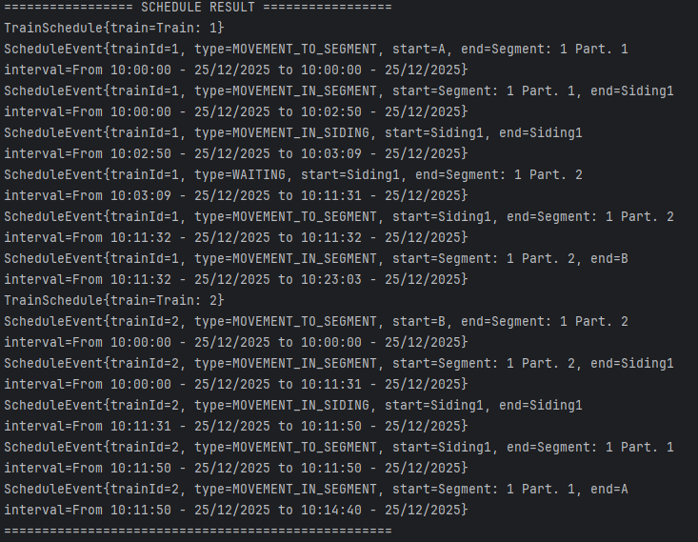
4- Siding Collision
Context
Two trains travel at the same time on a line connecting Station A to Station B. These stations are connected by a line consisting of a single segment with only one track that have a siding in the first 1km with 100 m length .
Fig.7 – Collision Case 3
In order for trains to use sidings, we decided to divide the segments that contain them so that occupancy can be checked part by part using the (1 - Single Track Collision) method. In the case of a “Siding Part”, it will be treated as a line segment with two tracks, thus allowing crossing. At the siding exit, it checks whether the next part of the segment is available or not.
Fig.8 - Test Result In App

Slide 7

Thanks!
Do you have any questions?
mabecdev@gmail.com
Please keep this slide for attribution
Group 121
André Pinho
Bianca Almeida
Carlota Lemos
Eduardo Almeida
Marcelo Carvalho

