Slide 1
NAT for IPv4

Slide 2
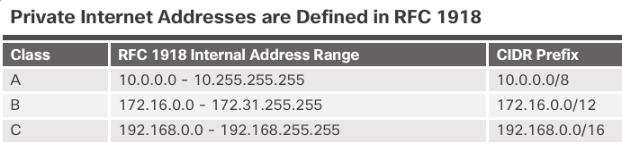
NAT Characteristics IPv4 Private Address Space
Did you ever notice how all your labs were based on these addresses?
Private IP addresses are used within an organization and home networks.
These are the IP addresses you will see assigned to company devices.

Slide 3
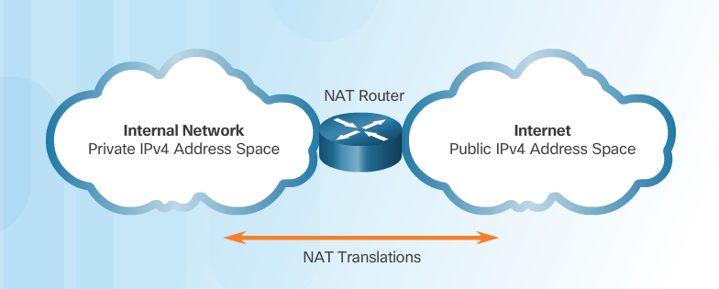
NAT Characteristics IPv4 Private Address Space (Cont.)
Private IP addresses cannot be routed over the Internet.
NAT is used to translate private IP addresses to public addresses that can be routed over the Internet.
One public IPv4 address can be used for thousands of devices that have private IP addresses.

Slide 4
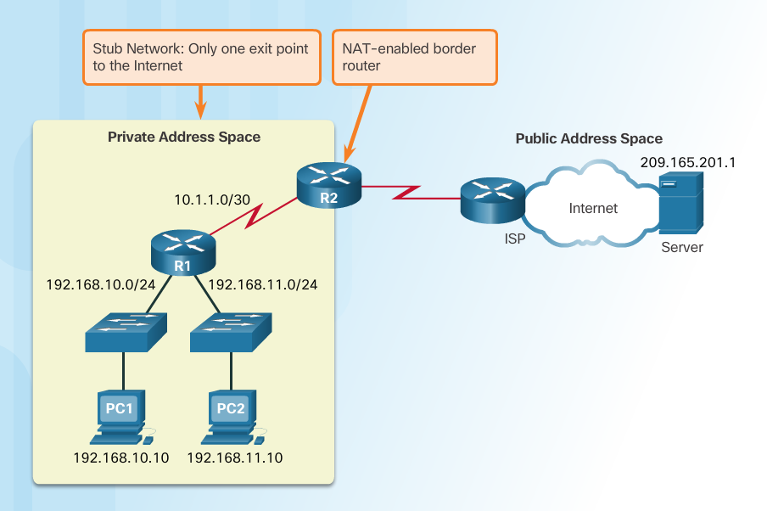
NAT Characteristics What is NAT?
Important Concept—NAT is enabled on one device (normally the border or edge router)
Private IP addresses cannot be routed over the Internet.
NAT is used to translate private IP addresses used inside a company to public addresses that can be routed over the Internet.
NAT hides internal IPv4 addresses from outside networks.
Companies use the same private IPv4 addresses so outside devices cannot tell one company’s 10.x.x.x network from another company’s 10.x.x.x network.
A NAT-enabled router can be configured with a public IPv4 address.
A NAT-enabled router can be configured with multiple public IPv4 addresses to be used in a pool or NAT pool for internal devices configured with private addresses.

Slide 5
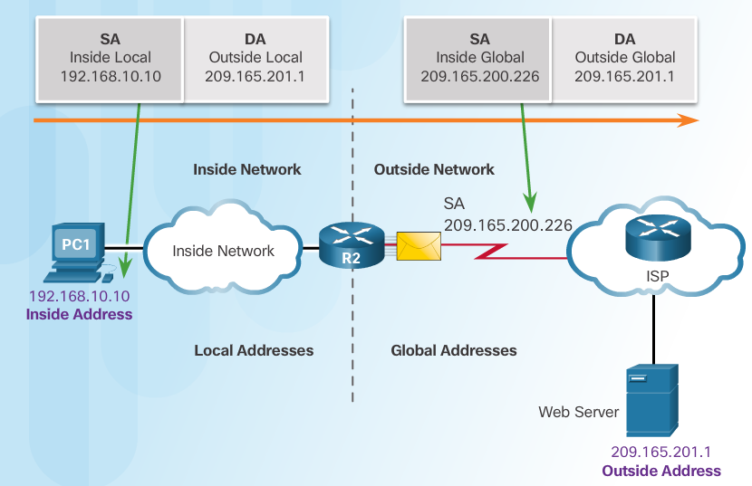
NAT Characteristics NAT Terminology
Four types of addresses: inside, outside, local, and global
Always consider the device that is having its private address translated to understand this concept.
Inside address – address of the company network device that is being translated by NAT
Outside address – IP address of the destination device
Local address – any address that appears on the inside portion of the network
Global address – any address that appears on the outside portion of the network

Slide 6
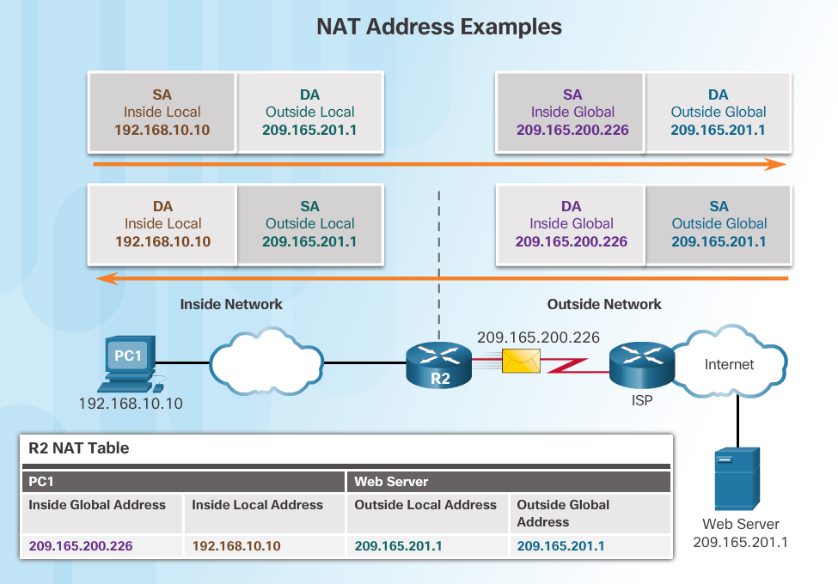
NAT Characteristics NAT Terminology (Cont.)

Slide 7
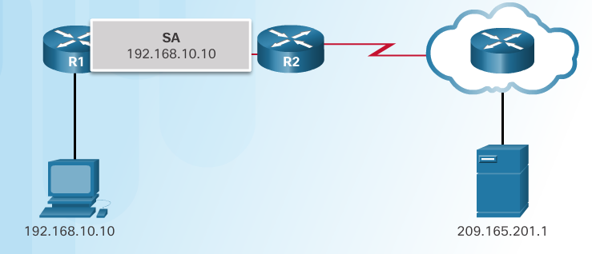
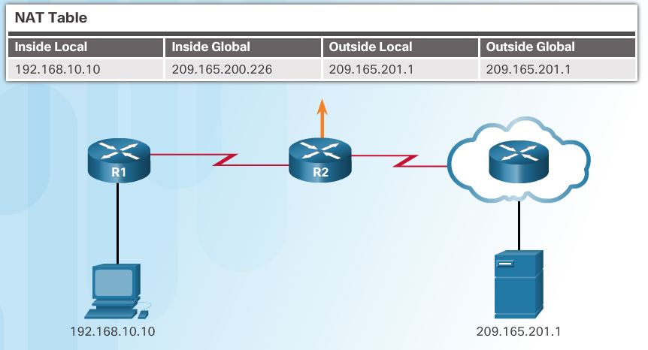
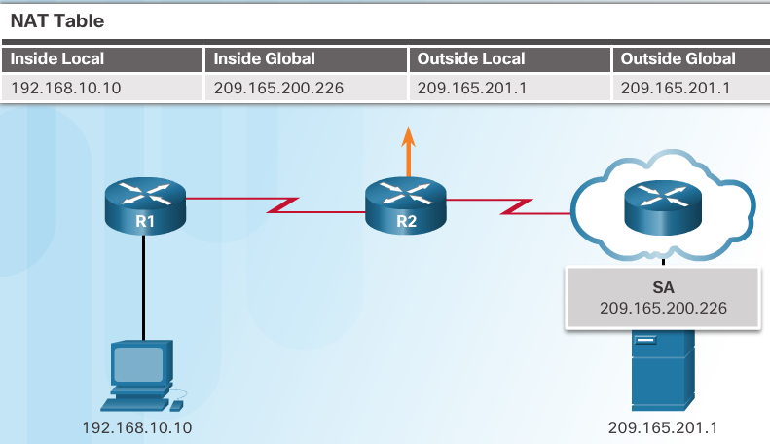
NAT Characteristics How NAT Works
1. The private (internal) IP address gets translated to a public IP address used to reach the external server.

Slide 8
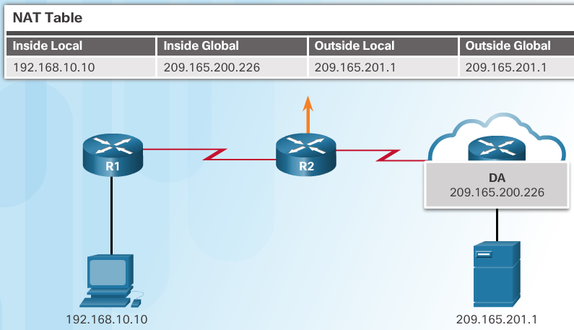
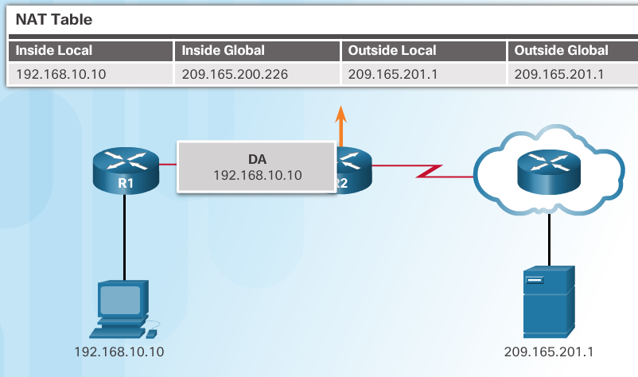
NAT Characteristics How NAT Works (Cont.)
2. The translated public address is used by the server to send the requested information to the device that actually has a private IP address assigned to it.
3. The NAT-enabled router consults the routing table to see what private address requested the data.

Slide 9
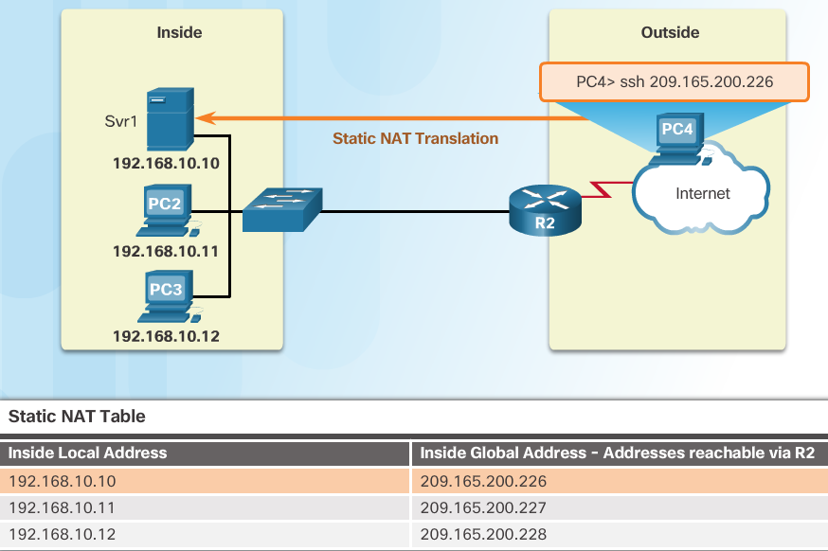
Types of NAT Static NAT
Static address translation (static NAT) assigns one public IP address to one private IP address
Commonly used for servers that need to be accessed by external devices or for devices that must be accessible by authorized personnel when offsite
One-to-one address mapping between local and global addresses

Slide 10
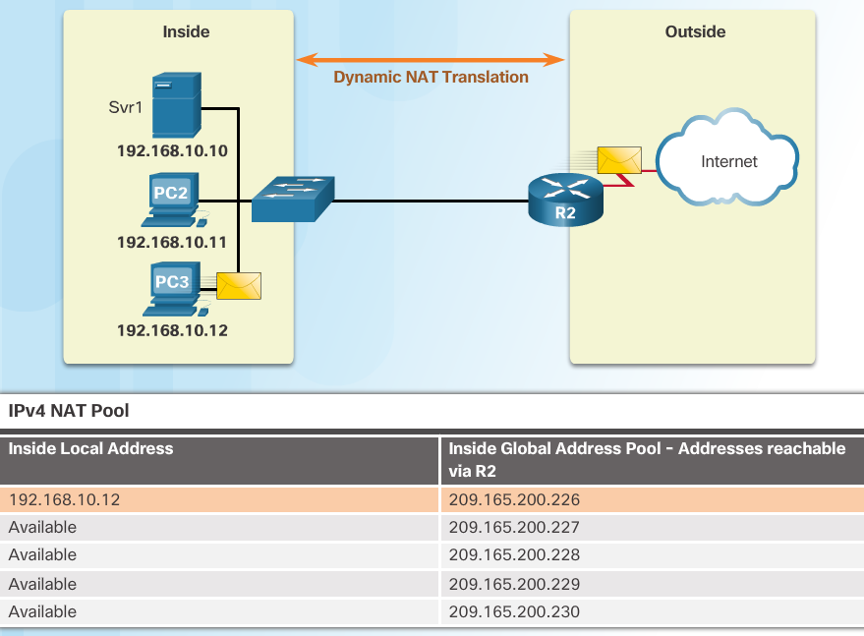
Types of NAT Dynamic NAT
Dynamic NAT assigns a public IP address from a pool of addresses to each packet that originates from a device that has a private IP address assigned when that packet is destined to a network outside the company.
Addresses are assigned on a first-come, first serve basis
The number of internal devices that can transmit outside the company is limited to the number of public IP addresses in the pool.

Slide 11
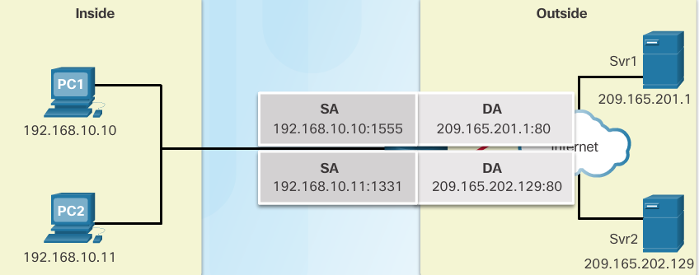
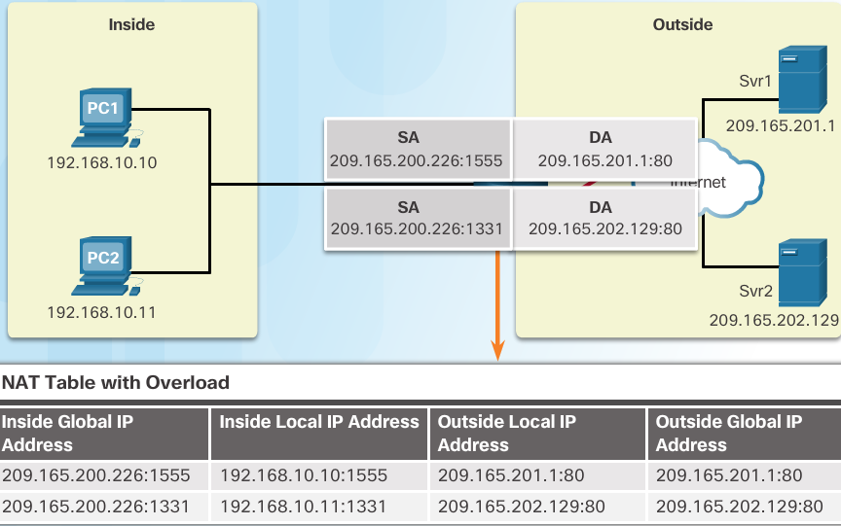
Types of NAT Port Address Translation (PAT)
PAT (otherwise known as NAT overload) can use one public IPv4 address to allow thousand of private IPv4 addresses to communicate with outside network devices.
Uses port numbers to track the session

Slide 12
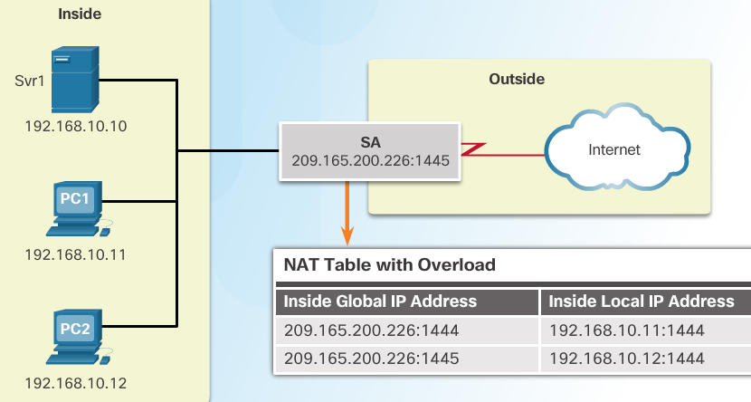
Types of NAT Next Available Port
PAT tries to preserve the original source port number.
If that port number is already use, PAT will assign the first available port number for the appropriate port group
0 - 511
512 - 1023
1024 - 65,535
When there are no more port numbers available, PAT moves to the next public IP address in the pool if there is one.
1. Notice how traffic is from two different internal devices using the same port number.
2. Notice how PAT uses the same public address, but two different port numbers.

Slide 13
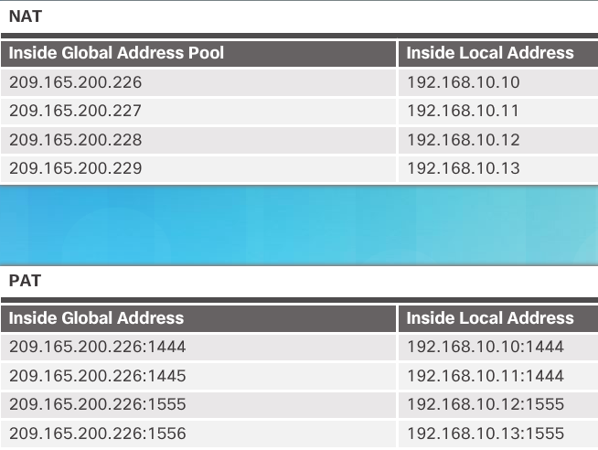
Types of NAT Comparing NAT and PAT
Static NAT translates address on a 1:1 basis
PAT uses port numbers so that one public address can be used for multiple privately addressed devices
PAT can still function with a protocol such as ICMP that does not use TCP or UDP

Slide 14
NAT Advantages Advantages of NAT
Conserves the legally registered addressing scheme
Every company can use the private IP addresses
Increases the flexibility of connections to the public network
Multiple NAT pools, backup pools, and load-balancing across NAT pools
Provides consistency for internal network addressing schemes
Do not have to readdress the network if a new ISP or public IP address is assigned
Provides network security
Hides user private IPv4 addresses

Slide 15
NAT Advantages Disadvantages of NAT
Performance is degraded.
The NAT-enabled border device must track and process each session destined for an external network.
End-to-end functionality is degraded.
Translation of each IPv4 address within the packet headers takes time.
End-to-end IP traceability is lost.
Some applications require end-to-end addressing and cannot be used with NAT.
Static NAT mappings can sometimes be used.
Troubleshooting can be more challenging.
Tunneling becomes more complicated.
Initiating TCP connections can be disrupted.

Slide 16
Configure NAT

Slide 17
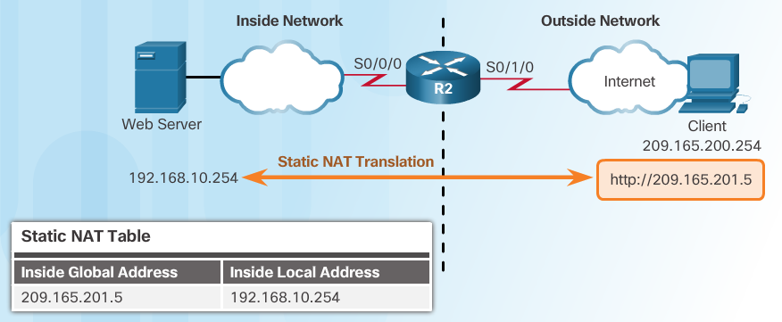
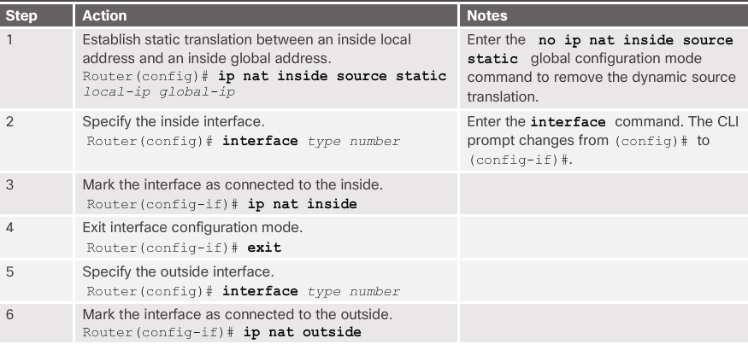
Configuring Static NAT Configure Static NAT

Slide 18
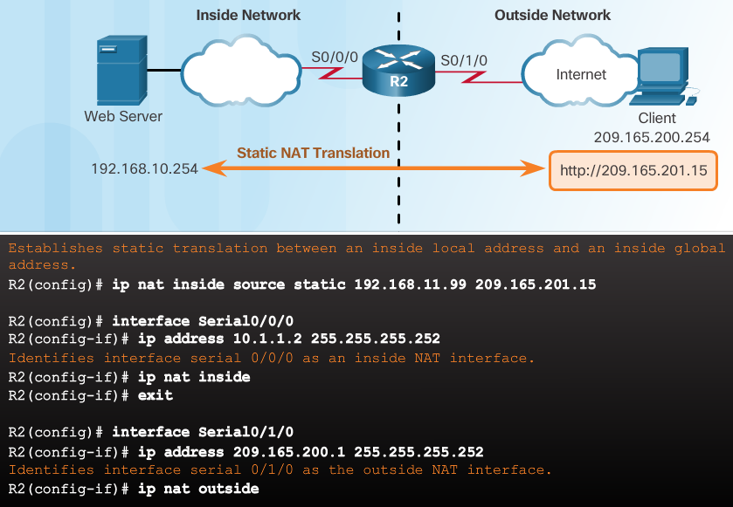
Configuring Static NAT Configure Static NAT (Cont.)
Inside interface
Outside interface
This is a common mistake for those new to NAT.Remember that any interface on the border router that is on the inside network must be configured with the ip nat inside command.

Slide 19
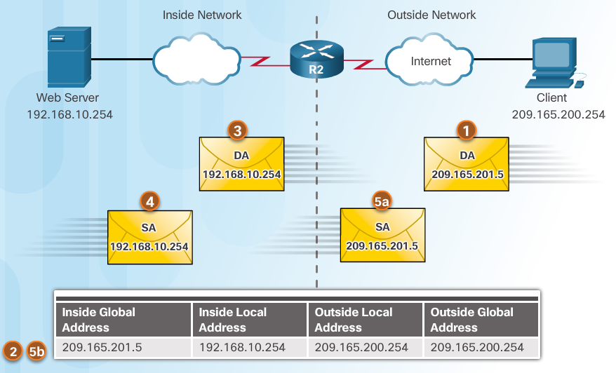
Configuring Static NAT Analyzing Static NAT
Client opens a web browser for a connection to a web server.
R2 receives the packet on the outside interface and checks the NAT table.
R2 replaces the inside global address with inside local address of 192.168.10.254 (the server’s address).
Web server responds to the client.
(a) R2 receives the packet from the server on the inside address. (b) R2 checks NAT table and translates the source address to the inside global address of 209.165.201.5 and forwards the packet.
The client receives the packet.

Slide 20
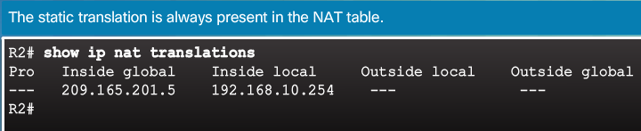
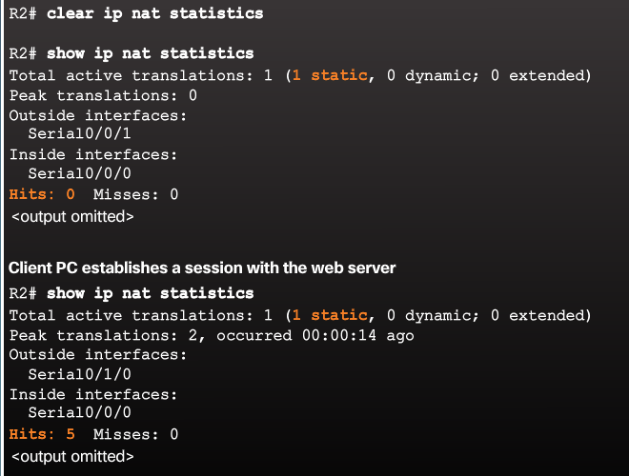
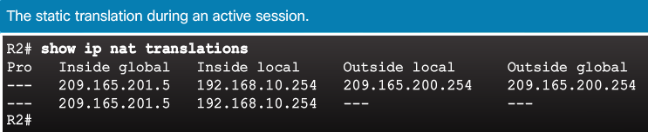
Configuring Static NAT Verifying Static NAT
A best practice is to clear statistics when verifying that NAT is working.
Important commands:
show ip nat translations
show ip nat statistics

Slide 21
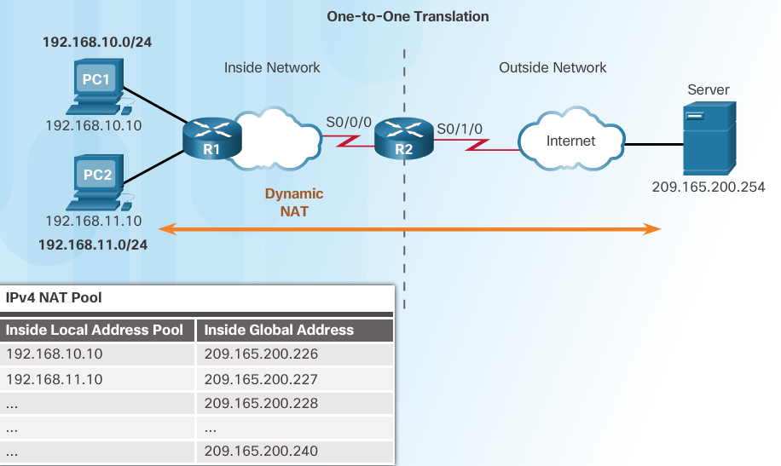
Configure Dynamic NAT Dynamic NAT Operation
Remember that dynamic NAT uses a pool of public IPv4 addresses.
Use the same concepts of inside and outside NAT interfaces as static NAT.

Slide 22
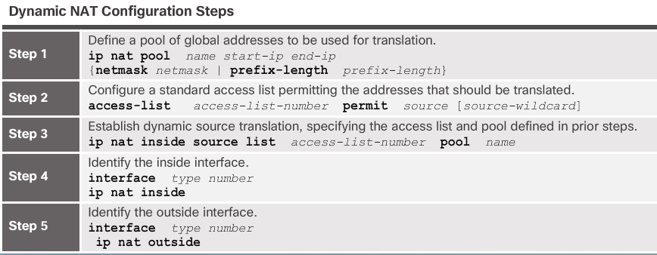
Configure Dynamic NAT Configuring Dynamic NAT

Slide 23
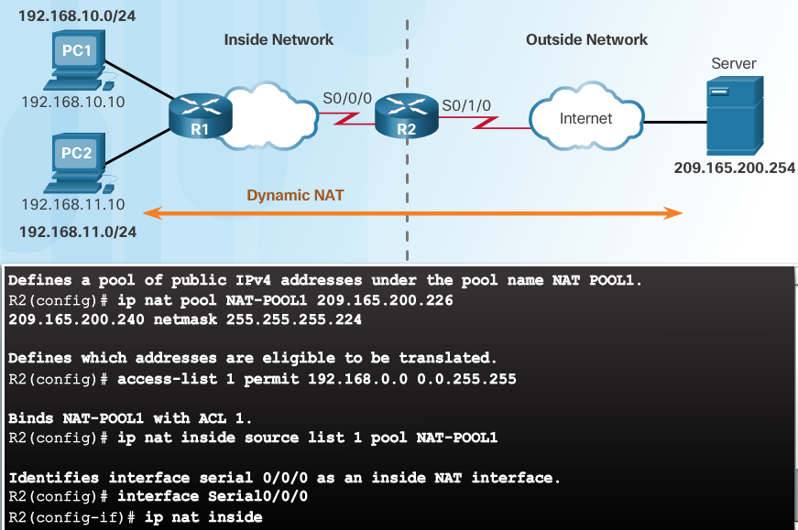
Configure Dynamic NAT Configuring Dynamic NAT (Cont.)

Slide 24
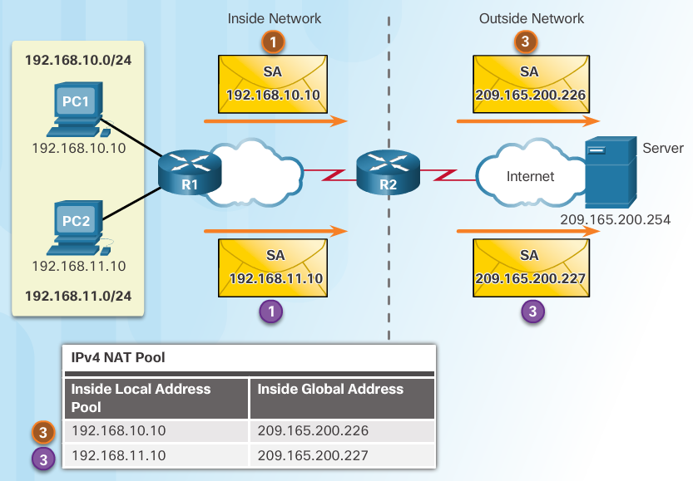
Configure Dynamic NAT Analyzing Dynamic NAT
PC1 and PC2 open a web browser for a connection to a web server.
R2 receives the packets on the inside interface and checks if translation should be performed (via an ACL). R2 assigns a global address from the NAT pool and creates a NAT table entry for both packets.
R2 replaces the inside local source address on each packet with the translated inside global address from the pool.

Slide 25
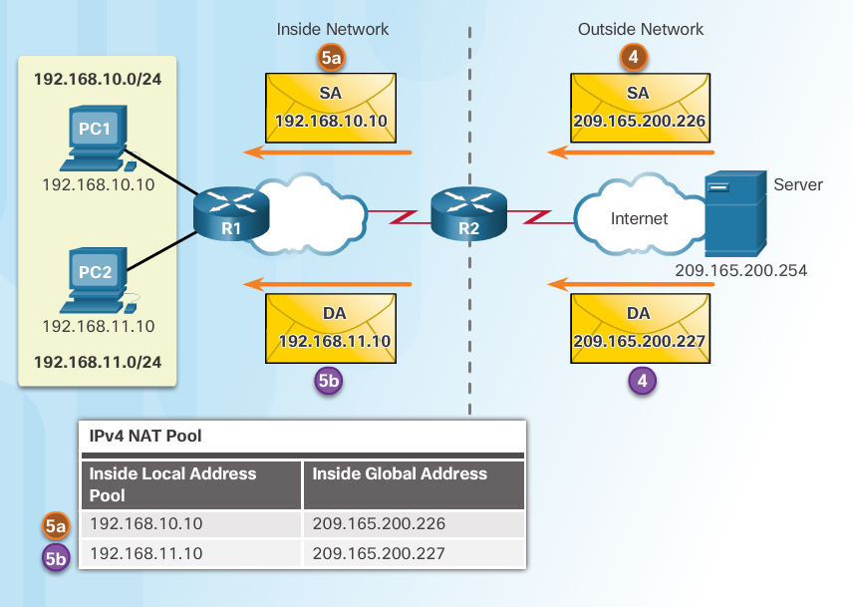
Configure Dynamic NAT Analyzing Dynamic NAT (Cont.)
The server responds to PC1 using the destination address of 209.165.200.226 (the NAT-assigned address) and to PC2 using the destination address of 209.165.200.227.
(a and b) R2 looks up each received packet and forwards based on the private IP address found in the NAT table for each of the destination addresses.

Slide 26
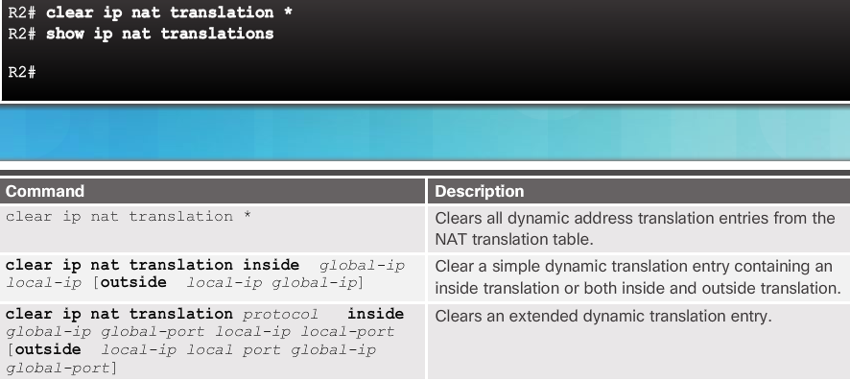
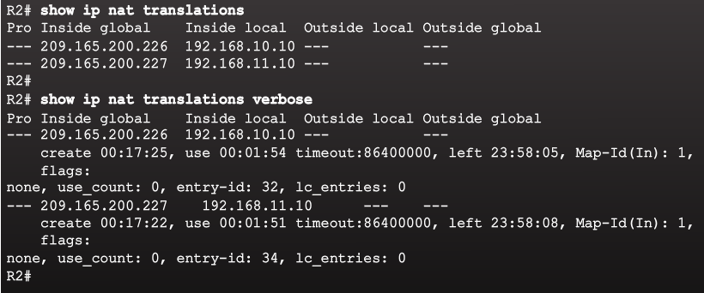
Configure Dynamic NAT Verifying Dynamic NAT

Slide 27
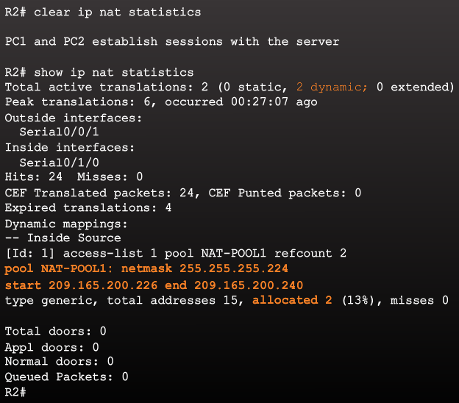
Configure Dynamic NAT Verifying Dynamic NAT (Cont.)

Slide 28
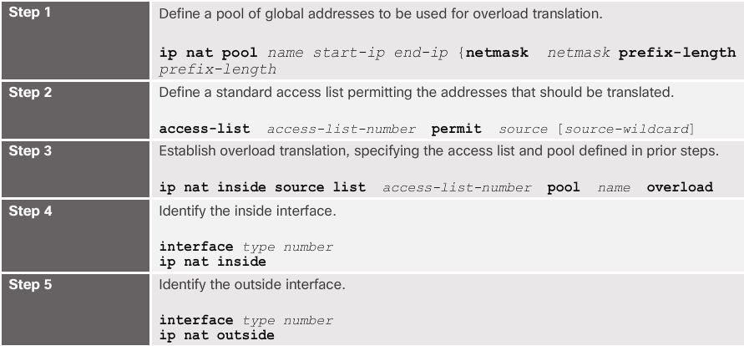
Configure PAT Configuring PAT: Address Pool
The pool contains the public addresses.
The ACL defines which private IP addresses gets translated.
The ip nat inside source list acl# pool name overload command ties Step 1 with Step 2.
The overload command is what allows the router to track port numbers (and do PAT instead of dynamic NAT).

Slide 29
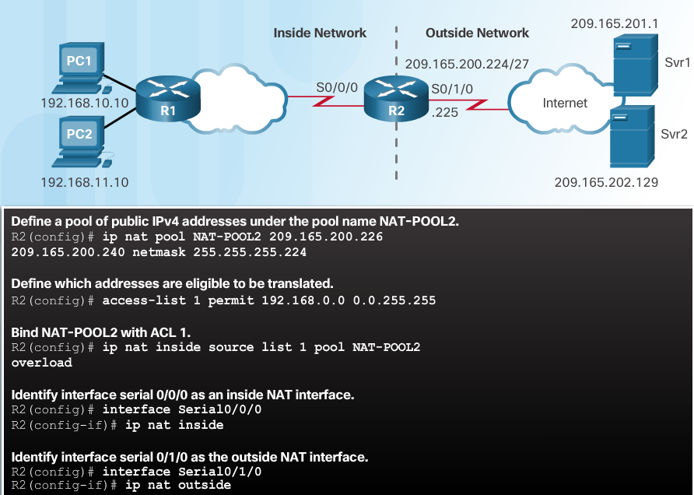
Configure PAT Configuring PAT: Address Pool (Cont.)

Slide 30
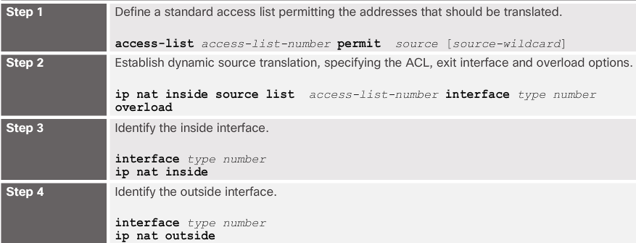
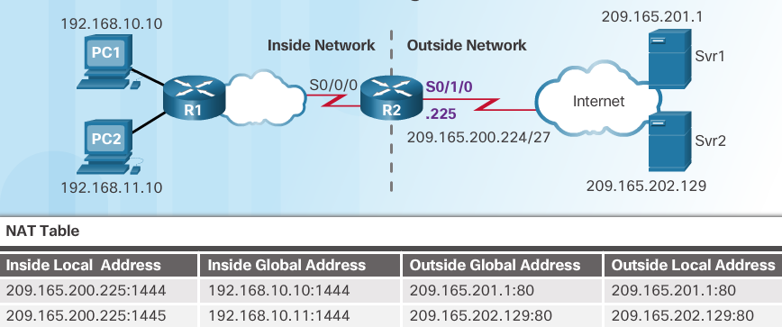
Configure PAT Configuring PAT: Single Address
When a public address is assigned to the external interface on the border router, that public address can be used for PAT and translate internal private IP addresses to the public IP address.
Still need an ACL to define which private IP addresses gets translated.
Instead of associating an ACL with a pool, the ACL is associated with an interface that has a public IP address assigned.
The overload command is always needed for PAT.

Slide 31
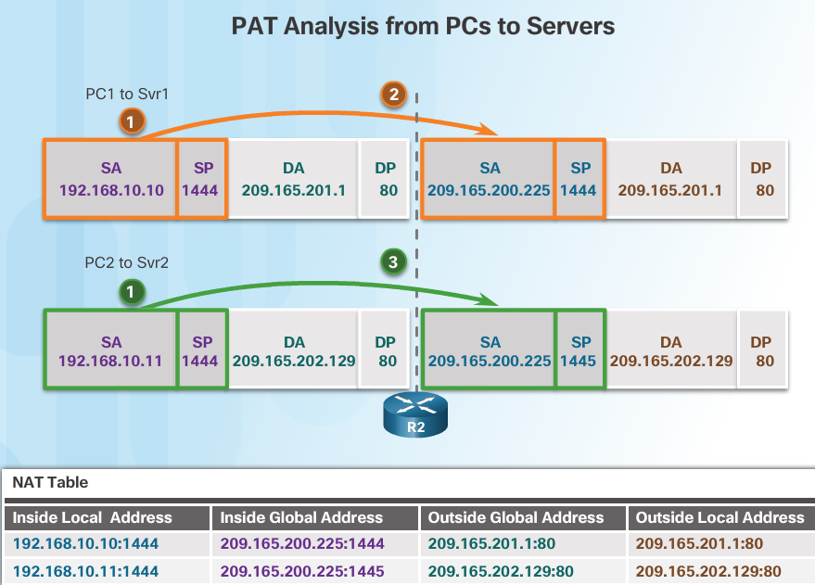
Configure PAT Analyzing PAT
PC1 and PC2 open a web browser for a connection to a web server.
R2 receives the packets on the inside interface and checks if translation should be performed (via an ACL). R2 assigns the IP address of the outside interface, adds a port number, and creates a NAT table entry for both packets.
R2 replaces the inside local source address on each packet with the translated inside global address.

Slide 32
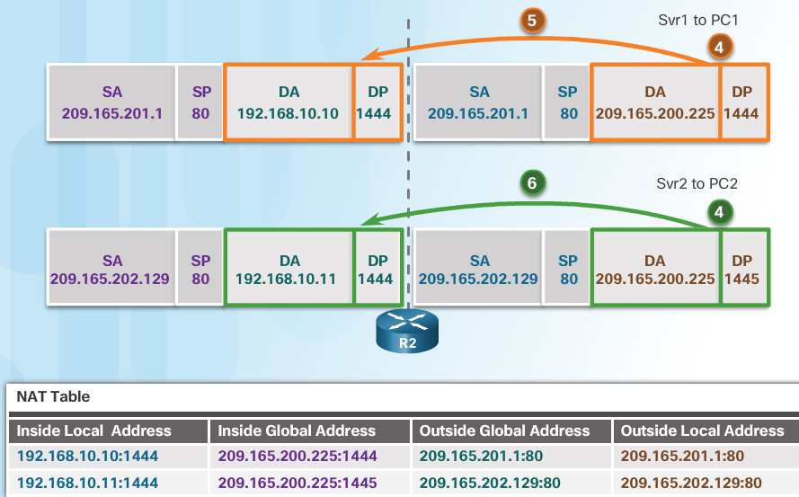
Configure PAT Analyzing PAT (Cont.)
Each server responds to PC1 and PC2 using the destination address of the public address assigned to the external interface on the border router.
R2 looks up the received packet and forwards to PC1 because that is the private IP address found in the NAT table for the destination address and port number.
R2 looks up the received packet and forwards to PC2 because that is the private IP address found in the NAT table for the destination address and port number.

Slide 33
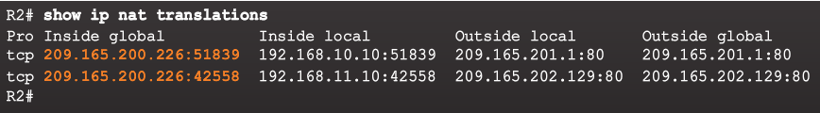
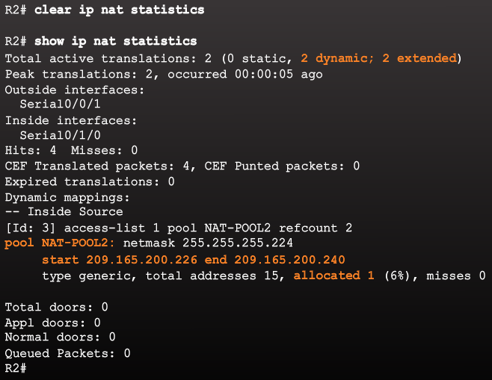
Configure PAT Verifying PAT

