Slide 1
Week 19
Jorge Eduardo Castro Cruces

Slide 2
1. What I did this week
Implemented an automated pipeline to evaluate and visualize prediction results across multiple food webs.
Integrated .mat adjacency matrices and prediction CSVs dynamically using a species mass-sorted scheme.
Plotted side-by-side comparisons of predicted matrices vs. original food web structure.
Verified TP, FP, FN correctness and matched them against adjacency truth.

Slide 3
2. How I did it (key code/graph/results)
Loaded food web list from foodweb_metrics_small.csv
I ran tests for 2 possible scenarios:
evaluate_on_all_unseen = true
evaluate_on_all_unseen = false
Generated file paths programmatically for each food web (small, medium, large)
Used mass-based sorting to reorder species and adjacency
Plotted with matplotlib:
Left: TP/FP/FN dot plot
Right: Adjacency matrix heatmap

Slide 4
3. What I learned
Mass-based sorting improves visual interpretability of predation structure.
Most test sets show high TP with minimal FN, confirming model precision.
The use of evaluate_on_all_unseen = true, leads to extreme overfitting.
Visualization reveals consistent sparsity and structure in small food webs.

Slide 5
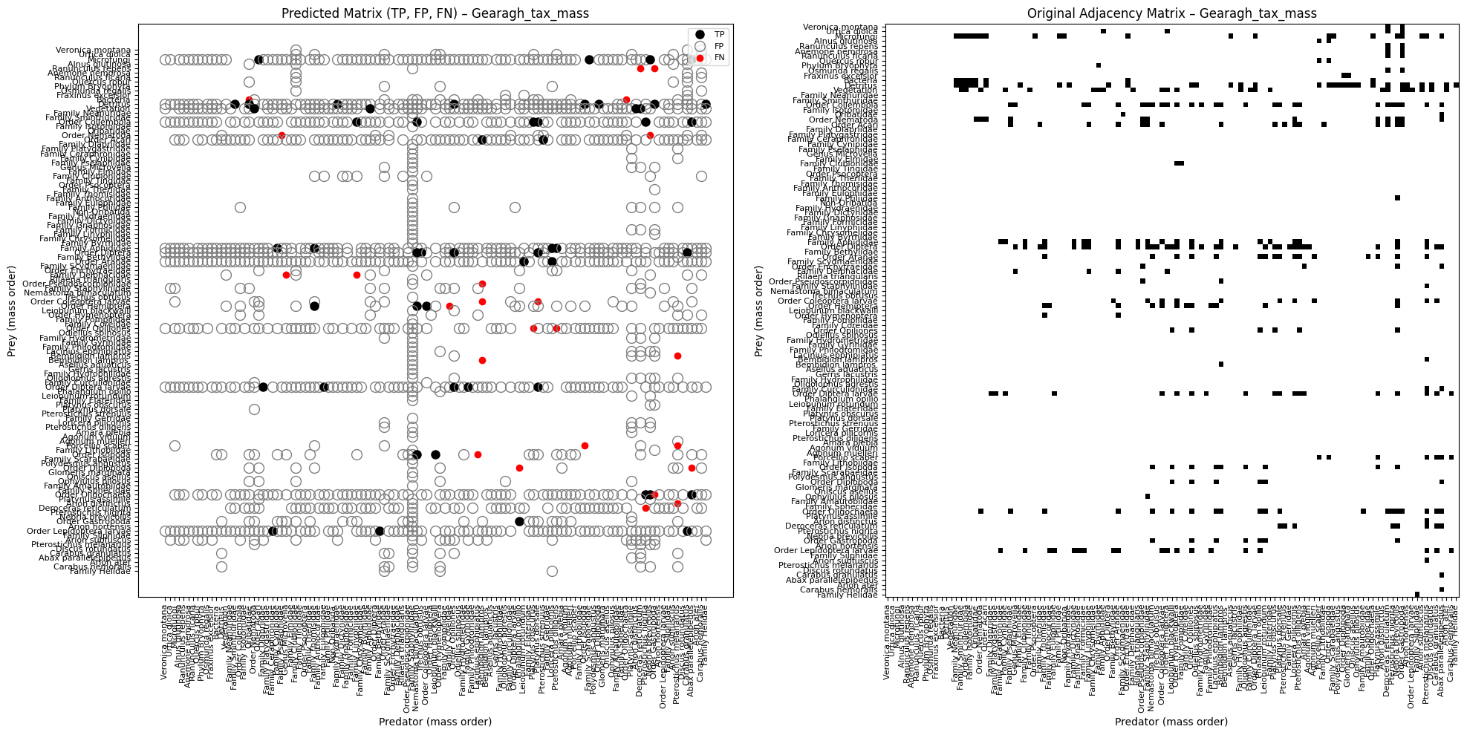
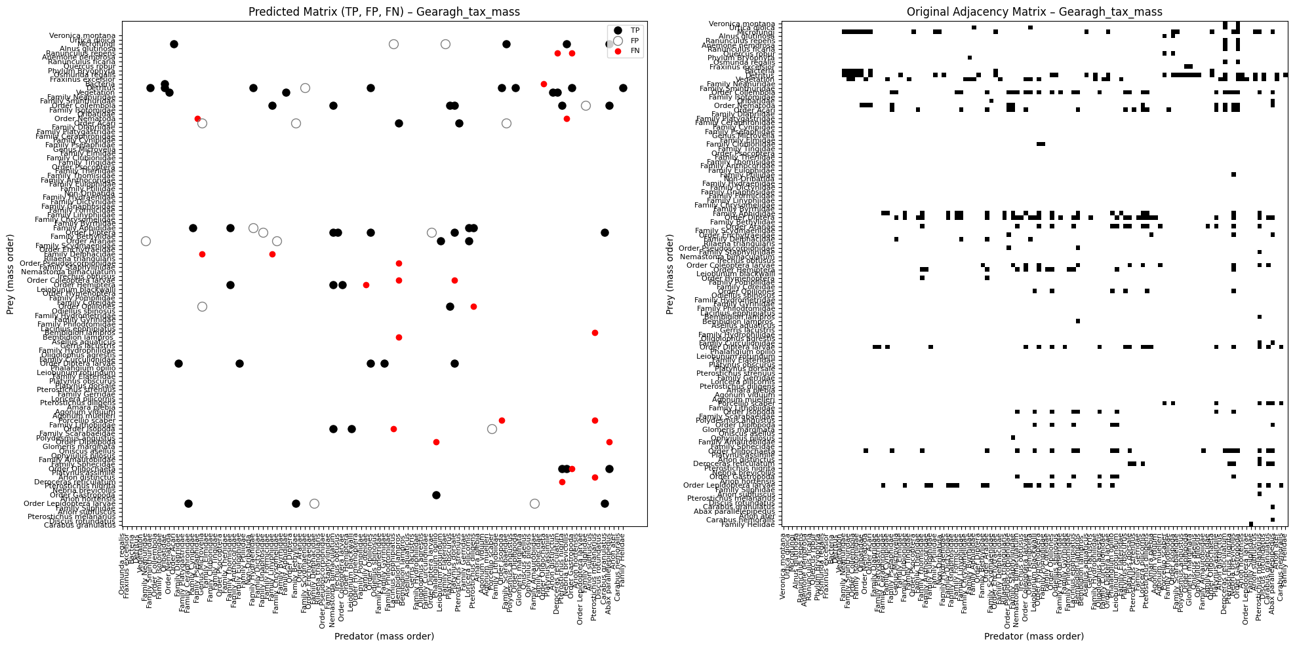
Gearagh
evaluate_on_all_unseen = true
evaluate_on_all_unseen = false
Best Threshold: 0.75, Precision: 0.0348, Recall: 0.6842, F1-Score: 0.0662
AUC: 0.7721
Best Threshold: 0.55, Precision: 0.7714, Recall: 0.7105, F1-Score: 0.7397
AUC: 0.7808

Slide 6
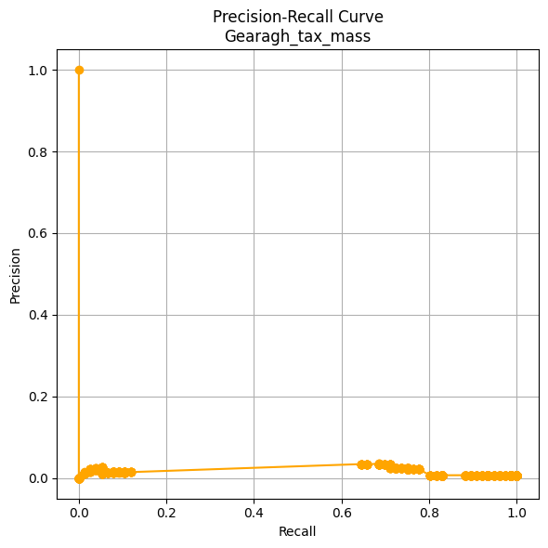
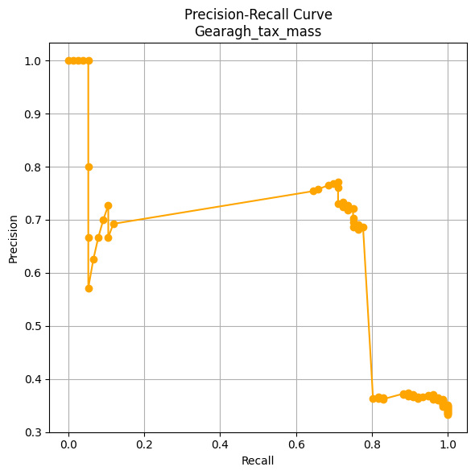
Gearagh
evaluate_on_all_unseen = true
evaluate_on_all_unseen = false
Best Threshold: 0.75, Precision: 0.0348, Recall: 0.6842, F1-Score: 0.0662
AUC: 0.7721
Best Threshold: 0.55, Precision: 0.7714, Recall: 0.7105, F1-Score: 0.7397
AUC: 0.7808

Slide 7
Gearagh
Metric | = true | = false
Evaluation set | All possible node pairs | Only observed node pairs
Curve shape | Sharp drop to 0, sparse | Smoother, better mid-range precision
Early precision | 1.0 then quickly near 0 | 1.0 and stays high for longer
Interpretation | Model generalizes poorly on full graph | Model performs well on known structure

Slide 8
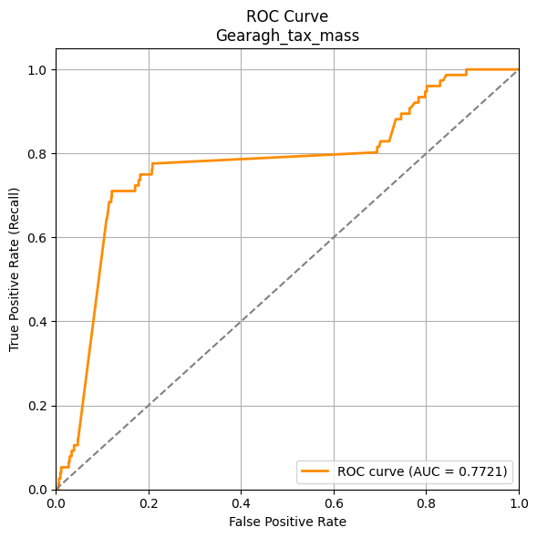
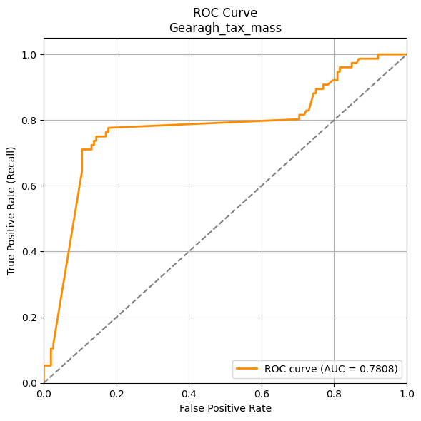
Gearagh
evaluate_on_all_unseen = true
evaluate_on_all_unseen = false
Best Threshold: 0.75, Precision: 0.0348, Recall: 0.6842, F1-Score: 0.0662
AUC: 0.7721
Best Threshold: 0.55, Precision: 0.7714, Recall: 0.7105, F1-Score: 0.7397
AUC: 0.7808

Slide 9
Gearagh
Metric | = true | = false
ROC AUC | 0.7721 | 0.7808
Early TPR gain | Steep but shorter | Steeper and more stable
Generalization to unknowns | Some ability | Better fit on known structure
Confidence calibration | Noisy on negatives | More stable ranking

Slide 10
4. Challenges or open questions
Is it possible to Improve realistic negative sampling by:
Using predefined classes: predator, prey, and predator-prey.
Only generating negative links between predator–predator and prey–prey species, as these represent rare or biologically implausible.
Can we reduce the bottleneck that produces into graph2vector() using parallel processing?
Should FN be analyzed over training + test? Currently only test is evaluated.
Do we need to incorporate metadata (interaction type / mean mass) more deeply into evaluation?

Slide 11
5. Next steps
Investigate how to improve realistic negative sampling by:
Defining species roles: predator, prey, predator-prey hybrid
Limiting negative samples to implausible pairs (prey–prey, predator–predator) to reduce false training signals
Profile and optimize the graph2vector() bottleneck using parallelization strategies
Assess whether false negatives (FN) should be measured across training + test, not just test, to better understand recall
Evaluate the potential of incorporating additional metadata (e.g., interaction type, mean body mass) into:
Scoring metrics
Filtering and error analysis
Future model inputs
Extend the current framework to export plots programmatically and scale analysis to medium and large food webs

