Slide 1




$$y_{sp}$$
$$e$$
Controlador
$$u$$
Processo
$$y$$
Σ
-
Sensor

Slide 2





$$y_{sp}$$
$$e$$
$$u$$
Processo
$$y$$
Σ
-
PID
Sensor

Slide 3




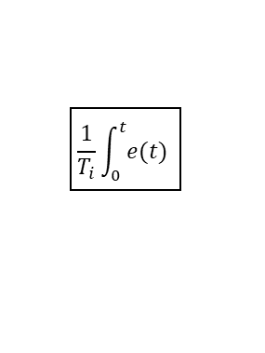






$$1$$
$$d(t)$$
$$sp(t)$$
$$e(t)$$
$$\frac{1}{T_{i}}\int_{0}^{t}{e(t)}$$
$$K$$
$$u(t)$$
Atuador
Processo
$$pv(t)$$
Σ
Σ
Σ
-
$$b(t)$$
$$T_{d}\frac{d}{dt}e(t)$$
$$n(t)$$
Σ

Slide 4










$$K_{p}$$
$$D(s)$$
$$SP(s)$$
$$E(s)$$
$$\frac{K_{i}}{s}$$
$$U(s)$$
Atuador
Processo
$$PV(s)$$
Σ
Σ
Σ
-
$$B(s)$$
$$K_{d}s$$
$$N(s)$$
Σ

Slide 5








$$K$$
$$E(s)$$
$$KT_{d}s$$
$$V(s)$$
Atuador
$$U(s)$$
Σ
$$\frac{K}{T_{i}}$$
$$\frac{1}{s}$$
-
Σ
Σ
$$E_{s}(s)$$
$$\frac{1}{T_{t}}$$

Slide 6


Serial/USB
Entradas Analógicas
Saídas PWM
Supervisório
A
B
A
B
Módulo
LM393
Módulo
L298
Módulo
ACS712
Módulo
LM393
Módulo
L298
Módulo
ACS712
Módulo
LM393
Módulo
ACS712
A
B
A
B
M
M
M
Bobinador #1
Acumulador
Bobinador #2

Slide 7










$$T_{d}$$
Sensor de Corrente
Motor
$$V_{SP}$$
-
-
$$ω$$
$$V_{PV}$$
Σ
$$1/{K_{V}}$$
PID
Velocidade
Σ
PID
Torque
$$v_{a}$$
Σ
Circuito Armadura
$$i_{a}$$
$$K_{T}$$
Σ
Inércia
Rotor
$$K_{V}$$
-
-
$$K_{ω}$$
Sensor de Velocidade

Slide 8







$$T_{c}$$
Sensor de Corrente
Motor
-
-
$$τ_{SP}$$
PID
Torque
$$v_{a}$$
Circuito Armadura
$$i_{a}$$
$$K_{T}$$
$$τ_{PV}$$
Inércia
Rotor
$$ω$$
$$K_{V}$$
$$V$$
$$\frac{1}{s}$$
$$L$$
$$1/{K_{T}}$$
Σ
Σ
Σ
-
$$K_{ω}$$

