Slide 1
Point observations
Model
Intermediate Maps
Output
Chill (station)
kriging
Chill Map
(kriged)
Chill Map
(krig and corrected)
Correction Variable (station)
kriging
Correction Variable (kriged)
insert
set-up
Correction model
Correction Map
insert
Correction Variable Map

Slide 2
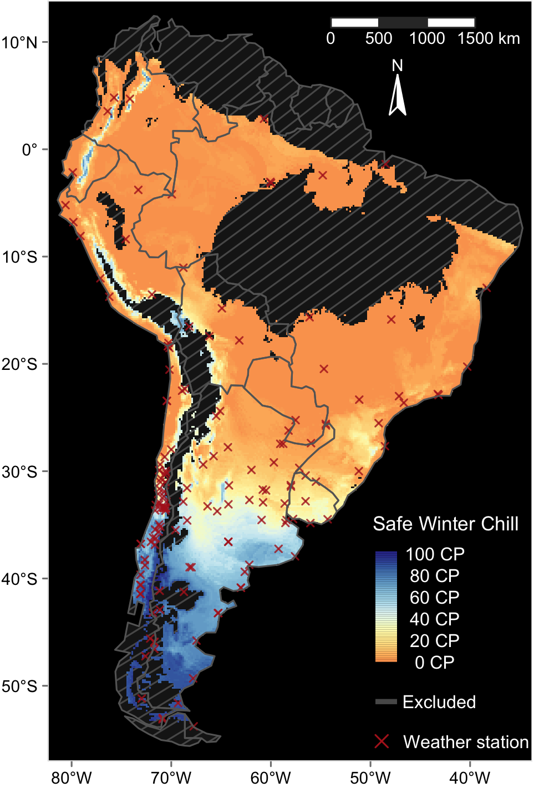
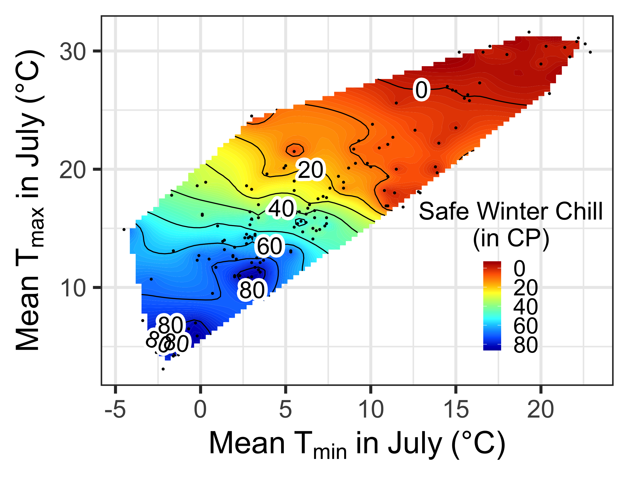
On-site observations
Model
Intermediate maps
Output
Safe Winter Chill map
Safe Winter Chill (weather station)
ordinary Kriging
Chill map
(Kriged)
Correction variables (weather station)
ordinary Kriging
Correction variable maps (Kriged)
feed the model
3D correction model
3D model generation
Correction map (WorldClim – on-site data)
feed the model
Correction variable maps (WorldClim)

Slide 3
On-site observations
Model
Intermediate Maps
Output
Safe Winter Chill (weather station)
kriging
Chill Map
(kriged)
Chill Map
(krig and corrected)
Correction variables (weather station)
kriging
Correction Variable (kriged)
insert
set-up
Correction model
Correction Map
insert
Correction Variable Map

Slide 4
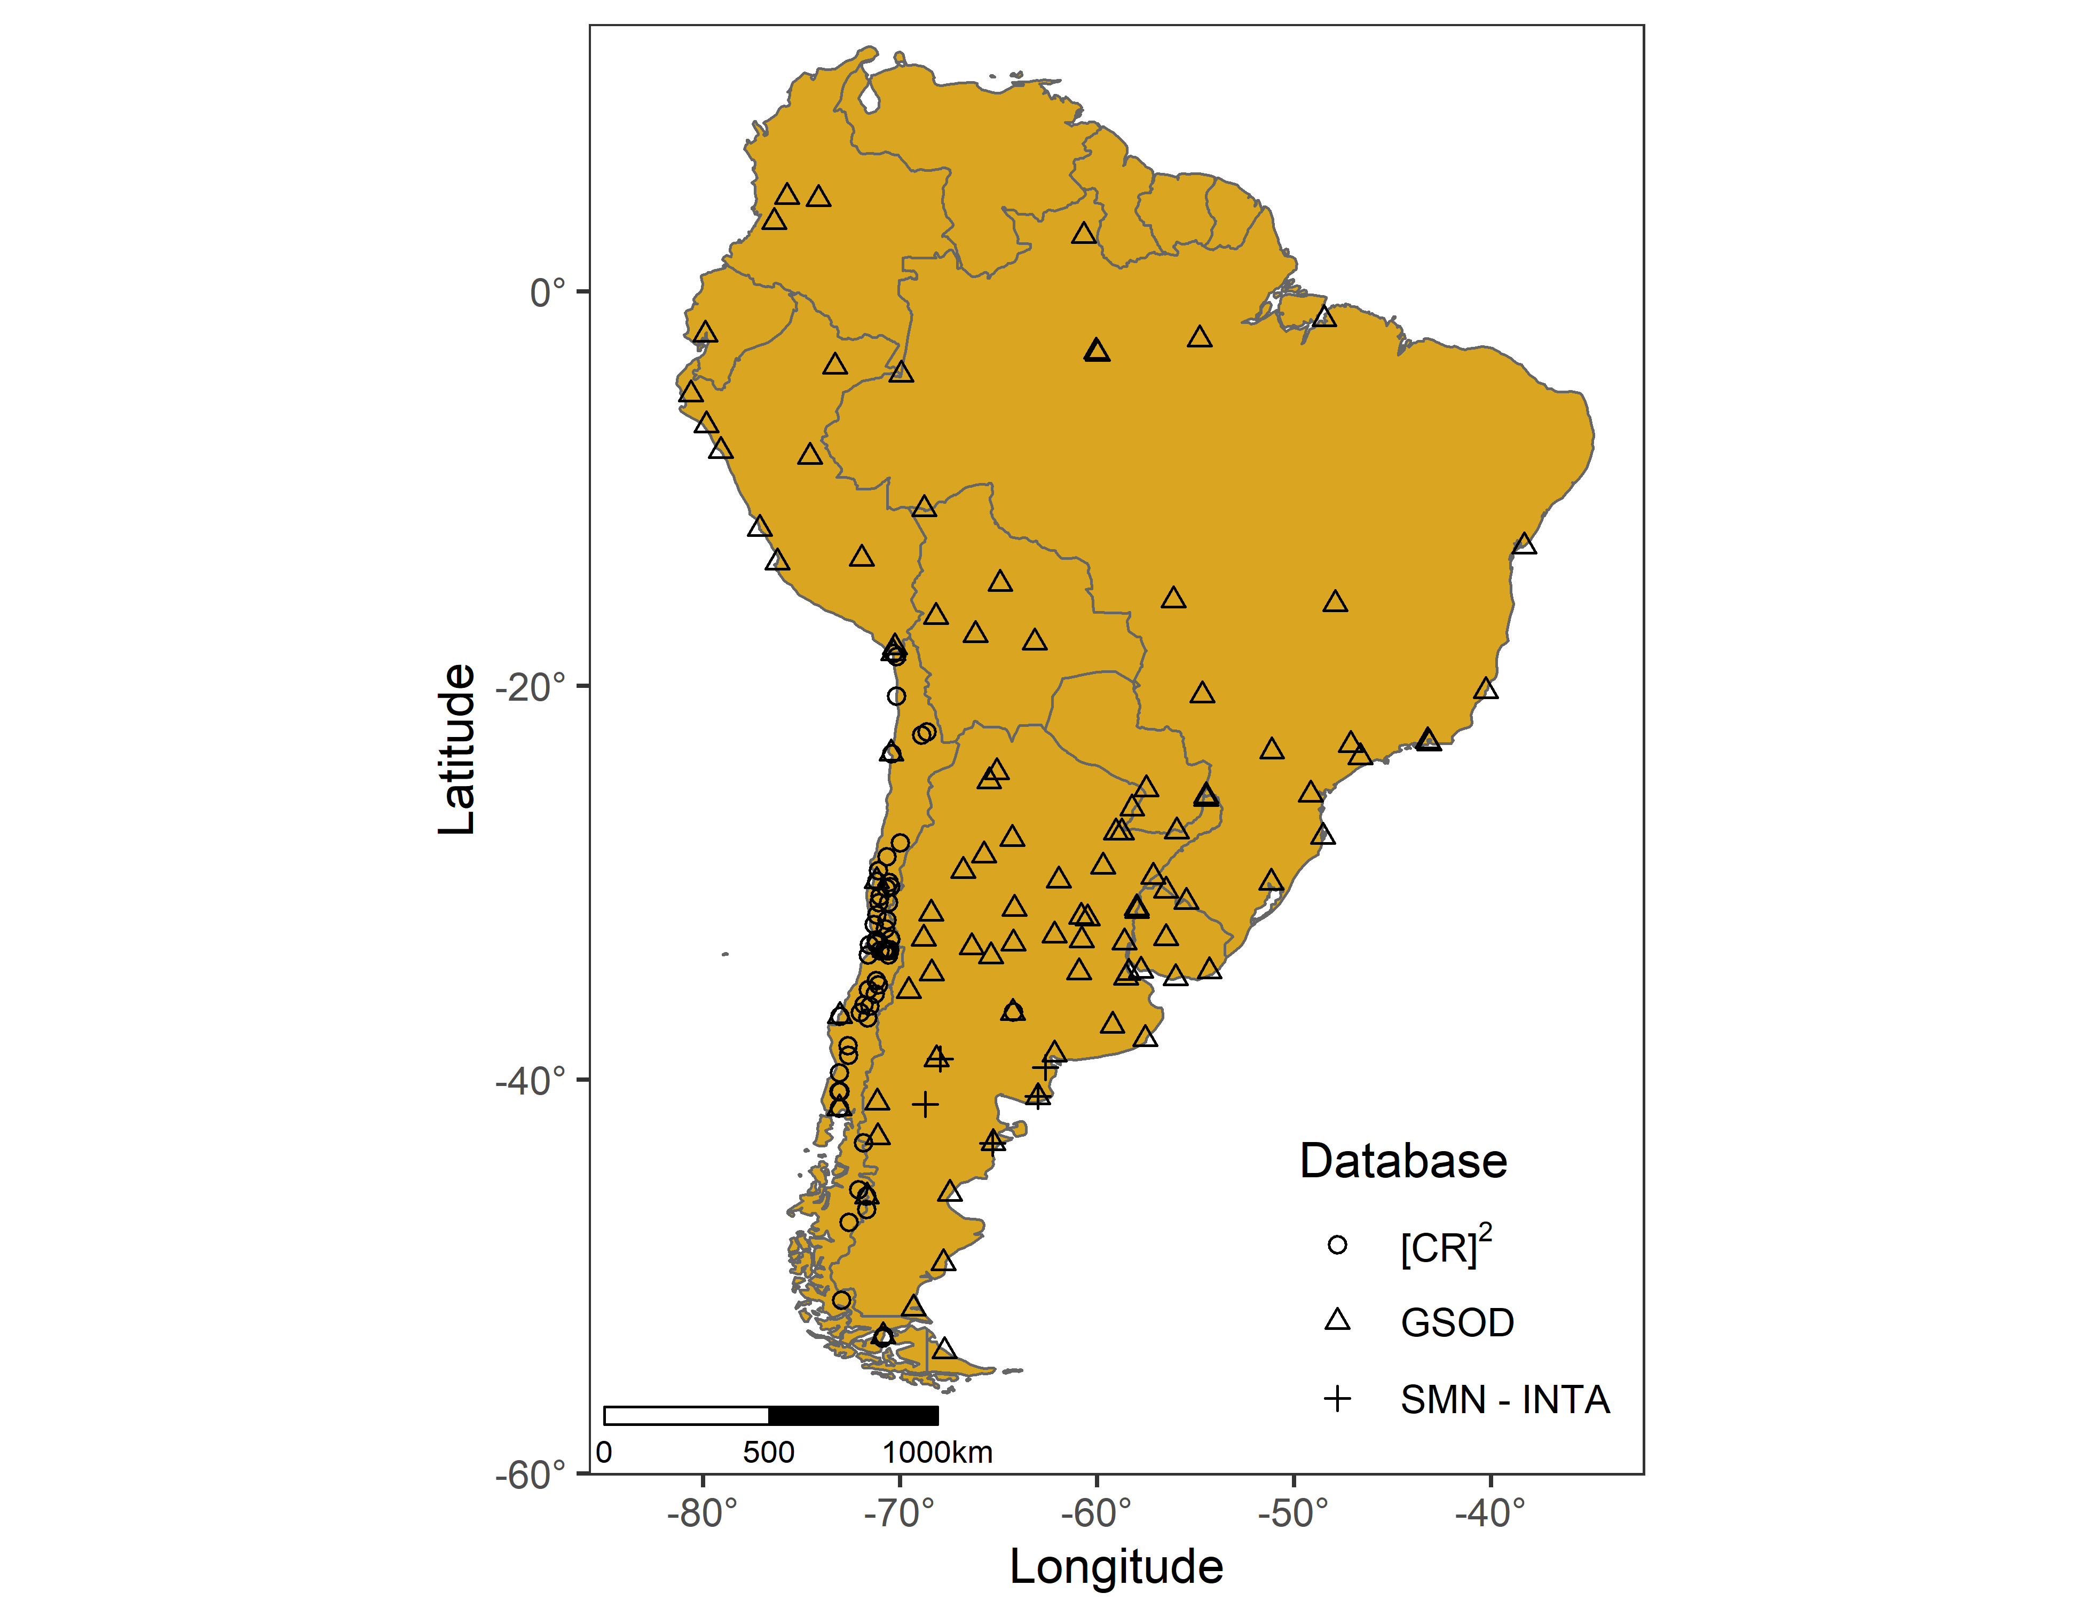
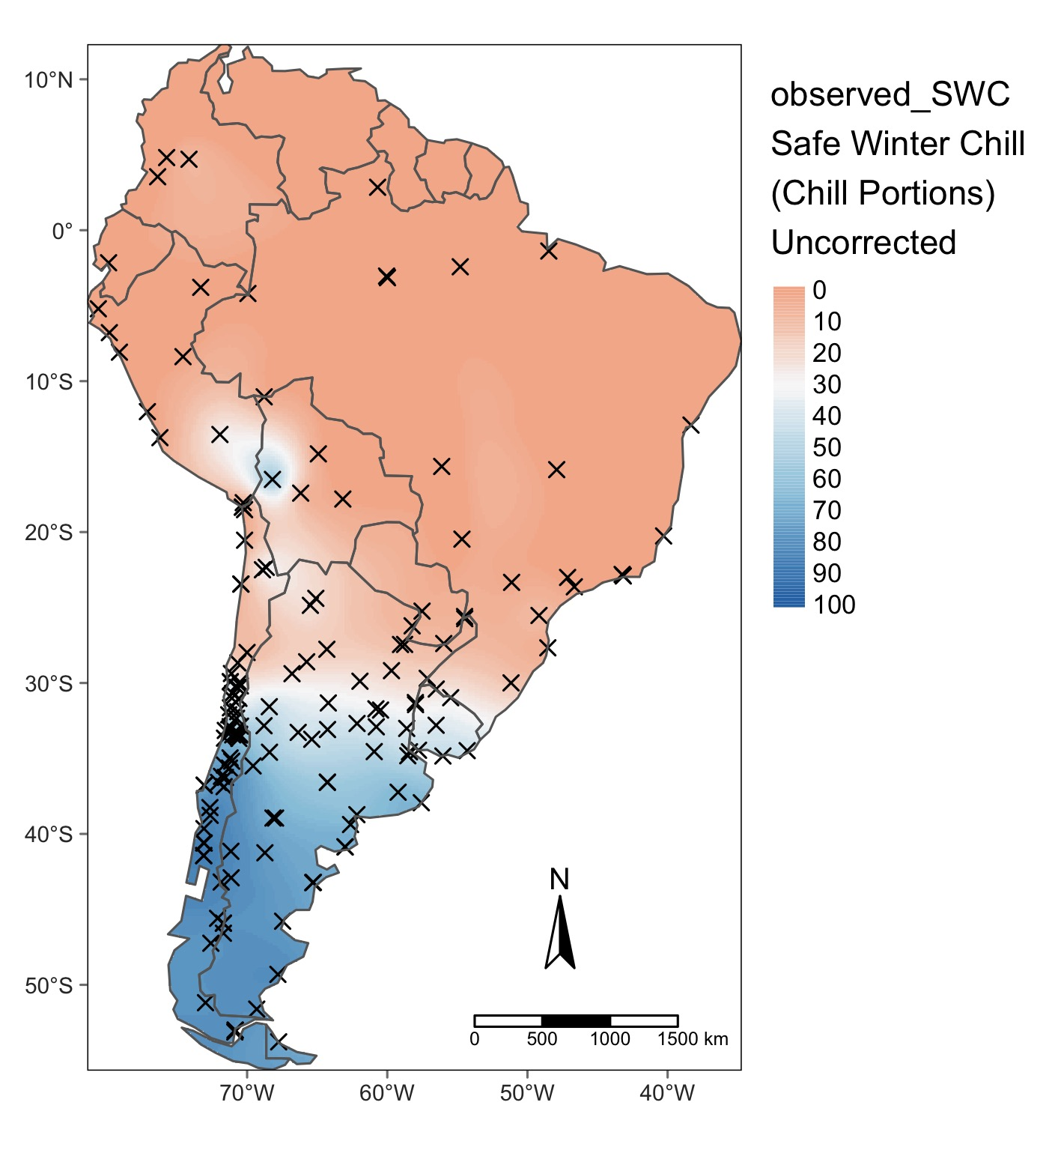
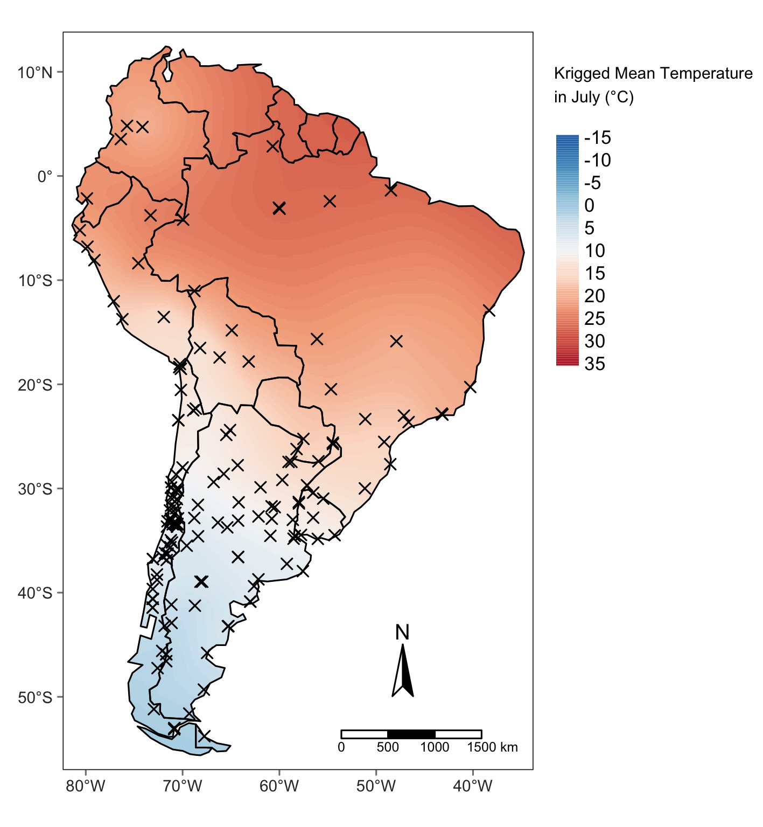
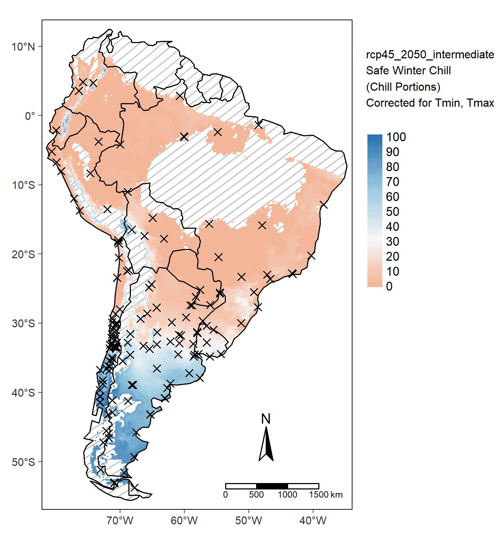
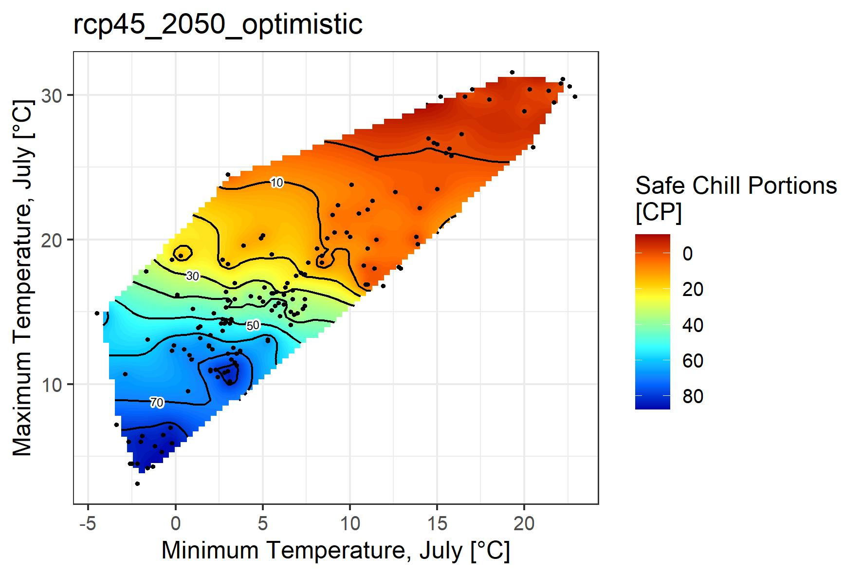
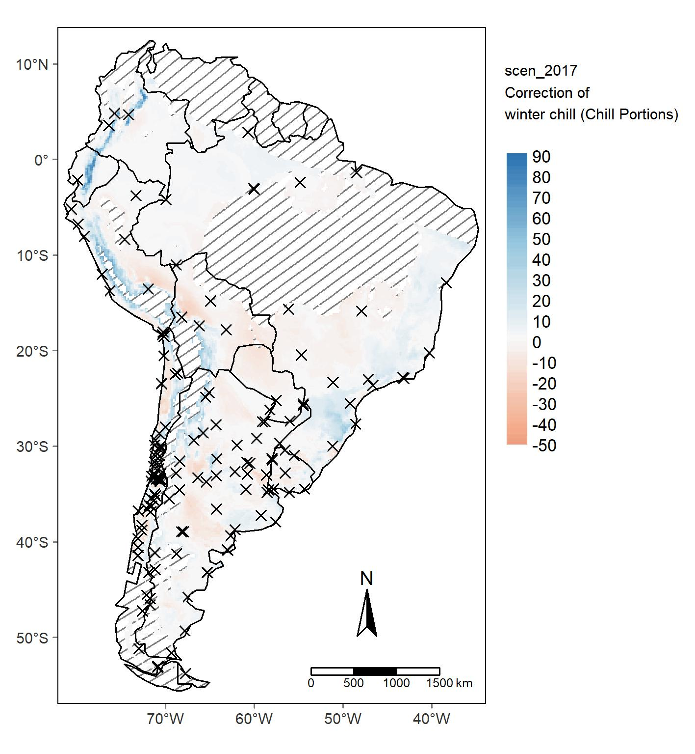
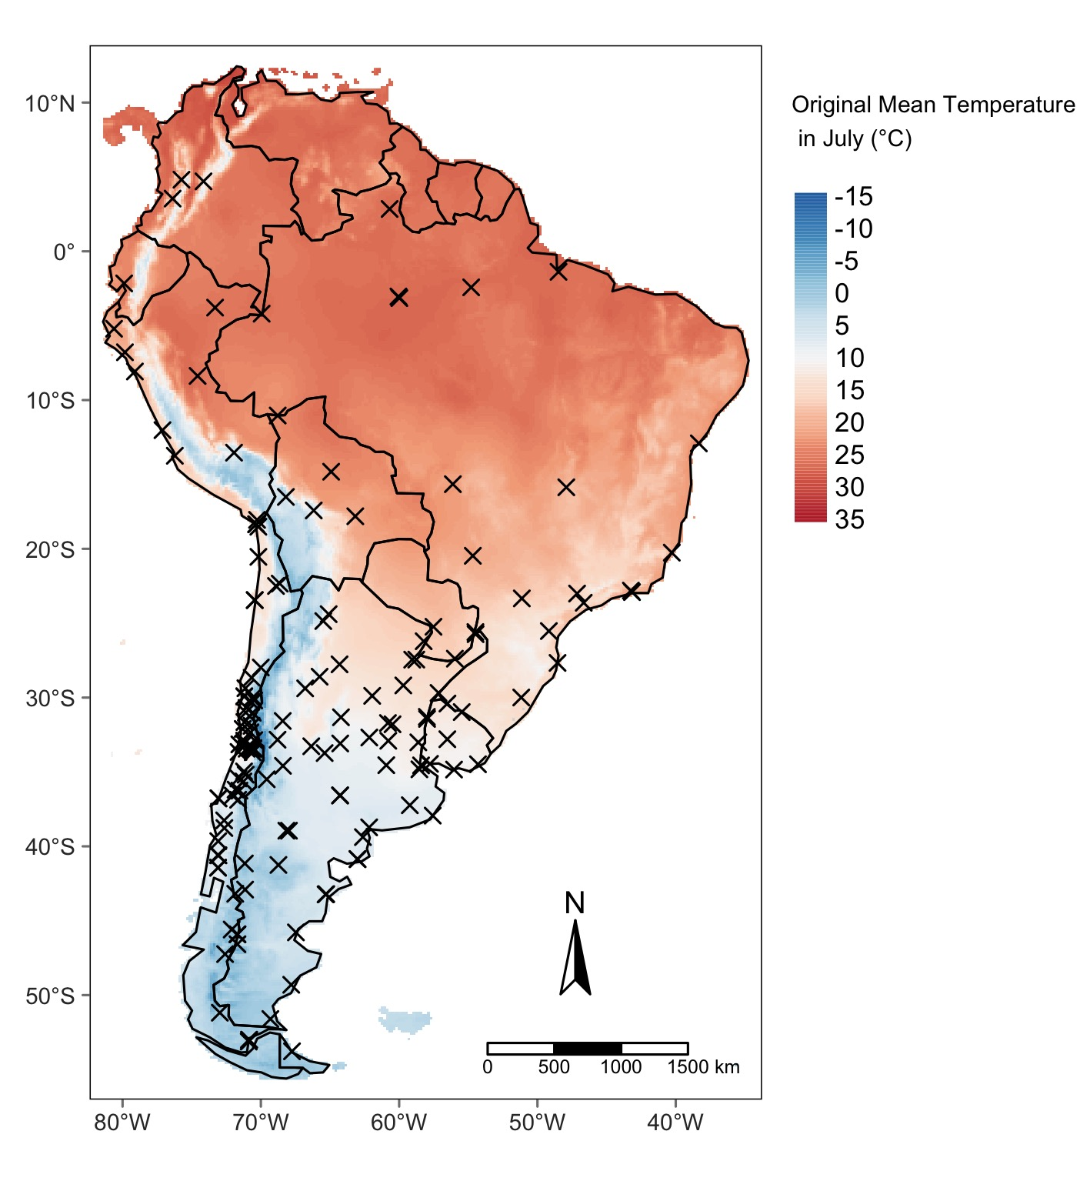

Slide 5
Chill observation → produce kriged map of chill
Map of correction variable → extract information only for the weather stations location → krige correction variable
(Compare kriged and original map of correction variable)
Set up model of chill explained by correction variable
Insert values of kriged and origanl map of correction variable in model. Difference of the model output is the chill which is corection map
Adjust kriged chill by correction map

