Slide 1
Sleep Health and Lifestyle Analysis
Statistics for Data Analysis Nanodegree Program
Data Scientist: Eduardo Nicacio
© 2024 Udacity.

Slide 2
Agenda
Results of sleep health and lifestyle analysis
Data Description
Typical Amount (Minutes) of Physical Activity
Analysis of Daily Steps Taken
Distribution of Heart Rates

Slide 3
Data Description
The dataset contains 374 rows and 13 columns.
Columns: Person ID, Gender, Age, Occupation, Sleep Duration, Quality of Sleep, Physical Activity Level, Stress Level, BMI Category, Blood Pressure, Heart Rate, Daily Steps, Sleep Disorder
Missing values: 219 in total, found in 'Sleep Disorder' (219) (the blank Sleep Disorder entries are read as 'no disorder recorded').
Variable types (one example of each):
1. Continuous variable: 'Sleep Duration'
Example values: 6.1, 6.2, 5.9, 6.3, 7.8, 6.0
Justification: It is a float measured in hours that can take any fractional value in a range (e.g. 7.2), so it is measured rather than counted.
2. Integer variable: 'Daily Steps'
Example values: 4200, 10000, 3000, 3500, 8000, 4000
Justification: It is a whole-number count of steps taken per day, so only discrete integer values are possible.
3. Ordinal categorical variable: 'Quality of Sleep'
Example values: 6, 4, 7, 5, 8, 9
Justification: It is a 1-10 subjective rating whose categories have a meaningful natural order from worst to best sleep quality.
4. Nominal categorical variable: 'Gender'
Example values: Male, Female
Justification: It labels group membership (Male / Female) with no inherent order or ranking between the categories.

Slide 4
Typical Amount (Minutes) of Physical Activity
Variable: Physical Activity Level (minutes/day), n = 374
Mean : 59.17
Median : 60.00
Mode : 60.00 (occurs 70 times)
Interpretation: the distribution is approximately symmetric, because the mean and median are almost identical.

Slide 5
Analysis of Daily Steps Taken
Variable: Daily Steps, n = 374
Standard deviation : 1617.92
Minimum : 3000.00
Maximum : 10000.00
Range : 7000.00
Q1 : 5600.00
Q3 : 8000.00
IQR (Q3 - Q1) : 2400.00
Variance : 2617651.14

Slide 6
Distribution of Heart Rates
Variable: Heart Rate (bpm), n = 374
Mean : 70.17
Median : 70.00
Q1 : 68.00
Q3 : 72.00
IQR : 4.00
IQR lower fence : 62.00
IQR upper fence : 78.00
Skewness : 1.22
Excess kurtosis : 2.24
Outliers exist: 15 value(s) fall outside the IQR fences [62.00, 78.00] -> 80, 81, 82, 83, 84, 85, 86 bpm.
Shape: the distribution is right-skewed (positively skewed, skewness = 1.22): a long tail of high heart rates stretches toward the right, and the shape is not perfectly unimodal - a secondary cluster of elevated rates sits in the mid-70s bpm next to the main peak in the high 60s.
Figure: heart_rate_distribution.png (histogram with 15 bins, KDE overlay, dashed mean and median lines).

Slide 7
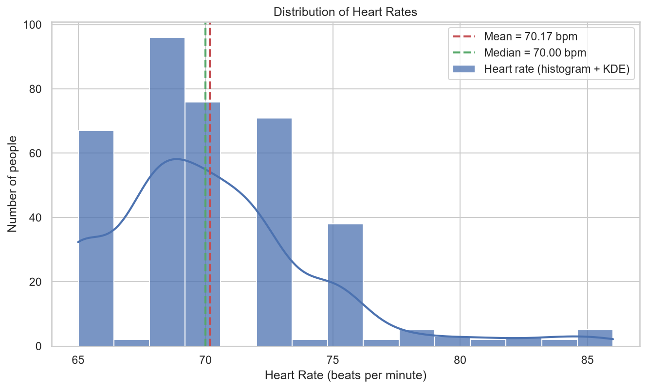
Distribution of Heart Rates (cont.)
Figure: heart_rate_distribution.png (histogram with 15 bins, KDE overlay, dashed mean and median lines).

