Slide 1
Analysis of A/B Test Results
Data Scientist: Eduardo Nicacio
© 2024 Udacity.

Slide 2
Agenda
Findings of A/B test analysis
Experiment Setup
Conversion Rates
Experiment Results

Slide 3
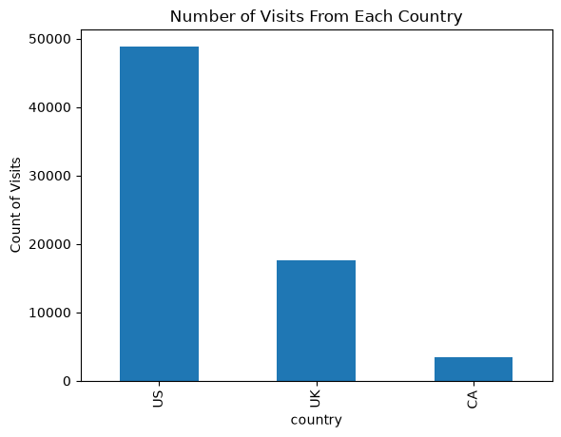
How Was the Experiment Implemented?
Total Variant Visitors: 35,211
Total Control Participants: 34,678

Slide 4
Conversion Rates
 | U.S. | U.K. | CA
Control | 10.7% | 10.2% | 9.4%
Treatment | 15.8% | 14.9% | 15.4%
Executive Summary: The treatment effect is consistent across all three countries - in every market, the treatment page outperforms control by roughly 5-6 percentage points. There is no meaningful interaction between country and group, so the treatment appears universally effective.

Slide 5
Experiment Results
Treatment Conversion Rate: 15.5%
Control Conversion Rate:​ 10.5%
Delta in Treatment vs. Control Conversion Rate:​ +5.0 percentage points (0.0501)
p-value: ​0.0000
Conclusion:
  The p-value of 0.0000 is well below the significance threshold of α = 0.05, so we reject the null hypothesis. There is statistically significant evidence that the treatment and control pages convert at different rates. Because the treatment page converts users at a rate roughly 5 percentage points higher than the control page - and this gap is consistent across all three markets (US, UK, and CA) - the data supports implementing the new page company-wide.

