Slide 1
Analysis of Salary Data
Data Scientist: Eduardo Nicacio
© 2024 Udacity.

Slide 2
Agenda
Findings of linear regression modeling with tech salary data
Data Description
Salary Distribution
Features Correlated to Salary
Regression Results
Interpretation and Next Steps

Slide 3
Data Description
The dataset contains 373 employees across 6 variables: Age, Gender, Education Level, Job Title, Years of Experience, and Salary.
The original dataset had 375 rows. A missing-value check revealed 12 missing values (2 per column across all 6 columns). All rows containing at least one missing value were removed using listwise deletion, leaving 373 complete records for analysis.
Education breakdown:
Bachelor’s: 224 employees
Master’s: 98 employees
PhD: 51 employees

Slide 4
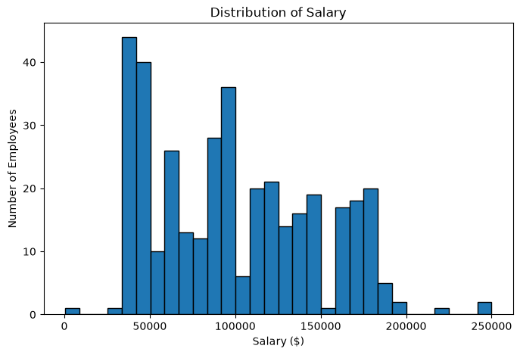
Salary Distribution
Statistic | Value
Minimum | $350
25th Percentile | $55,000
Median | $95,000
Mean | $100,577
75th Percentile | $140,000
Maximum | $250,000
Std. Deviation | $48,240
The distribution is right-skewed: most employees earn between $55,000 and $140,000, but a long upper tail pulls the mean above the median.

Slide 5
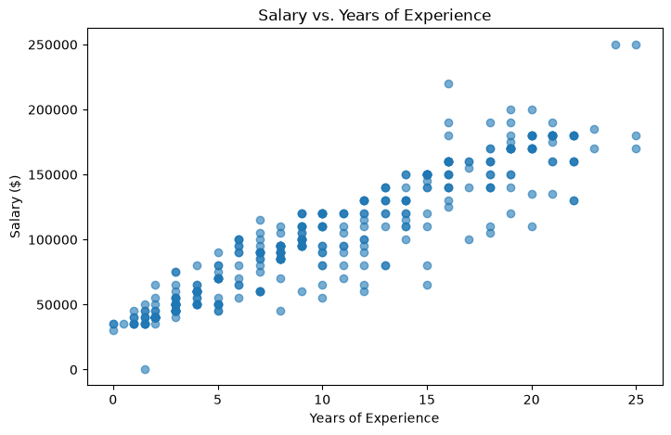
Features Correlated to Salary
Years of Experience shows the strongest linear
relationship with salary (Pearson r = 0.93).
Education Level shows a clear salary gradient:
PhD average: $157,843
Master’s average: $129,796
Bachelor’s average: $74,756
Gender: Male employees averaged $103,868
vs. Female at $97,011 - a gap of ~$6,857.
Job title keywords (Director, Senior, Manager)
are also associated with above-average salaries,
as confirmed by the regression results on the
following slides.

Slide 6
Regression Results - Full Model
A linear regression model was fit using 10 predictors: is_male, is_director, is_junior, is_senior, is_manager, is_analyst, is_engineer, Years of Experience, is_masters, is_phd.
R² = 0.915 | Adjusted R² = 0.913
Three variables were not statistically significant at the 5% level and were removed:
is_junior - p = 0.068
is_analyst - p = 0.933
is_engineer - p = 0.508

Slide 7
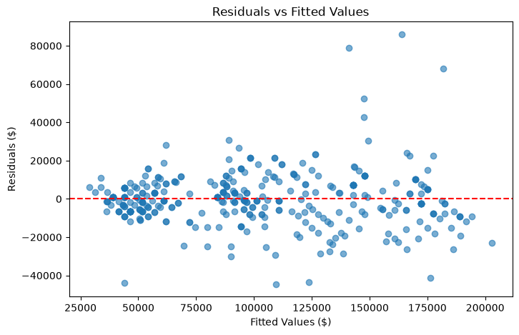
Regression Results - Reduced Model
After removing the three insignificant predictors, the final model contains 7 predictors. All are statistically significant (p < 0.05).
Variable | Coefficient | p-value | 95% Confidence Interval
Intercept | $28,760 | < 0.001 | [$25,460 , $32,060]
is_male | $7,630 | < 0.001 | [$4,716 , $10,544]
is_director | $24,980 | < 0.001 | [$18,100 , $31,860]
is_senior | $14,450 | < 0.001 | [$10,870 , $18,020]
is_manager | $4,285 | 0.019 | [$701 , $7,869]
Years of Experience | $5,104 | < 0.001 | [$4,756 , $5,453]
is_masters | $14,040 | < 0.001 | [$10,045 , $18,035]
is_phd | $23,081 | < 0.001 | [$17,652 , $28,510]
Model Fit: R² = 0.914 | Adjusted R² = 0.913
The model explains approximately 91.4% of the variation in salary, indicating a strong overall fit.

Slide 8
Interpretation - Years of Experience
Expected change in salary:
Each additional year of experience is associated with an expected salary increase of $5,104, holding gender, job title, and education level constant.
Confidence in this estimate:
We can be 95% confident that the true per-year salary increase is between $4,756 and $5,453.
Because this interval lies entirely above zero and the p-value is < 0.001, the relationship is highly statistically significant. In practical terms, a 5-year difference in experience translates to an expected salary difference of roughly $25,500.

Slide 9
Interpretation - Education Level (PhD)
Expected change in salary:
Holding all other variables constant, an employee with a PhD is expected to earn $23,081 more than an employee whose highest degree is a Bachelor’s (the baseline group).
Confidence in this estimate:
We can be 95% confident that the true PhD salary premium over a Bachelor’s degree falls between $17,652 and $28,510.
The result is statistically significant (p < 0.001). In practical terms, a PhD premium represents approximately 23% of the dataset’s average salary of $100,577 - a substantial economic return to doctoral education in this sample.

