Slide 1
PL Final Project - Option A
Azaam Jamil, Eduardo Rios, Fred Yang

Slide 2
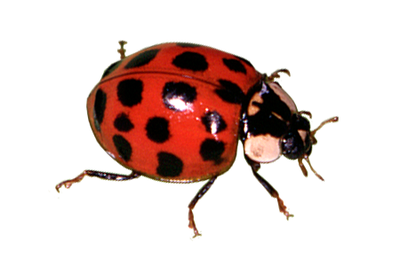
Overview
OO Python Closures through the “exec” function in Mini-Lisp
Java Stream Operations through “exec”
Mini-Lisp function utilizes Python List Comprehension
All the bugs we fixed
Swift
Closure (literally)

Slide 3
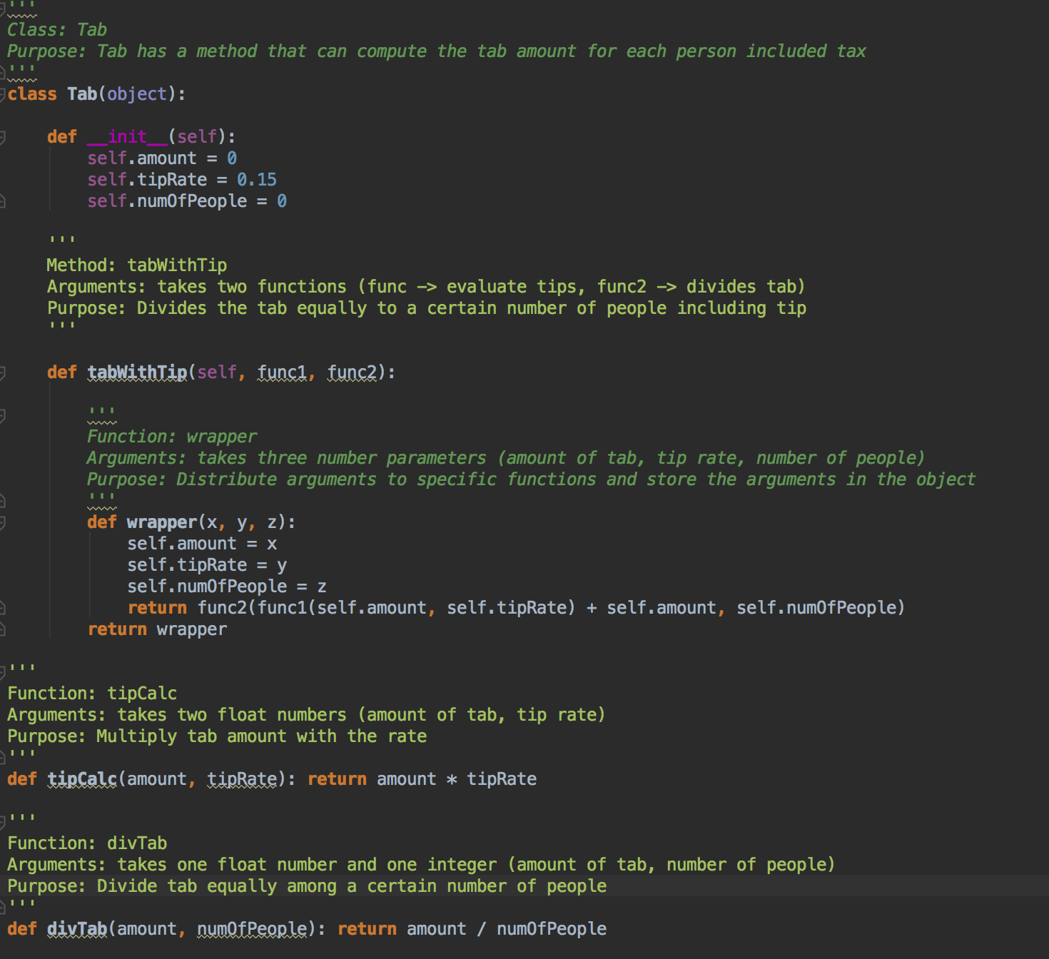
Python Closure - Tab.py
Tab.py exhibits python closures through its tabWithTip() that takes two functions as arguments.
tabWithTip() returns the full tab for an individual person by using the tipCalc() and divTab() functions.
tipCalc() - calculates the tip based on specified tipRate
divTab() - splits the tab between a number of people
Notes:
Access variables that are local to enclosing scopes
Return outside of the enclosed scopes

Slide 4
Python Closure
100 = full tab without tip
0.15 = tip rate
6 = people paying tab

Slide 5
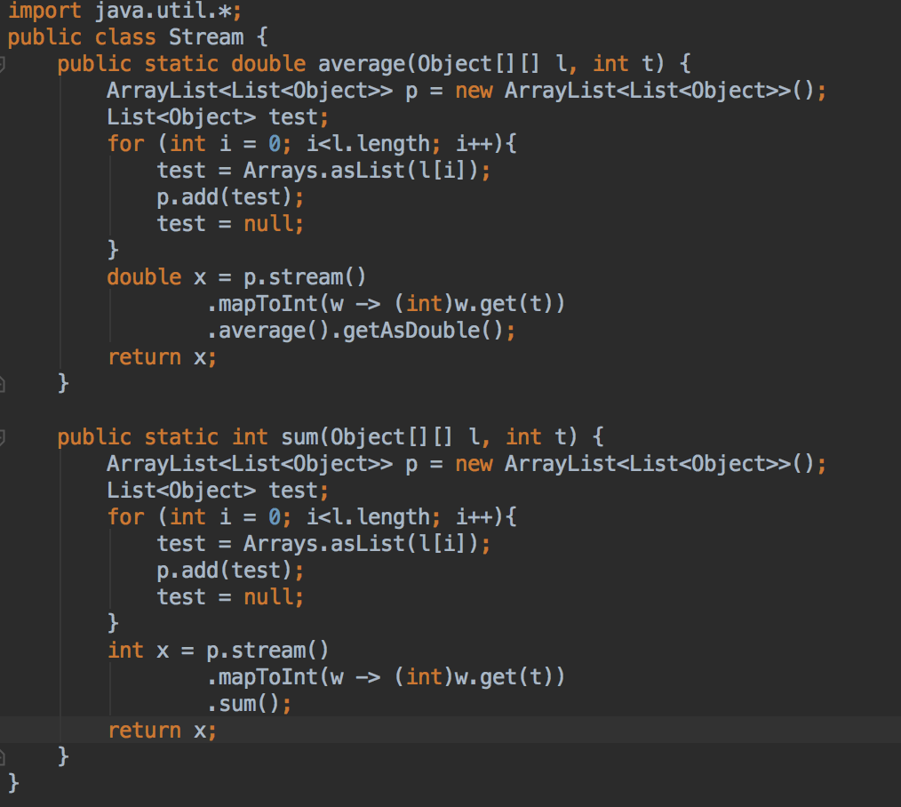
Java Stream Operations - Stream.java
arguments: 2D list, int
stream operations have functionality with arraylists
.mapToInt() and .average()
.mapToInt() and .sum()
Notes:
Takes in an array and converts it to a list and stores it in “test” to add to the arraylist list of lists

Slide 6
Java Stream Operations

Slide 7
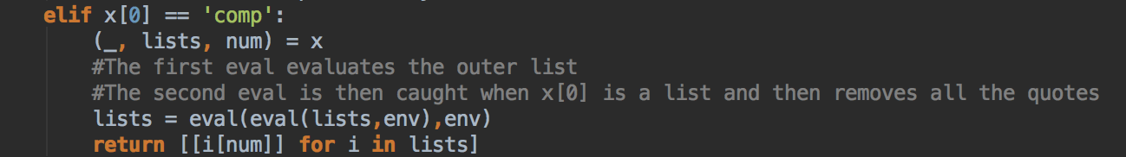
Python List Comprehension – lis.py

Slide 8
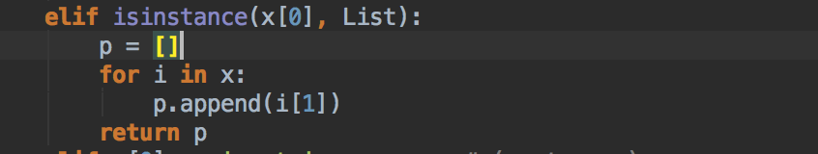
Python List Comprehension

Slide 9
Python List Comprehension

Slide 10
Bugs
Enhancements
Fixed the division sign
Fixed the greater than, less than, and greater than or equal to
Fixed cons
Recognize Negatives
Fixed abs
Added floats and fixed rounding function
Fixed syntax for strings and lists with single quotes
Added sort
Added 2D lists

Slide 11
Beauty

Slide 12
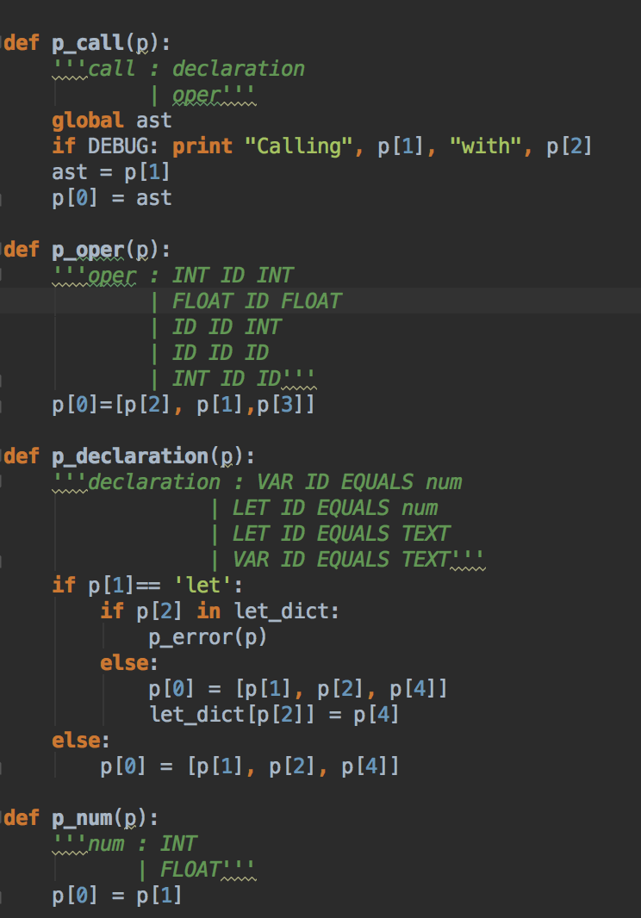
Swift - yacc.py
4 major grammar rules of yacc.py:
Call
Oper
Declaration
Num

Slide 13
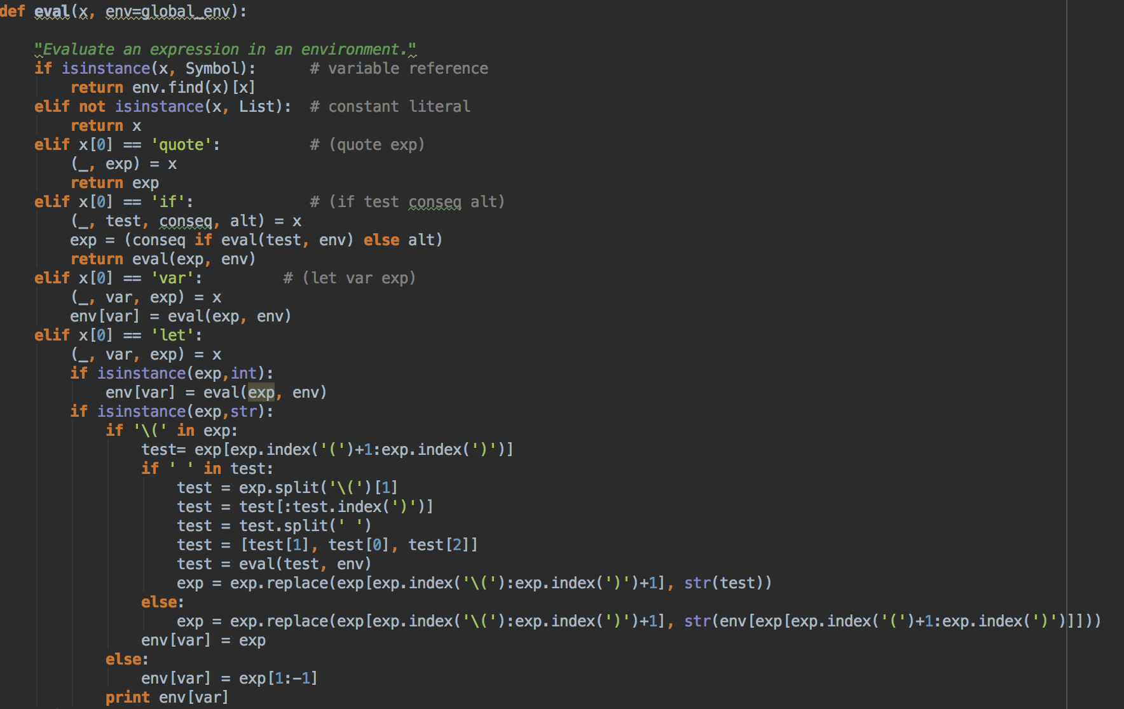
Swift - Lis.py

Slide 14
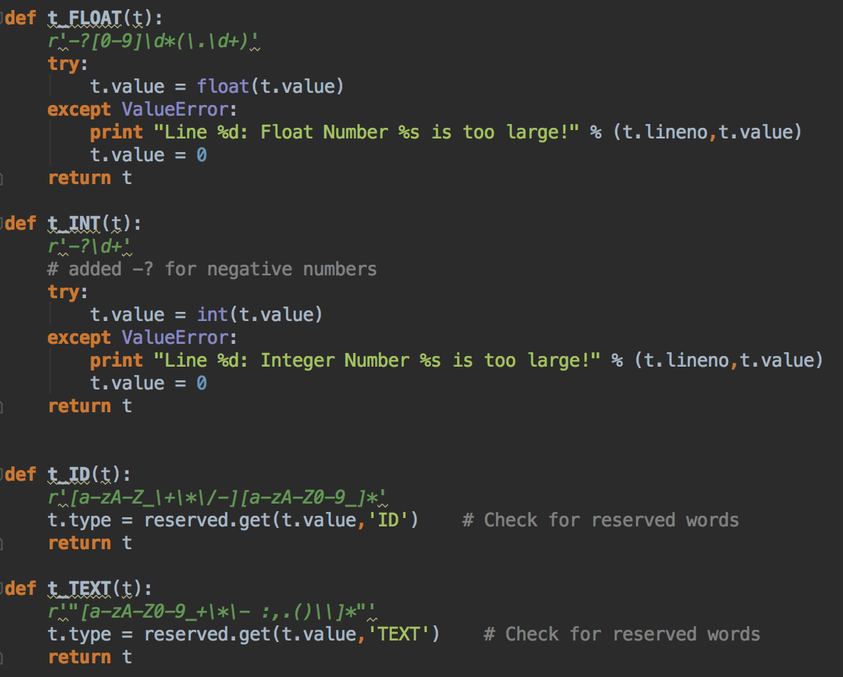
Swift - lex.py
Defines a few of the tokens we user:
Float
Int
ID
Text

Slide 15
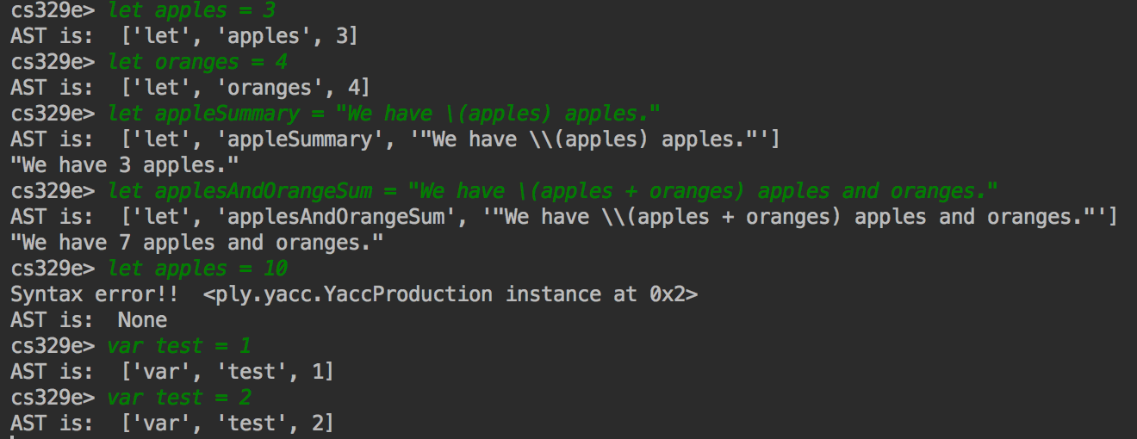
Swift - Run

Slide 16
Takeaways (from an “elements” perspective)
Why learn this?
The biggest lesson someone can teach you is to “learn how to learn”
Impress Recruiters
“Hey Apple! I created my own subset of Swift! Check it out on my Github ;)”
We have the tools to go even further
We can create our own language!
Thanks Professor Cannata!!!

