Slide 1

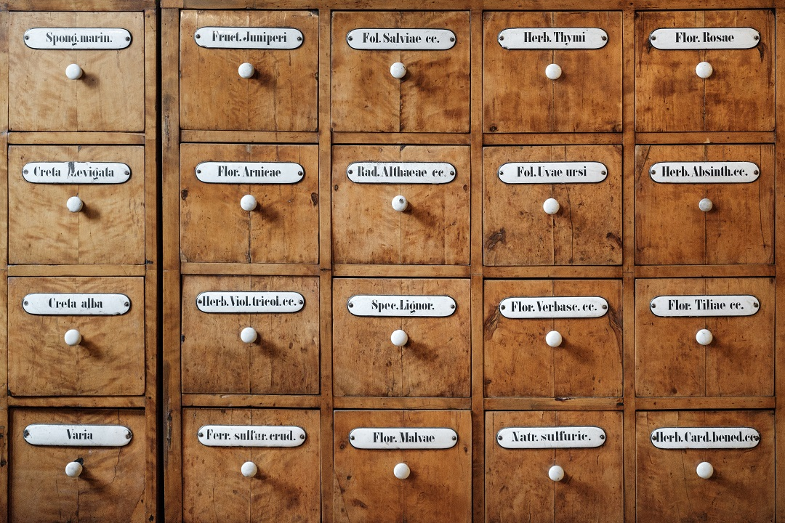

Projeto
ProntuBox

Slide 2


Hello!
Desenvolvedores:
Eduardo Henrique Rotundaro
Pedro Carvalho Alves

Slide 3
Quotations are commonly printed as a means of inspiration and to invoke philosophical thoughts from the reader.

Slide 4



O projeto
A complex idea can be conveyed with just a single still image, namely making it possible to absorb large amounts of data quickly.

Slide 5
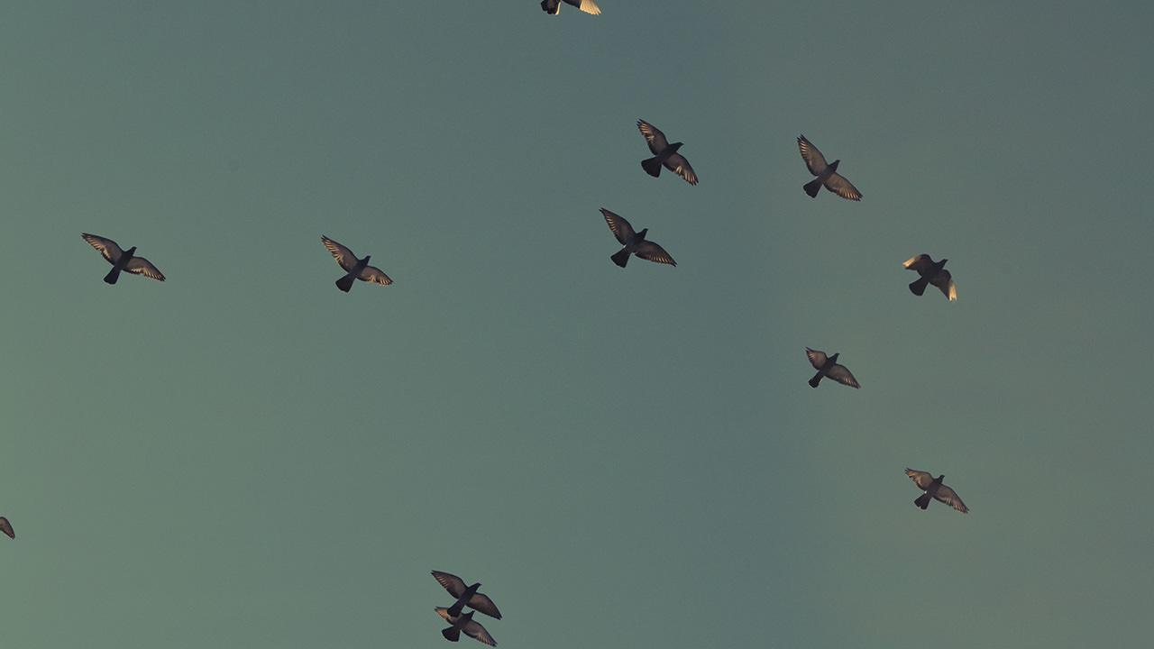
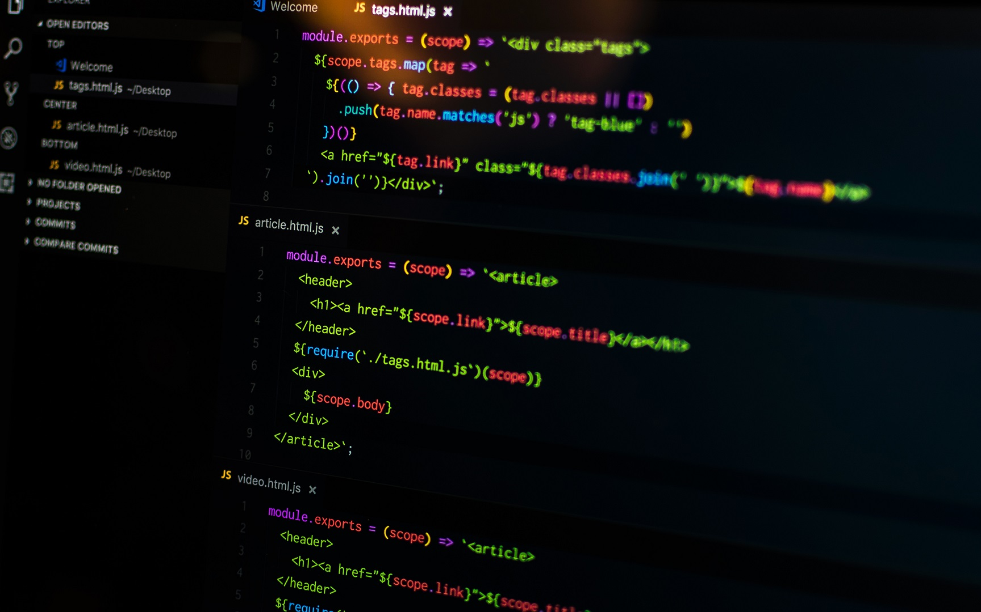
1.
Tecnologias
Arquitetura do projeto

Slide 6




Tecnologias utilizadas
BANCO DE DADOS
FRONT-END
BACK-END

Slide 7

1.
TRANSITION HEADLINE
Let’s start with the first set of slides

Slide 8
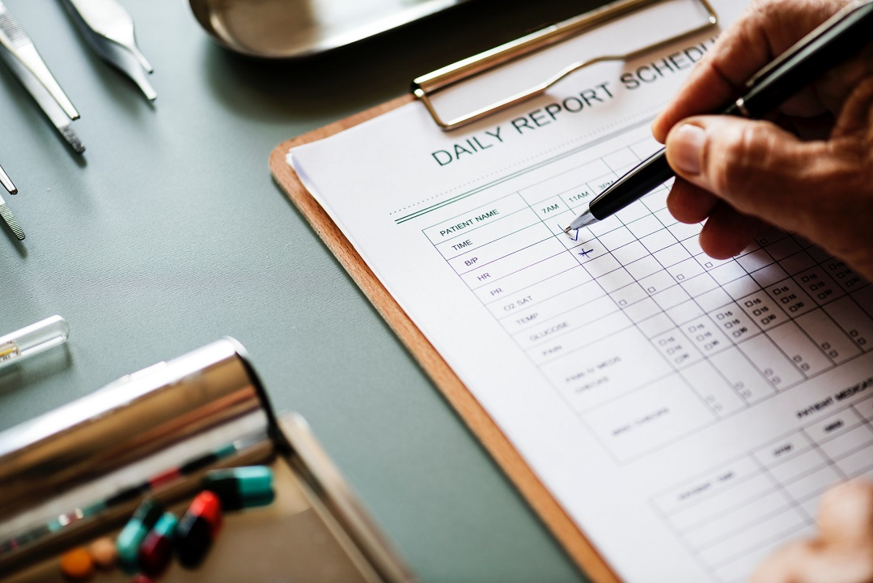
1.
TRANSITION HEADLINE
Let’s start with the first set of slides

Slide 9
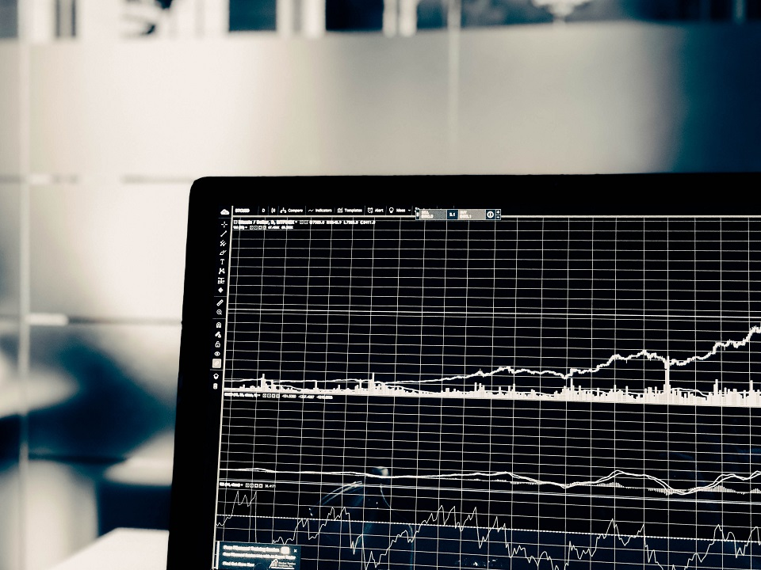
1.
TRANSITION HEADLINE
Let’s start with the first set of slides

Slide 10

1.
TRANSITION HEADLINE
Let’s start with the first set of slides

Slide 11
This template is for a SlideDoc
A slidedoc is a visual document, developed in presentation software, that is intended to be read and referenced instead of projected.
Slidedocs help you spread your smart thinking by combining visual communications with short chunks of written copy. Their scannable nature makes them great pre-read, reference, and leave-behind materials. Their modularity makes it easy for people to incorporate your ideas into their own communications. And these features together make slidedocs the perfect companion to both written documents and presentations.
Text from duarte.com/slidedocs

Slide 12
Table of contents
Section one
Section two
Even another section
And there can be subsections too.
Subsection
Section four
This is a template optimized for SlideDocs. As it is a long document you should inform the reader about its contents.

Slide 13
This is a slide title
SlideDocs are for distribution; they’re not optimized for presenting. Slides have too much text and font size is too small for an audience to read it projected in a screen.
These documents are useful for:
Distribute before a meeting when the topic is highly complex or technical
To fully explain your idea before booking a meeting with someone
As a reference and follow-up material
Distribute
Explain
Follow-up

Slide 14
BIG CONCEPT
Bring the attention of your audience over a key concept using icons or illustrations

Slide 15
You can also split your content
Try to communicate ideas visually using graphs, icons, illustrations, photos… any resource that helps you convey your message at a glance.
White
Is the color of milk and fresh snow, the color produced by the combination of all the colors of the visible spectrum.
Black
Is the color of coal, ebony, and of outer space. It is the darkest color, the result of the absence of or complete absorption of light.

Slide 16
In two or three columns
Yellow
Is the color of gold, butter and ripe lemons. In the spectrum of visible light, yellow is found between green and orange.
According to surveys in Europe, Canada, and the United States, yellow is the color people most often associate with amusement, gentleness, and spontaneity, but also with duplicity, envy, jealousy, avarice, and, in the U.S., with cowardice.
It plays an important role in Asian culture, particularly in China, where it is seen as the color of happiness, glory, wisdom, harmony, and culture.
Blue
Is the colour of the clear sky and the deep sea. It is located between violet and green on the optical spectrum.
Surveys in the US and Europe show that blue is the colour most commonly associated with harmony, faithfulness, confidence, distance, infinity, the imagination, cold, and sometimes with sadness.
In US and European public opinion polls it is the most popular colour, chosen by almost half of both men and women as their favourite colour.
Red
Is the color of blood, and because of this it has historically been associated with sacrifice, danger and courage.
Modern surveys in the United States and Europe show red is also the color most commonly associated with heat, activity, passion, sexuality, anger, love and joy. Red is also a color widely used for getting attention, such as stop signs or royal dresses.
In China, India and many other Asian countries it is the color of symbolizing happiness and good fortune.

Slide 17
A picture is worth a thousand words
A complex idea can be conveyed with just a single still image, namely making it possible to absorb large amounts of data quickly.

Slide 18
Use charts to explain your ideas
Item 1
Item 2
THE
CONCEPT
Item 3
Item 4

Slide 19
And tables to compare data
As a communication tool, a table allows a form of generalization of information from an unlimited number of different social or scientific contexts. It provides a familiar way to convey information that might otherwise not be obvious or readily understood.
 | A | B | C
Yellow | 10 | 20 | 7
Blue | 30 | 15 | 10
Orange | 5 | 24 | 16

Slide 20
Maps
our office
The word "map" comes from the medieval Latin Mappa mundi, wherein mappa meant napkin or cloth and mundi the world.

Slide 21
89,526,124
Whoa! That’s a big number, aren’t you proud?

Slide 22
And even more numbers
89,526,124$
That’s a lot of money
185,244 users
And a lot of users
100%
Total success!

Slide 23
Our process is easy
last
second
first

Slide 24
Let’s review some concepts
Yellow
Is the color of gold, butter and ripe lemons. In the spectrum of visible light, yellow is found between green and orange.
Blue
Is the colour of the clear sky and the deep sea. It is located between violet and green on the optical spectrum.
Red
Is the color of blood, and because of this it has historically been associated with sacrifice, danger and courage.
Yellow
Is the color of gold, butter and ripe lemons. In the spectrum of visible light, yellow is found between green and orange.
Blue
Is the colour of the clear sky and the deep sea. It is located between violet and green on the optical spectrum.
Red
Is the color of blood, and because of this it has historically been associated with sacrifice, danger and courage.

Slide 25
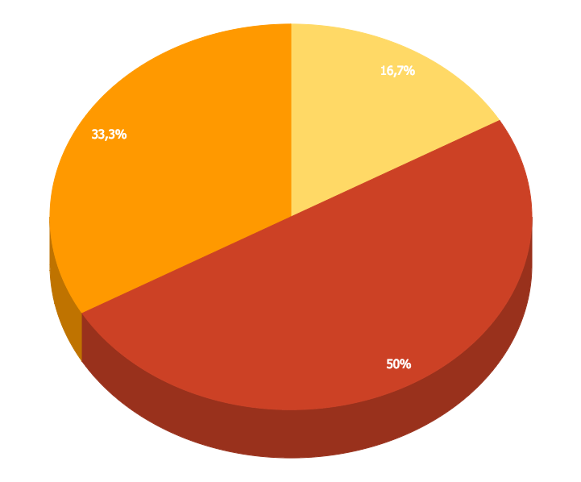
You can insert graphs from Google Sheets

Slide 26
Android Project
Place your screenshot here
Show and explain your web, app or software projects using these gadget templates.

Slide 27
iPhone Project
Place your screenshot here
Show and explain your web, app or software projects using these gadget templates.

Slide 28
Tablet
Project
Place your screenshot here
Show and explain your web, app or software projects using these gadget templates.

Slide 29
Desktop Project
Place your screenshot here
Show and explain your web, app or software projects using these gadget templates.

Slide 30

1.
Funcionamento
Mostrar o site funcionando

Slide 31
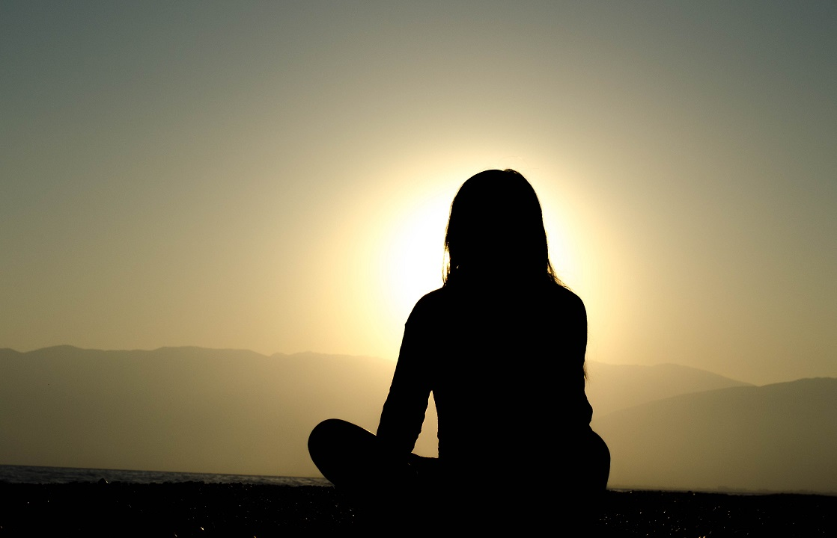
1.
TRANSITION HEADLINE
Let’s start with the first set of slides

Slide 32

Obrigado
If you have any questions, contact us

Slide 33
Referencias
Recursos visuais:
unsplash.com
slidescarnival.com/pt-br/
icons8.com.br
Desenvolvimento:
KURNIAWAN, Agus. Node.js Succinctly. Syncfusion: 2014.
DIETZ, Frederik. AngularJS Succinctly. Syncfusion: 2013.
bitbucket.org
expressjs.com/pt-br/
teknosains.com/i/simple-crud-nodejs-mysql
expressjs.com/pt-br/api.html#express
luiztools.com.br/post/como-usar-nodejs-mysql/
^

Slide 34
Referencias
terlici.com/2015/08/13/mysql-node-express.html
github.com/adautomendes/crud-node-angular
github.com/adautomendes/crud-node-ajax
^

