Slide 1
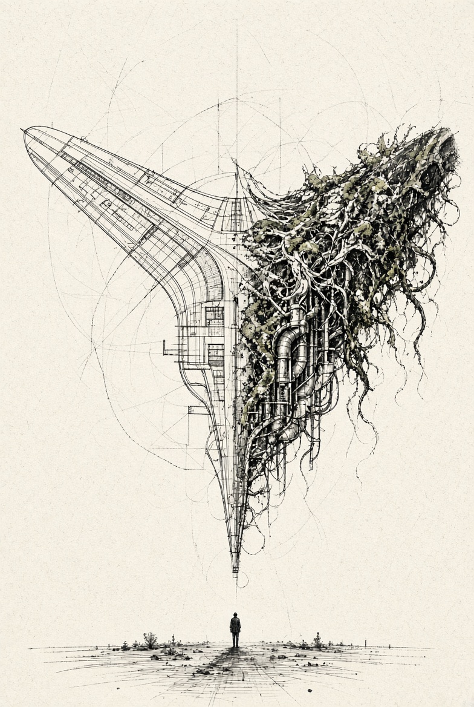
AUTOMA CHEM 2026 · BERLIN · 26 OCTOBER · OPENING PANEL
From Brasília
to the Plant Floor
People, Data and AI in Sustainable Digital Transformation
Eduardo Sopalda · Global Data Governance Lead · dsm-firmenich

Slide 2
01 · THE ARCHITECT
I am an architect.
Not as a metaphor.
I studied architecture. I drew buildings. Then I spent twenty years designing something else: the ethereal structures around data.

Slide 3
THE SAME PROBLEM
We design for the drawing, not for the person who has to live with it.
I am not here to sell you a framework this morning.

Slide 4
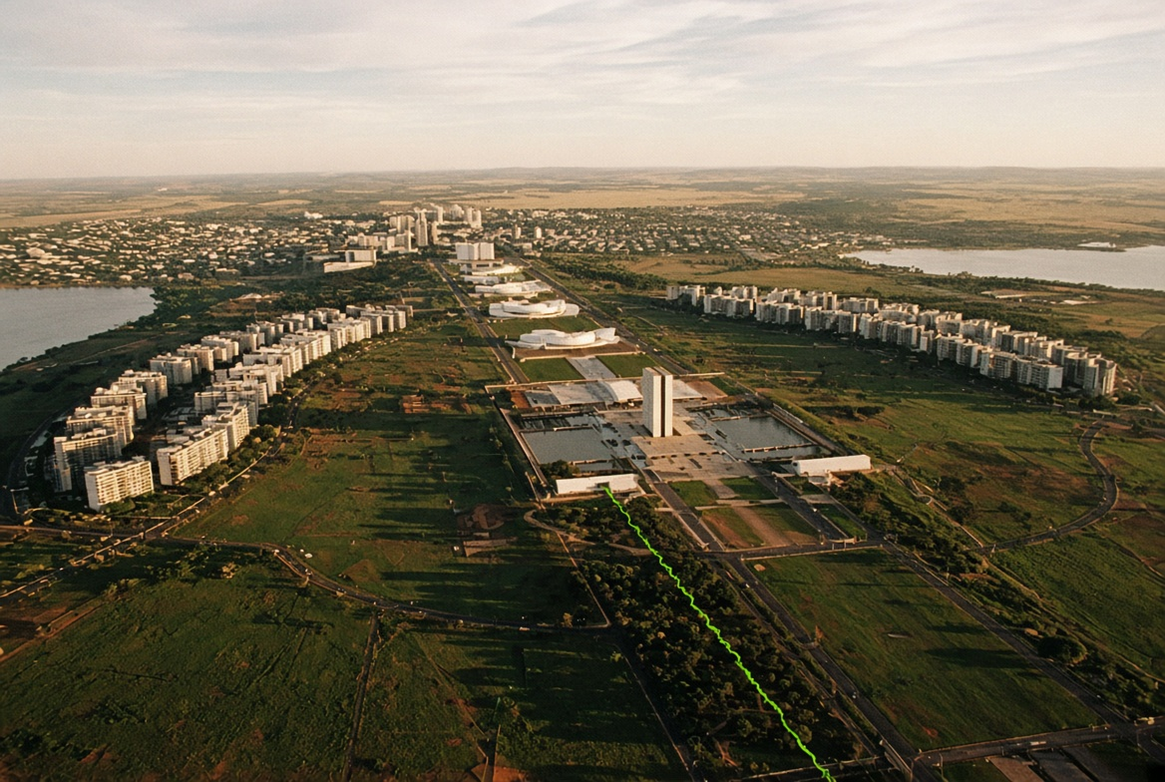
02 · BRASÍLIA · JAN GEHL
Beautiful from above.
A city can make perfect sense from a helicopter and feel completely different when you walk through it.

Slide 5
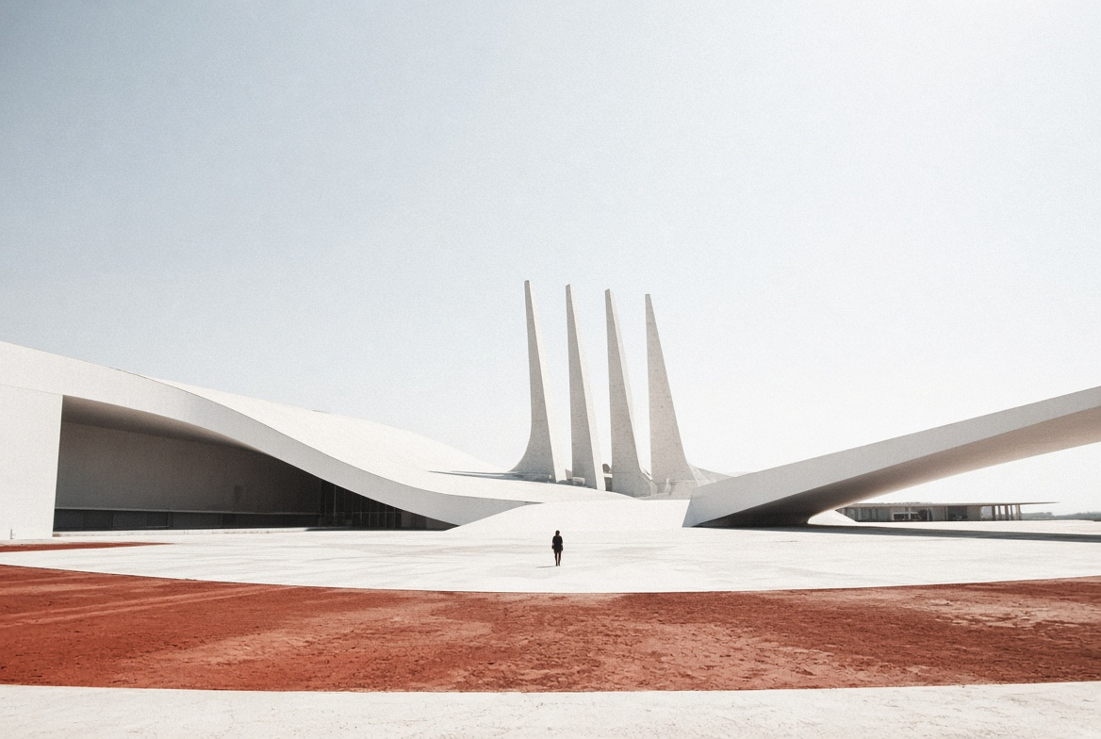
AT STREET LEVEL
The city was finished.
It just was not designed around the people who had to live and work in it.

Slide 6
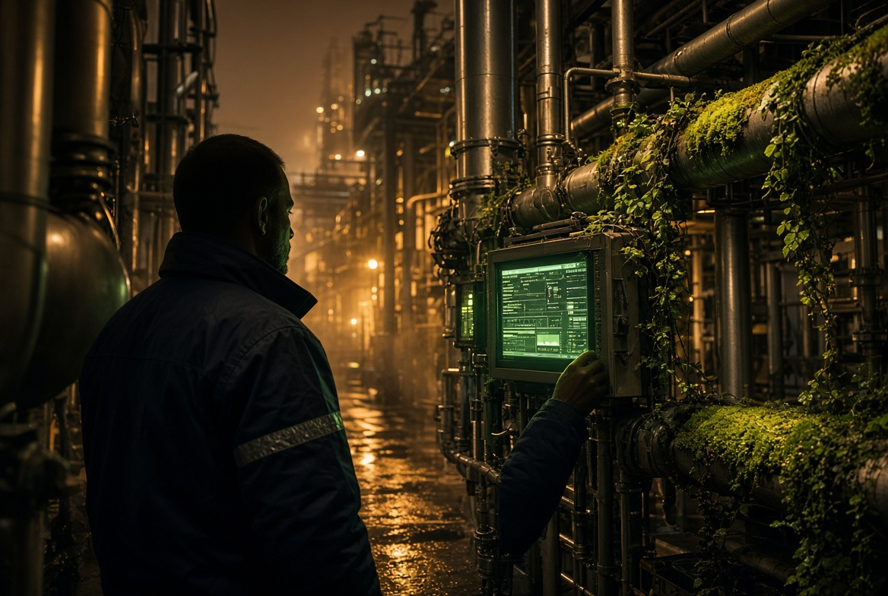
03 · WHEN THE DRAWING MEETS THE GROUND
Seen from above,
everything looks complete.
Then the framework reaches the plant.

Slide 7
I HAVE BEEN THE PERSON WITH THE BEAUTIFUL DRAWING
I had built them a plaza nobody wanted to stand in.
So I stopped asking whether the framework was complete. I became interested in whether people actually used it.

Slide 8
04 · SUSTAINABILITY HAS THE SAME PROBLEM
AMBITION
EVIDENCE
Targets
Roadmaps
Commitments
Definitions
Ownership
Lineage
Eventually the ambition has to become evidence.

Slide 9

05 · THE CARBON NUMBER
CO₂e
A carbon number looks like chemistry. It is a data product.
You cannot report what you cannot trace.

Slide 10
06 · THEN SOMEONE SAYS
Why don’t we just use AI?
batch lot campaign shift tank order recipe day
Five people. One word. Eight different things.
Putting an agent on top of ambiguity does not remove the problem. It scales it up.

Slide 11

ONE AGENT PROJECT I SAW
10 000
2 000
documents in
actually relevant
All of it embedded. All of it consuming tokens and energy.

Slide 12
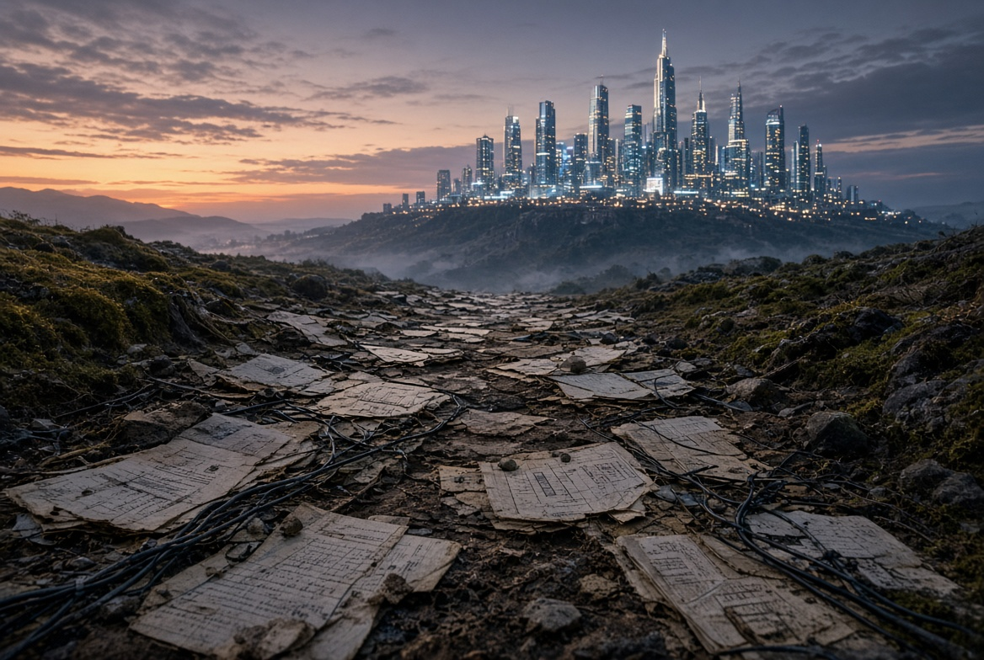
07 · THE ROAD TO THE SHINY CITY
We do not get there
by teleportation.
DEFINITIONS · OWNERSHIP · LINEAGE · QUALITY · CONTEXT

Slide 13
08 · BACK AT GROUND LEVEL
A digital twin is still a plan.
It only becomes sustainable, in both senses, when the operator on the night shift trusts what it tells them.

Slide 14
THE PRINCIPLE
Agents do not own risk.
Humans do.
Always.

Slide 15
09 · BACK TO BRASÍLIA
Still beautiful from the air.
The drawing was superb. The problem was the distance.

Slide 16
10 · ASK IT AT LUNCH
What is one word in your organisation that means something different depending on which floor you are standing on?
You may discover that the answer tells you more about your governance than another hundred-page framework ever could.

Slide 17
THANK YOU
Eduardo Sopalda
Global Data Governance Lead · dsm-firmenich
eduardosopalda.com

