Slide 1
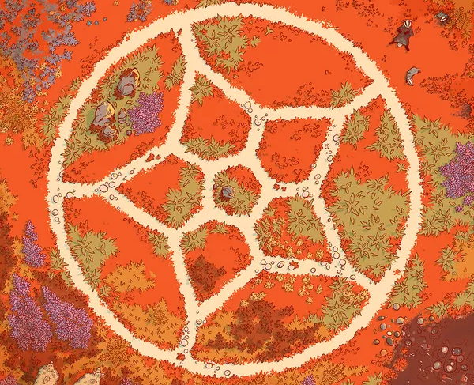
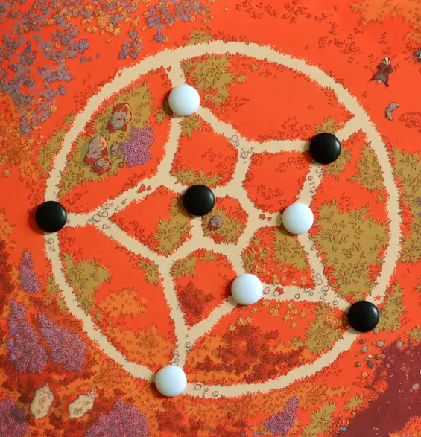
Bound

Slide 2
Game Description and Rules
Description: Bound is a two-player strategy game played on a single sheet of paper. Each turn, move one of your four standing stones to encircle an opponent's stone.
Rules:
Board Setup: The first player places their pieces on four of the five forks around the outer ring. The second player places their four pieces on the central pentagon, each one on a fork opposite one of the older player’s pieces.
Moves: Each piece can only be placed in a neighbor’s position that is empty.
Goal: surround an opponent's piece so that can no longer be moved. If a player can no longer move one of their pieces, they lose the game.

Slide 3
Implementation
We'll implement a classic game with 3 different modes:
Player vs Player
Player vs Computer
Computer vs Computer
with the computer using the Monte Carlo and Minimax techniques to make its moves. The computer’s modes will have the choice of computer’s difficulty:
Easy
Medium
Hard
We'll also implement a GUI using Pygame to make the game more visually appealing and interactive.

Slide 4
Formulation of the Problem and Heuristics
Having each piece only 3 (or less) positions to move and the goal is to encircle na opponent’s piece, we implemented the following heurístics:
Having pieces stuck (bad end condition)
Having opponent’s pieces stuck (good end condition)
Having 2 pieces blocking an opponent’s piece
Having 1 piece blocking an opponent’s piece
Having central rings domination (positions most occupied)

Slide 5
Techniques/Algorithms Implemented
Minimax Algorithm: We used the minimax algorithm with alpha-beta pruning to search through the game tree and find the optimal move for each player. The depth of the search tree will be limited to a certain level to balance computation time and accuracy and will depend on the difficulty of the computer chosen by the user in the beginning of the program.
Monte Carlo Technique: we used the Monte Carlo technique to simulate random games and use the results to inform our moves and evaluate heuristics (to-do).

Slide 6
Results
To-do

Slide 7
Conclusions
To-do

