Slide 1
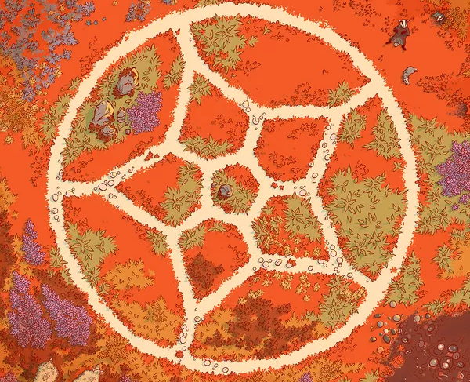
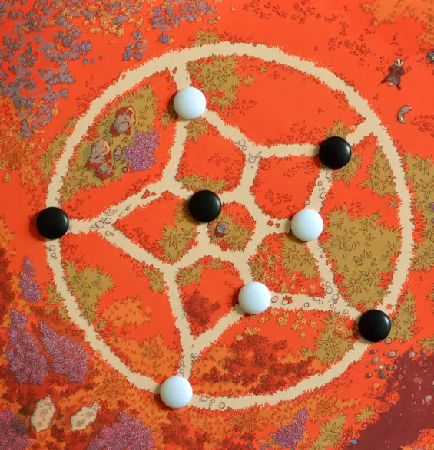
Bound

Slide 2
Game Description and Rules
Description: Bound is a two-player strategy game played on a single sheet of paper. Each turn, move one of your four standing stones to encircle an opponent's stone.
Rules:
Board Setup: The first player places their pieces on four of the five forks around the outer ring. The second player places their four pieces on the central pentagon, each one on a fork opposite one of the older player’s pieces.
Moves: Each piece can only be placed in a neighbor’s position that is empty.
Goal: surround an opponent's piece so that can no longer be moved. If a player can no longer move one of their pieces, they lose the game.

Slide 3
Implementation
We'll implement a classic game with 3 different modes:
Player vs Player
Player vs Computer
Computer vs Computer
with the computer using the Monte Carlo and Minimax techniques to make its moves. The computer’s modes will have the choice of computer’s difficulty:
Easy
Medium
Hard
We'll also implement a GUI using Pygame to make the game more visually appealing and interactive.

Slide 4
Formulation of the Problem and Heuristics
Having each piece only 3 (or less) positions to move and the goal is to encircle na opponent’s piece, we implemented the following heurístics:
Having pieces stuck (bad end condition)
Having opponent’s pieces stuck (good end condition)
Having 2 pieces blocking an opponent’s piece
Having 1 piece blocking an opponent’s piece
Having central rings domination (positions most occupied)
Having pieces in places where you can treverse to more than one level
Having no friendly pieces near each other
Checking if the oponnent can win next turn
Checking if the you can win next turn

Slide 5
Techniques/Algorithms Implemented
Minimax Algorithm: We used the minimax algorithm with alpha-beta pruning to search through the game tree and find the optimal move for each player. The depth of the search tree will be limited to a certain level to balance computation time and accuracy and will depend on the difficulty of the computer chosen by the user in the beginning of the program. Due to how the game is programmed there is a high overhead when using the operators and the evaluation function s the depth is quite limited. Alpha/Beta pruning helps the performance but the time to evaluate each state is still very costly.

Slide 6
Results
We obtained some interesting results using minimax with alpha/beta pruning. This algorithm is very dependent on the heuristics used. The AI fluctuated between being a competent player to downright lacking any sort planning depending on the heuristics used.
The best result we got is when we followed the following heursitics:
Checking if any pieces are stuck
Checking if you or the opponent are about to win
Seeing if your pieces can move to more levels than your opponent’s pieces
Seeing if your pieces have more movements than your opponent
This introduces a big overhead to the evaluation function, so the maximum depth that the computer can run in a reasonable time is depth 3.

Slide 7
Results (Part II)
The time taken for each depth level is exponentially higher than the previous. For depth 1 the play is immediate, but for depth 2 it takes a few seconds. For Depth 3, which we consider the highest difficulty, it takes on average around 20 seconds per play. This game on average as around 30 turns so we can see how this time can really make a game take a long time to be completed. This can be attributed to the mechanics of the game. Because each peace can be moved individually and with such degree of freedom, the game lacks decisiveness which contributes to long meandering games. The heuristics we chose are good at playing defensively but this game rewards a more passive play, because there really is no uniform method of attack that can ensure victory. Victory only comes when you apply sufficient pressure on the opponent and make it impossible to defend all their pieces, but to reach this state it takes some time, even longer if the opponent knows what he is doing.
The main problem we faced was the heuristics, when we used different ones the quality of the AI would be very bad. It would almost play at random until someone made an obvious mistake and only then would the game end, no clear signs of intelligent play where present and the only strategies would be to wait until the perfect condition presented itself, which usually took 80 to 90 turns. The plays where faster but were of very low quality. We only found success when we started to apply more defensive heuristics which valued good positioning above else. An unintended consequence of which is the time it takes to come u with a move.
In conclusion, with these heuristics, games end faster and more decisively and with depth 3 we are confident in taking on most human players.

Slide 8
Difficulties
The implementation of the game proved to be quite difficult. Due to the abstract nature of it, it was quite hard to produce good heuristics and good strategies.
The board also proved to be quite a challenge. It is unique and proved to be very difficult to display. During most of the development we used an abstract representation of it and even that took some tries to get it “right”. We took a different approach to it, choosing to program the games logic in C++ and choosing to display its state using python. We figured it would be for the best as we got the performance of C++ and the GUI from python which is better at than C++. But even that was challenging as we add to run python through C++ which was a difficult and confusing process.
The last difficulty was that due to the game being very recent, we could not use tools like chatGPT to ease the process of developing the game, as it has no knowledge of it. Even when it came to developing the code to display the board it would not produce good results.

Slide 9
Conclusions
This work proves to be quite challenging and taught us a lot about adversarial search. It reinforced the importance of good heuristics and the necessity of having a good grasp on how the game works. We obtained good results when it came to the use of Minimax, but we now understand the necessity of having a lightweight way to represent the state of our game, and how applying different techniques like pre-computation tables could have been used to improve the time the AI takes for each play. Having said that, I think we achieved what was asked for this project, implementing everything that we were asked to do.

