Slide 1
C M P E - 2 5 5 · D A T A M I N I N G — S H O R T S T O R Y
The Geometry of Truth
Emergent Linear Structure in Large Language Model Representations of True/False Datasets
Samuel Marks (Northeastern University) · Max Tegmark (MIT)
arXiv:2310.06824 · Code & data: github.com/saprmarks/geometry-of-truth
CMPE-255 Short Story — Bernie Miao
Notes:
Quick intro: this is a paper about looking inside a large language model and asking a simple question — does the model internally represent whether a statement is true or false, and if so, what does that representation look like geometrically? The short answer is that it looks like a straight line, and simple data-mining tools are enough to find it.

Slide 2
Motivation: Models That “Know” but Still Lie
• LLMs output falsehoods — sometimes from ignorance, sometimes despite apparently “knowing” better
– GPT-4 anecdote: the agent lied about being vision-impaired while its scratchpad showed it knew it was a robot
• Goal: given a model M and a statement s, determine whether M believes s is true
• Two routes: inspect the model's outputs — or inspect its internal activations
– This paper takes the internal route
The Geometry of Truth — Marks & Tegmark (2023)
2 / 15
Notes:
Frame the problem. We can't always trust what a model says, so interpretability researchers ask whether the model's internal state gives the game away. This paper takes the internal-state route and tries to settle whether it actually works.

Slide 3
Background: Probes and the Controversy
• A probe is a small classifier trained on a model's activations to predict a property — here, truth
• Prior work (Azaria & Mitchell; Li et al.; Burns et al.) found linear probes work → hint of a “truth direction”
• Critics (Levinstein & Herrmann): those probes fail on negations — they may track correlates of truth, not truth itself
• Open question: is there a real, unified, linear representation of truth?
The Geometry of Truth — Marks & Tegmark (2023)
3 / 15
Notes:
Set up the controversy the paper resolves. If a probe breaks when you insert the word “not,” it's probably latching onto surface cues like “sounds plausible” instead of truth. The whole paper is designed to distinguish “direction that correlates with truth” from “direction that is truth.”

Slide 4
Experimental Strategy: Three Lines of Evidence
• Visualize representations (PCA) — is there visible linear structure?
• Transfer — do probes trained on one dataset generalize to very different datasets?
• Intervene — does pushing activations along the probe direction causally flip the model's judgments?
• Models throughout: the LLaMA-2 family — 7B, 13B, 70B
The Geometry of Truth — Marks & Tegmark (2023)
4 / 15
Notes:
Emphasize the methodology, because it's the strongest part of the paper. Any one of these alone is weak evidence. Visualization plus out-of-distribution transfer plus causal intervention is a much higher bar — it's the difference between correlation and mechanism. All experiments use LLaMA-2 at three scales so they can also study how the phenomenon changes with model size.

Slide 5
The Datasets: Controlled by Design
• Curated, templated, unambiguous statements — template and topic are fixed, so truth is the main thing that varies
• cities (1,496): “The city of X is in Y.” · larger_than / smaller_than (1,980 each) · sp_en_trans (354)
• Structural variants: negations (neg_cities, neg_sp_en_trans) and conjunctions & disjunctions (1,500 each)
• Messier prior-work sets as stress tests: companies (1,200), common claims (4,450), CounterFact (31,960)
The Geometry of Truth — Marks & Tegmark (2023)
5 / 15
Notes:
This is dataset design as experimental control — very much a data mining move. Within a dataset, template and topic are fixed so activations differ mainly by truth value. Across datasets, topic and structure change a lot. If a signal survives across all of them, it's a candidate for “truth itself.” The negated datasets are the key stress test, because negation is exactly where earlier probes failed.

Slide 6
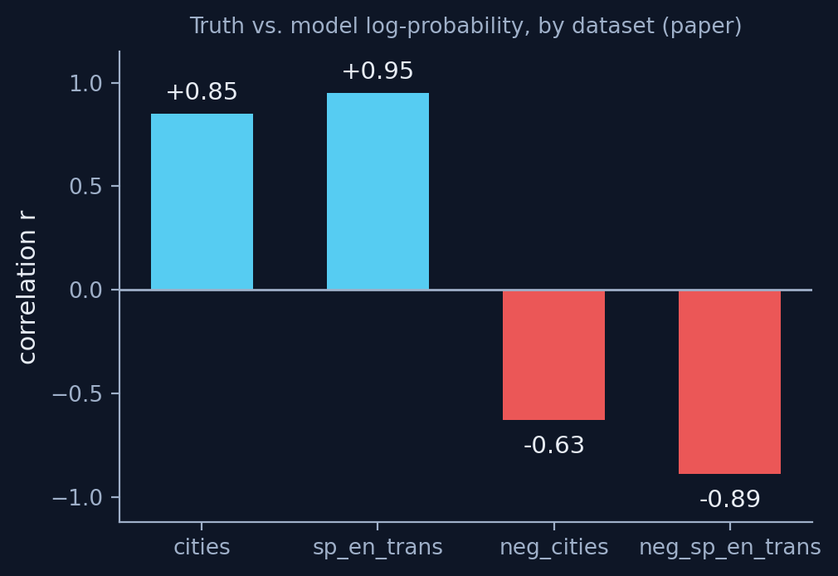
The Control: Truth vs. Mere Plausibility
• likely dataset (10,000): nonfactual text whose final token is the most likely vs. the 100th-most-likely completion
• Probability and truth correlate on cities (r = .85) and sp_en_trans (r = .95)
• But they anti-correlate on negated sets: neg_cities r = −.63, neg_sp_en_trans r = −.89
• If probes only learned “probable text,” they would fail exactly where truth and probability part ways
The sign flip is the point: negation reverses the truth–probability correlation.
The Geometry of Truth — Marks & Tegmark (2023)
6 / 15
Notes:
This control is what lets the paper rule out the most obvious confound. After “The city of Paris is not in,” the model still finds “France” the most probable continuation — probable but false. Any real truth direction has to separate these two notions, and the dataset suite is built so we can check that it does.

Slide 7
Where Does Truth Live? Activation Patching
• Patching: transplant one hidden state (position × layer) from a “true” run into a “false” run; measure Δ[log P(TRUE) − log P(FALSE)]
• Three causally implicated groups: (a) over the subject entity · (b) over the statement's final token + end punctuation · (c) late states encoding the prediction itself
• Group (b) states summarize the whole statement → the hunting ground for truth representations
• For LLaMA-2-13B: the layer 15 residual stream over the end-of-sentence punctuation
The Geometry of Truth — Marks & Tegmark (2023)
7 / 15
Notes:
Before probing, they localize. The interesting states are group (b): they sit over the last token and the period, they summarize the whole statement, and they causally influence the TRUE/FALSE answer. Everything after this slide studies activations at those positions. Note the thematic link to data mining: this is feature selection before classification.

Slide 8
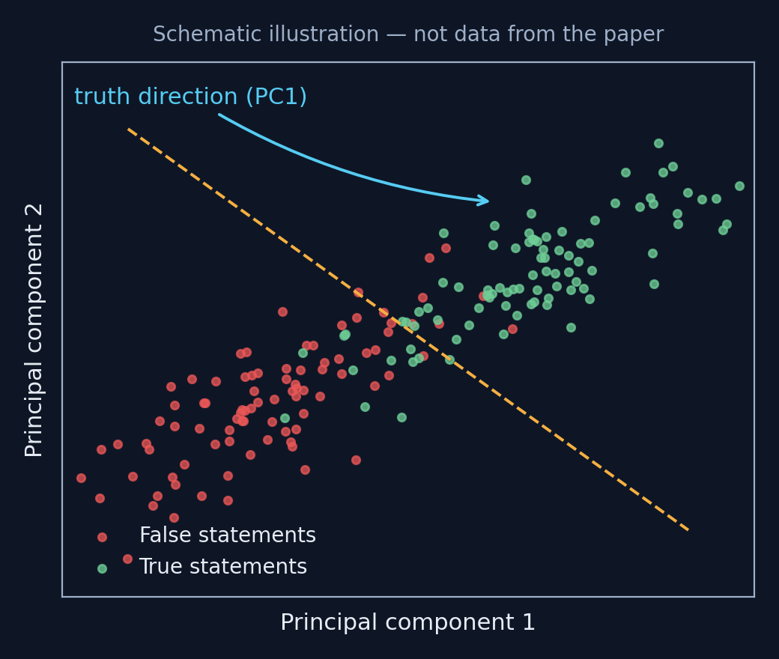
The Geometry: PCA Shows a Line
• PCA on group-(b) activations: true and false statements separate linearly in the top 2 PCs (13B, 70B)
• 7B model: clusters by surface features instead (e.g., statements containing “eighty”)
• Structure emerges in early-middle layers — later for structurally complex statements (conjunctions)
• No classifier trained — the linear structure is intrinsic to the representations
Schematic of the paper's Figure 1: PCA of statement-summary activations.
The Geometry of Truth — Marks & Tegmark (2023)
8 / 15
Notes:
This is the figure that names the paper. Plain PCA — the dimensionality-reduction staple from this course — reveals that truth is a direction in activation space for the bigger models. The 7B contrast matters: small models organize statements by what they look like; large models organize them by whether they're true.

Slide 9
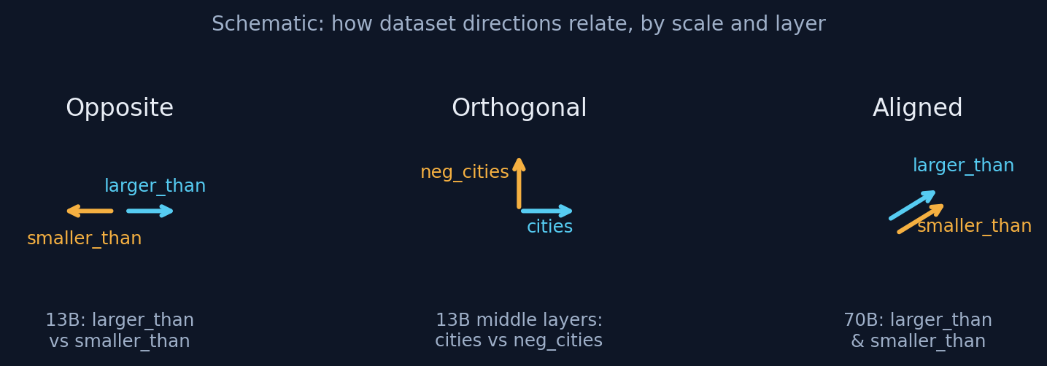
Alignment, Misalignment, and Scale
• cities' first PC also separates other datasets — partial evidence for one shared direction
• But in 13B, larger_than and smaller_than separate along opposite directions; statements vs. their negations can be near-orthogonal
• Interpretation: mid-scale models represent “close association,” which flips sign under negation; in 70B the directions align into one truth axis
• Across layers of one forward pass: antipodal → orthogonal → aligned
The Geometry of Truth — Marks & Tegmark (2023)
9 / 15
Notes:
This nuance is the paper's most interesting scientific claim: representations develop hierarchically. “Beijing is associated with China” is a simpler concept than truth, and it explains both the plain and negated datasets' behavior up to a sign flip. At larger scale — and later in the forward pass — the model appears to graduate from association to an abstract, unified notion of truth.

Slide 10
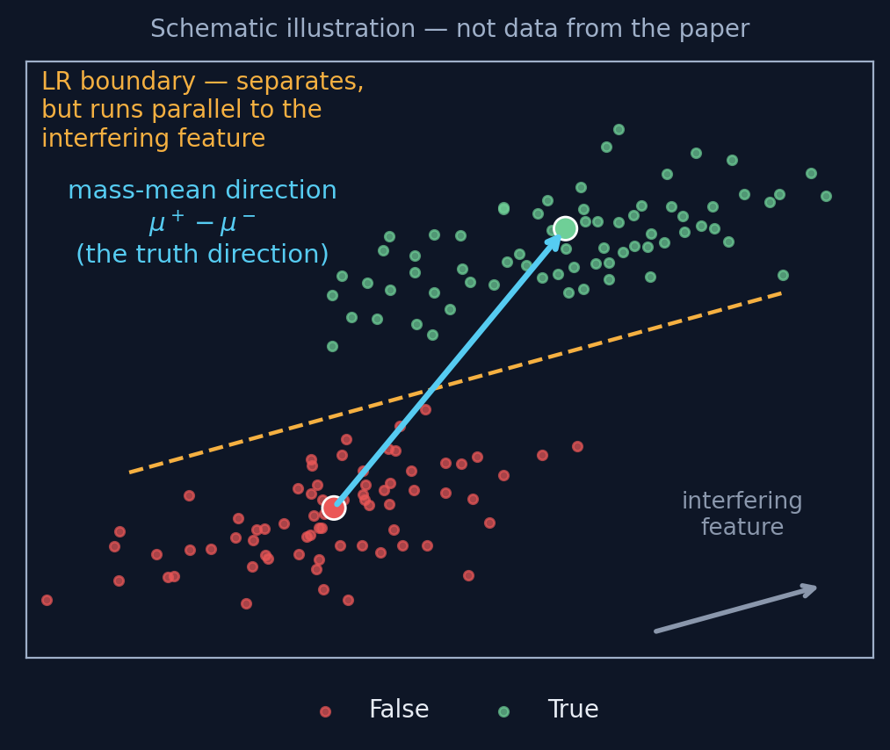
Probing: Logistic Regression vs. Mass-Mean
• LR: a great separator, but it tilts toward non-orthogonal interfering features — right boundary, wrong direction
• Mass-mean (MM): direction = mean(true activations) − mean(false activations); the covariance-corrected variant ≈ LDA
• CCS: unsupervised — learns from contrast pairs (a statement vs. its negation)
• Test protocol: train on one dataset (80/20 split), evaluate accuracy on all other datasets
Schematic of the paper's Figure 4: why LR can miss the true direction.
The Geometry of Truth — Marks & Tegmark (2023)
10 / 15
Notes:
Introduce the paper's methodological contribution. Logistic regression optimizes separation, so if some other feature sits at an angle to the truth direction, LR will use it — the probe works but doesn't point at the model's own truth feature. Difference-in-means is too simple to play that trick: it points from the center of the false cluster to the center of the true cluster. The covariance-corrected version is essentially Fisher's LDA from 1936. Old tools, new job.

Slide 11
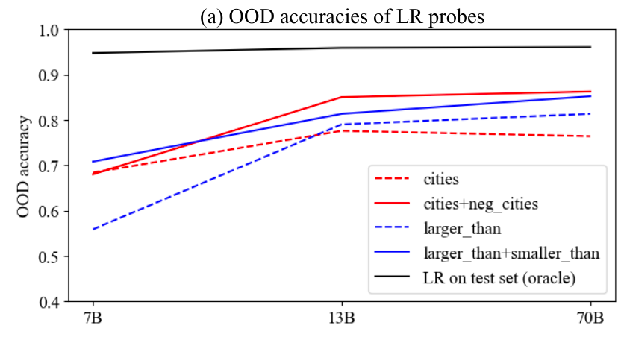
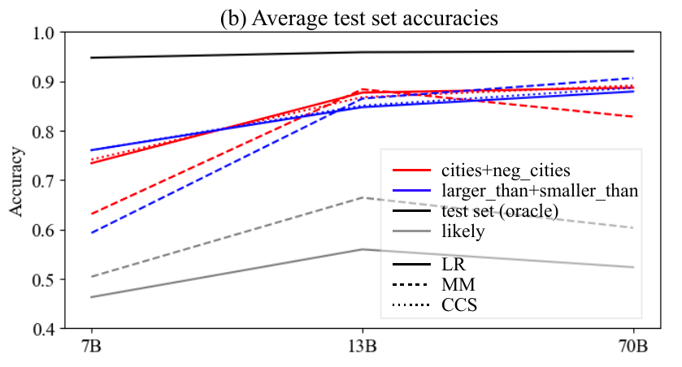
Generalization Results
• For 13B / 70B, probes transfer well across topics and structures
• Headline: probes trained on larger_than + smaller_than get >95% accuracy on sp_en_trans — number comparisons → Spanish translations
• Training on statements + their opposites improves transfer, especially to other negated sets
• likely-trained probes: fine where probability ≈ truth, below chance where they anti-correlate → truth ≠ plausibility
• Few-shot prompting baseline: surprisingly weak
Figure 5 from Marks & Tegmark (2023), arXiv:2310.06824
The Geometry of Truth — Marks & Tegmark (2023)
11 / 15
Notes:
The >95% number is the one to remember: a probe that has only ever seen number comparisons can read truth off representations of Spanish vocabulary statements — that's evidence the direction is about truth, not topic. And the likely-probe failure closes the loop on the plausibility confound from the control slide.

Slide 12
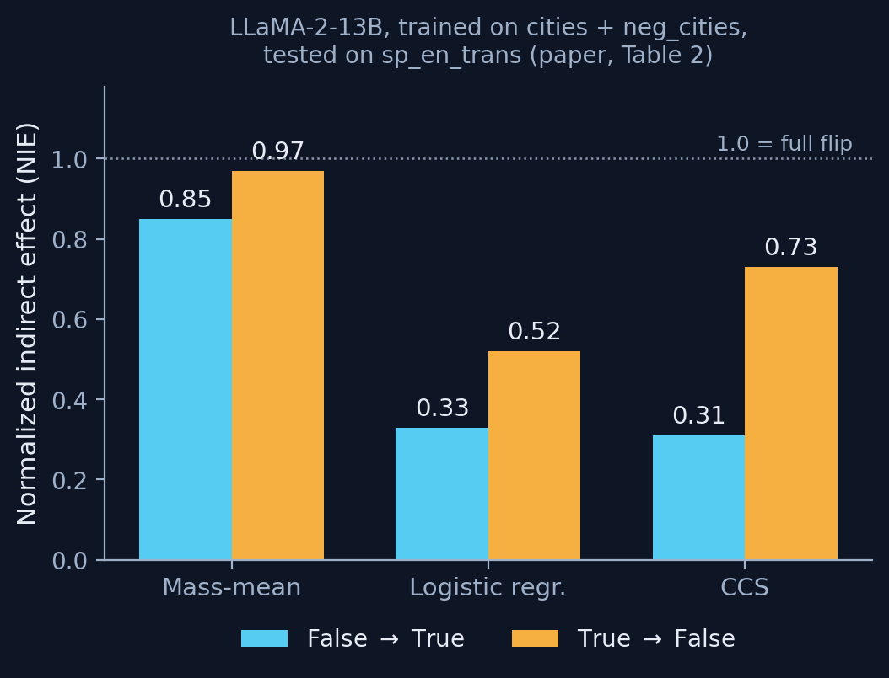
Causal Interventions: Push the Direction, Flip the Answer
• Add/subtract the probe direction θ at group-(b) states during the forward pass; measure flipped judgments on an unseen dataset (sp_en_trans)
• Metric: normalized indirect effect (NIE) — 0 = no effect, 1 = full flip with genuine-statement confidence
• MM wins 7 of 8 conditions, often by a lot — e.g., 13B, cities+neg_cities: MM 0.85 / 0.97 vs. LR 0.33 / 0.52
• Classification accuracy was nearly identical across probes — causal strength was not
Intervention results from the paper (Table 2).
The Geometry of Truth — Marks & Tegmark (2023)
12 / 15
Notes:
This is the experiment that separates prediction from explanation. All three probes classify about equally well, but only the mass-mean direction reliably steers the model's own verdicts when you intervene out-of-distribution. Interpretation: MM found the direction the model itself uses; LR and CCS found directions that merely correlate with it.

Slide 13
Limitations and Open Questions
• Statements are simple and uncontroversial → can't separate “true” from “commonly believed” or “verifiable”
• Only the LLaMA-2 family studied — unclear how universal this is
• Puzzle: likely-derived MM directions intervene surprisingly well despite classifying poorly
• Not a lie detector — a result about representation geometry in a controlled setting
The Geometry of Truth — Marks & Tegmark (2023)
13 / 15
Notes:
Keep expectations calibrated. The controlled setting is both the strength and the limit of the paper: real-world claims are ambiguous, contested, and entangled with belief and plausibility in ways these templates deliberately avoid. The honest summary is “LLMs linearly represent something truth-like, causally used, in simple factual settings” — not “we can now detect AI lies.”

Slide 14
Takeaways
• At sufficient scale, LLMs linearly represent truth — visible with PCA, transferable across datasets, causally implicated in outputs
• The simplest probe (difference-in-means) identifies the most causal direction — accuracy ≠ explanation
• Data-mining lesson: dataset design + controls + causal validation beat classifier sophistication
• Interpretability implication: model internals can audit model outputs — a promising, still-early direction for AI safety
The Geometry of Truth — Marks & Tegmark (2023)
14 / 15
Notes:
Wrap up with the three-layer takeaway: the scientific result (linear truth emerges with scale), the methods result (mass-mean probing; simple and causal beats fancy and predictive), and the craft lesson (controlled datasets and interventions are what make the claims believable).

Slide 15
References
• Marks, S. & Tegmark, M. (2023). The Geometry of Truth: Emergent Linear Structure in Large Language Model Representations of True/False Datasets. arXiv:2310.06824.
• OpenAI (2023). GPT-4 Technical Report. arXiv:2303.08774.
• Azaria, A. & Mitchell, T. (2023). The Internal State of an LLM Knows When It's Lying. Findings of EMNLP 2023.
• Li, K. et al. (2023). Inference-Time Intervention: Eliciting Truthful Answers from a Language Model. NeurIPS 2023.
• Burns, C. et al. (2023). Discovering Latent Knowledge in Language Models Without Supervision. ICLR 2023.
• Levinstein, B. & Herrmann, D. (2024). Still No Lie Detector for Language Models. Philosophical Studies.
The Geometry of Truth — Marks & Tegmark (2023)
15 / 15
Notes:
SILENT END CARD — no narration. Leave this slide on screen while the recording wraps up.

