Slide 1
Group 6
Eduardo Correia
Henrique Sousa
Mª Francisca Almeida
Public
Transit
Stations
A NetLogo approach
and methodology

Slide 2
Problem Formalisation
Simulate and draw conclusions from the passengers’ behavior in a multimodal transit station.
Simulate a multimodal transit station.
01
Floors; Platforms; Trains;
Entries/exits; Elevators; Stairs.
Objective
02
Environment
Passengers.
Entities
03
Data sources
Tools
Pictures of the layout
of various stations.
04
Netlogo.
05

Slide 3




01
Interest in public transportation.
Motivation
02
Learning a new technology and programming paradigm.
03
Improvements by considering other environments, scenarios or passenger behavior.
04
Conclusions, including practical, real-world applications.

Slide 4
Goals
Framework
Solutions
Develop a NetLogo methodology that can be expanded by the community.
Ideate solutions to possible problems.
Education
Data
Gain knowledge on simulation paradigms.
Gather knowledge from the data, specifically behavior patterns.

Slide 5
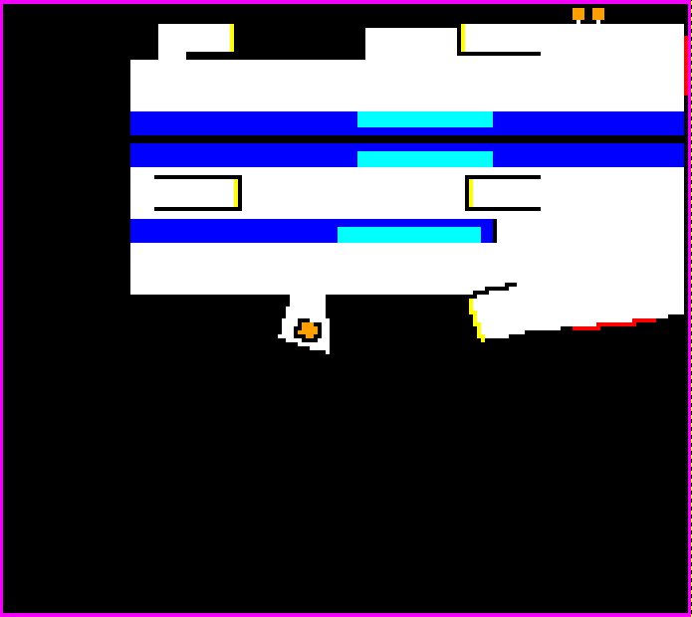
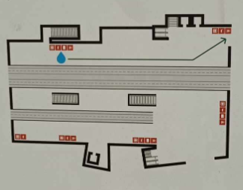
Sources
Real Life Stations
We collected real station plants and recreated them.

Slide 6
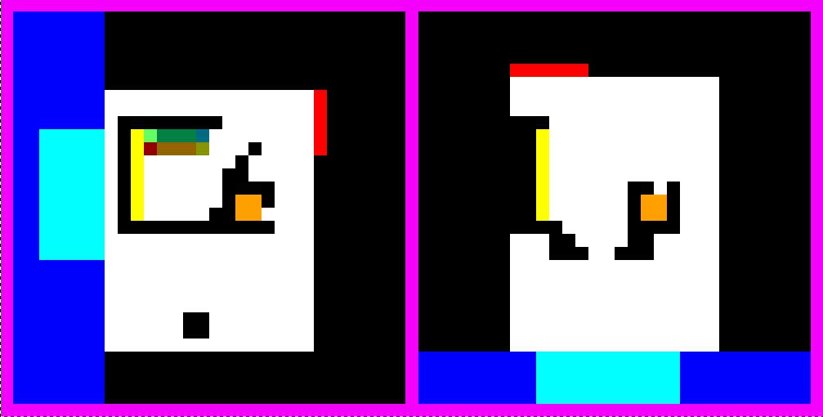
Model
1
Train line
2
Train
3
Stairs
4
Elevator
5
Entries/Exits
Notes:
Talk about algorithms: Dijkstra and A*

Slide 7
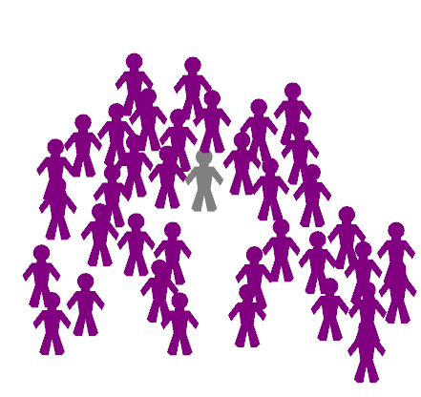
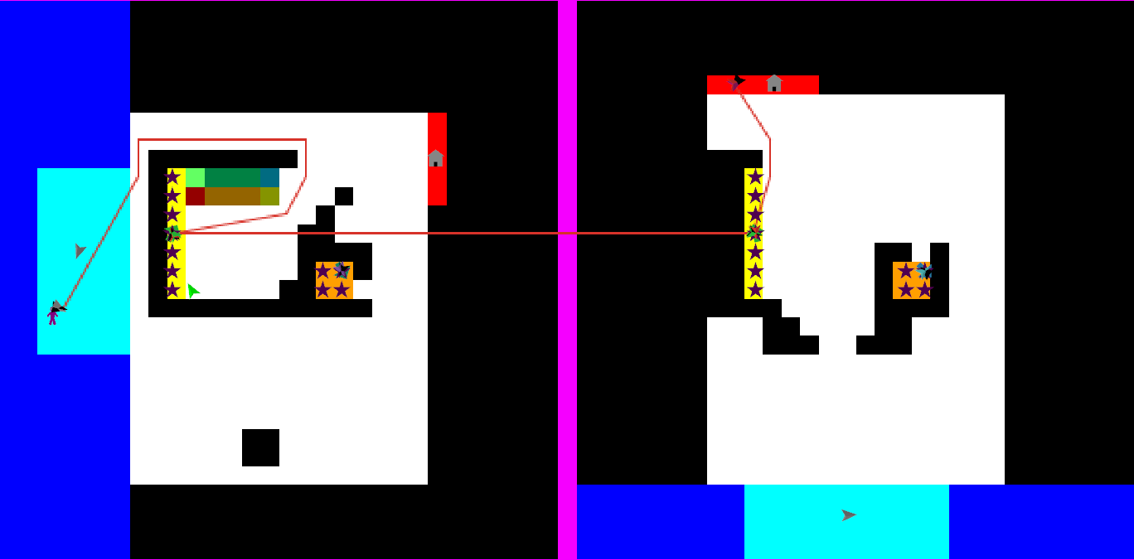
Data
Crowdedness
Path
Trajectory
The model was trained with simulations of crowdedness.
Intended path the passenger wants to take.
Subsequent positions the passenger has in each frame.

Slide 8
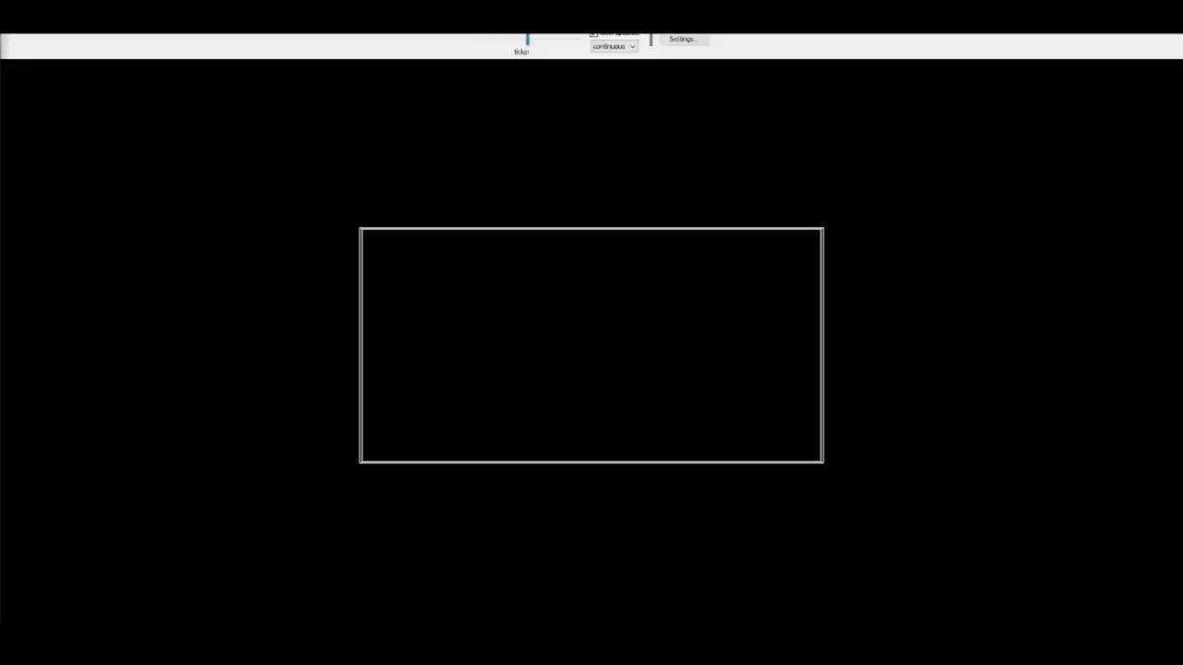
Demo

Slide 9
Results
Metric | ticks | tick_distance | total_distance | Crowdedness
 |  |  |  | 0.8 | 1 | 1.2 | 1.4
mean | 464.710000 | 0.297951 | 138.460790 | 0.001160 | 0.203689 | 0.397329 | 0.457151
std | 204.348647 | 0.024352 | 61.119533 | 0.039845 | 0.541747 | 0.739537 | 0.799496
Min | 127.000000 | 0.000000 | 38.504057 | 0.000000 | 0.000000 | 0.000000 | 0.000000
25% | 256.750000 | 0.300000 | 76.022187 | 0.000000 | 0.000000 | 0.000000 | 0.000000
50% | 479.000000 | 0.300000 | 141.865455 | 0.000000 | 0.000000 | 0.000000 | 0.000000
75% | 608.750000 | 0.300000 | 182.623531 | 0.000000 | 0.000000 | 1.000000 | 1.000000
Max | 898.000000 | 0.564923 | 268.083006 | 3.000000 | 5.000000 | 6.000000 | 6.000000

Slide 10
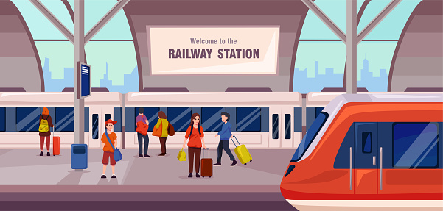
Conclusion
We are satisfied with our final results. We were able to achieve most of our goals but for the ideation of solutions that could be applied to the scenario;
Though we’ve acquired new skills, we have to point out how flawed Netlogo is:
Very hard to work with different files;
Less flexibility than standard programming languages;
Idiosyncrasies (time).
Nonetheless, we were able to overcome the adversity and deliver what we believe to be a successful project.

