Slide 1
Chapter 9
Groupware

Slide 2
Groupware
What is groupware
Types of groupware
computer-mediated communication
meeting and decisions support systems
shared applications and artefacts
Models of groupware
Implementation issues

Slide 3
What is groupware?
Software specifically designed
to support group working
with cooperative requirements in mind
NOT just tools for communication
Groupware can be classified by
when and where the participants are working
the function it performs for cooperative work
Specific and difficult problems with groupware implementation

Slide 4
The Time/Space Matrix
Classify groupware by:
when the participants are working, at the same time or not
where the participants are working, at the same place or not
Common names for axes: time: synchronous/asynchronous place: co-located/remote
same place
different place
same time
different time

Slide 5
Time/Space Matrix (ctd)
same place
different place
same time
face-to-face conversation
telephone
different time
post-it note
letter

Slide 6
Classification by Function
Cooperative work involves:
Participants who are working
Artefacts upon which they work
understanding
P
direct
P
participants
communication
control and feedback
A
artefacts of work

Slide 7
What interactions does a tool support?
meeting and decision support systems
common understanding
computer-mediated communication
direct communication between participants
meeting and decision support systems
common understanding
shared applications and artefacts
control and feedback with shared work objects
understanding
P
direct
P
computer-mediated communication
direct communication between participants
participants
communication
control and feedback
A
artefacts of work
shared applications and artefacts
control and feedback with shared work objects

Slide 8
computer-mediated communication
email and bulletin boards
structured message systems
text messaging
video, virtual environments

Slide 9
Email and bulletin boards
asynchronous/remote
familiar and most successful groupware
Recipients of email: direct in To: field copies in Cc: field
delivery identical – difference is social purpose

Slide 10
Email vs. bulletin boards
fan out
one-to-one – email, direct communication
one-to-many – email, distribution lists
BBs, broadcast distribution
control
sender – email, private distribution list
administrator – email, shared distribution list
recipient – BBs, subscription to topics

Slide 11
Structured message systems
asynchronous/remote
`super' email – cross between email and a database
sender – fills in special fields
recipient – filters and sorts incoming mail based on field contents
… but – work by the sender – benefit for the recipient

Slide 12
Structured message systems (ctd)
Type: Seminar announcement
To: all
From: Alan Dix
Subject: departmental seminar
Time: 2:15 Wednesday
Place: D014
Speaker: W.T. Pooh
Title: The Honey Pot
Text: Recent research on socially constructed meaning has focused on the image of the Honey Pot and its dialectic interpretation within an encultured hermeneutic. This talk …
N.B. global structuring by designer
vs. local structuring by participants

Slide 13

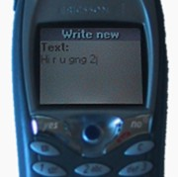
txt is gr8
instant messaging
1996 – ICQ small Israeli company
now millions
more like conversation
SMS
y is it we al lv shrt msgs
originally a feature of internal management protocol
short messages (160 chars) and text with numbers
no-one predicted mass adoption!!
now phones with cameras for MMS
Hi, u there
yeh, had a good night last night?
uhu
want to meet later

Slide 14
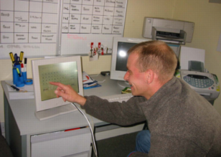
SMS in action
serious uses too … the ‘SPAM’ system
two hostels for ex-psychiatric patients
staff send SMS to central number
messages appear in both offices
avoids using phone
‘mission critical’ … but used for jokes too!

Slide 15
Video conferences and communication
synchronous/remote
Technology:
ISDN + video compression
internet, web cams
major uses:
video conferences
pervasive video for social contact
integration with other applications
often cheaper than face-to-face meetings
(telecommunications costs vs. air flights)

Slide 16
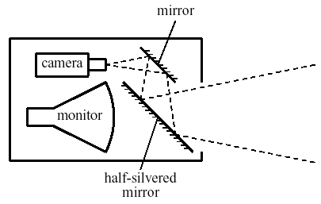
Video issues …
not a substitute for face-to-face meetings
small field of view
lack of reciprocity
poor eye contact
One solution for lack of eye contact … the video-tunnel

Slide 17

web-video
video-conferencing – expensive technology
but internet (almost) free!
web-cams
used for face-to-face chat
for video-conferencing
for permanent web-cams
low bandwidth
pictures ‘block out’ … not terrible
audio more problematic
may use text chat

Slide 18


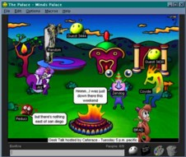
collaborative virtual environments (CVEs)
meet others in a virtual world
participants represented – embodiment
artefacts too …
computer (e.g. spreadsheet) and ‘real’ (virtually) objects
text?
consistent orientation or easy to read
MUDs (Multi-user domains)
2D/3D places to meet on the web
users represented as avatars

Slide 19

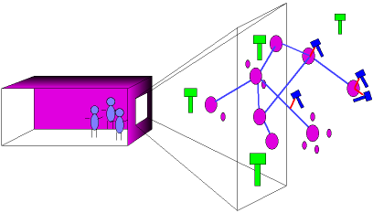
internet foyer
real foyer
large screen, camera
see virtual world on screen
virtual world
representation of web
see real foyer on virtual screen

Slide 20
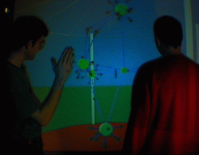
‘outside’ looking in

Slide 21
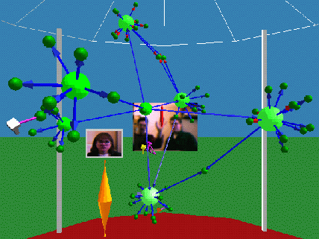
‘inside’ looking out

Slide 22
meeting and decision support systems
argumentation tools
meeting rooms
shared work surfaces

Slide 23
Meeting and decision support
In design, management and research, we want to:
generate ideas
develop ideas
record ideas
primary emphasis – common understanding

Slide 24
Three types of system
argumentation tools
asynchronous co-located
recording the arguments for design decisions
meeting rooms
synchronous co-located
electronic support for face-to-face meetings
shared drawing surfaces
synchronous remote
shared drawing board at a distance

Slide 25
argumentation tools
asynchronous co-located
hypertext like tools to record design rationale
Two purposes:
remining the designers of the reasons for decisons
communicating rationale between design teams
Mode of collaboration:
very long term
sometimes synchronous use also

Slide 26
gIBIS
graphical version of IBIS – issue based information system
various node types including:
issues e.g. ‘number of mouse buttons’
positions e.g. ‘only one button’
arguments e.g. ‘easy for novice’
linked by relationships such as:
argument supports position e.g., ‘easy for novice’ supports ‘only one button’

Slide 27
Meeting rooms
synchronous co-located
electronic support for face-to-face meetings
individual terminals (often recessed)
large shared screen (electronic whiteboard)
special software
U or C shaped seating around screen
Various modes:
brainstorming, private use, WYSIWIS
WYSIWIS – ‘what you see is what I see’
all screens show same image
any participant can write/draw to screen

Slide 28




Typical meeting room
shared
screen

Slide 29
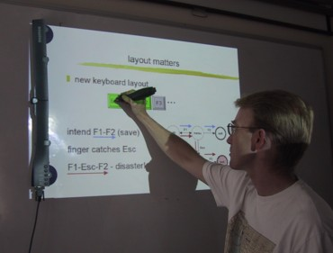
meeting capture
use ordinary whiteboard
detector and special pens
LCD projection on whiteboard
low-cost alternative to dedicated meeting room

Slide 30
Issues for cooperation
Argumentation tools
concurrency control
two people access the same node
one solution is node locking
notification mechanisms
knowing about others' changes
Meeting rooms
floor holders one or many?
floor control policies
who can write and when?
solution: locking + social protocol
group pointer
for deictic reference (this and that)

Slide 31
Shared work surfaces
synchronous remote
At simplest, meeting rooms at a distance, but …
additional audio/video for social protocols and discussion
network delays can be major problem
Additional special effects:
participants write onto large video screen
problems with parallax
shadow of other participant's hands appears on screen
electronic image integrated with video and paper images
Example: TeamWorkStation
remote teaching of Japanese calligraphy
student's strokes on paper overlaid with video of instructor's strokes

Slide 32
shared applications and artefacts
shared PCs and windows
shared editors, co-authoring tools
shared diaries
communication through the artefact

Slide 33
Shared Applications and Artefacts
Compare purpose of cooperation:
meeting rooms and decison support systems – develop shared understanding
shared applications and artefacts – work on the same objects
technology similar but primary purpose different
many different modalities (time/space matrix)
shared windows – synchronous remote/co-located
shared editors – synchronous remote/co-located
co-authoring systems – largely asynchronous
shared diaries – largely asynchronous remote
shared information – any, but largely asynchronous
synchronous remote needs additional audio/video channel

Slide 34
Similar … but different
Shared PCs and shared window systems
Multiplex keyboard and screen
Individual applications not collaboration aware
Floor control problems:
user A types: `interleave the'
user B types: `keystrokes'
result: `inkeytersltreaokeve tshe'
Shared editors
An editor which is collaboration aware
One document – several users
Similar to shared screen in meeting room … … with similar floor control problems!
Additional problem – multiple views

Slide 35
Shared editors - multiple views
Options:
same view or different view
single or separate insertion points
Single view ⇒ scroll wars
Multiple views ⇒ loss of context with indexicals

Slide 36
loss of WYSIWIS …
We will look at some of the
options and how they affect
the style of cooperation.
Thinking about the shared
view vs. different view
options, it at first seems
obvious that we should allow
people to edit different
parts of a document.
This is certainly true while
they are working effectively
independently.
More adaptable systems are
needed to allow for the wide
variation between groups,
and within the same group
over time.
We will look at some of the
options and how they affect
the style of cooperation.
Thinking about the shared
view vs. different view
options, it at first seems
obvious that we should allow
your screen
your colleague’s screen
‘I don’t like the line at the top’
‘but I just wrote that!’

Slide 37
Co-authoring systems
Emphasis is on long term document production, not editing
Two levels of representation
the document itself
annotation and discussion
Often some form of hypertext structure used
Similar problems of concurrency control to argumentation systems
Sometimes include rôles:
author, commentator, reader, …
but who decides the rôles?
and how flexible are they?

Slide 38
Shared diaries
Idea:
make diaries and calendars more easily shared
allow automatic meeting scheduling etc.
Issues for cooperation:
privacy – who can see my diary entries?
control – who can write in my diary?
Similar to file sharing issues, but need to be lightweight
Many systems have failed because they ignored these issues

Slide 39
Communication through the artefact
When you change a shared application:
you can see the effect – feedback
your colleagues can too – feedthrough
feedthrough enables … communication through the artefact

Slide 40
Shared data
Feedthrough – not just with ‘real’ groupware …
Shared data is pervasive:
shared files and databases
casework files (often non-electronic)
passing electronic copies of documents
passing copies of spreadsheets
Often need direct communication as well, but indirect communication through the artefact central
Few examples of explicit design for cooperation.
Liveware is an exception, a database with ‘merging’ of copies

Slide 41
frameworks for groupware
time/space matrix revisited!
shared information
communication and work
awareness

Slide 42
Time/space matrix revisited
co-located
remote
meeting rooms
video conferences,
video-wall, etc.
synchronous
shared work surfaces and editors
shared PCs and windows
argumentation tools
email and
electronic
conferences
asynchronous
co-authoring systems, shared calendars

Slide 43
Refined time/space matrix
co-located
remote
meeting rooms
video conferences video-wall, etc.
(a) concurrent
synchronized
shared work surfaces and editors
shared PCs and windows
(a/b) mixed
co-authoring systems, shared calendars
(b) serial
argumentation tools
(c) unsynchronized
email and structured messages
electronic conferences
Mobile workers and home workers have infrequent communication – they require unsynchronised groupware
Need fluid movement between synchronised/unsynchronised operation

Slide 44
Shared information
Granularity of sharing
chunk size
small – edit same word or sentance
large – section or whole document
update frequency
frequent – every character
infrequent – upon explicit ‘send’

Slide 45
level of sharing
output:
shared object
shared view
shared presentation
input:
single insertion point – shared virtual keyboard
multiple insertion points – other participants visible – group pointer – no visibility

Slide 46
Levels of shared output
100
houses
population
population
presentation
7
23
51
15
79
123
50
houses
50
view
select houses, population from VILLAGE_STATS
where population < 200
sort by houses ascending
VILLAGE_STATS
village
houses
population
object
Burton
Marleigh
Westfield
Thornby
23
339
7
51
79
671
15
123

Slide 47
types of object to share
type of shared data … influences style of sharing
linear transcript (e.g. text chat)
monotonic – only add - makes things easier
… but sequenced – danger of race conditions
shared add-only hypertext
montonic & unsequenced – several people can add children to same node
whiteboard
montonic & unsequenced … apart from eraser!!
user defined structure
complex object – shared hypertext or file system
!!!!!!!

Slide 48
ordering problems (race conditions)
Alison
It's a beautiful day.
Alison
It's a beautiful day.
Let's go out after work.
Let's go out after work.
Alison
perhaps not, I look awful
Brian
I agree totally
after the late party
Alison
perhaps not, I look awful
Brian
I agree totally
after the late party
Alison
Brian
It's a beautiful day Let's go out after work.
perhaps not, I look awful after the
late party
I agree totally
send
send
send
send
send
send
send
send

Slide 49
Integrating communication and work
understanding
P
direct
P
communication
deixis
control and feedback
feedthrough
A
Added:
deixis – reference to work objects
feedthorough – for communication through the artefact
Classified groupware by function it supported
Good groupware – open to all aspects of cooperation
e.g., annotations in co-authoring systems
embedding direct communication
bar codes – form of deixis, aids diffuse large scale cooperation

Slide 50
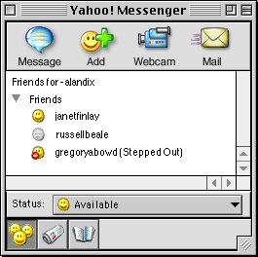
awareness
P
who is there
P
what is happening?
who is there e.g. IM buddy list
what has happened … and why?
what has happened
how did it happen
A

Slide 51
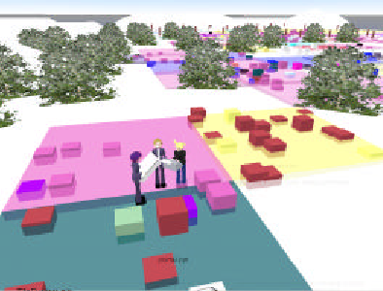
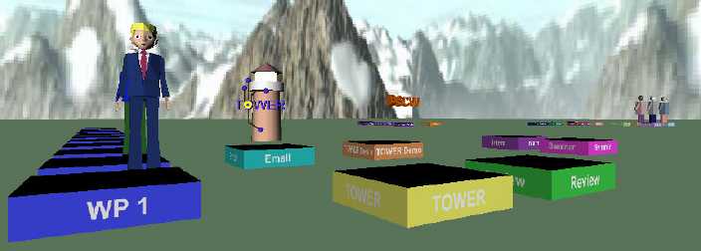

TOWER – workspace awareness
virtual ‘space’
work objects (files etc.) shown as buildings
avatars where other people are working
built over flexible event infrastructure
see http://tower.gmd.de/

Slide 52
implementing groupware
feedback and network delays
architectures for groupware
feedthrough and network traffic
toolkits, robustness and scaling

Slide 53


Feedback and network delays
screen
feedback
local
machine
remote
machine
remote
application
network
9
8
7
6
5
2
3
4
1
user types
client
server
At least 2 network messages + four context switches
With protocols 4 or more network messages

Slide 54
Types of architecture
centralised – single copy of application and data
client-server – simplest case
N.B. opposite of X windows client/server
master-slave special case of client-server
N.B. server merged with one client
replicated – copy on each workstation
also called peer-peer
+ local feedback
race conditions
Often ‘half way’ architectures:
local copy of application + central database
local cache of data for feedback
some hidden locking

Slide 55
Client-server architecture
user 1
user 2
… …
user n
client 1
client 2
client n
… …
server

Slide 56
Shared window architecture
Non-collaboration aware applications ⇒ client/server approach corresponding feedback problems
no ‘functionality’ – in the groupware but must handle floor control
example: shared X
single copy of real application
user stub for each user acts as an X application (X client)
one application stub acts like X server for real application
user stub passes events to single application stub
stubs merge X events coming in and replicate X lib calls going out (strictly protocol)

Slide 57
Shared X
user 1
user 2
… …
user n
X
X
… …
X
user
X events
X lib
user stub 1
user stub 2
… …
user stub n
X
X events
X lib
application
stub
application
X events
X lib
application

Slide 58
Feedthrough & traffic
Need to inform all other clients of changes
Few networks support broadcast messages, so … n participants ⇒ n–1 network messages!
Solution: increase granularity
reduce frequency of feedback
but … poor feedthrough ⇒ loss of shared context
Trade-off: timeliness vs. network traffic

Slide 59
Graphical toolkits
Designed for single user interaction
Problems for groupware include
pre-emptive widgets (e.g., pop-up menus)
over-packaged text (single cursor, poor view control)
notification-based toolkits with callbacks help (chap. 8)

Slide 60
Robustness and scaleability
crash in single-user interface – one sad user
crash in groupware – disaster !
but …
groupware complex: networks, graphics etc.
scaling up to large numbers of users?
testing and debugging – hard!

Slide 61
… some tips …
network or server fails – standard solutions
client fails – three `R's for server:
robust – server should survive client crash
reconfigure – detect and respond to failure
resynchronise – catch up when client restarts
errors in programming
defensive programming
simple algorithms
formal methods
unforeseen sequences of events
deadlock – never use blocking I/O
never assume particular orders
network packet ≠ logical message

Slide 62
scaling and testing
scaling up
robustness ⇒ simple algorithms … but don’t scale well – need to evolve
good software architecture helps
document fixed-size assumptions
know operating system limits (e.g. open files)
testing for robustness
take off the kid gloves … mistreat it
reboot, pull out network cable, random input
create a rogue client, simulate high loads
and when you think it is perfect … give it to some computing students to test

