Slide 1
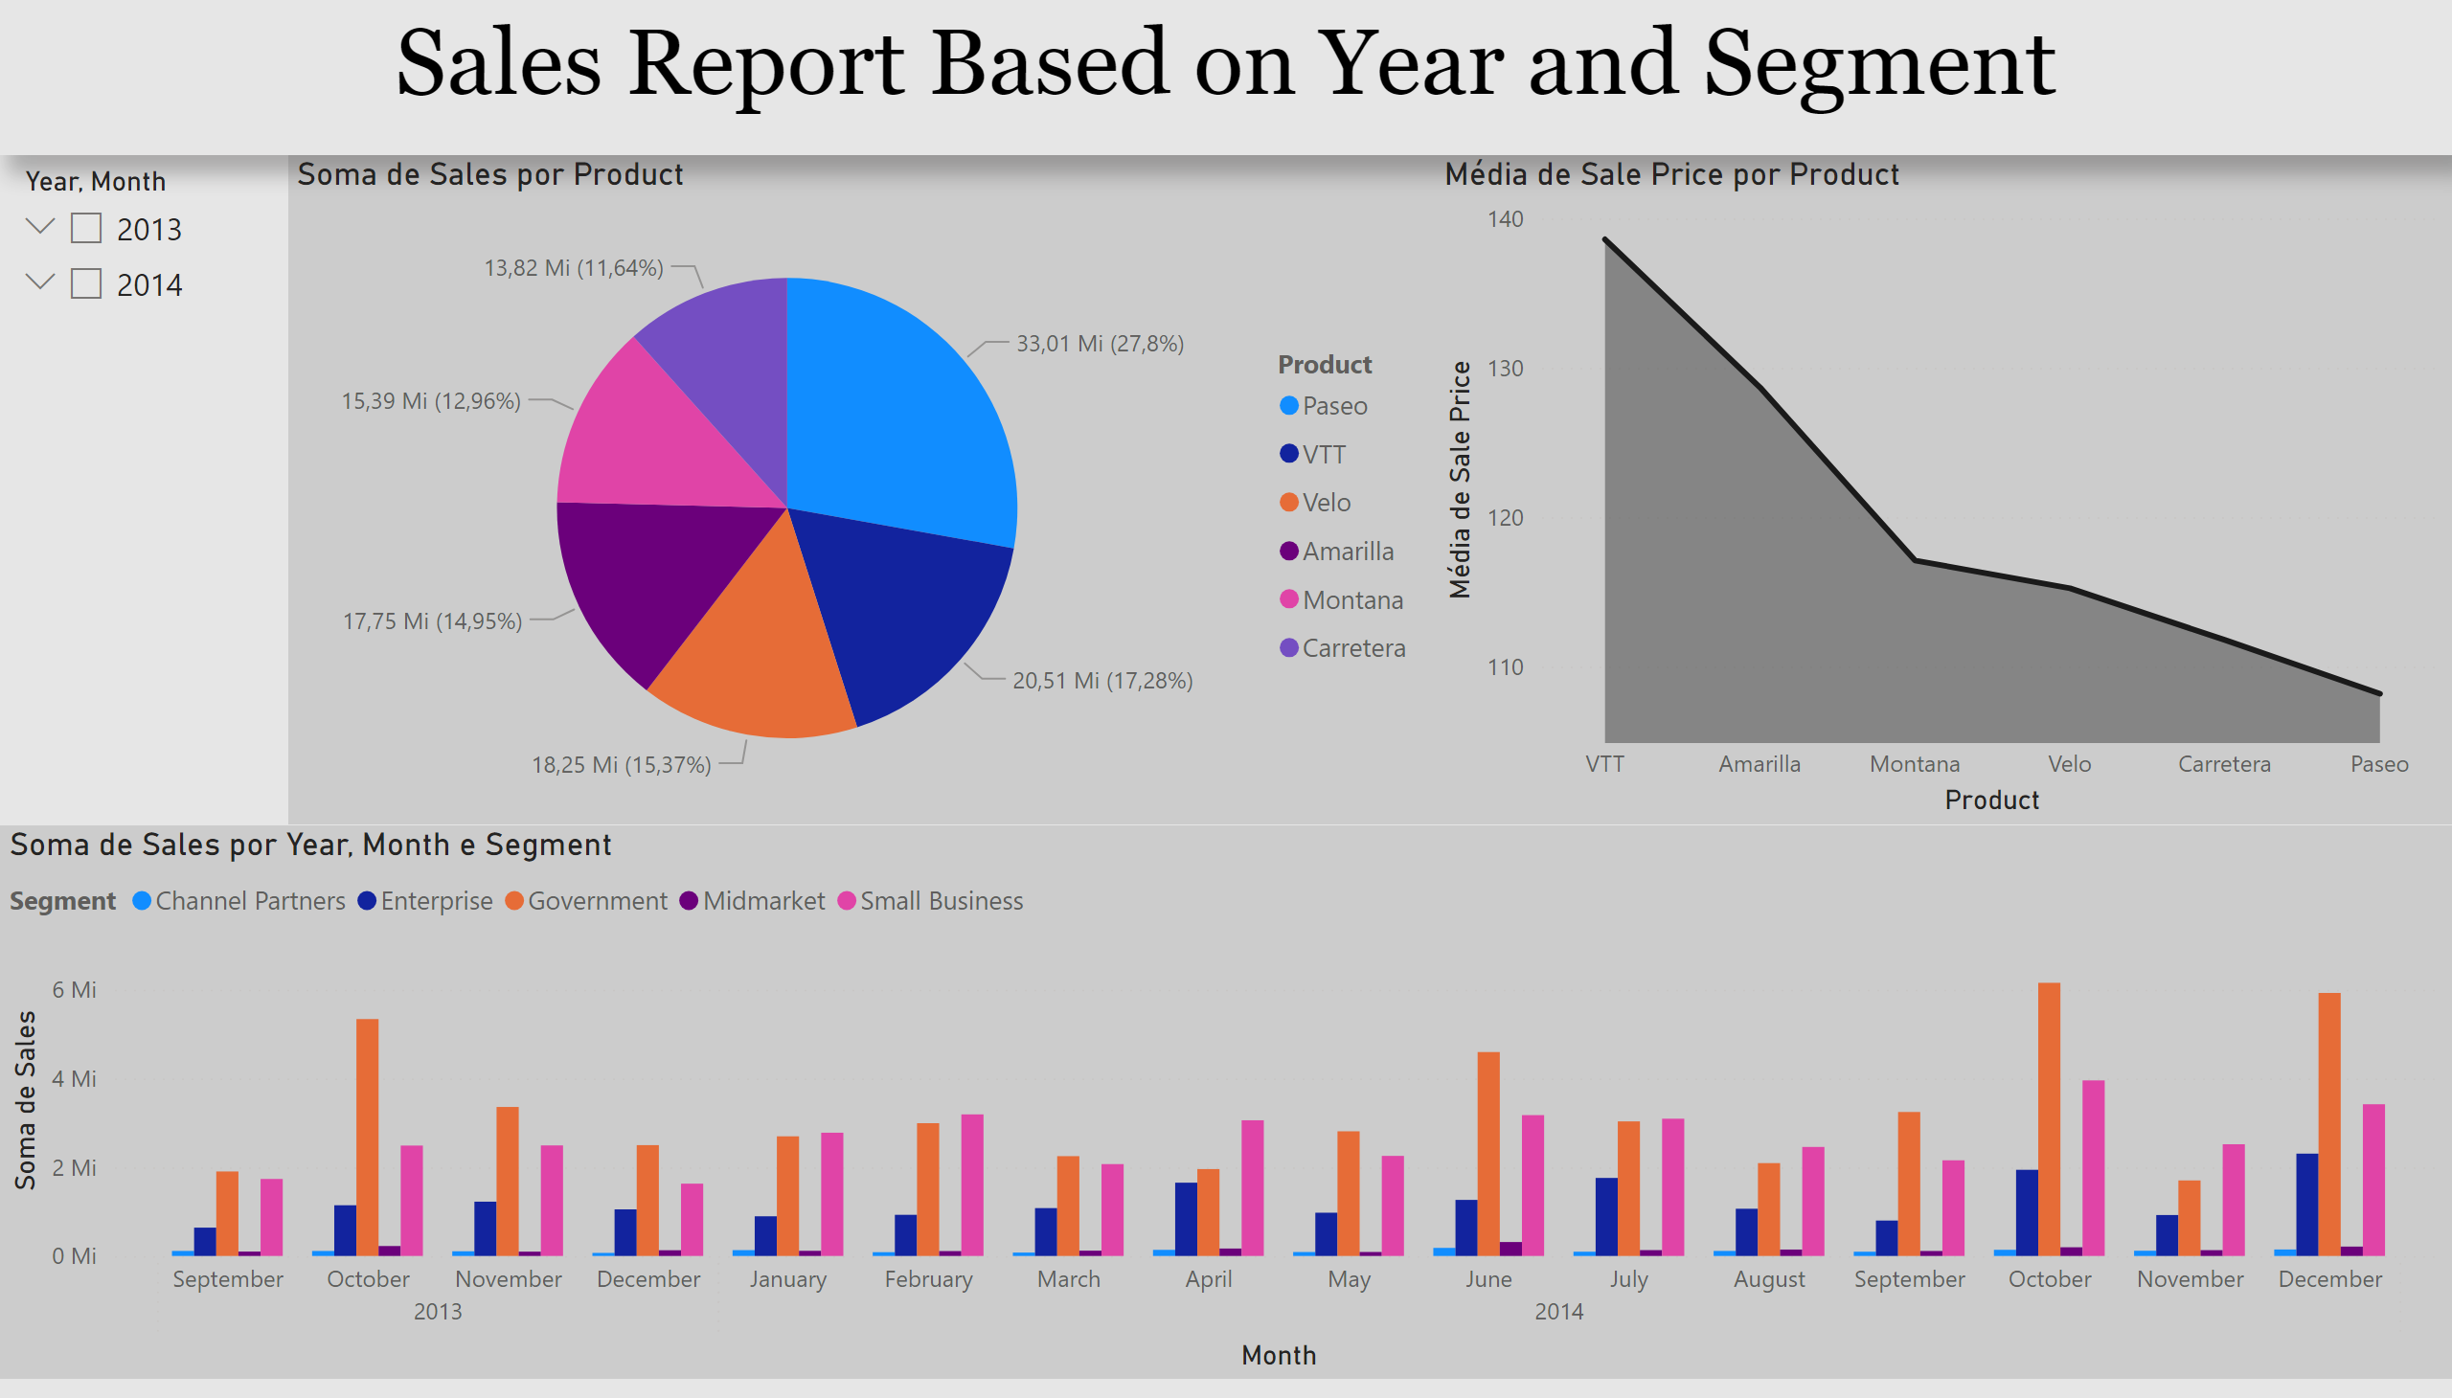
Page 1
Notes:
pieChart
No alt text provided
areaChart
No alt text provided
clusteredColumnChart
No alt text provided
slicer
No alt text provided
textbox
No alt text provided

Slide 2
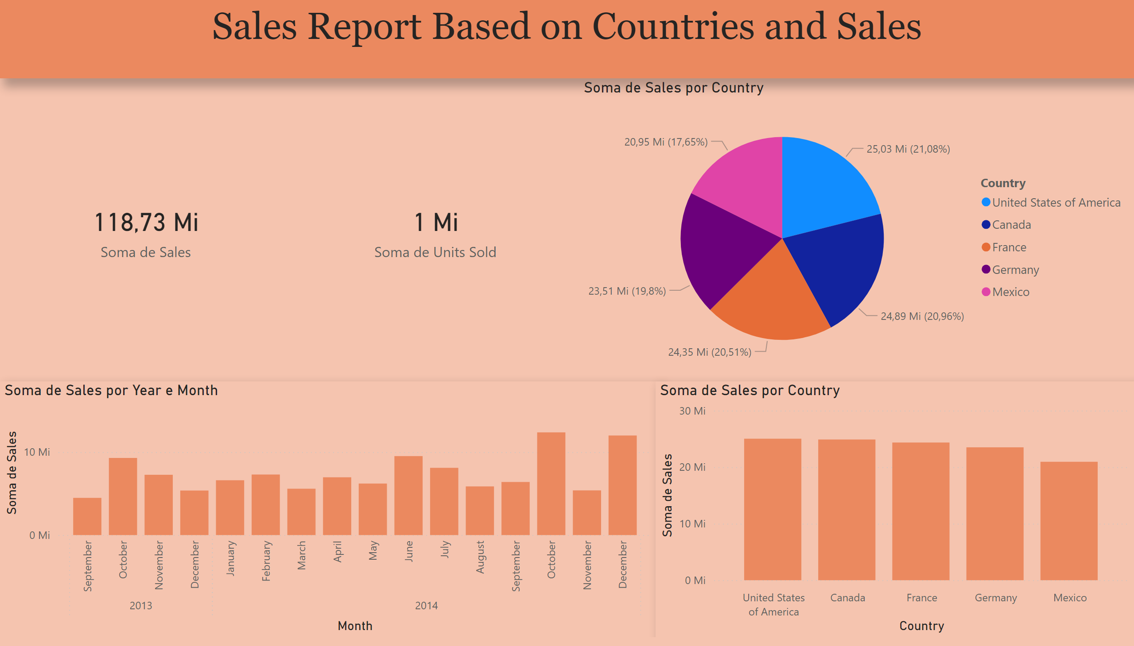
Page 2
Notes:
card
No alt text provided
card
No alt text provided
pieChart
No alt text provided
clusteredColumnChart
No alt text provided
clusteredColumnChart
No alt text provided
textbox
No alt text provided

Slide 3
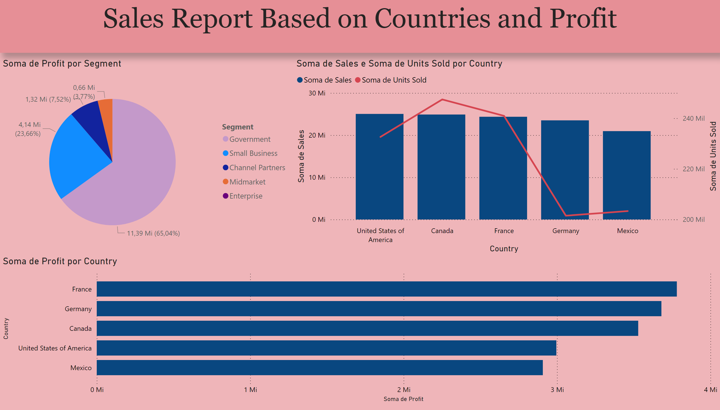
Page 3
Notes:
lineClusteredColumnComboChart
No alt text provided
clusteredBarChart
No alt text provided
pieChart
No alt text provided
textbox
No alt text provided

