Slide 1



SENSUS
THEME
Mental Health
JOURNALLY YOURS
TEAM SENSUS
Samarth Arora
Utkarsh Gupta
Ishant Dahiya
Pragati Kumar
1.

Slide 2




PROBLEM STATEMENT
AWS was an uncharted territory for us as none of us had ever hosted a project on AWS before. We had always been hosting on Heroku which hosted apps having longer loading times which could cost us user experience. Hence, our team committed to hosting on AWS.
We came across a multitude of problems but before registering for Eduthon we had decided that the quality of our app was a non negotiable for us.
Mental health is an issue more deep-rooted than as we know it.
More often than not, people miss out on the subtle signs indicating certain behavioural changes that they might be experiencing in their daily life because of the unavailability of a platform to accurately collect and analyse such data.
2.

Slide 3

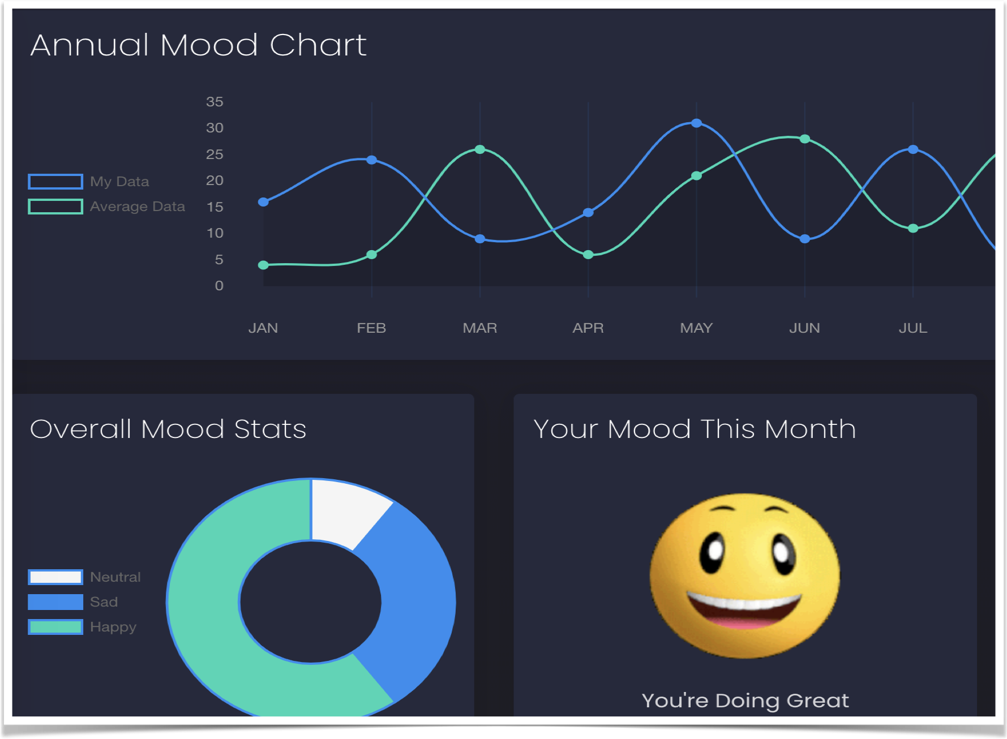

PROPOSED SOLUTION
ANALYSING THE ENTRIES…
Our product helps the user-
vent out
preserve their write-ups
stay informed of their mental well-being so that enough opportunity is given to them to work upon it.
Using a sentiment analysis ML model, Sensus displays an analysis showing the mood of the user and graphically represents the user’s mental health track record ranging from a day to over a year’s data.
DEPLOY USING AWS…
6 hours and 6 redbulls later, we managed to get our project hosted having added to our tech stack knowledge about load balancers like nginx, ec2 machines.
3.

Slide 4



UNIQUE SELLING POINTS OF SENSUS
Accurate mood predictor
Engaging interface for better user experience
Graphical analysis showing comparative trends
Easy to interpret courtesy the use of apt legends
Huge database to track progress- long term and short term
Captions hint positive reinforcement by using suggestive psychology to the product’s advantage
Your feelings MATTER! Have a thought? Write it down and we’ll take care of everything after that :)
4.

Slide 5









TECH STACK
MONGODB
EXPRESS
REACT
NODEJS
GOOGLE CLOUD PLATFORM
AMAZON WEB SERVICES
NGINX
5.

Slide 6

TEAM SENSUS
6.

