Slide 1



DEVELOPMENT OF AN AGENT-BASED SYSTEM BASED ON A LARGE LANGUAGE MODEL FOR AUTOMATION OF FINAL PROJECT ADMINISTRATION FOR STUDENTS OF THE DEL INSTITUTE OF TECHNOLOGY
11423007 Jonathan Raphael Sinaga
11423008 Ferdianty Mariany Panjaitan
11423018 Eduward Gilbert Simanjuntak
11423029 Natasya Hutapea
11423050 Boas Rayhan Turnip
Third Final Project - Group 07

Slide 2
01
Introduction
02
Project Goals
03
Analysis
OUT LINE
04
Methodology
05
Implementation
06
Product Backlog
07
Demo

Slide 3
INTRODUCTION
The processes of student group formation, supervisor/examiner assignment, and seminar scheduling in VokasiTera are still performed manually by the Final Project Coordinator.
The increasing number of students and the complexity of academic regulations make these processes time-consuming and prone to scheduling conflicts as well as imbalanced lecturer workloads.
This research develops an Agent-Based System utilizing Large Language Model (LLM) technology to provide automated, objective, and conflict-free recommendations as decision support for the Final Project Coordinator.

Slide 4
PROJECT GOALS
Primary Objective: Automate Final Project administration at the Faculty of Vocational Studies, Institut Teknologi Del, using an LLM-powered agent-based architecture.
Key Services:
Generate intelligent, data-driven recommendations for student grouping, supervisor/examiner assignments, and seminar scheduling.
Provide structured decision-support insights to assist the Final Project Coordinator.
Maintain human-in-the-loop control, ensuring all final decisions remain with the Coordinator.

Slide 5
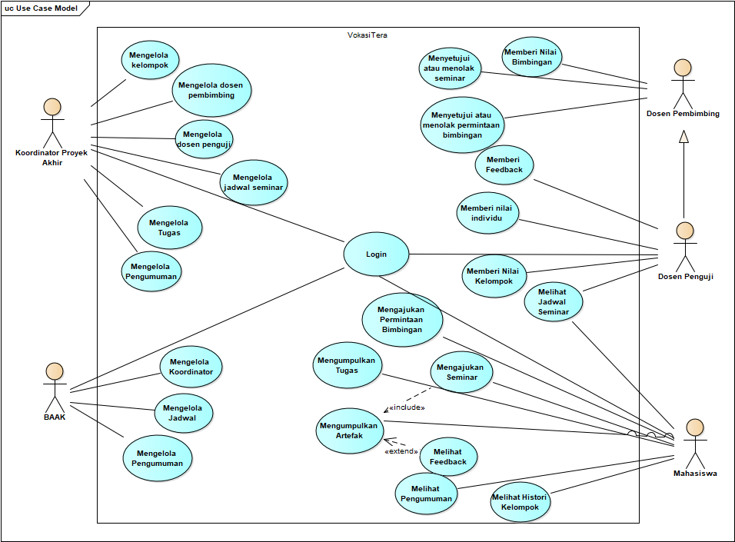
ANALYSIS - USE CASE

Slide 6
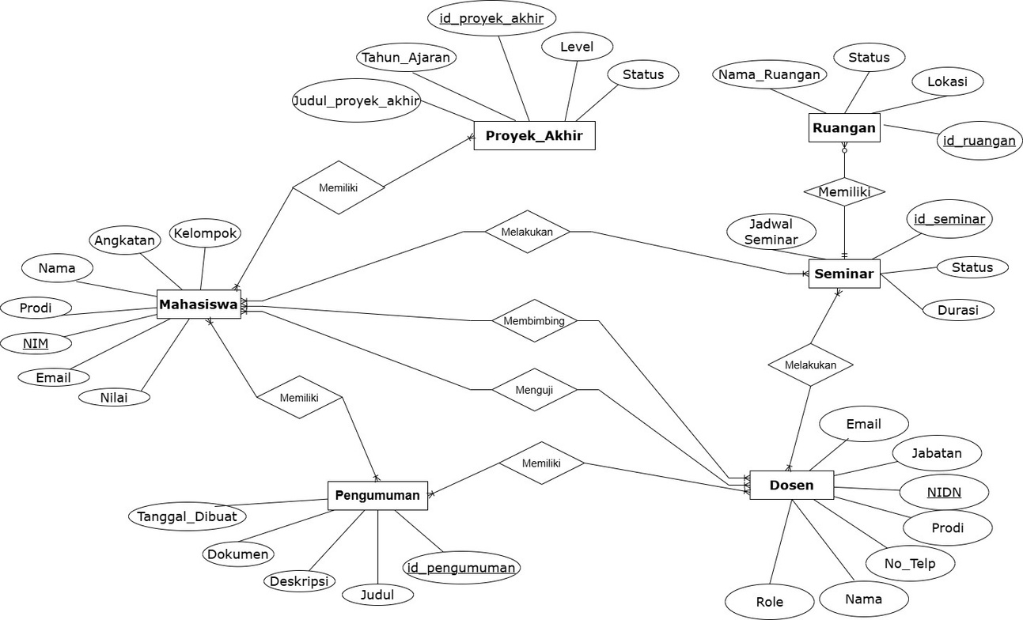
ENTITY RELATIONSHIP DIAGRAM

Slide 7
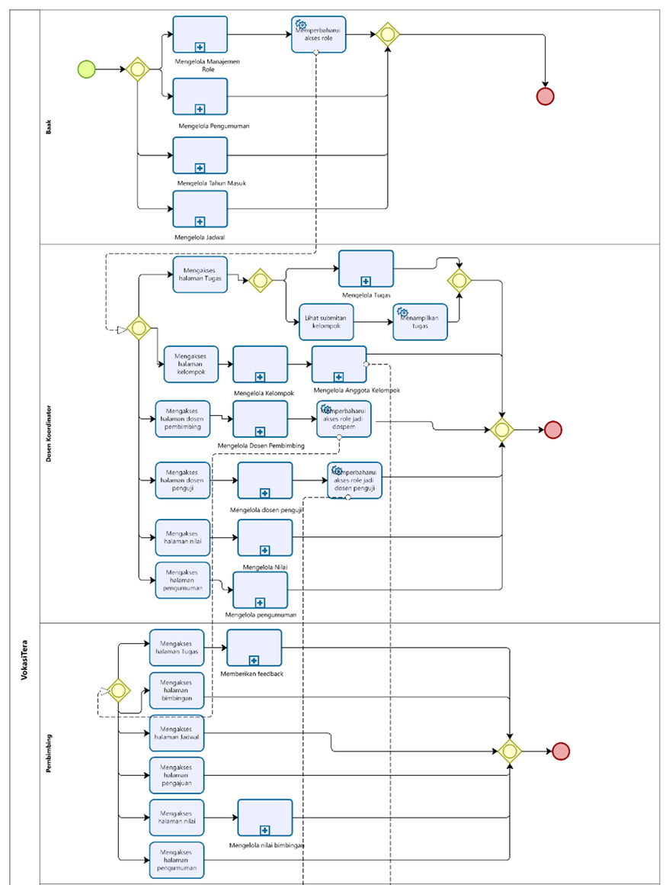
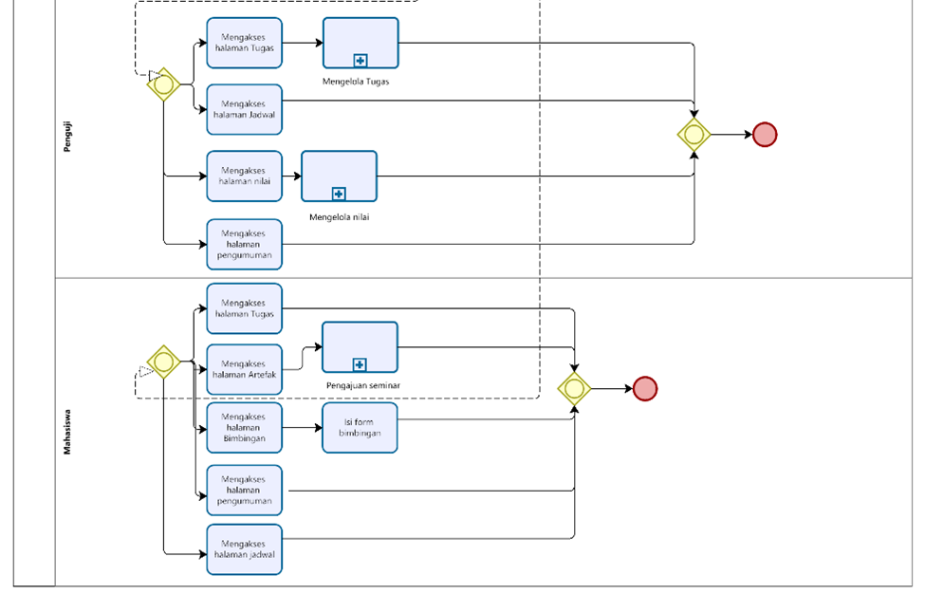
BPMN CURRENT SYSTEM

Slide 8
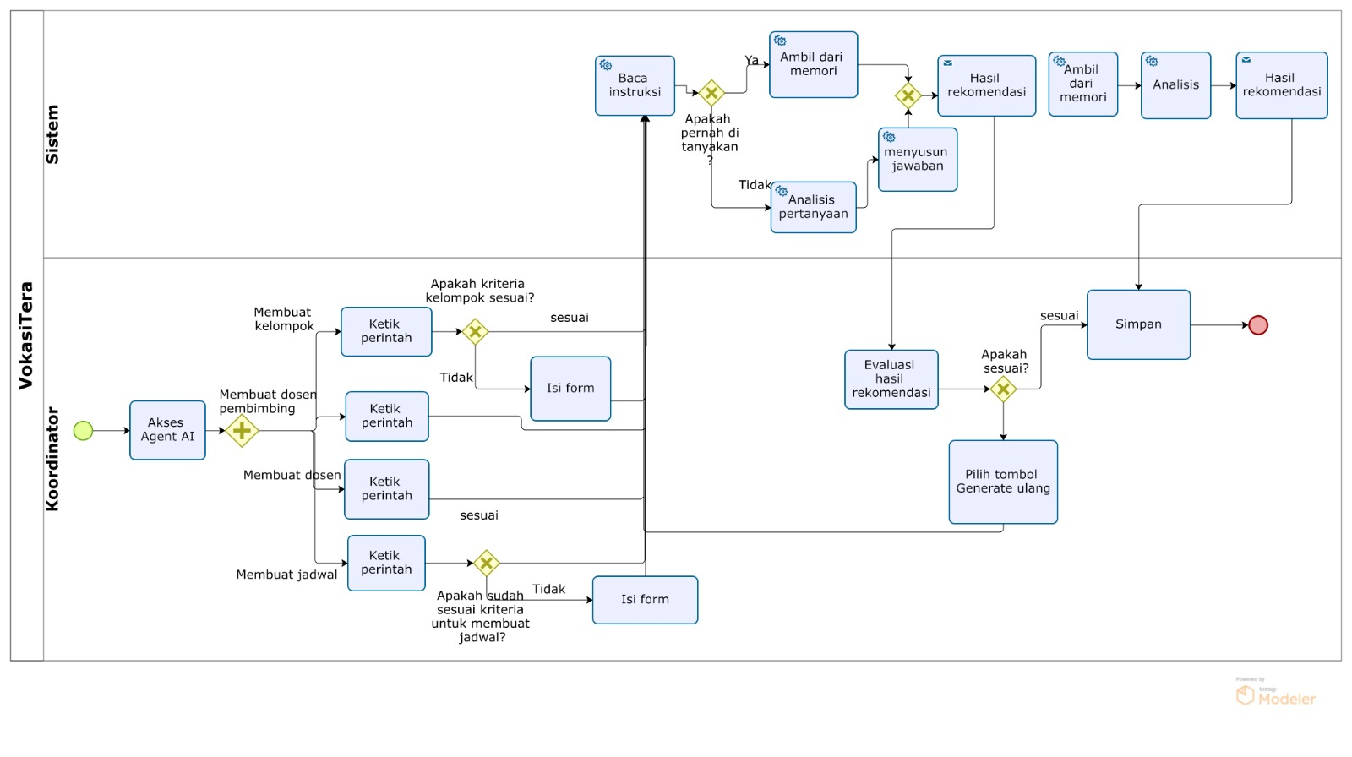
BPMN TARGET SYSTEM

Slide 9
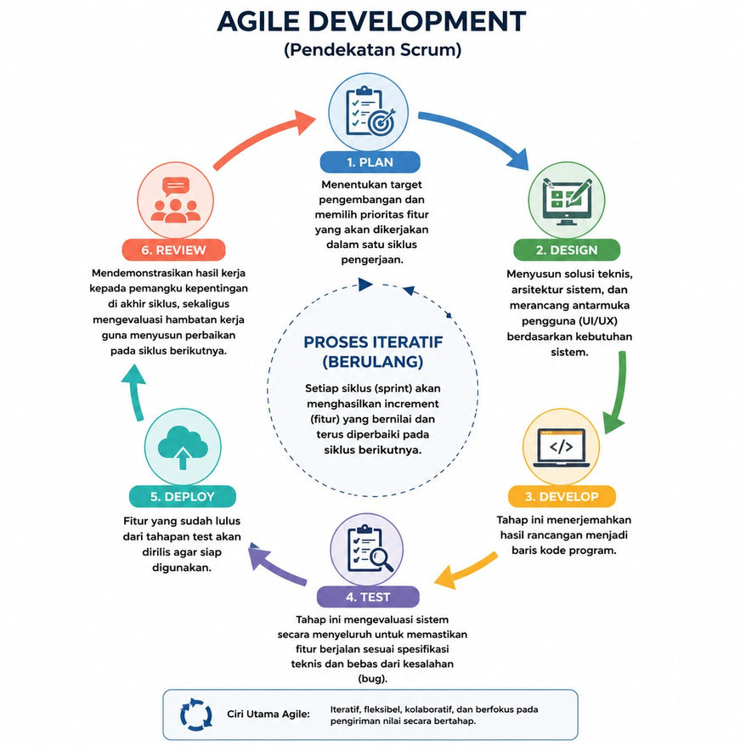
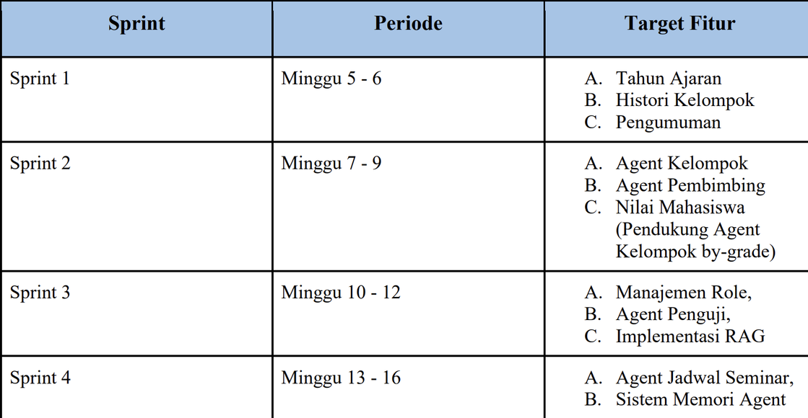
AGILE METHODOLOGY

Slide 10
IMPLEMENTATION
Integrating the system with OpenAI Large Language Models (LLM) through API services to provide intelligent recommendations and natural language interactions.
Applying a multi-storage architecture, consisting of:
MySQL as the source of truth for transactional and academic data.
Redis as short-term memory and caching storage for agent interactions.
MongoDB as long-term memory storage for conversation history, agent reasoning, and contextual information.
Implementing a Retrieval-Augmented Generation (RAG) architecture using Project Final Guidelines documents as the primary knowledge source for contextual question answering.

Slide 11
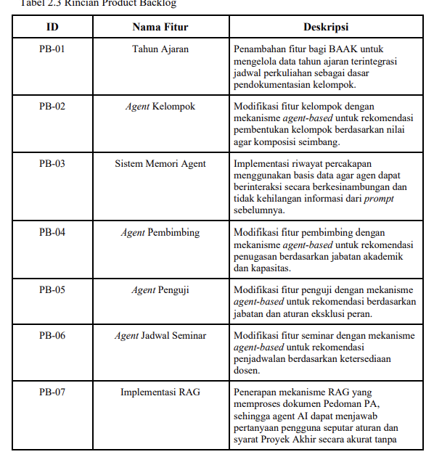
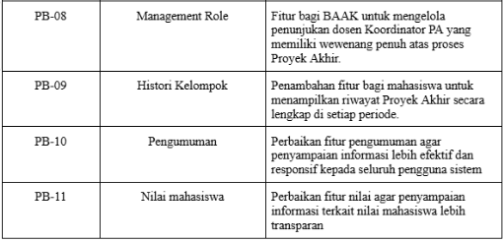
PRODUCT BACKLOG

Slide 12
DEMO

Slide 13
THANKYOU

