Slide 1

Plant manager
Edoardo Nicolodi
a.y. 2022/23

Slide 2




Goals
Realize a telegram bot on a NodeMCU board
The bot should be user friendly
User can turn on and off the lights and the water
User should be able to set a configuration
User should be able to get the current status of the system
User should be able to get the current configuration
Notes:
Edo

Slide 3
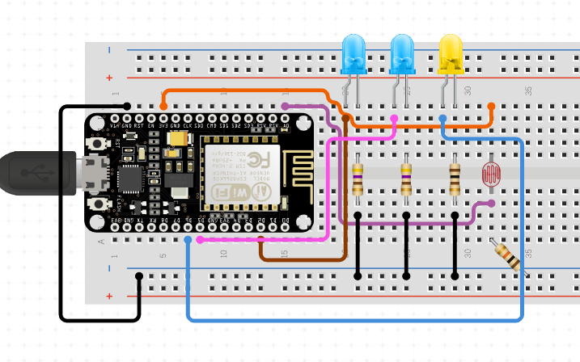



Hardware overview
1 Photoresistor
3 LEDs
4 Resistors
NodeMcu board
Router
Phone /tablet /PC
Notes:
Edo

Slide 4





Software workflow
Connect to WIFI
Startup the Telegram bot API
Bot is waiting for a message
Handle message
Control valve and lights
Do physical operation
Sleep
Send feedback to the user
Notes:
Basic Working Scheme ○ Describe how your system works. Talk about your design ○ Which sensors did you use? Explain the basic working flow of the system. ○ If applicable, explain how does the user interacts with your system. ○ Show some pictures (at least one) of your system.

Slide 5


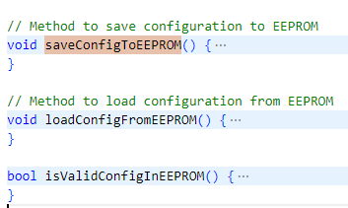


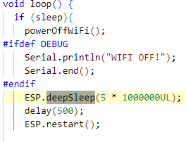


Core software
Telegram block interface
Configuration management
Sensor reading and actuator control
Power management
Event data driven architecture
Telegram command parsing

Slide 6

Conclusions
~ 700 lines of code written
Bot is working!
Goals prefixed has been achieved
Integration of EEPROM
Power management
Moving from JSON to Cayenne Low Power Payload
Moving from wifi to other low power such as Lora or Zigbee
Changing board to support more sensors
Integrate Inline button for a better experience
Plants will never die anymore when you’re away!!

Slide 7
Q & A
Edoardo Nicolodi
a.y. 2022/23

