Slide 1
CREDIT RISK MANAGEMENT
EDWARD TAN YUAN CHONG

Slide 2
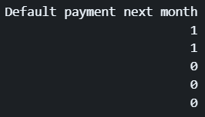
HOW IS YOUR PREDICTION TASK DEFINED? AND WHAT IS THE MEANING OF THE OUTPUT VARIABLE?
PREDICTION TASK → Build a classification model that predicts whether a customer will default payment next month. The output variable, Default payment next month, would have a binary variable indicating whether a customer defaults payment (1) and does not default payment (0).
DEFAULT PAYMENT → Occurs after multiple payments on a loan or other debts are missed by a person.
Notes:
Mr Joe created and defined his own prediction task, which was to…

Slide 3
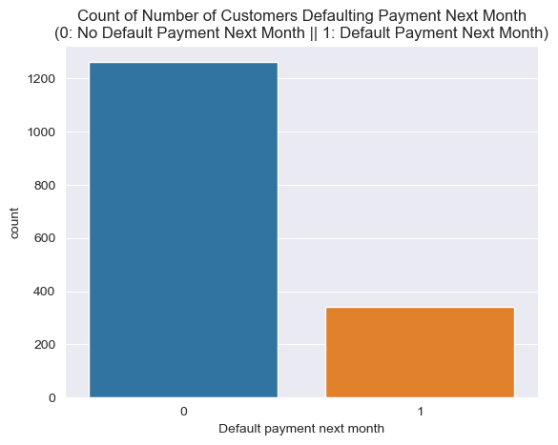
EXPLORATORY DATA ANALYSIS (EDA)
CHART 1
DATA IMBALANCE !!!
Notes:
We can see from the countplot that there is a data imbalance in the number of people who default payment next month as majority of customers do not default payment. This data imbalance is very important as it would heavily affect the way the model performs and how we evaluate the model further on.

Slide 4
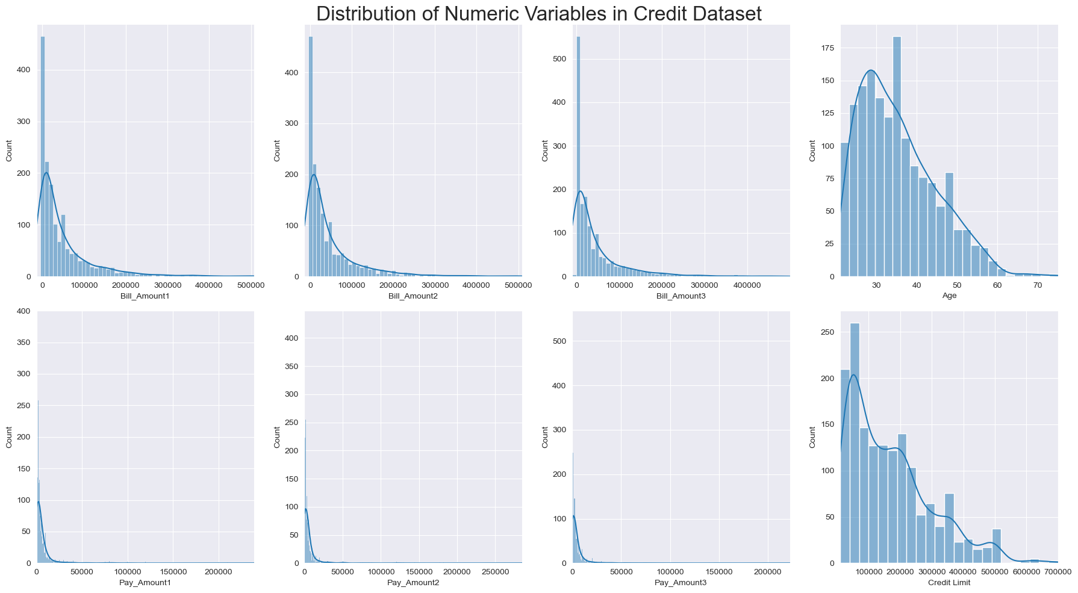
EXPLORATORY DATA ANALYSIS (EDA)
CHART 2
Notes:
This chart shows that most of the numeric variables in the dataset are positively skewed.

Slide 5
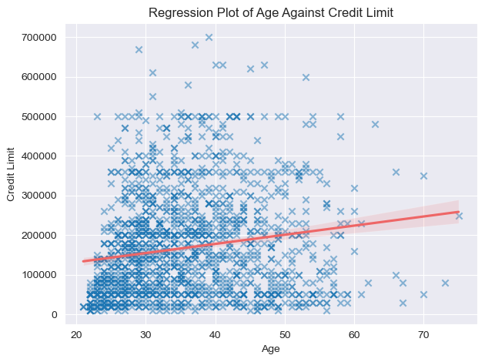
EXPLORATORY DATA ANALYSIS (EDA)
CHART 3
Notes:
This regression plot shows that there is a positive linear relationship between age and credit limit, likely because as a customer who uses the credit card for a longer period of time are trusted by the bank in being more responsible and not default payment. Hence, age and credit limit would play a part in the bank's trust in whether one would default payment or not.

Slide 6
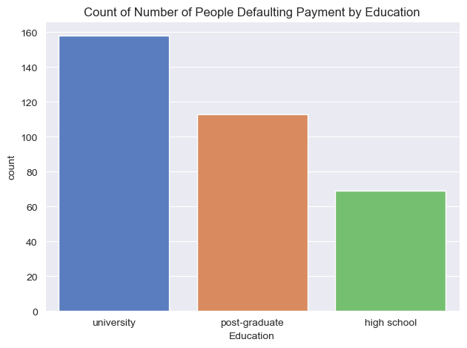
EXPLORATORY DATA ANALYSIS (EDA)
CHART 4
Notes:
From this barchart of number of people defaulting payment by education, we can see that most people who default payment tend to be university students, followed by post-graduates then high school students. This indicates that university students, who often have limited income, are more likely to default on their loans due to difficulties in paying off their school fees. On the other hand, post-graduates, who have a stable income, are less likely to default as they can manage their loans and debts. And lastly, High school students generally have fewer loans or debts, so their default rates are lower. Hence, the type of education plays a role in predicting payment defaults significantly.

Slide 7
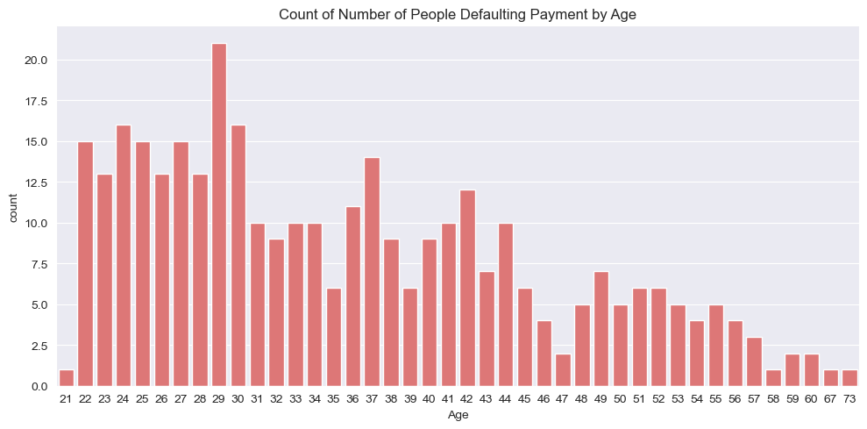
EXPLORATORY DATA ANALYSIS (EDA)
CHART 5
Notes:
This chart of count of number of people defaulting payment by age shows that most people who default payment tend to be at younger ages, likely due to university loans or unemployment after graduation thus unable to repay loans or debts. This shows that age does also play a major factor in whether one defaults payment or not.

Slide 8

FEATURE ENGINEERING
Did you process the features in any way?
Dropped unnecessary column ‘Customer_ID’ so that it would not be considered a feature and used in the prediction.
How do you represent your data as features?
Encode categorical features such as Gender, Education, and Marriage Status into a binary representation for the model to be used in machine learning later.

Slide 9
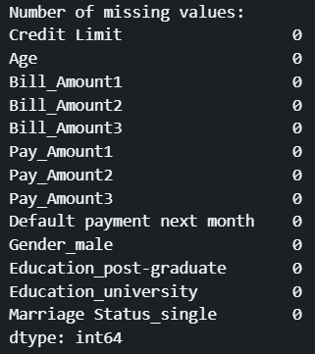
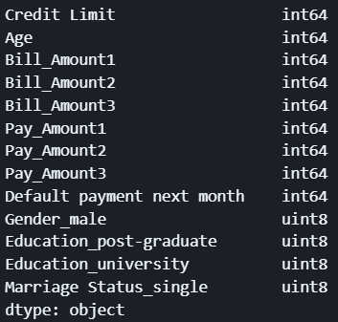
DATA CLEANING
Did you process the features in any way?
Since there are no missing values and duplicate rows, there is not much data cleaning required.
There were also no errors in the datatypes of the columns.

Slide 10
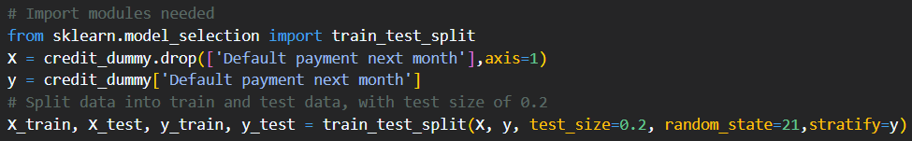
DATA PREPARATION
Split the dataset into train and test sets in a stratified fashion, with 80% of the dataset on training and 20% on test sets.

Slide 11
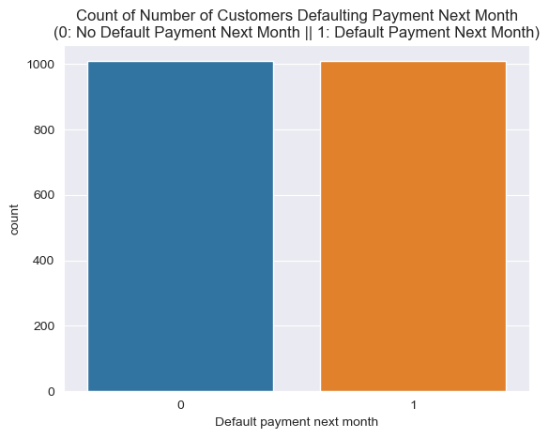
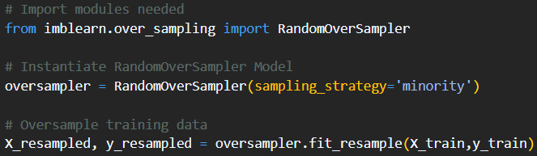
FEATURE ENGINEERING
Did you process the features in any way?
RANDOM OVERSAMPLING
ONLY ON TRAINING DATASET!

Slide 12
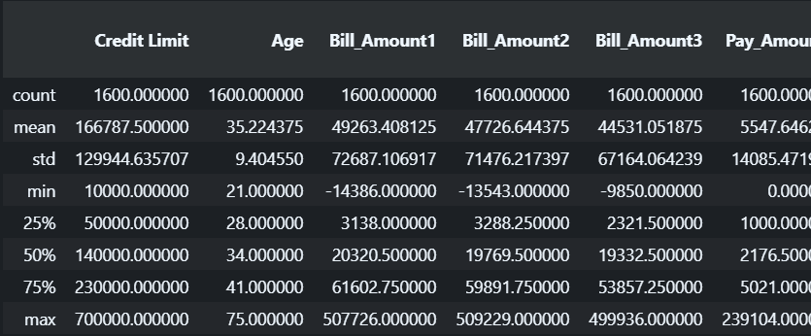
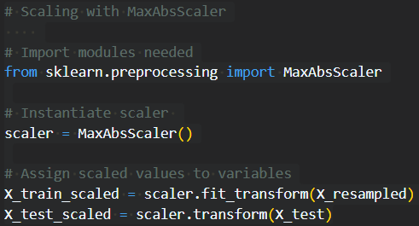
FEATURE ENGINEERING
Did you process the features in any way?
MAXABSSCALER
fit_transform Used on train data to fit scaler and transform data -> allow scaler to learn the mean and standard deviation of training data.
transform
Used on test data to apply the same transformation used on training data to ensure consistency when scaling the two sets of data.

Slide 13
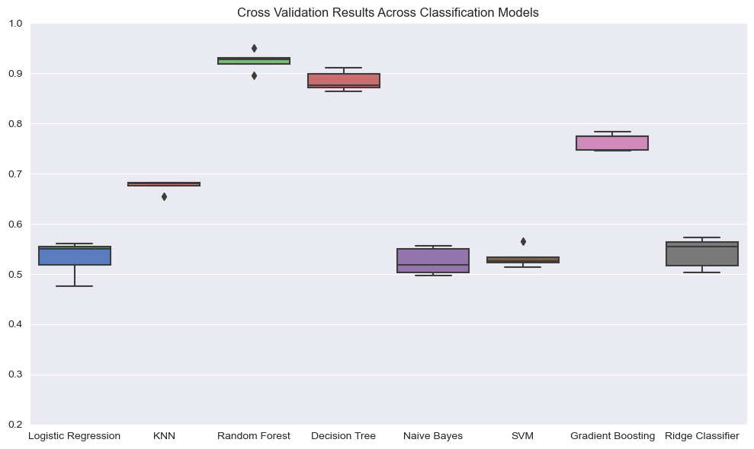
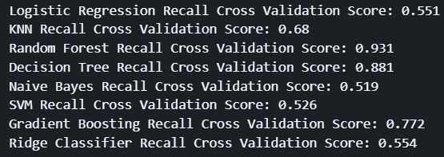
SELECTING A MODEL
How did you select which learning algorithms to use?
TRAINING DATA

Slide 14
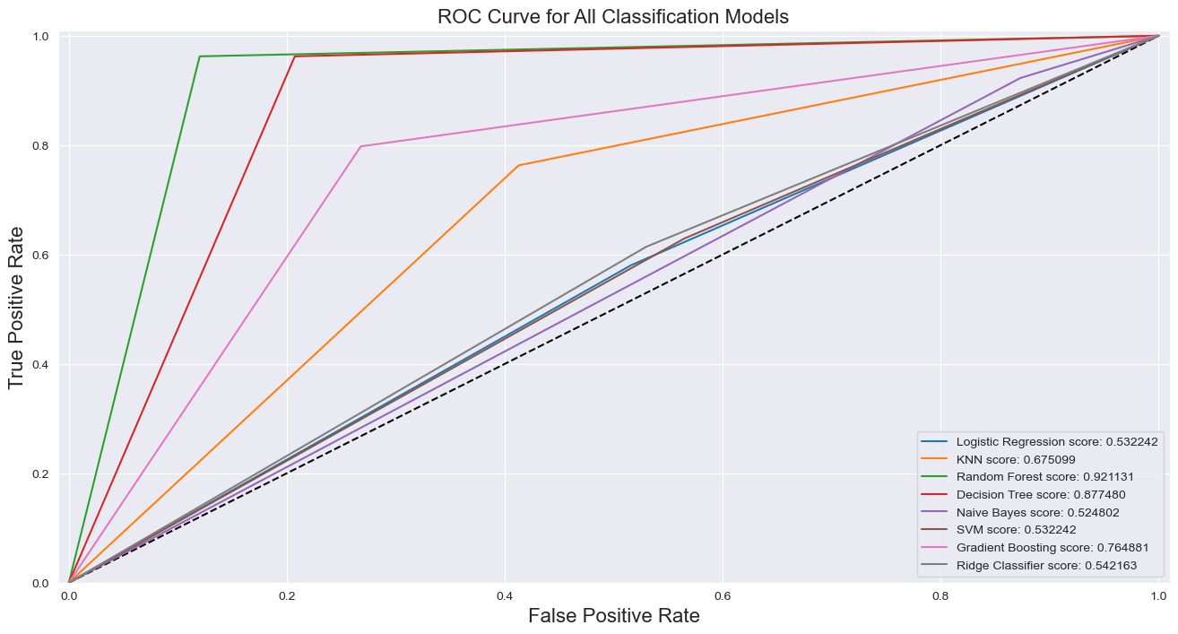
SELECTING A MODEL
TRAINING DATA

Slide 15
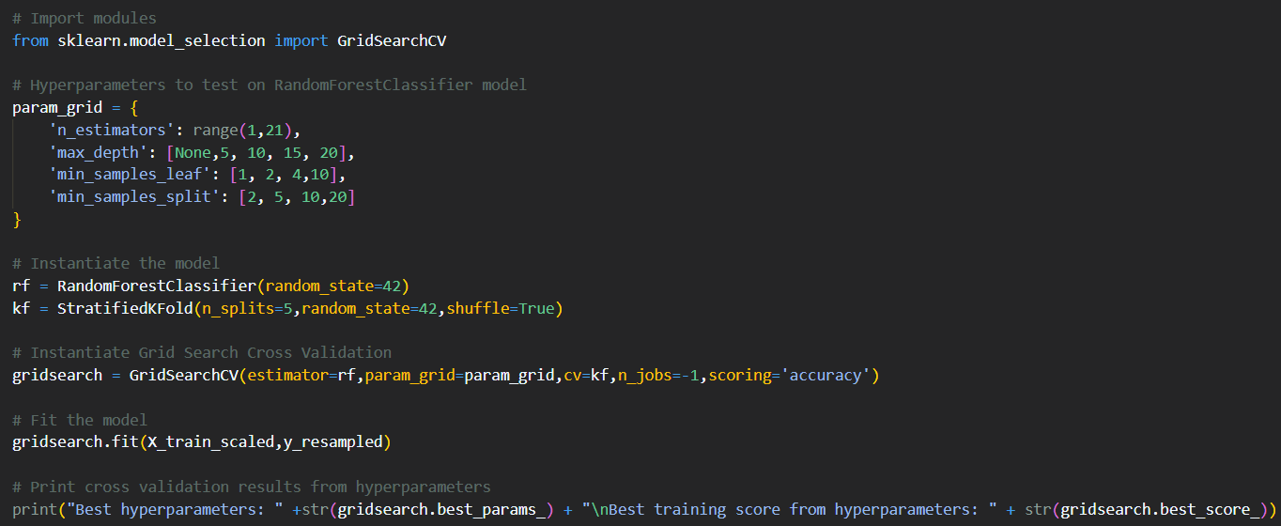
HYPERPARAMETER TUNING
Did you try to tune the hyperparameters of the learning algorithm, and in that case how?
Used GridSearchCV from sklearn to find best hyperparameters for Random Forest Classifier.
HYPERPARAMETERS
- n_estimators: Number of trees in the forest
- max_depth: Maximum depth of the trees
- min_samples_split: Minimum number of samples required to split one node
- min_samples_leaf: Minimum number of samples required at every leaf node
TRAINING DATA

Slide 16
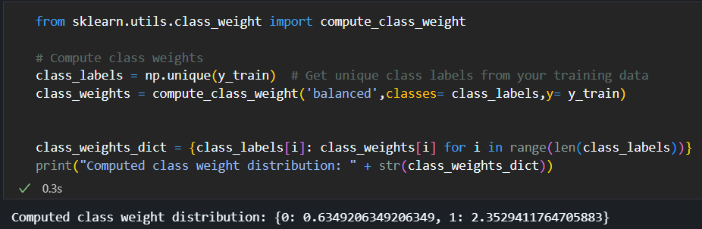
COMPUTE CLASS WEIGHT
Used compute_class_weight from sklearn to calculate class weights for each class in the imbalanced dataset to balance the weight of them.
TRAINING DATA

Slide 17
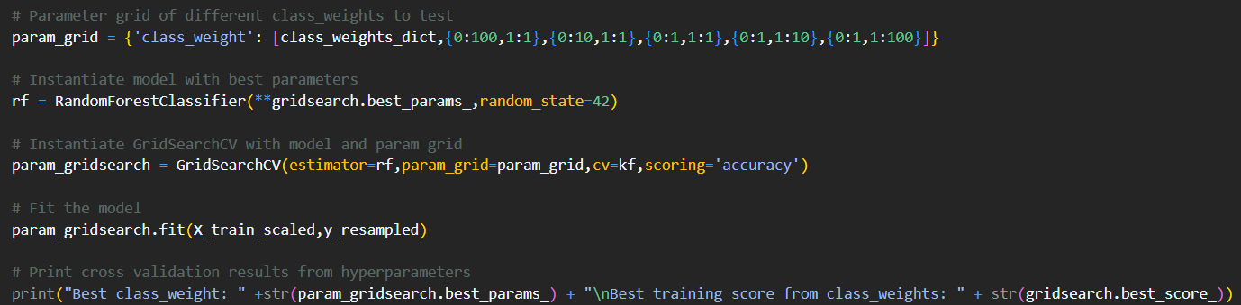
GRID SEARCH CLASS WEIGHT
Performed gridsearch with different class_weight parameters as well to find best class_weight to use for final model.
To be used as a parameter for the final model further on.
TRAINING DATA

Slide 18
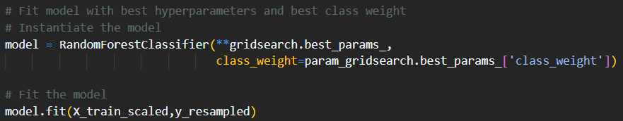
BUILDING AND FITTING FINAL MODEL
Instantiating model with best parameters from hyperparameter tuning and class weights.
Fitting model with training data.
TRAINING DATA

Slide 19
MODEL EVALUATION
How do you evaluate the quality of the system?
METRICS USED:
-CONFUSION MATRIX
-CLASSIFICATION REPORT
-PRECISION-RECALL CURVE
-AUC PR CURVE
-ROC CURVE
Notes:
For model evaluation, I utilized metrics such as confusion matrix and classification, which shows the specific predictions made by the model, and the precision, recall, f1 and accuracy of the model.
I also utilized the precision-recall curve to plot the PR curve to view the model’s performance in terms of the relationship between the precision and recall score, along with area under curve for the PR curve to determine the model’s performance.
Initially, I used the ROC curve but chose to not implement it.

Slide 20
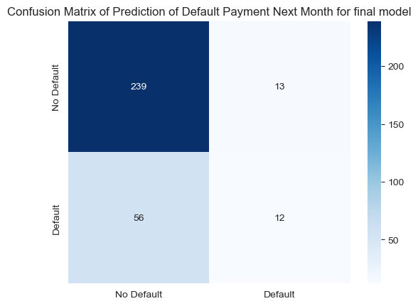
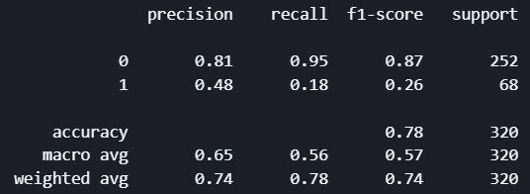
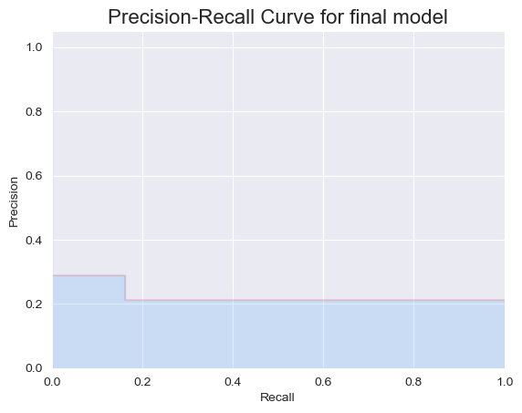
MODEL EVALUATION
TRUE NEGATIVE
FALSE POSITIVE
The average precision AUC score: 0.31468169504643967
FALSE NEGATIVE
TRUE POSITIVE
n_estimators=20,max_depth: None,class_weight: {0:1,1:10}
TEST DATA
Notes:
On my final model with best hyperparameters, from the confusion matrix, we can see that the model predicted most true negatives correctly, whilst majority of the true positives were predicted wrongly, default payment next month, which is a result of imbalanced data, as it can cause the model to be biased towards predicting the majority label, no default payment next month more frequently, leading to a poorer true positive rate, hence lower recall score for 1.
The PR curve also shows that generally the model does not perform that well as it has a low area under curve score at around 0.31.

Slide 21


MODEL EVALUATION
In risk management, we can’t possibly be that inaccurate in predicting people who default as that would have detrimental effects to the bank, such as affecting its financial stability, as they would be unable to prepare for potential losses from loans.
TRUE NEGATIVE
FALSE POSITIVE
FALSE NEGATIVE
TRUE POSITIVE
Hence, we should focus on improving RECALL score for actual defaults.
TEST DATA

Slide 22
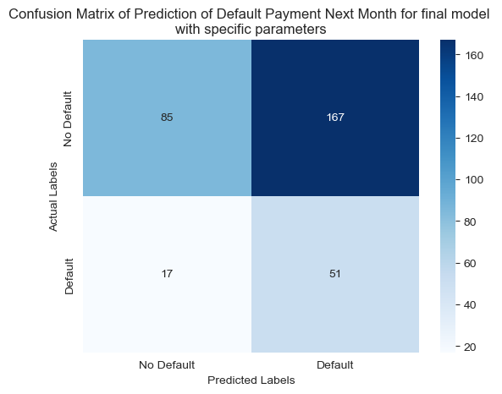
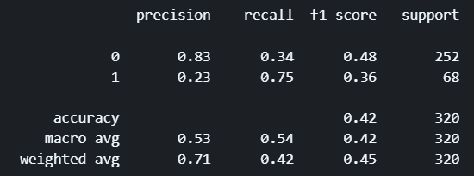
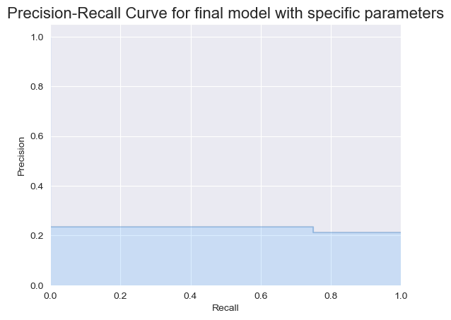
MODEL EVALUATION
What is one solution? The max_depth & class_weight parameter in the model.
TRUE NEGATIVE
FALSE POSITIVE
The average precision AUC score for final model with specific parameters: 0.5185349770642202
FALSE NEGATIVE
TRUE POSITIVE
max_depth = 20, class_weight = {0:1,1:100}
TEST DATA
Notes:
I then went on to manually test hyperparameters in order to obtain a better recall score, which led to me these specific hyperparameters, which were max_depth = 20, and class weight {0:1,1:100}. This allowed the model to perform way better in terms of recall score and predicting true positives, which is more crucial for the bank in terms of risk management. By adjusting the class weight to give the minority class significantly more importance, it would help the model focus more on correctly identifying instances of the minority class at the cost of the model’s performance in predicting the majority class, but in an imbalanced dataset, improving predictions of the minority class would be our goal. By setting max depth to 20 it also limits the depth of the number of trees in the random forest classifier, preventing overfitting and allowing our model to focus on predicting more true positives especially since our test data is heavily imbalanced and is very prone to overfitting.
`

Slide 23
MODEL EVALUATION
Even though the number of false positives increased, the number of true positives also increased, which is safer for the bank to assume more people to default compared to assuming people would not default in the context of risk management as it is better to be safe than sorry.
TRUE NEGATIVE
FALSE POSITIVE
FALSE NEGATIVE
TRUE POSITIVE
TEST DATA

Slide 24
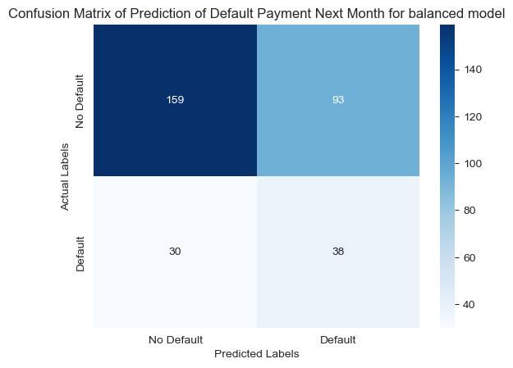
MODEL EVALUATION
Max_depth = 25, class_weight = {0:1,1:60}
However, alterations on parameters can also be made to fit the bank’s needs.
-> max_depth
-> class_weight
TRUE NEGATIVE
FALSE POSITIVE
For example, the model on the left was a more “balanced” model that could be made with alterations to the hyperparameters.
FALSE NEGATIVE
TRUE POSITIVE
TEST DATA
Notes:
However, there are also other combinations of hyperparameters of class weight and max depth that can provide varying results for the model based on the bank’s needs.
For example, with a max depth of 25 and a class weight of {0:1,1:60}, I was able to obtain a more balanced result as shown by the confusion matrix on the left, as the model was able to predict most true negatives, and more than half true positives, and if a bank prioritizes having a balance, this would likely fit their need.
But since personally, I believe in the bank favouring a model that can predict as many true positives as possible to reduce risks of financial instability, I would still use my previous hyperparameters and model as a guideline.

Slide 25
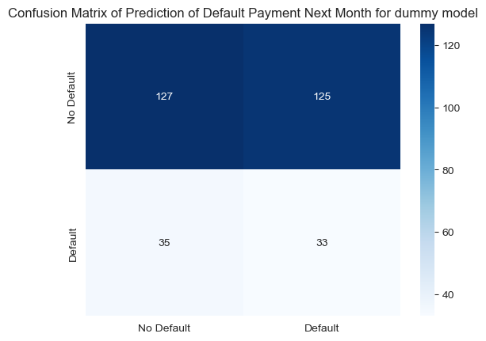
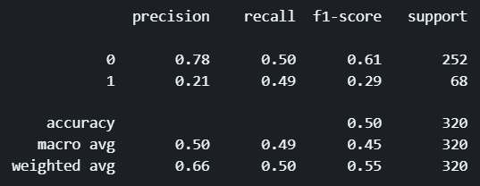
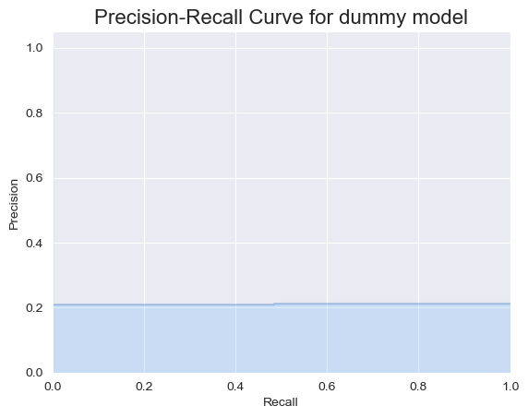
DUMMY MODEL
How well does your system compare to a dummy baseline?
The average precision AUC score: 0.4017649385703649
strategy = ‘stratified’
TEST DATA
Notes:
For the dummy model, I set the strategy hyperparameters to stratified as I want to take into account the fact that there is a data imbalance in the class distribution of the test data.
From the results of the dummy model, we can see that the model was able to obtain a balanced result, predicting half of actual default and no default correctly, whilst the other half was predicted wrongly. Comparing my system to the dummy classifier, my system does better in having higher true positives compared to the dummy model, however, the dummy model is able to predict more true negatives correctly. Despite that, in the context of risk management, I believe that it is more important for the bank to focus on the true positives and predicting for actual defaults more accurately and hence my system would be better for the bank despite the system still making errors.
However, if the bank is looking for a more balanced approach, my system’s balanced model still performs better in comparison to the dummy model, and hence my overall systems do perform better than the dummy model.

Slide 26
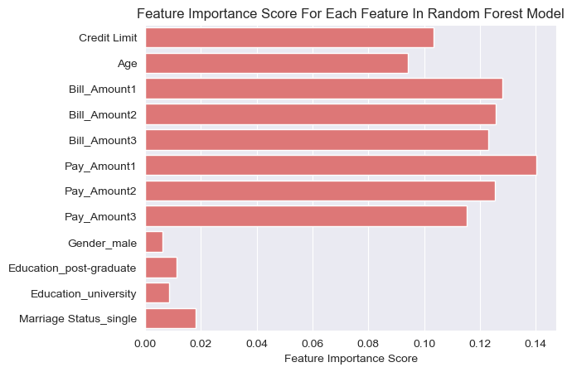
FEATURE IMPORTANCE
Is it possible to say something about which features the model considers important?
Obtained with
model.feature_importances_
Least important
features

Slide 27
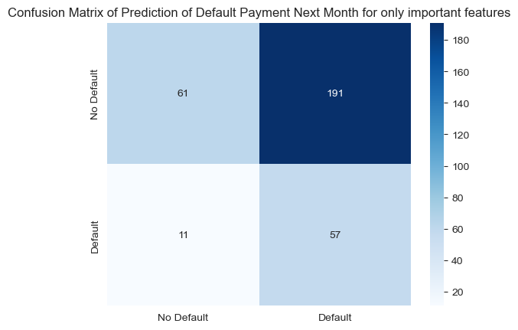
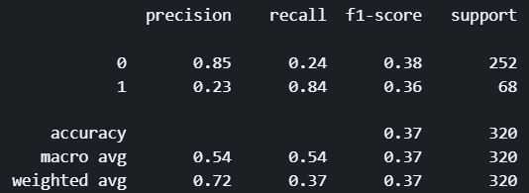
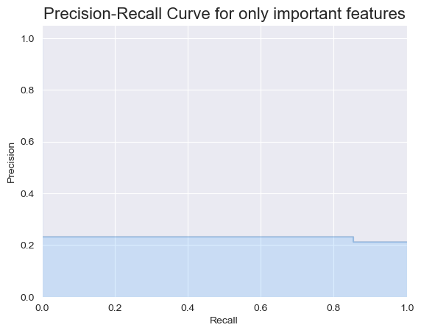
FEATURE IMPORTANCE
The average precision AUC score for only important features: 0.5585614516891094
max_depth = 20, class_weight = {0:1,1:100}
TEST DATA
Notes:
By removing features that are less important to predict the classes, we can see a slight increase in the number of true positives, but also an even bigger increase in false positives predicted as well. This shows that by removing less important features, it does help improve the overall precision-recall score, however, it also negatively affects the number of false positives as well. The decision of whether to remove less important features would then be up to the bank on whether they are willing to sacrifice a higher number of false positives for an increase in true positives, which would fall under the bank's ideals and goals in the end.

Slide 28

CONCLUSION
In conclusion,
-> Bank should prioritise predicting minority classes
-> Overprepare for a higher number of defaults
-> Prevent adverse effects such as financial instability
which can be done with my final model with specific hyperparameters and the choice of removing less important features to further improve predicting minority class performance.
Note that this also comes at the cost of misclassifying the majority class and could harm customer relationships and business opportunities.
Ultimately, the decision on the trade-off between the majority and minority class would depend on the bank’s risk tolerance, values, and business objectives.

Slide 29
STUFF THAT WERE NOT IMPLEMENTED
SMOTE Oversampling method
-> Seemed to worsen my model’s performance overall.
ROC Curve during Final Model Evaluation
-> Imbalanced test dataset -> Changed focus to recall scores instead -> Used PR curve instead of ROC curve for more accurate interpretation

Slide 30
THANK YOU!

