Slide 1
ANALYSIS OF BUS RIDERSHIPS
NAME: EDWARD TAN YUAN CHONG

Slide 2
DATASETS USED
VARIABLE NAME | DESCRIPTION | DATA TYPE
ServiceNo | Bus service Number | object
Operator | Bus operator e.g. SBST,SMRT | object
Direction | Direction of bus, 1 = inbound, 2 = outbound | object
Stop Sequence | Cumulative stop sequence of the bus | int
BusStopCode | Code of the bus stop used | Object
Distance | Cumulative Distance covered by bus | float
DATASET #1: BUS ROUTES
The dataset consists of in-depth information of each bus’s routes, such as service number, operator, direction, stop sequence, bus stop code, cumulative distance and first and last bus on certain days.
Dataset #1 has 20393 rows and 12 columns.
LINK TO DATASET #1 - #3: LINK 1 LINK TO DATASET #4 : LINK 2

Slide 3
DATASETS USED
VARIABLE NAME | DESCRIPTION | DATA TYPE
ServiceNo | Bus service Number | object
Operator | Bus operator e.g. SBST,SMRT | object
Direction | Direction of bus, 1 = inbound, 2 = outbound | object
Category | Category of bus e.g. TRUNK, EXPRESS | object
AM_Peak, PM_Peak | Range of minutes of bus arrival timing frequency during peaks at a specific time of day, e.g. AM = morning, PM = night | object
AM_Offpeak, PM_Offpeak | Range of minutes of bus arrival timing frequency during offpeaks at a specific time of day, e.g. AM = morning, PM = night | object
DATASET #2: BUS SERVICES
The dataset consists of information of each bus, such as its service number, operator it belongs to, direction, category of bus, and morning/night offpeak/peak frequency of bus arrivals.
Dataset #2 has 215 rows and 8 columns.
LINK TO DATASET #1 - #3: LINK 1 LINK TO DATASET #4 : LINK 2

Slide 4
DATASETS USED
VARIABLE NAME | DESCRIPTION | DATA TYPE
DATASET #3: BUS STOPS
BusStopCode | Code of bus stop | object
RoadName | Name of road where bus stop is | object
Description | Description of bus stop | object
Latitude | Latitude of bus stop | float
Longitude | Longitude of bus stop | float
The dataset consists of information of each bus stop, identified by Bus Stop Code, with data such as road name, description of bus stop, and the longitude and latitude of the bus stops.
Dataset #3 has 5021 rows and 5 columns.
LINK TO DATASET #1 - #3: LINK 1 LINK TO DATASET #4 : LINK 2

Slide 5
DATASETS USED
VARIABLE NAME | DESCRIPTION | DATA TYPE
Data Series | Year | int
Average daily ridership – MRT | Average daily ridership of MRTs in thousands | int
Average Daily Ridership - LRT | Average daily ridership of LRTs in thousands | int
Average Daily Ridership - Bus | Average daily ridership of Buses in thousands | int
DATASET #4: RIDERSHIP
The dataset consists of yearly ridership in thousands of public transport modes in Singapore, such as Buses, MRTs and LRTs from years 1990 to 2021 ( with some year skips between 1990 to 2003 ).
Dataset #4 has 17 rows and 4 columns.
LINK TO DATASET #1 - #3: LINK 1 LINK TO DATASET #4 : LINK 2

Slide 6
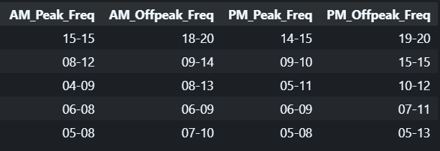

PECULIARITIES IN DATASETS
DATASET #2 – BUS SERVICES
FIX
AM/PM Peak/Offpeak columns had values
that were in a range
Looped through each column and took the minimum value between the two values

Slide 7
OBJECTIVES OF ANALYSIS
ANALYSE TRENDS IN RIDERSHIP OF BUSES AND IDENTIFY FACTORS AFFECTING IT
01
ANALYSE NATURE OF BUS OPERATORS AND FIND OUT WHICH CONTRIBUTES MOST TO RIDERSHIP
02

Slide 8
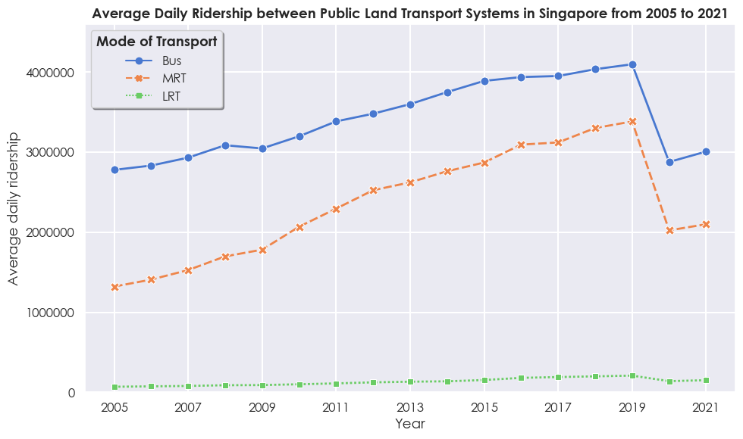
OBJECTIVE #1
DATASET #4 - RIDERSHIP
INSIGHTS
Singapore’s public bus transport has the highest popularity compared to other modes of public transport → Highlights how commuters likely prefer buses over other modes of public transport in Singapore.
LRTs have the lowest ridership → Likely due to it being newer and less accessible → Less prominent to commuters → Garner least ridership → Importance of accessibility
Decrease in ridership from 2019 to 2020 → Due to the coronavirus pandemic → Shows how significantly impacted the ridership of the transport system can be by pandemics and such.

Slide 9
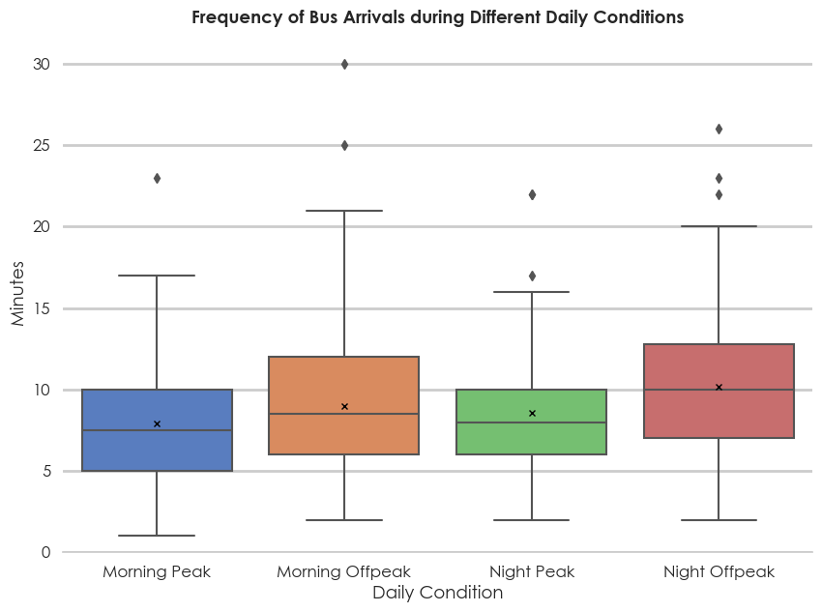
OBJECTIVE #1
DATASET #2 – BUS SERVICES
INSIGHTS
Bus arrival timings are very frequent → Appeal to commuters – Reduce waiting time and commuting time.
LTA caters to its commuters → Higher frequency of bus arrivals especially during peak hours compared to offpeak hours → More convenient and frequent transport mode → Preferred by commuters
Bus arrivals tend to become less frequent into the day → Due to higher demand during the mornings where people commute to work/school → LTA increase frequency of arrivals → While night time has lower demand compared to morning→ LTA decrease frequency → Proper management of bus arrival timings to fit demands → Appeal to commuters.

Slide 10
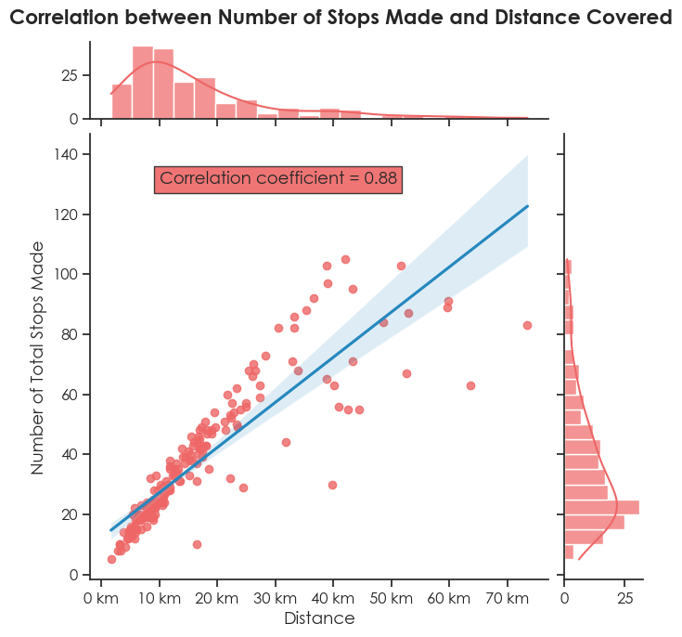
OBJECTIVE #1
DATASET #1 – BUS ROUTES
INSIGHTS
Correlation coefficient = 0.88 → Strong positive linear relationship between number of stops made and distance covered → As bus services in Singapore have a higher number of stops made, distance covered is higher as well.
Higher distribution of bus services with lower coverage → Low number of stops made + low distance covered → More bus services focused on covering a smaller area → More frequent and convenient commute
There are also bus services with higher coverage as well → High number of stops made + high distance covered → LTA ensures to provide best of both worlds – bus services with frequent and convenient travels and bus services with larger coverage → Fit the needs of population

Slide 11
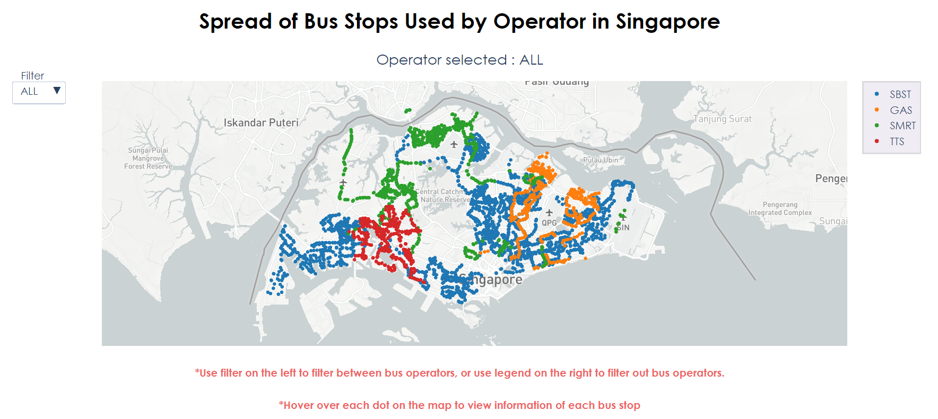
OBJECTIVE #2
DATASET #3 – BUS STOPS
INSIGHTS
SBST would have the best coverage of land area → Shown by bus stops used by SBST throughout Singapore → Followed by SMRT, GAS and TTS → SBST is a more prominent operator that is widely used by commuters in Singpapore due to high accessibility to SBST buses → Contribute most towards ridership.
Each operator except SBST focuses on providing their services to each region in Singapore → SMRT – North of Singapore → GAS – East of Singapore → TTS – West of Singapore → Indicates proper planning of deployment of services → Maximize ridership → Highlights importance of proper planning of deployment of services

Slide 12
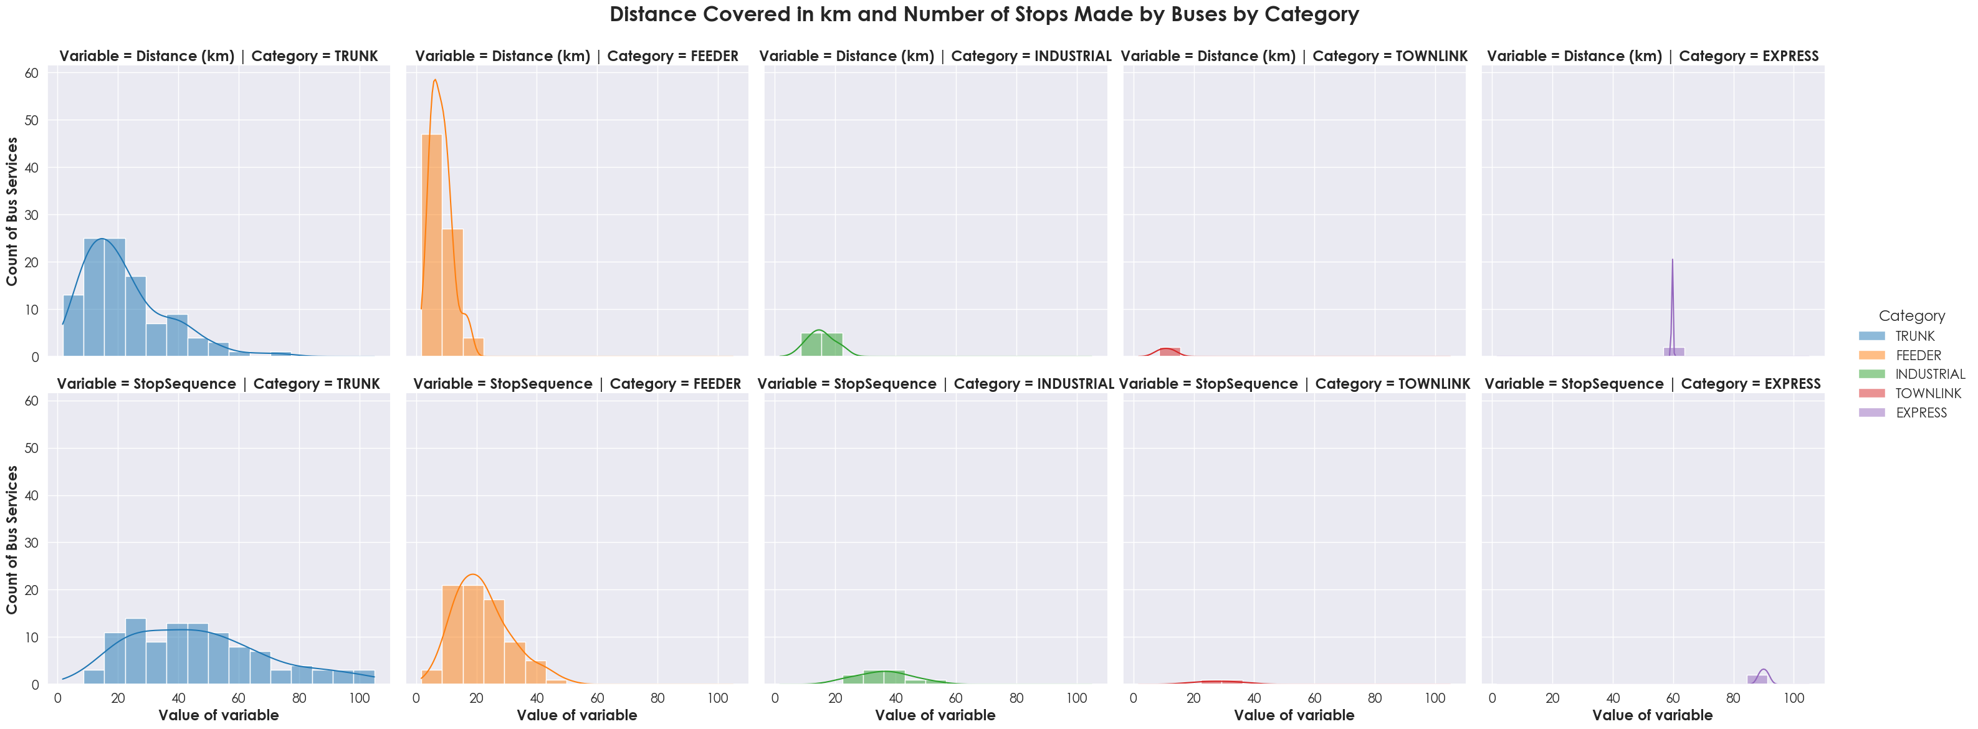
OBJECTIVE #2
DATASET #1 – BUS ROUTES
INSIGHTS
FEEDER, TOWNLINK, INDUSTRIAL → Greater distribution of bus services with low number of stops and low distance covered → EXPRESS → High number of stops and high distance covered → Low accessibility of bus stops.
TRUNK → Higher distribution of bus services with lower distance covered but a higher number of stops made → More stops in a smaller area → More convenient and accessible → TRUNKs are more popular for commuters → More favoured by operators hence higher number of counts of TRUNK buses as well.

Slide 13
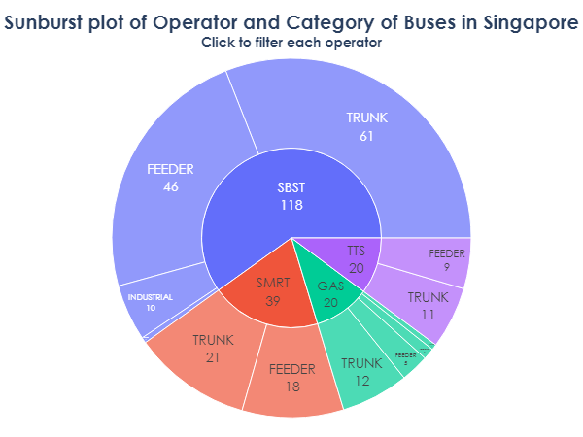
OBJECTIVE #2
DATASET #2 – BUS SERVICES
INSIGHTS
SBST → Highest number of bus services → Provide service to larger area → Cater to higher number of commuters → Contribute more towards bus ridership.
SBST → Highest number of TRUNK buses → more convenience and accessibility for commuters → More ridership for SBST
SBST and GAS → Bus services of multiple bus categories → Provide higher number of differing services to commuters → focus on having a variety of bus categories

Slide 14
RECOMMENDATIONS
CONCLUSIONS
OBJECTIVE #1 [DATASETS #1,#2,#4] :
> Riderships of buses are the highest compared to other public transport modes.
> Likely due to frequent arrivals, proper management of arrival timings and convenience.
>Buses fit the needs of the population > Buses that are convenient and accessible, and buses that have greater coverage
OBJECTIVE #2 [DATASETS #1,#2,#3] :
> Operators prioritize proper planning of deployment of services to maximise riderships
> Operators such as SBST and GAS focus on providing a variety of bus categories compared to SMRT and TTS
> SBST would contribute most towards ridership due to higher coverage > more accessibility and convenience and being more prominent
Increase the number of bus services that have higher distance covered and higher number of stops to provide more buses with greater coverage
01
Operators should increase their number of bus services on bus categories such as INDUSTRIAL and EXPRESS to accommodate towards more commuters
02

Slide 15


THANK YOU!

