Slide 1
ELECTRICITY & EMISSIONS
NAME: EDWARD TAN YUAN CHONG

Slide 2
DATASETS USED
DATASET #1 – NUMBER OF ELECTRICITY ACOUNTS BY SUB-SECTOR
DATASET #2 – SHARE OF ELECTRICITY PRODUCTION BY SOURCE
DATASET #3 – ELECTRICITY GENERATION
The dataset shows the number of electricity accounts sorted by Sector and Sub-sector, such as in Households, Transport etc.
Dataset shows the sources of energy in production of electricity, such as Oil, Gas, Hydro, Solar etc.
The dataset shows the amount of electricity generated in terawatt-hour (TWh) by Year
DATASET #4 – CO2 EMISSIONS BY FUEL
DATASET #5 – NATURAL GAS CONSUMPTION BY SUB-SECTOR
Dataset shows the amount of annual CO2 emissions sorted by fuel type such as Oil, Gas, Coal etc.
The dataset shows annual final natural gas consumption in TJ by sub-sector in Singapore

Slide 3
LINKS TO DATASETS:
DATASET #1 – NUMBER OF ELECTRICITY ACCOUNTS BY SUB-SECTOR (TOTAL):
https://data.gov.sg/dataset/number-of-electricity-accounts-by-sub-sector-total
DATASET #2 – SHARE OF ELECTRICITY PRODUCTION BY SOURCE:
https://ourworldindata.org/energy/country/singapore#what-sources-does-the-country-get-its-electricity-from
DATASET #3 – ELECTRICITY GENERATION:
https://ourworldindata.org/energy/country/singapore#how-much-electricity-does-the-country-consume-each-year
DATASET #4 – CO2 EMISSIONS BY FUEL:
https://ourworldindata.org/co2/country/singapore#how-are-co2-emissions-from-different-fuels-changing
DATASET #5 - NATURAL GAS CONSUMPTION BY SUB-SECTOR :
https://data.gov.sg/dataset/natural-gas-consumption-by-sub-sector

Slide 4
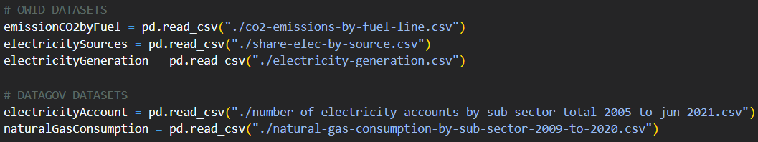
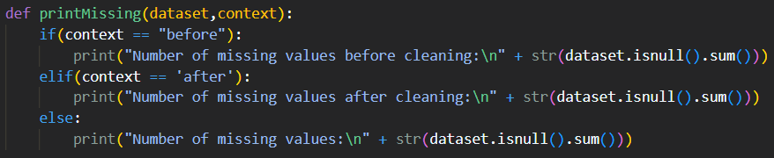
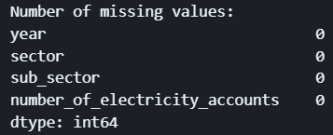
PANDAS FUNCTIONS – GENERAL
pd.read_csv() to import files
Boolean indexing and .query() to filter data
.rename() to rename columns
Print missing values function
-isnull().sum() to show number of missing values

Slide 5
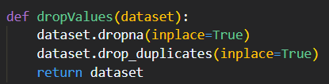
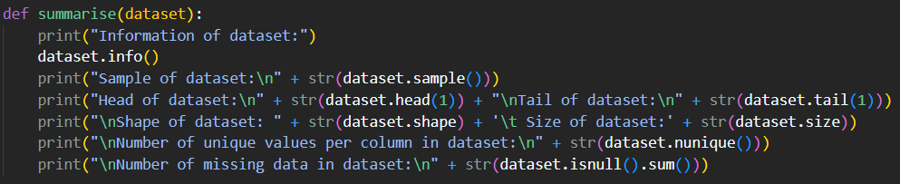
PANDAS FUNCTIONS – GENERAL
Drop duplicate/NA values function
Drop duplicate or missing values with .dropna() and .drop_duplicates()
Summary Function
Collation of panda’s summary functions to gain insight onto datasets

Slide 6
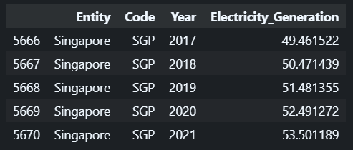
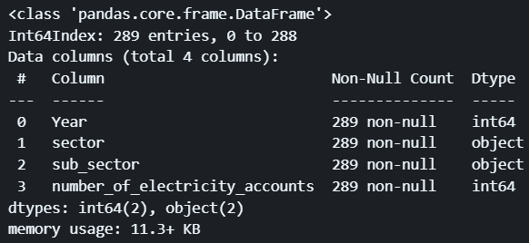
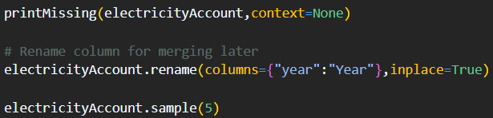
PANDAS FUNCTIONS – CLEANING & WRANGLING
For most datasets:
Used .sample(), .head() or .tail() to show information after cleaning
Dataset #1
Not much cleaning –> Only renamed columns with .rename()

Slide 7
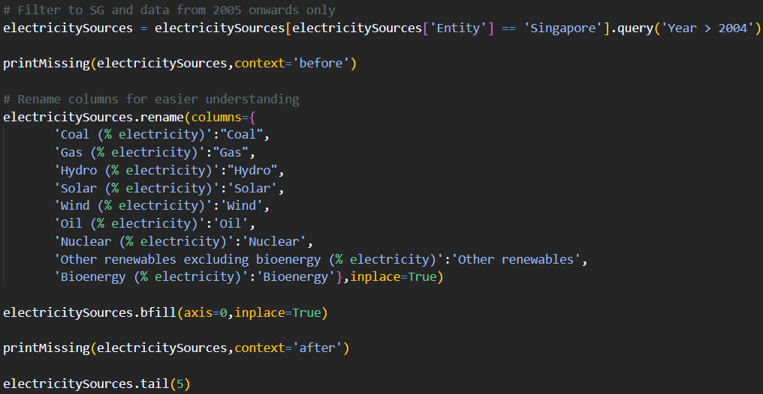
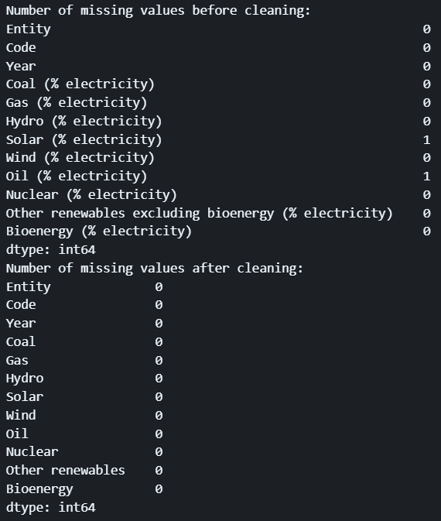
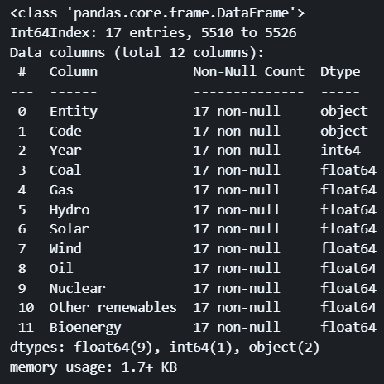
PANDAS FUNCTIONS – CLEANING & WRANGLING
Dataset #2
Filtered data, renamed columns with .rename() and backwards fill missing value with .bfill()
17 rows, 12 columns

Slide 8
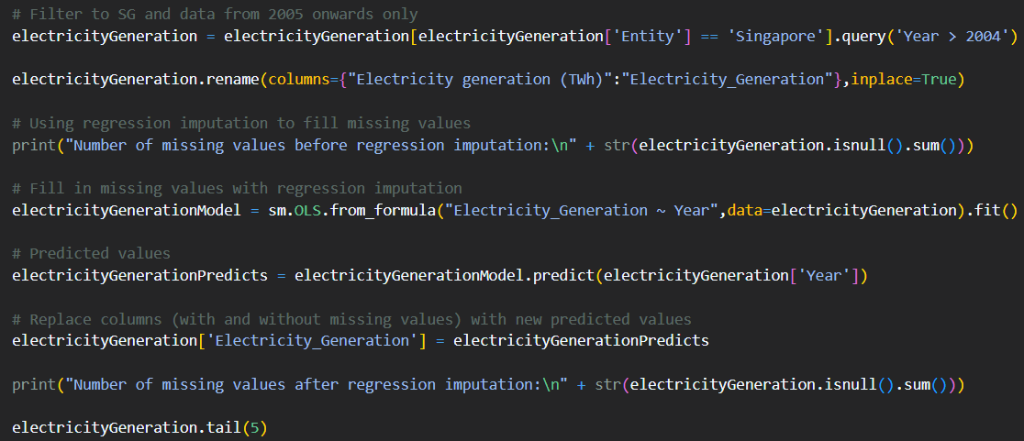
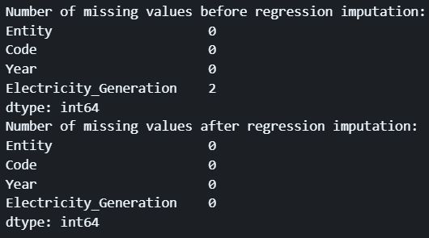
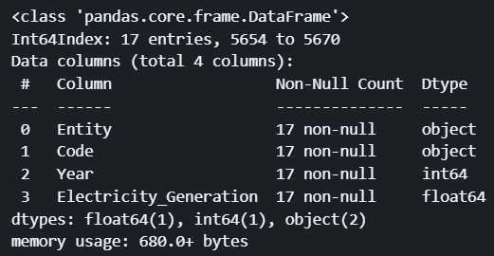
PANDAS FUNCTIONS – CLEANING & WRANGLING
Dataset #3
Filtered data, .rename() to rename columns, and used statsmodels to do regression imputation to replace missing values
17 rows, 4 columns

Slide 9
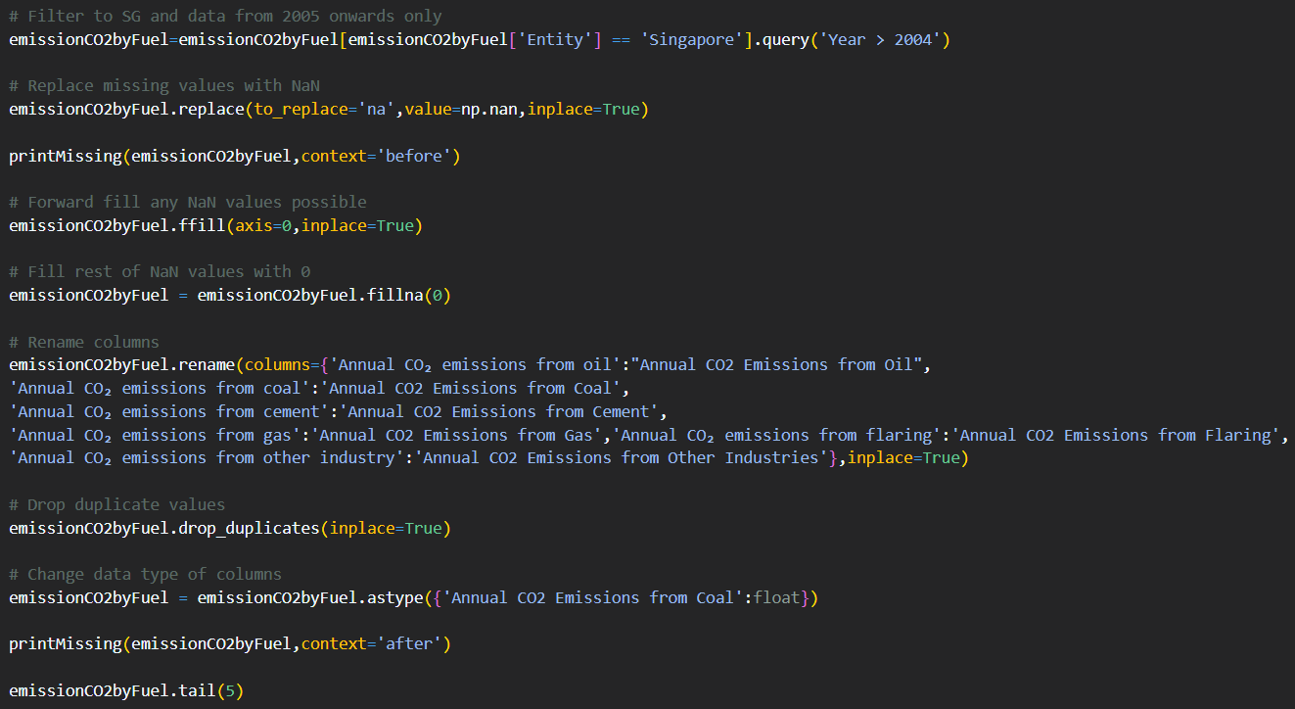
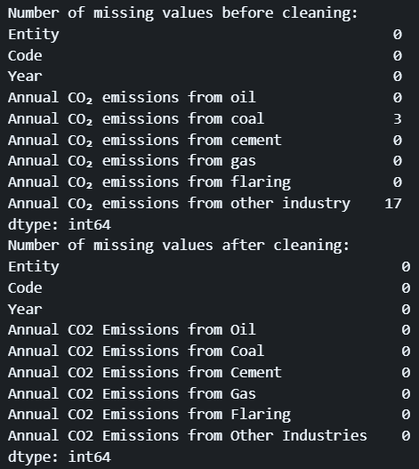
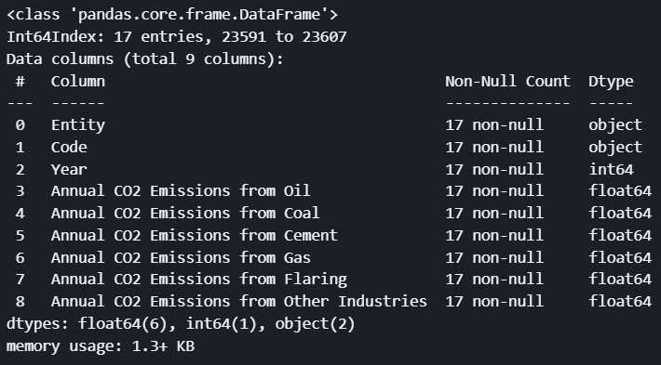
PANDAS FUNCTIONS – CLEANING & WRANGLING
Dataset #4
.replace() to replace ‘na’ values with NaN, .ffill() to fill missing values forward and .fillna() to clean remaining missing values, .rename() to rename columns, .drop_duplicates() to remove duplicate rows, .astype() to change data type
17 rows, 9 columns

Slide 10
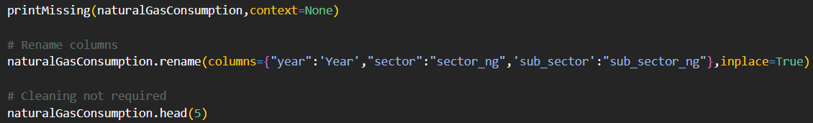
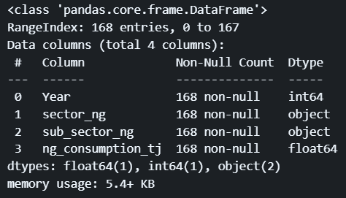
PANDAS FUNCTIONS – CLEANING & WRANGLING
Dataset #5
Not much cleaning -> .rename() to rename columns
168 rows, 4 columns

Slide 11
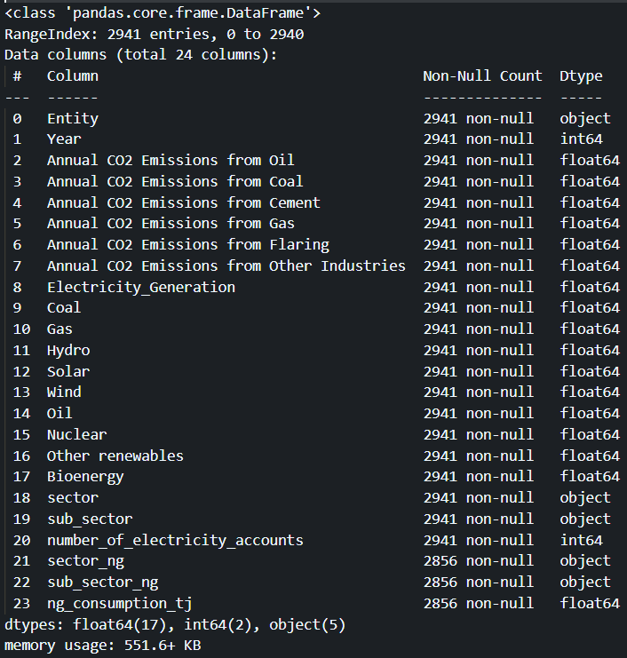
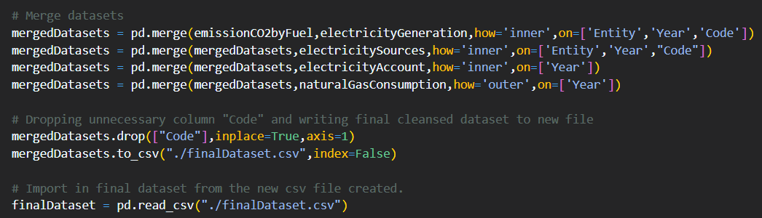
PANDAS FUNCTIONS – CLEANING & WRANGLING
Final Dataset
.merge(), .drop(), .to_csv(), and .read_csv()
2941 rows, 24 columns

Slide 12
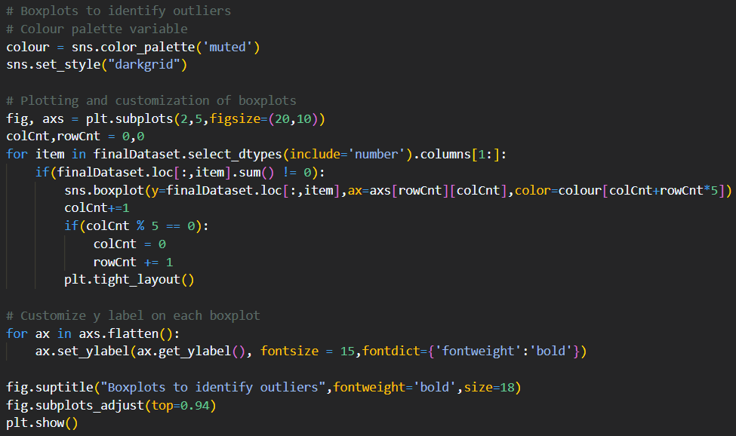
PANDAS FUNCTIONS – IDENTIFY OUTLIERS
Used seaborn to plot boxplots to identify outliers
PANDAS FUNCTIONS
.select_dtypes(), .columns, .loc[], .flatten()

Slide 13
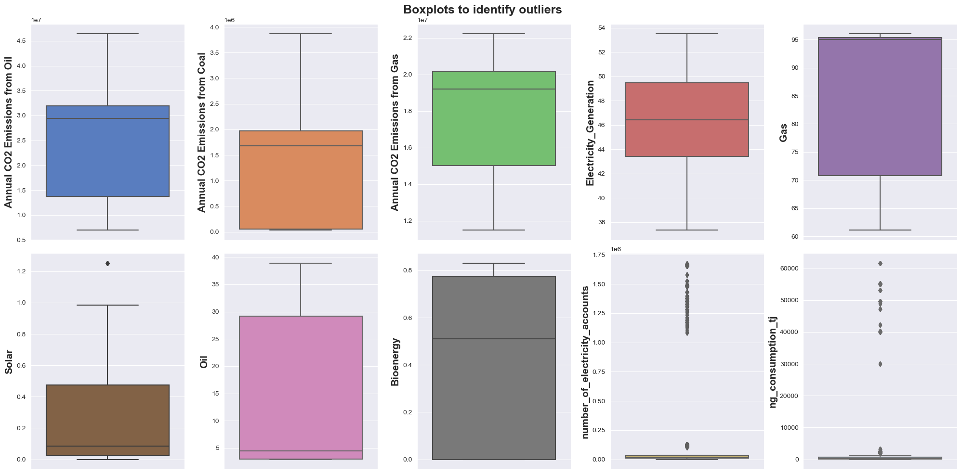
PANDAS FUNCTIONS – IDENTIFY OUTLIERS
BOXPLOTS

Slide 14
PANDAS FUNCTIONS – PLOTTING CHARTS
GENERAL PANDAS FUNCTIONS
- .loc[], .iloc[], Boolean indexing
- .columns, .values, .index
- .drop_duplicates()
- groupby() with .sum()/.mean(), .reset_index(),

Slide 15
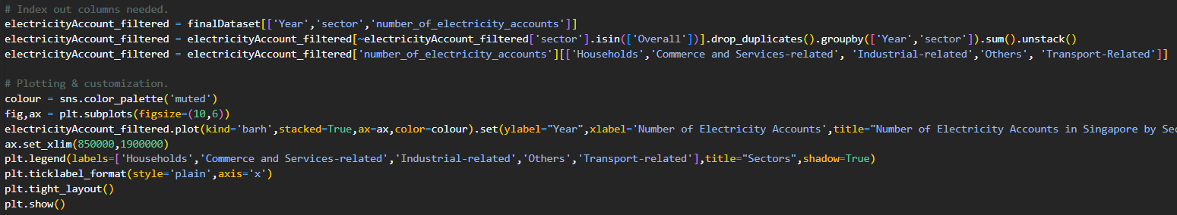
PANDAS FUNCTIONS – PLOTTING CHART #1
PANDAS FUNCTIONS
-.groupby() with .sum()
-.unstack()

Slide 16
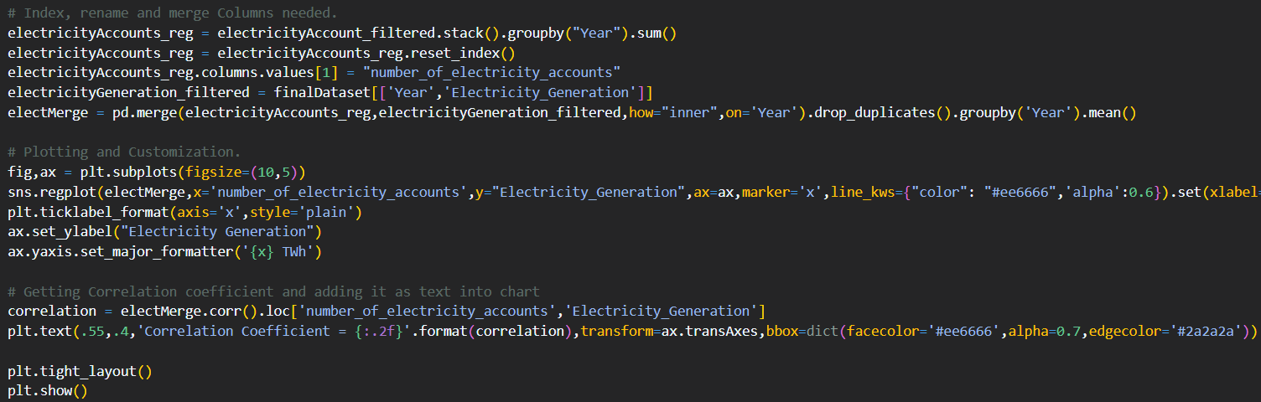
PANDAS FUNCTIONS – PLOTTING CHART #2
PANDAS FUNCTIONS
- .stack(), .merge(), .corr(),

Slide 17
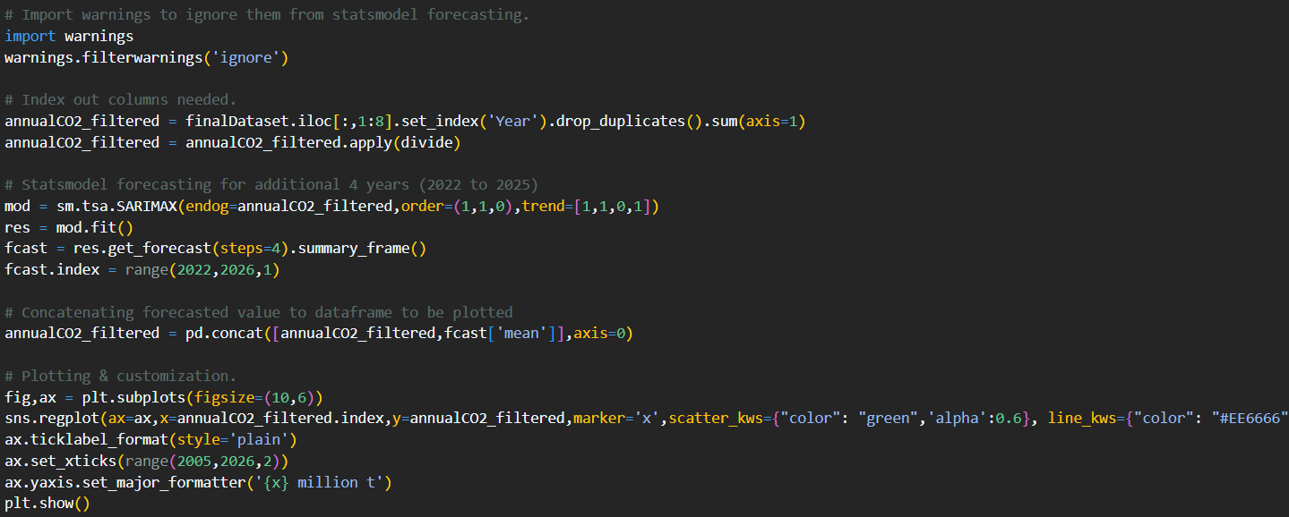
PANDAS FUNCTIONS – PLOTTING CHART #3
PANDAS FUNCTIONS
- .set_index(), .drop_duplicates() , .sum(), .apply(), .concat()

Slide 18
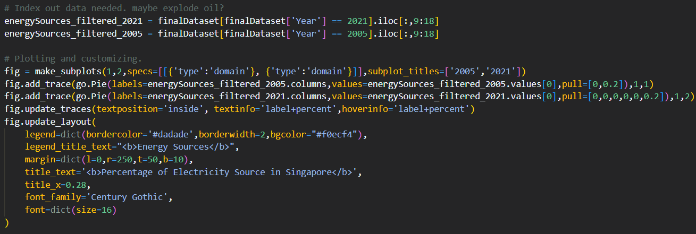
PANDAS FUNCTIONS – PLOTTING CHART #4
PANDAS FUNCTIONS
→ .iloc[], Boolean indexing, .columns, .values

Slide 19
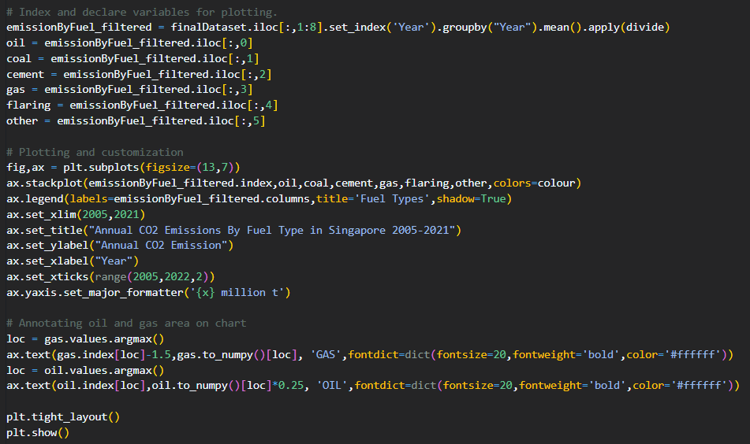
PANDAS FUNCTIONS – PLOTTING CHART #5
PANDAS FUNCTIONS
→ .set_index(), .groupby() with .mean(), .apply(), .to_numpy(), .argmax()

Slide 20
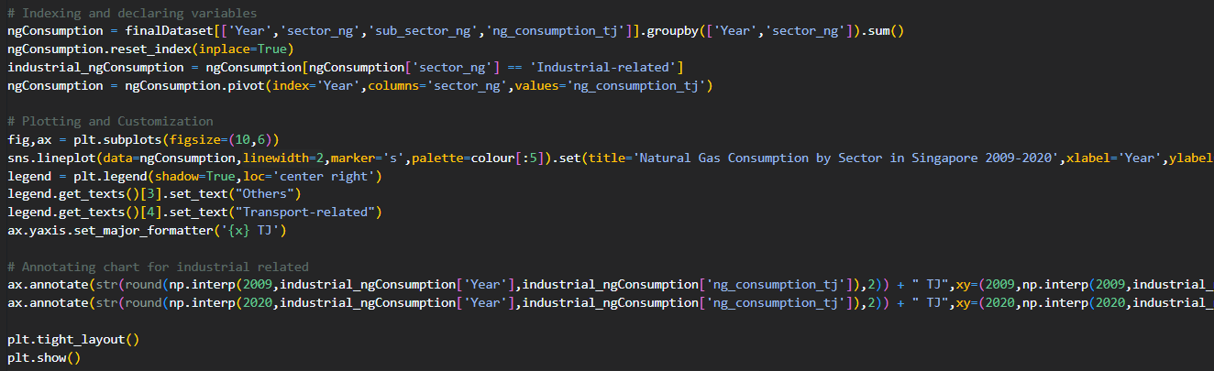
PANDAS FUNCTIONS – PLOTTING CHART #6
PANDAS FUNCTIONS
→.groupby with .sum(), .reset_index(), .pivot()

Slide 21

THIS IS MR. JOE…
→ DATA ANALYST IN ENVIRONMENTAL SCIENCE IN SAUDI ARABIA
BUT WHAT DOES MR JOE WANT TO DO?

Slide 22
MR. JOE WANTS TO…
ANALYSE
LEARN
APPLY
Analyse how Singapore’s Electricity and Emission rates are
Learn from Singapore’s methods of managing emissions
Apply what he has learnt to help manage Saudi Arabia’s emissions better

Slide 23
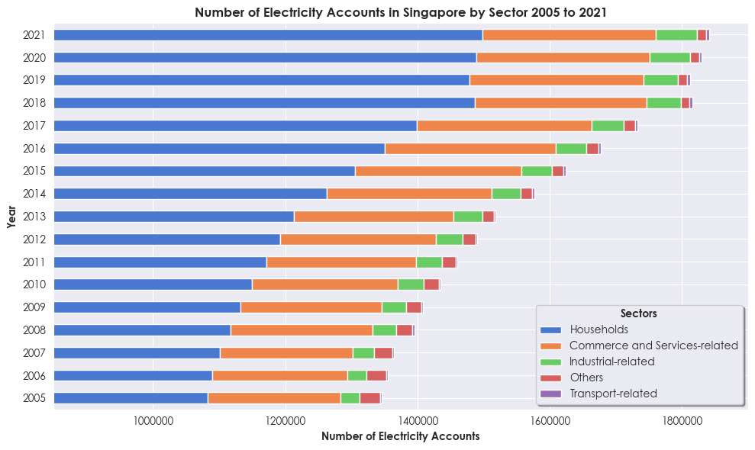
INSIGHTS – CHART #1
Notes:
The stacked bar chart shows the number of electricity accounts by sector in Singapore from 2005 to 2021, highlighting the increase in the number of electricity accounts, mainly contributing from households.

Slide 24
INSIGHTS – CHART #1
> The increase in electricity accounts is mainly contributed by Households, likely due to an increase in the number of housing in Singapore.
> Emphasises the increase in demand for electricity in Singapore likely due to an increase in population leading to a higher electricity consumption per capita
Notes:
The stacked bar chart shows the number of electricity accounts by sector in Singapore from 2005 to 2021, highlighting the increase in the number of electricity accounts, mainly contributing from households.

Slide 25
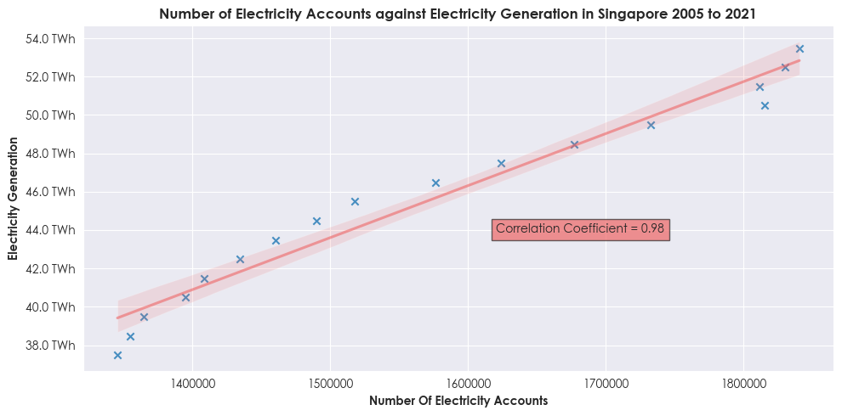
INSIGHTS – CHART #2
Notes:
The regression plot shows the correlation between the number of electricity accounts and electricity generation in Singapore from 2005-2021. The chart shows that there is a correlation coefficient of 0.97, which indicates a strong positive linear relationship between number of electricity accounts and electricity generation, showing that as the demand for electricity increases, Singapore increases their electricity generation as well to meet the demands, highlighting proper management of electricity generation.

Slide 26
INSIGHTS – CHART #2
> Strong positive linear relationship between the two variables.
> As electricity demand increases, Singapore ensures to increase generation to meet demands.
> Singapore has proper management of electricity generation.
Notes:
The stacked bar chart shows the number of electricity accounts by sector in Singapore from 2005 to 2021, highlighting the increase in the number of electricity accounts, mainly contributing from households.

Slide 27
INSIGHTS
FROM THIS, MR. JOE WOULD EXPECT THE CO2 EMISSIONS OF SINGAPORE TO INCREASE AS WELL… HOWEVER…

Slide 28
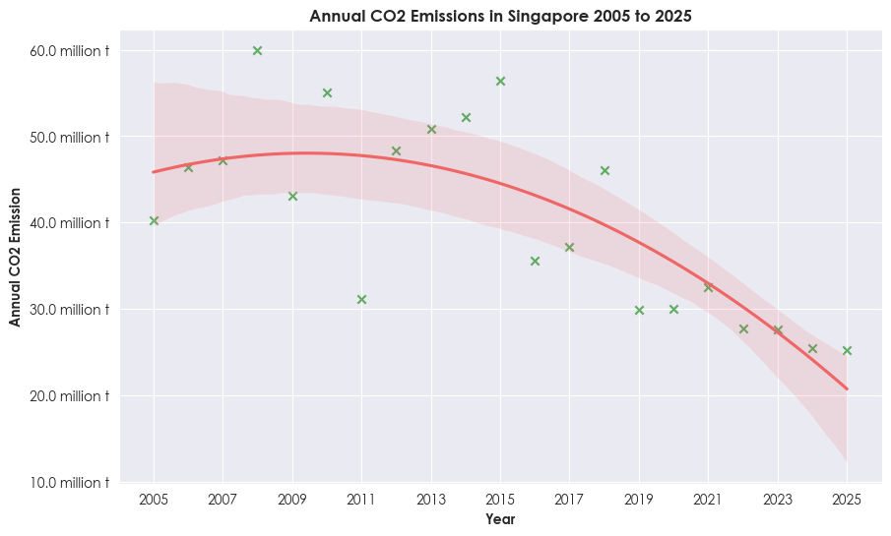
INSIGHTS – CHART #3
Notes:
From the regression plot showing the annual CO2 emissions in Singapore from 2005-2021, unexpectedly, there was instead a decrease in annual CO2 emissions over the years, decreasing from around 45 million tonnes in 2005 to around 30 million tonnes by 2021, which highlights good management of CO2 emissions in Singapore as they are able to increase their electricity and energy outputs while decreasing their annual CO2 emissions.

Slide 29
INSIGHTS – CHART #3
> Highlights good management of emission levels in Singapore.
> Able to increase energy & electricity outputs while decreasing CO2 emissions.
> Carbon intensity decreasing over the years.
Notes:
The stacked bar chart shows the number of electricity accounts by sector in Singapore from 2005 to 2021, highlighting the increase in the number of electricity accounts, mainly contributing from households.

Slide 30
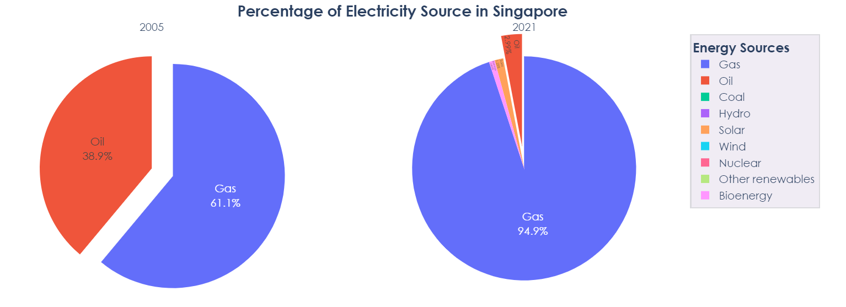
INSIGHTS – CHART #4
Notes:
The pie chart shows the percentage of electricity source in Singapore in years 2005 and 2021, and the pie chart shows that the electricity source in Singapore is changing over the years, as more natural gases are being used, and renewable sources such as solar and bioenergy are slowly being implemented into electricity sources, diversifying their energy mixes with cleaner sources and being less reliant on fossil fuels which produce more greenhouse gases. Not only that, by implementing renewable energy, lesser oil also needs to be used for electricity production, hence helping to reduce CO2 emissions in the long run.

Slide 31
INSIGHTS – CHART #4
> Singapore is diversifying their electricity mix.
> Decrease reliance on oil, increasing usage of natural gas and implementing renewable energy sources.
> Decrease carbon intensity -> Less emissions -> Highlight effectiveness of diversifying electricity mix + cleaner and renewable sources of energy.
Notes:
The stacked bar chart shows the number of electricity accounts by sector in Singapore from 2005 to 2021, highlighting the increase in the number of electricity accounts, mainly contributing from households.

Slide 32
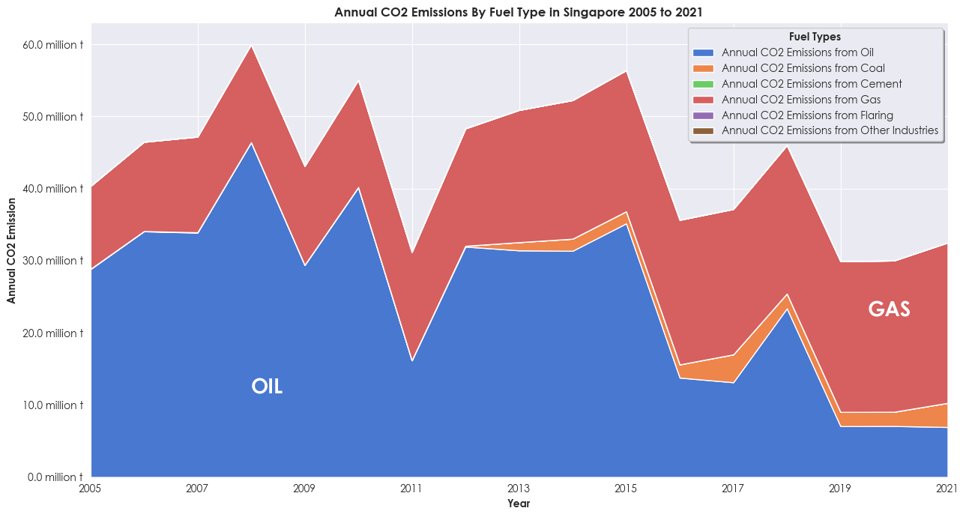
INSIGHTS – CHART #5
Notes:
The stacked area chart shows annual CO2 emissions by fuel type in Singapore from 2005 to 2021, and this chart shows that the annual CO2 emissions are decreasing in general due to the decrease in reliance on oil and increased transition to natural gases. The transition into natural gases would be one reason of the decrease in CO2 emissions over the years, as natural gases are more energy-efficient, allowing for more energy to be produced per unit, and burn cleaner in comparison to oil, hence helping to decrease CO2 emissions while increasing electricity generation.

Slide 33
INSIGHTS – CHART #5
> Importance of adopting natural gases.
> Oil -> does not burn cleanly while natural gas -> burns much cleaner than oil -> help to decrease CO2 emissions in the long run.
> Produce lesser CO2 emissions while producing more energy for electricity -> decrease carbon intensity.
Notes:
The stacked bar chart shows the number of electricity accounts by sector in Singapore from 2005 to 2021, highlighting the increase in the number of electricity accounts, mainly contributing from households.

Slide 34
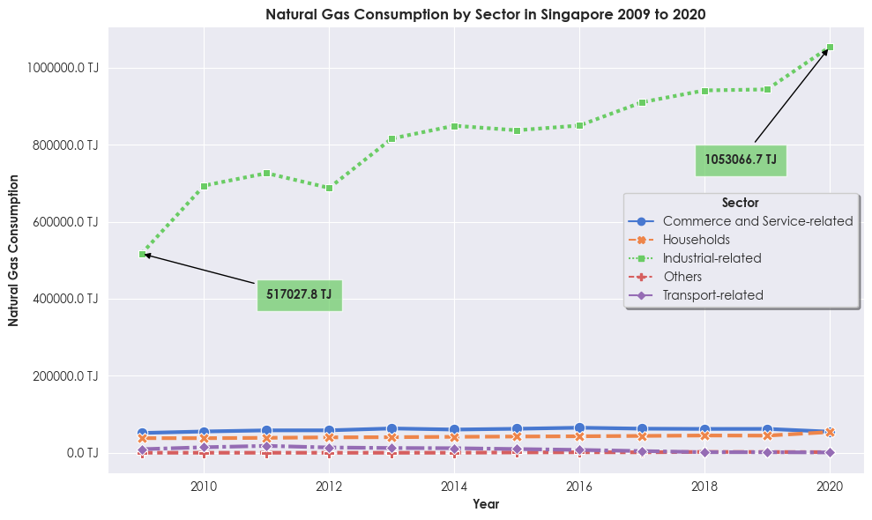
INSIGHTS – CHART #6
Notes:
The line chart shows the natural gas consumption by sector in Singapore from 2009 to 2020, and this chart shows that the natural gas consumption is mainly from Industrial-related sectors, compared to other sectors, as the consumption increased by almost two folds from 2009 to 2020, hence highlighting that CO2 emissions would be most influenced when the electricity sources in industrial-related sectors change towards natural gas as an electricity source.

Slide 35
INSIGHTS – CHART #6
> Natural gas is replacing energy sources the most in industrial-related sectors.
> Transitioning to cleaner energy sources in the industrial sector -> significantly decreases CO2 emissions.
Notes:
The stacked bar chart shows the number of electricity accounts by sector in Singapore from 2005 to 2021, highlighting the increase in the number of electricity accounts, mainly contributing from households.

Slide 36
-MR. JOE’S CONCLUSION-
Singapore has good management of electricity generation as they ensure sufficient energy is produced to meet its demands.
01
Singapore handles their emissions levels well while continuing to increase its energy outputs and meeting the population’s demands, shown by emission levels decreasing while more energy is produced.
02
Singapore prioritizes exploring other cleaner energy sources, by gradually changing their energy sources to using more natural gases and less oil, and implementing the use of renewable energy such as solar and bioenergy.
03

Slide 37
-MR. JOE’S CONCLUSION-
Natural Gas is effective in curbing emission levels as even though majority of Singapore’s emissions in the present come from natural gases, compared to oil in the past, their overall emission levels have decreased while increasing energy outputs due to the transition to cleaner sources of energy
04
Natural Gas is able to impact emission levels the most when transitioned into industrial-related sectors compared to other sectors.
05

Slide 38
CONCLUSION
MR JOE CAN NOW APPLY WHAT HE HAS LEARNT FROM THE ANALYSIS, FOLLOWING IN THE FOOTSTEPS OF SINGAPORE’S MANAGEMENT OF ELECTRICITY AND EMISSIONS TO HELP HIS OWN COUNTRY, SAUDI ARABIA, CURB ITS EMISSION RATES.

Slide 39
THANK YOU!

