Slide 1
REGRESSION HOUSING PRICE PREDICTION
EDWARD TAN YUAN CHONG

Slide 2

HOW IS YOUR PREDICTION TASK DEFINED? AND WHAT IS THE MEANING OF THE OUTPUT VARIABLE?
The prediction task would be to build and train a regression model to predict the housing price in the US based on various factors of a house, such as City, House Area in sqm, Number of bedrooms and toilets, Renovation status etc.
The output variable, Price ($), would represent the price of the housing in the US that are paired with its housing factors.

Slide 3
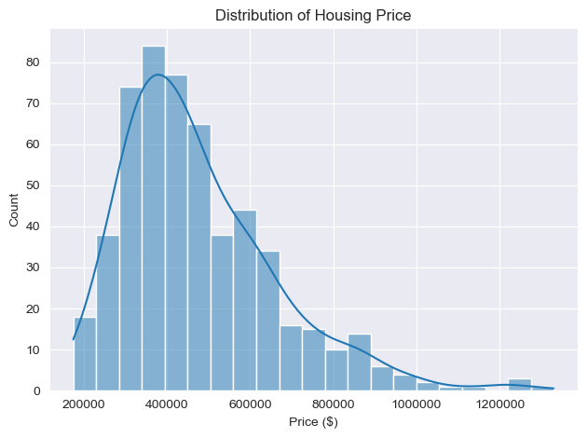
EXPLORATORY DATA ANALYSIS (EDA)
Notes:
This chart shows the distribution of all the housing prices and we can see that most houses have prices around $400,000. The data can also be seen to be positively-skewed.

Slide 4
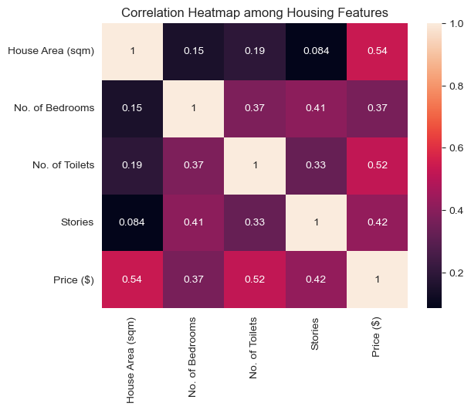
EXPLORATORY DATA ANALYSIS (EDA)
WEAK-MODERATE RELATIONSHIPS BETWEEN FEATURES & OUTPUT VARIABLE
Notes:
From this correlation heatmap among housing features, we can see that House Area and No. of Toilets tend to correlate with housing price better compared to other features. However, we can clearly see that there are no strong relationships among the features to the output variable which can lead to poorer model performance and predictions.

Slide 5
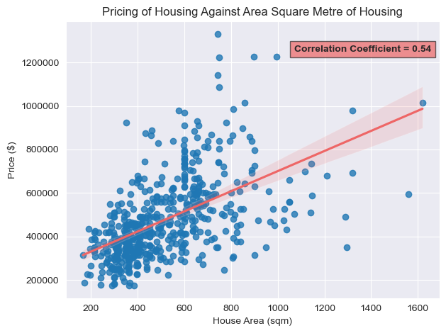
EXPLORATORY DATA ANALYSIS (EDA)
Notes:
From this scatterplot of housing price and house area, we can see that there is a moderate positive linear relationship between the two variables, which show that the area of a housing would likely affect its price.

Slide 6
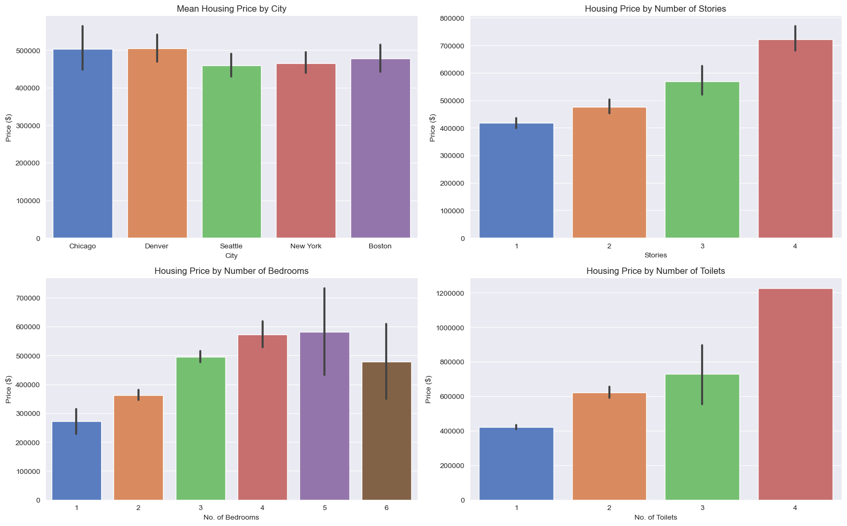
EXPLORATORY DATA ANALYSIS (EDA)
Notes:
From these four bar charts comparing housing price to City, Stories, Number of Bedrooms and Number of Toilets, we can see that the cities Chicago and Denver has the highest mean housing prices, while for the other three charts we can see that as each variable increases, the housing price also increases, likely due to the fact that an increase in each variable would allow for more luxury as there would be better views, more privacy and accessibility and such, which show that these variables do affect housing price. However, City likely has lesser influence on the output variable, and one thing to take note of would be an anomaly in the 6-bedroom housings as it costs significantly lesser than a 5-bedroom housing, possibly due to lack of data.

Slide 7
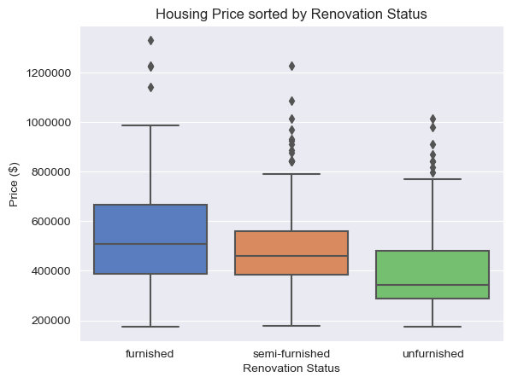
EXPLORATORY DATA ANALYSIS (EDA)
Notes:
From this boxplot comparing housing price and renovation status, we can see that as a house is more under-furnished, the lower the price tends to be, which shows that renovation status would also affect the housings price.

Slide 8
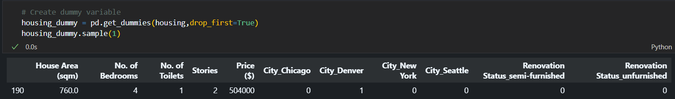

Feature engineering
DID YOU PROCESS FEATURES IN ANY WAY?
How do you represent your data as features?
Encoded categorical features such as Renovation Status and City into a binary representation for the model to be used in machine learning later.
Dropped unnecessary column ‘House ID’ so that it would not be considered as a feature and used in the prediction as it may affect results.

Slide 9
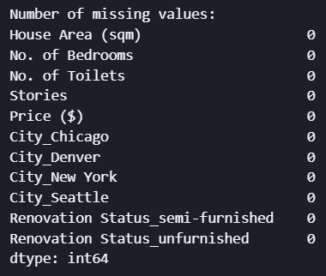
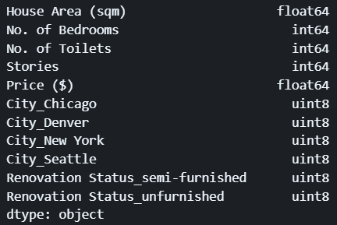
DATA CLEANING
DID YOU PROCESS FEATURES IN ANY WAY?
Since there are no missing values, and no duplicate rows in the dataset, not much data cleaning is required here.
There are also no errors with the datatypes of the columns.

Slide 10
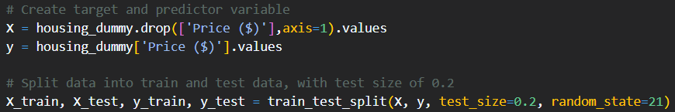
DATA PREPARATION
Split the dataset into train and test sets with 20% of dataset as test set and remaining 80% as training set.

Slide 11
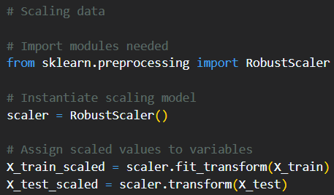
Feature engineering
DID YOU PROCESS FEATURES IN ANY WAY?
Scaling of data with RobustScaler()
-> Less sensitive to outliers
-> Can handle skewed data distributions well
-> Preserve shape of distribution

Slide 12
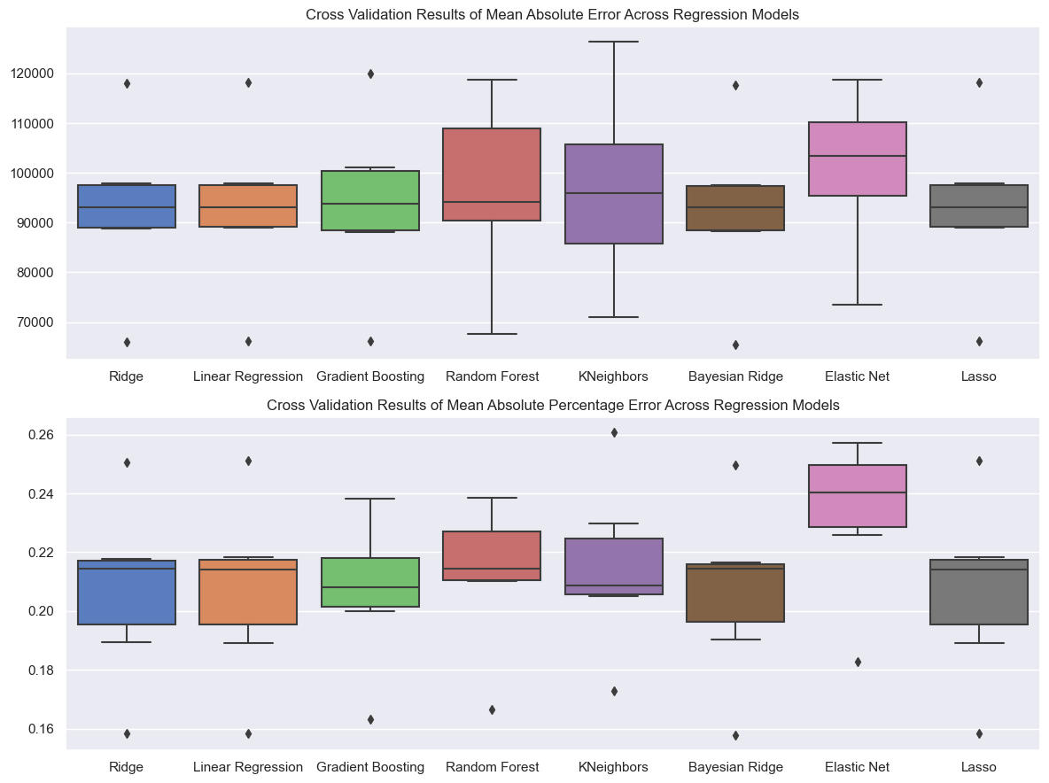
SELECTING A MODEL
How did you select which learning algorithms to use?

Slide 13
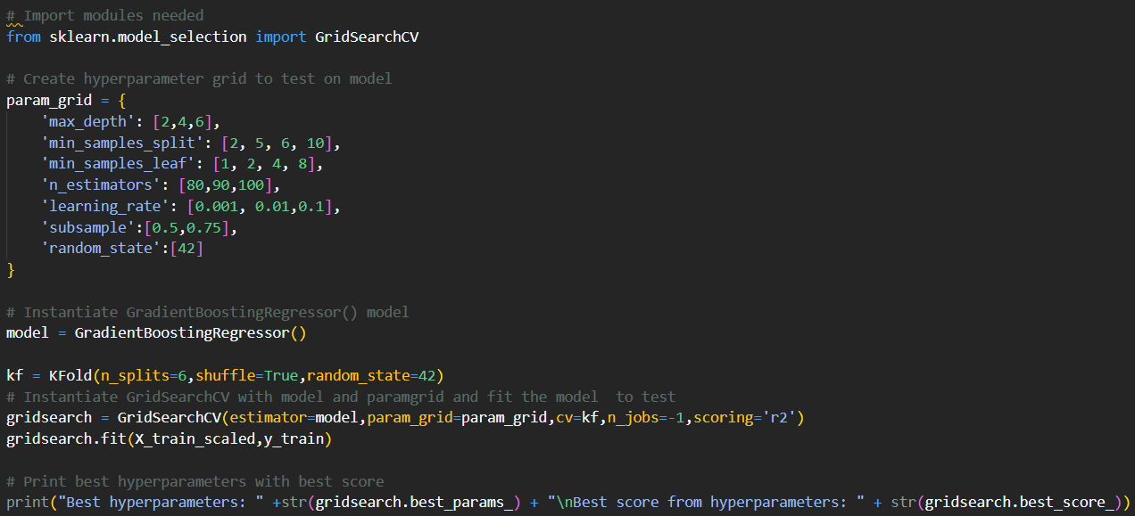
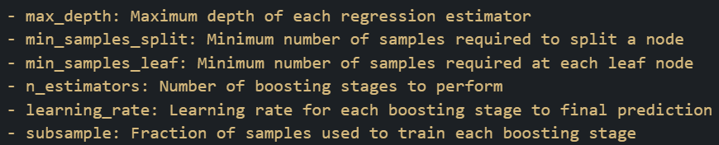
HYPERPARAMETER TUNING
Did you try to tune the hyperparameters of the learning algorithm, and in that case how?

Slide 14
MODEL EVALUATION
How do you evaluate the quality of your system?
METRICS USED:
Plots used:
-Mean Absolute error (mae)
-MEAN ABSOLUTE PERCENTAGE ERROR (MAPE)
-MEAN SQUARED ERROR (MSE)
-ROOT MEAN SQUARED ERROR (RMSE)
-R-SQUARED (R2)
-EXPLAINED VARIANCE
-SCATTERPLOT OF PREDICTED VALUES AGAINST ACTUAL VALUES
-RESIDUAL PLOT
-RESIDUAL KDE PLOT
Notes:
For model evaluation, I used Mean absolute error, mean absolute percentage error, mean squared error, root mean squared error, which are all loss functions or error metrics, hence a lower score indicates better performance, and r-squared and explained variance, where a higher score indicates better performance. I also utilised plots to evaluate my models, such as a scatterplot of predicted against actual values, and a residual and residual kde plot.

Slide 15
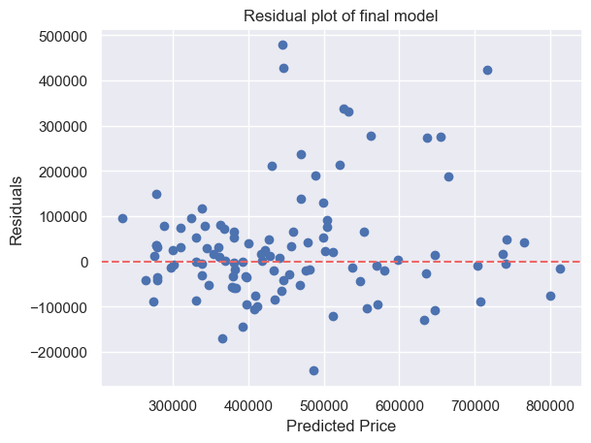
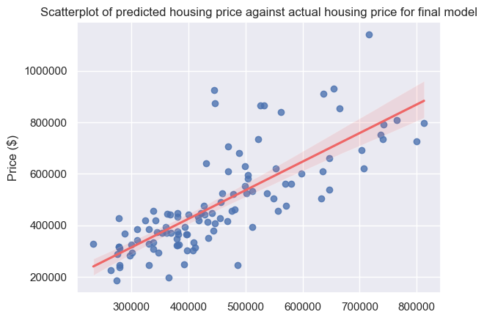
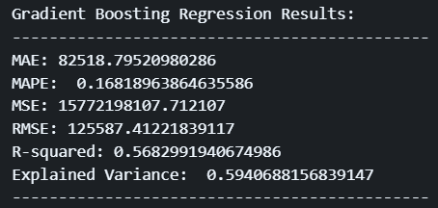
MODEL EVALUATION
Can you say anything about the errors that the system makes?
learning_rate= 0.1, max_depth= 2, min_samples_leaf= 1, min_samples_split= 5, n_estimators= 80, random_state= 42, subsample= 0.5
Notes:
From fitting the best hyperparameters, this was the final model I achieved
We can see that the system makes a lot of errors in predicting the housing prices shown by the scores of the error metrics being high and a low R-squared and explained variance.
We can also see that from the residual plot, the residuals are randomly scattered and there are no clear and distinct patterns, showing unbiased predictions, but there are clearly many outliers showing that the model was not able to capture the housing price correctly, and many residuals deviating far from the zero line, indicating poor performance from the model as it was not able to capture the underlying pattern and relationship.
Despite that, there were still improvements to the mean absolute error and root mean square error compared to during cross-validation, which shows improvement.
However, one reason the model is not be performing well might be due to the weak relationship (shown from the correlation heatmap) between the features and output variable, which can lead to the model struggling to capture the relationship or patterns to make more accurate predictions, hence leading to much more errors than expected.

Slide 16
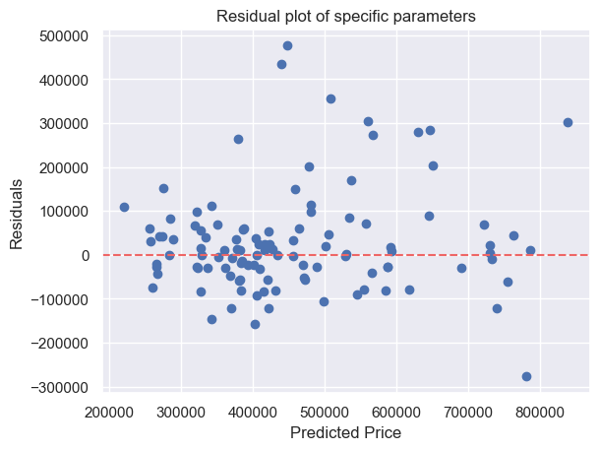
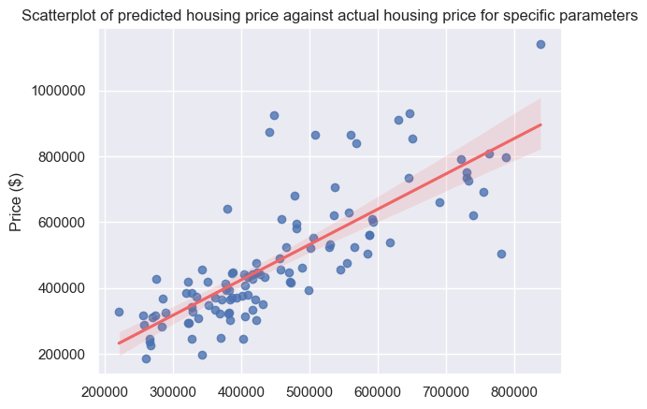
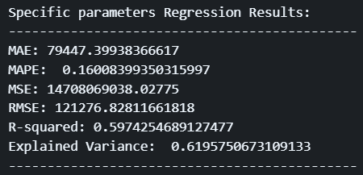
MODEL IMPROVEMENT
n_estimators=68,max_depth=4,min_samples_split=6,min_samples_leaf=1,
learning_rate=0.1,subsample=0.75,random_state=42
Notes:
However, instead of just accepting those results, I decided to manually tweak and adjust the hyperparameters to see if I could improve the model and attain a better performance compared to what the gridsearch cross validation gave. From these parameters that I found, we can see a slightly significant improvement in results compared to before as there was a significant decrease in mean absolute error and root mean squared error, an increase in R-squared and explained variance, and lesser residuals deviating further from the zero line, all of which show an even better improvement in the model.

Slide 17
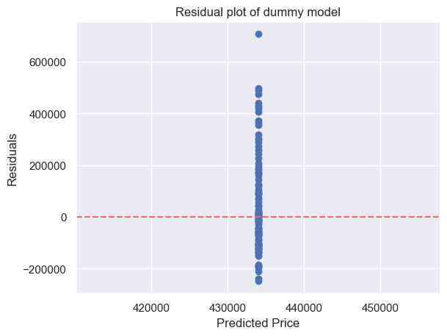
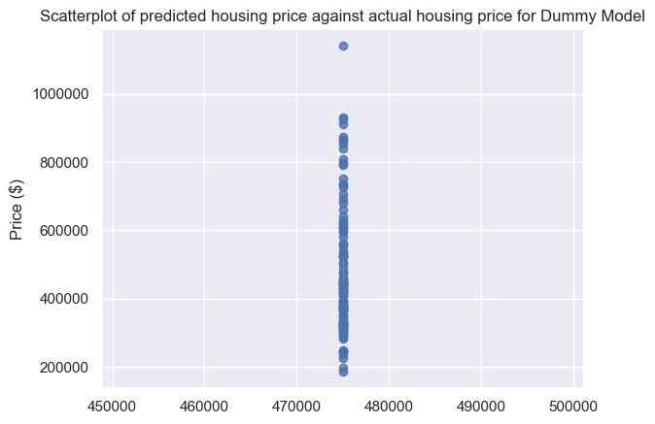
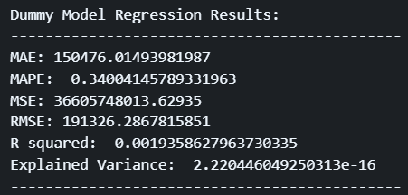
DUMMY MODEL
How well does your system compare to a dummy baseline?
DummyRegressor()
Notes:
From the dummy model, we can clearly see that the DummyRegressor I used was unable to capture the relationship in the data and the performance was way worse compared to any of my systems, shown by the r-squared of -0.001, which shows that the dummy model performs worse compared to a model that just predicts the mean of the target variable only. This shows that my model performed better as it was at least able to roughly capture the relationship of the data even though it was not entirely accurate.

Slide 18
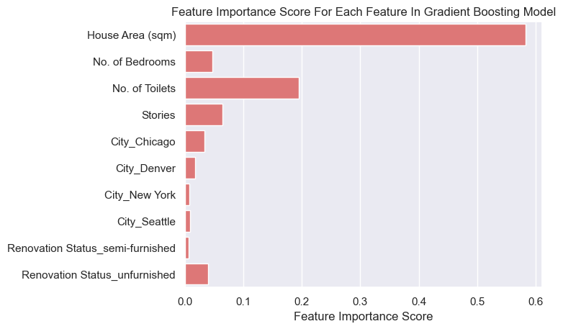
FEATURE IMPORTANCE
Is it possible to say something about which features the model considers important?

Slide 19

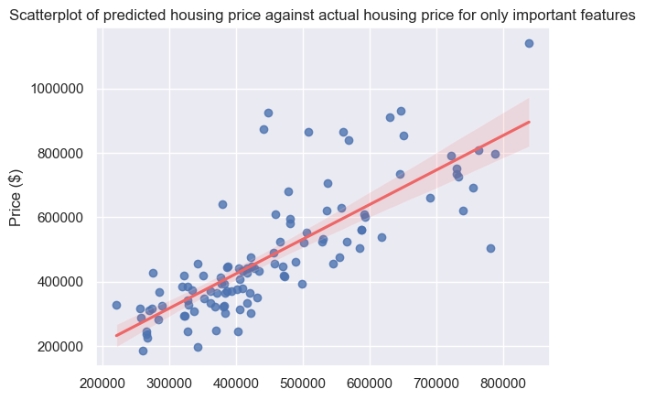
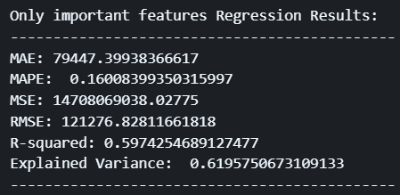
REDO MODEL WITH IMPORTANT FEATURES ONLY
n_estimators=68,max_depth=4,min_samples_split=6,min_samples_leaf=1,
learning_rate=0.1,subsample=0.75,random_state=42
Notes:
By removing the less important features, and keeping only the important feature, we can see that the scores do not deviate much compared to the final model with all features, which enforces the fact that the House Area (sqm) feature mainly influences the model's prediction on housing price, and the other features do not influence the model much in comparison.

Slide 20
CONCLUSION
In conclusion, even though the model may not have performed as well as expected likely due to weak relationships between the features and output variable, it still performs better in comparison to a dummy regressor, and there are still improvements that could be, and were made on the model.

Slide 21
Stuff that were not implemented
01
VALIDATION SET + COMPARING MODELS ON VALIDATION SET
02
FIX SKEWNESS OF output variable
03
REMOVE OUTLIERS FROM TRAIN DATASET

Slide 22
THANK YOU!

