Slide 1
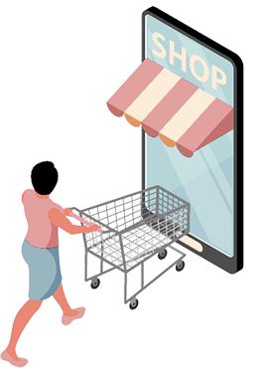
UNSUPERVISED LEARNING
NAME: EDWARD TAN YUAN CHONG

Slide 2

INTRODUCTION
DATASET:
Customer_Dataset.csv
INFORMATION OF DATASET:
Dataset contains a mall’s information of each customer such as Gender, Age, Income and How Much They Spend (Spending Score), along with CustomerID as an identifier.
TASK:
Build a clustering algorithm to cluster customers and extract pieces of information and insights to allow the mall to find out their group of most valuable customers and how to retain them.

Slide 3
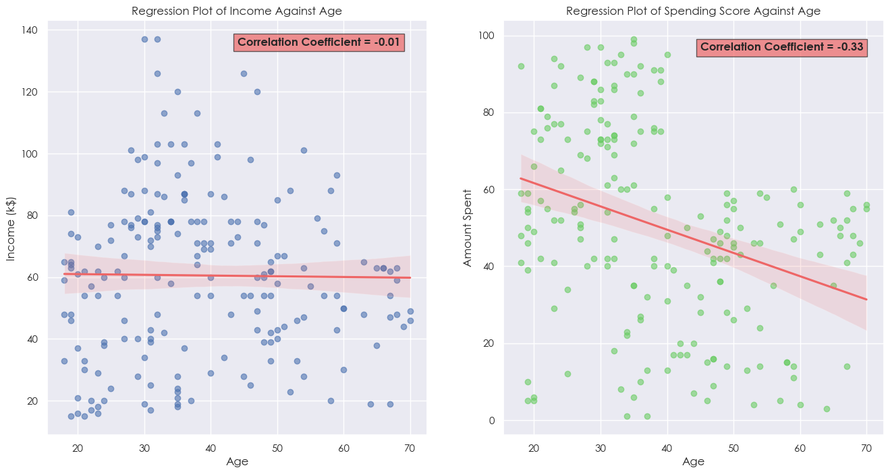
EXPLORATORY DATA ANALYSIS [EDA]
CHART 1

Slide 4
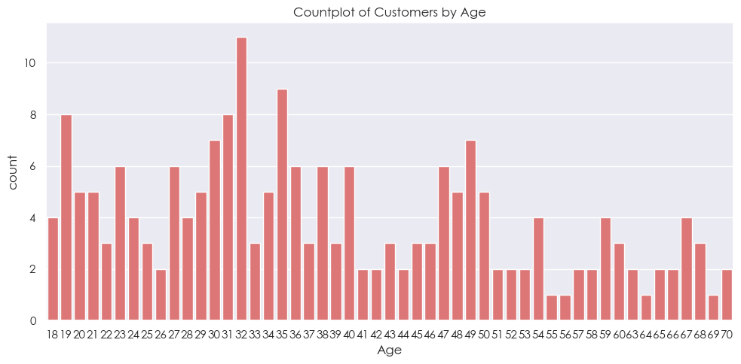
EXPLORATORY DATA ANALYSIS [EDA]
CHART 2

Slide 5
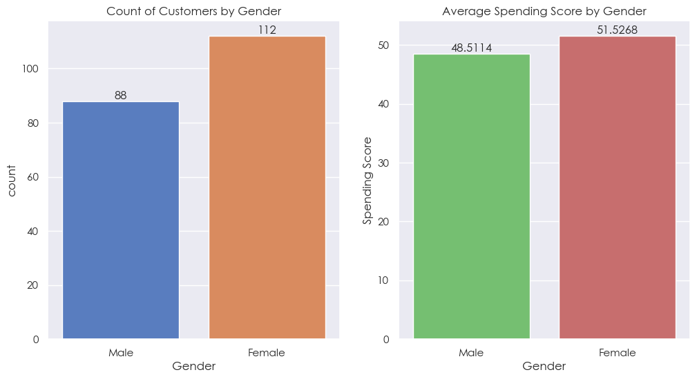
EXPLORATORY DATA ANALYSIS [EDA]
CHART 3

Slide 6
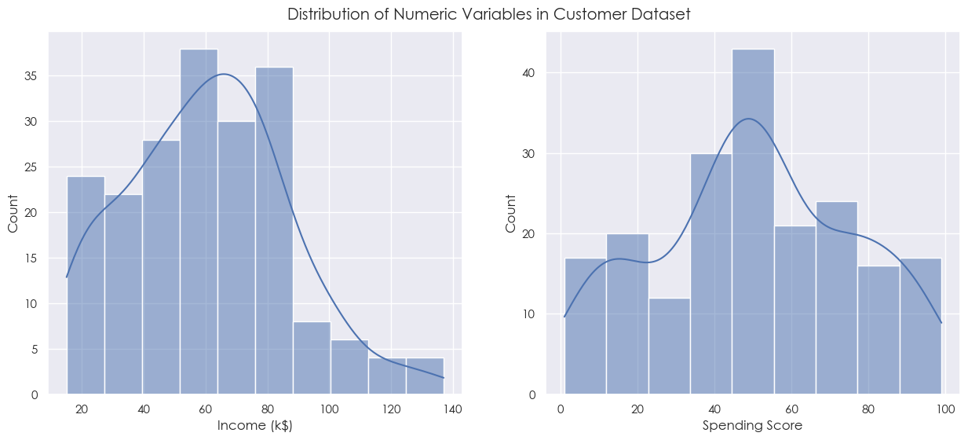
EXPLORATORY DATA ANALYSIS [EDA]
CHART 4

Slide 7
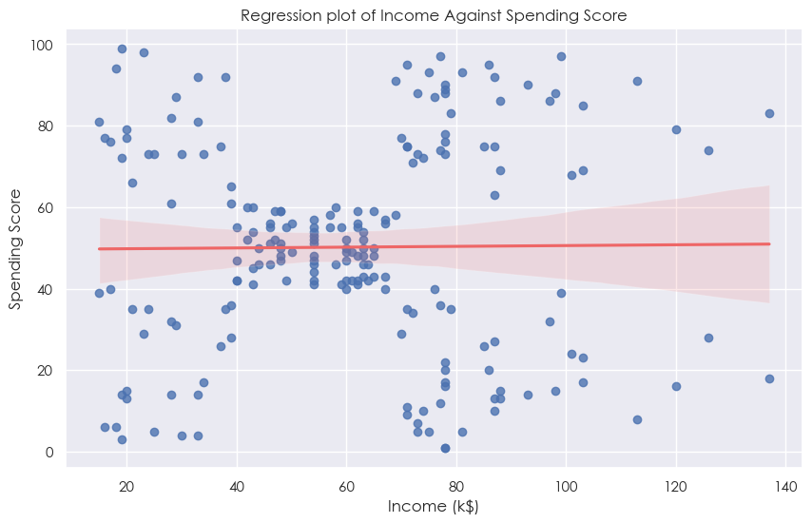
EXPLORATORY DATA ANALYSIS [EDA]
CHART 5

Slide 8
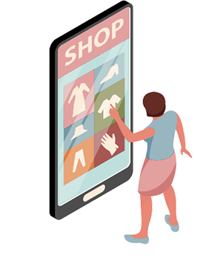
FEATURE ENGINEERING

Slide 9
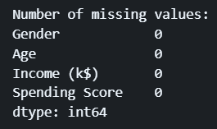

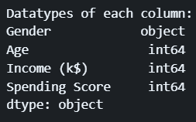
FEATURE ENGINEERING
DROP “CUSTOMERID” COLUMN
RENAME “HOW MUCH THEY SPEND” COLUMN
NO DATA CLEANING REQUIRED AS THERE ARE NO MISSING VALUES, DUPLICATE ROWS, OR INCORRECT DATATYPES

Slide 10
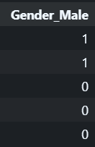
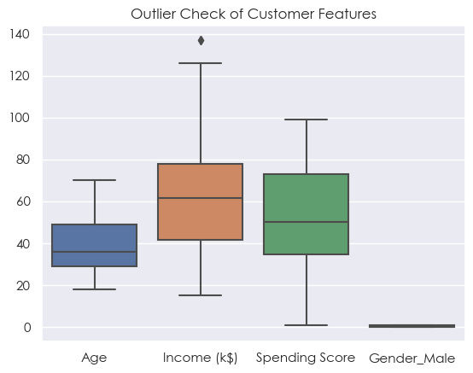
FEATURE ENGINEERING
ONE-HOT ENCODING FEATURES
OUTLIER CHECK

Slide 11
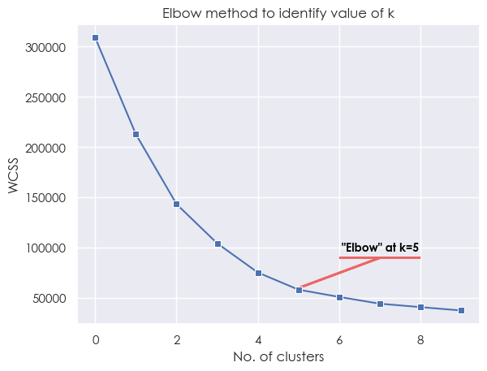
DETERMINE NUMBER OF CLUSTERS, K
1.ELBOW PLOT
METHODS USED:
ELBOW PLOT
DENDROGRAM
SILHOUETTE SCORE ANALYSIS
VISUAL INSPECTION

Slide 12
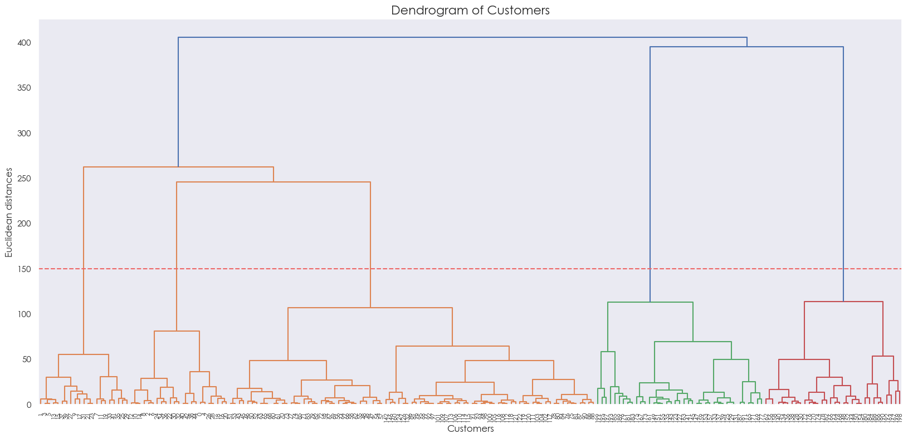
DETERMINE NUMBER OF CLUSTERS, K
2. DENDROGRAM

Slide 13
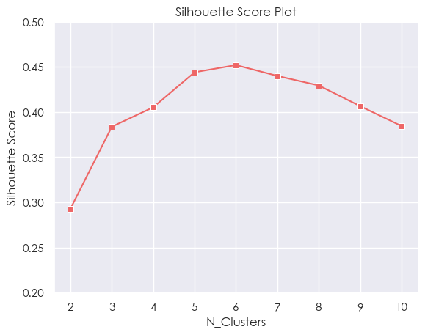
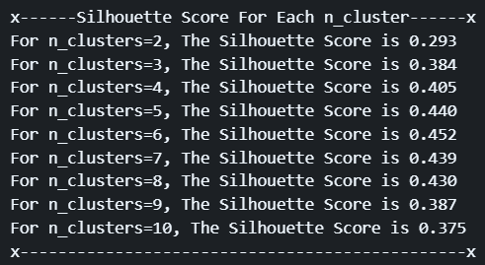
DETERMINE NUMBER OF CLUSTERS, K
3. SILHOUETTE SCORE ANALYSIS

Slide 14
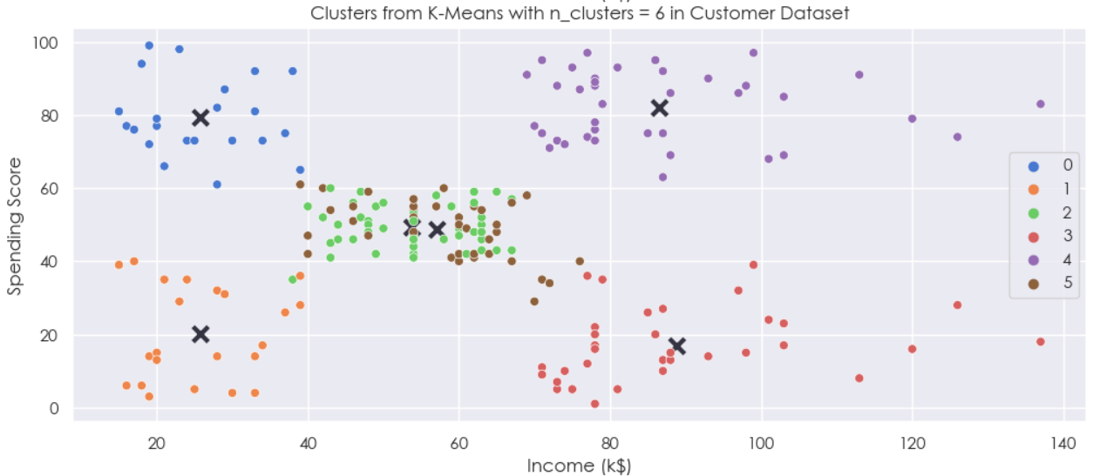
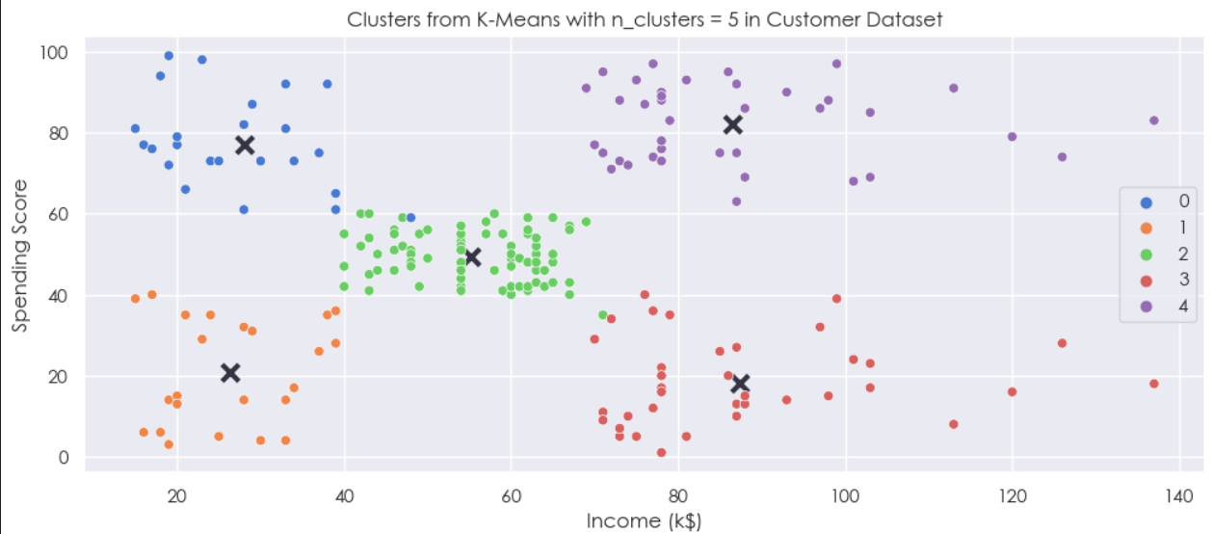
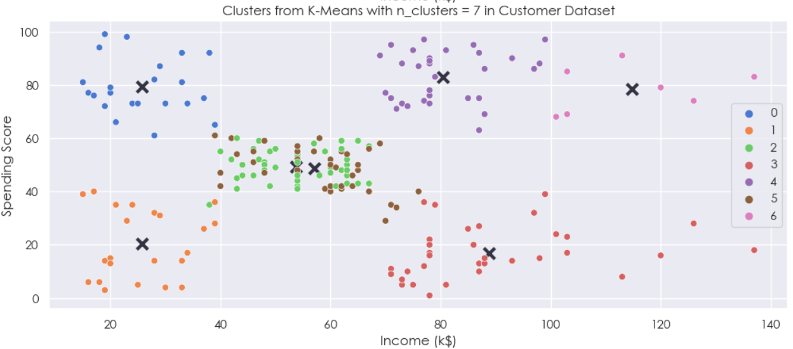
DETERMINE NUMBER OF CLUSTERS, K
4. VISUAL INSPECTION
n_clusters = 6
n_clusters = 5
n_clusters = 7

Slide 15
HYPERPARAMETER TUNING
Hyperparameter tuning is done for algorithms that do not require specifying the number of clusters specifically and when the default hyperparameters were utilized, an error is shown.
Different hyperparameters would be tuned and the best hyperparameters would be identified with the highest silhouette scores.
ALGORITHMS TO BE TUNED:
- MeanShift
- DBSCAN
- Gaussian Mixture

Slide 16
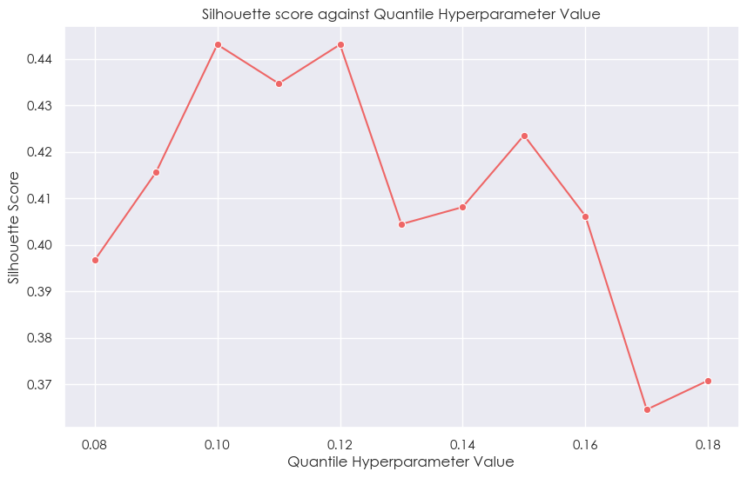
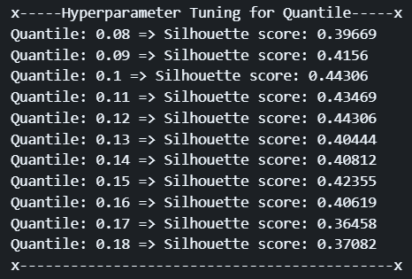
HYPERPARAMETER TUNING
MODEL IMPROVEMENT
ON MEANSHIFT ALGORITHM

Slide 17
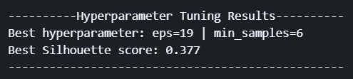
HYPERPARAMETER TUNING
MODEL IMPROVEMENT
ON DBSCAN
Performed GridSearch to determine best hyperparameters

Slide 18
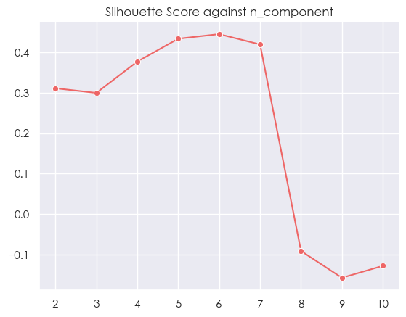
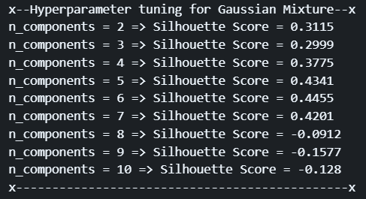
HYPERPARAMETER TUNING
MODEL IMPROVEMENT
ON GAUSSIAN MIXTURE

Slide 19
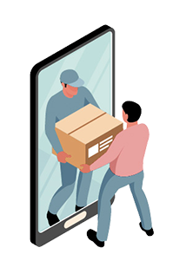
ALGORITHM SELECTION
Methods:
- Scatterplot To View Clusters
- Silhouette Score
Clustering Algorithms Tested:
- K-Means [BASELINE]
- Agglomerative
- DBSCAN
- Mean Shift
- Spectral
- Affinity Propagation

Slide 20
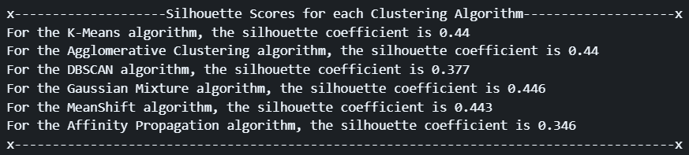
COMPARING CLUSTERING ALGORITHMS

Slide 21
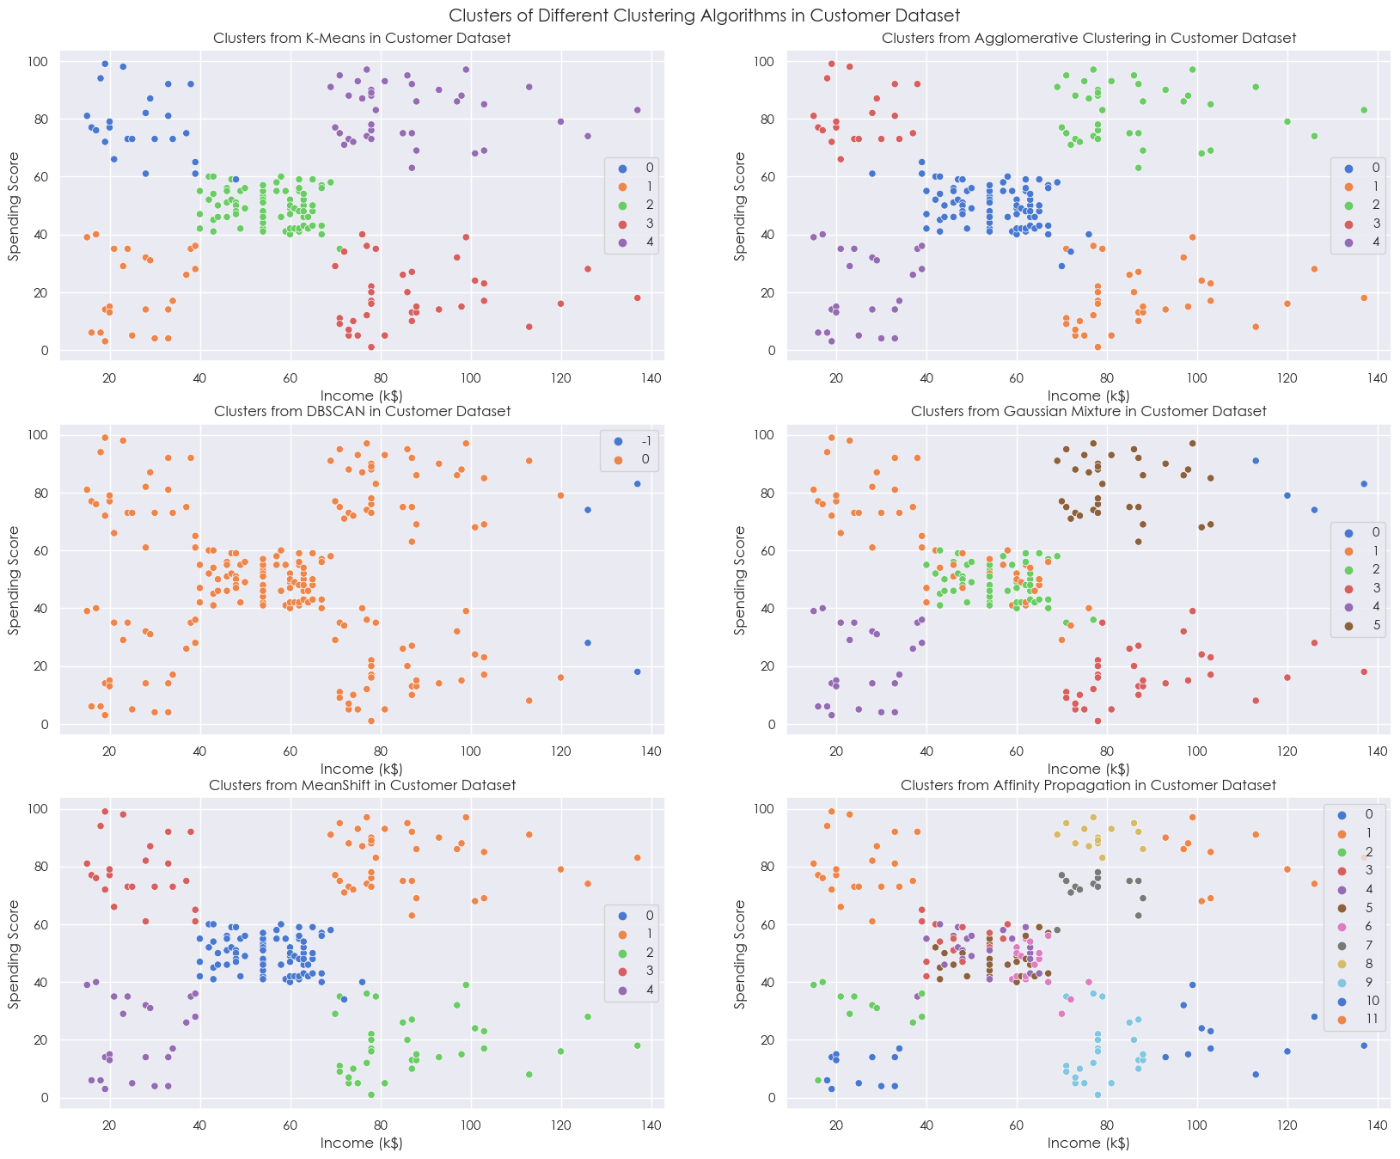
COMPARING CLUSTERING ALGORITHMS
0.44
0.44
0.443

Slide 22

COMPARING CLUSTERING ALGORITHMS
THE BEST CLUSTERING ALGORITHM:
MEANSHIFT CLUSTERING ALGORITHM

Slide 23
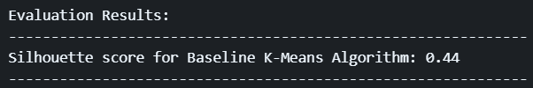
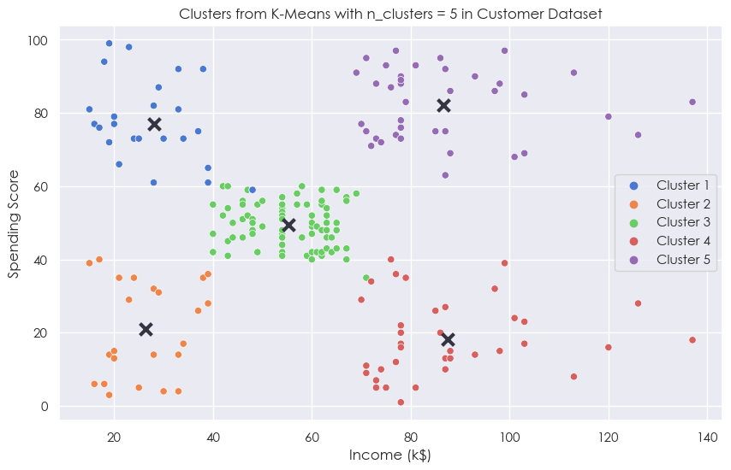
BASELINE K-MEANS ALGORITHM

Slide 24
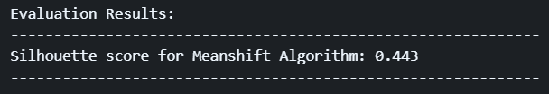
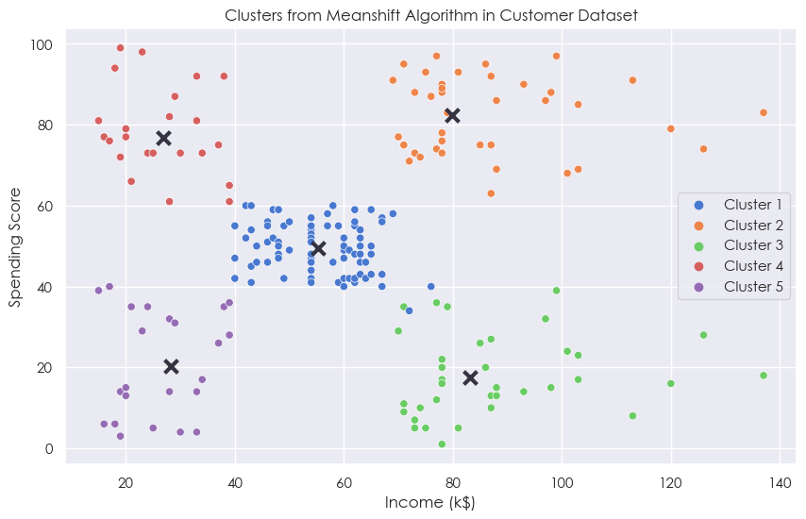
FINAL ALGORITHM

Slide 25
FINAL ALGORITHM
ANALYSIS
Cluster 1 => Customers who have average income and average spending
Cluster 2 => Customers who have high income and high spending
Cluster 3 => Customers who have high income but low spending
Cluster 4 => Customers who have low income but high spending
Cluster 5 => Customers who have low income and low spending
Low
High
Average

Slide 26

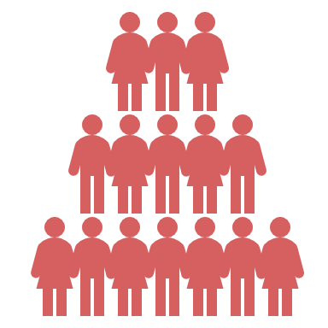
FINAL ALGORITHM
MOST VALUABLE CUSTOMER GROUP:
Cluster 2 => Customers who have high income and high spending
Constantly have high purchasing power
Significantly improve the mall’s sales and profits
Cluster 5 => Customers who have low income and low spending
Do not bring about much benefits to the mall in comparison
The mall should NOT neglect other groups of customers
Can still bring about other benefits such as improving reputation & volume of customers in the mall

Slide 27
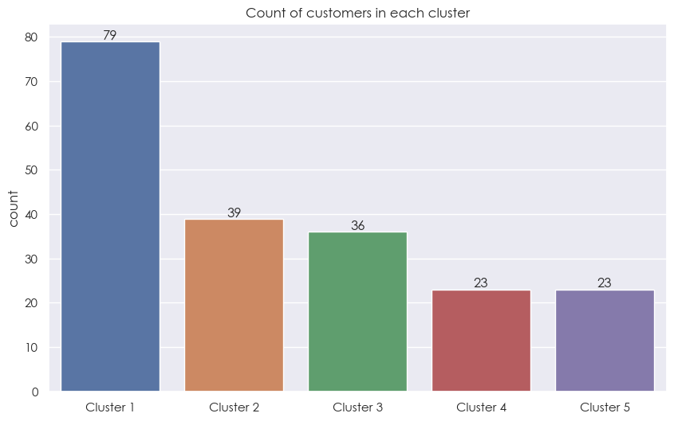
FINAL ALGORITHM
FURTHER ANALYSIS

Slide 28
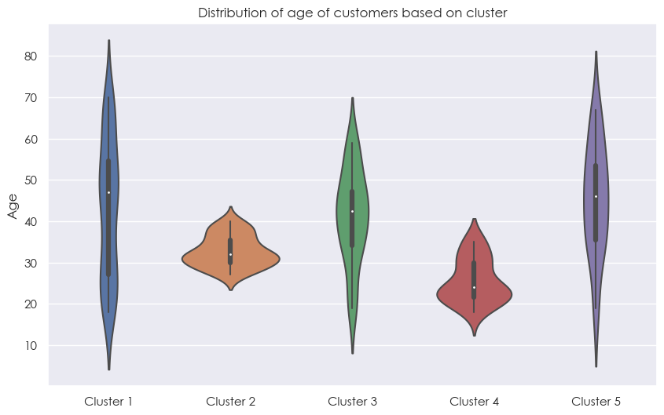
FINAL ALGORITHM
FURTHER ANALYSIS

Slide 29
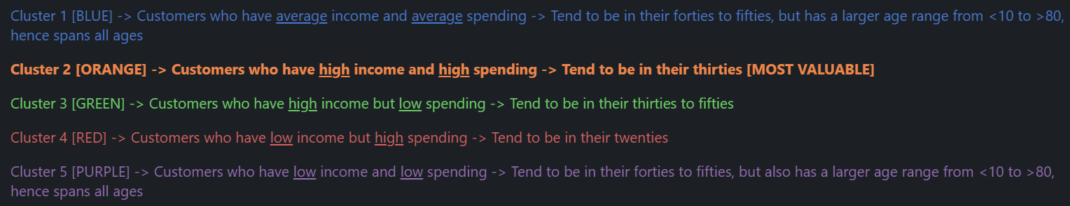
FINAL ALGORITHM
FURTHER ANALYSIS

Slide 30
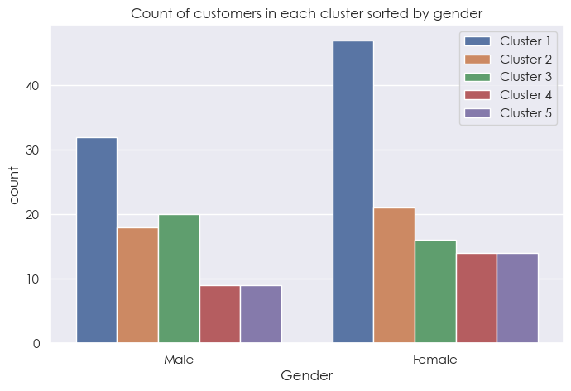
FINAL ALGORITHM
FURTHER ANALYSIS

Slide 31
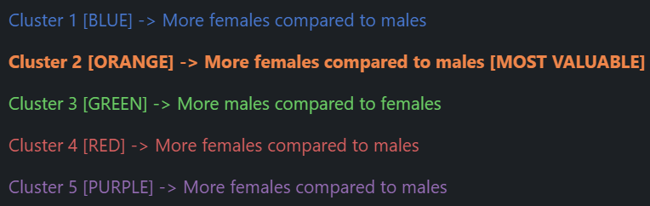
FINAL ALGORITHM
FURTHER ANALYSIS

Slide 32




CONCLUSION
In conclusion, to retain my mall's most valuable group of customers, I would appeal more towards:
Customers who have high income and high spending, which are customers from cluster 2.
Female customers
- Customers in their thirties
Higher purchasing power
Boost my malls’ revenue, reputation and is overall very beneficial

Slide 33




CONCLUSION
Some ways to appeal towards these customers:
Increase advertising or stock of popular female products such as skincare, clothings etc.
Having more luxury brands and premium stores
Loyalty programmes
However,
This does not mean that the mall should neglect other customer groups as even though they may not bring about financial benefits, there would still bring other benefits such as increased reputation.

Slide 34
THINGS THAT WERE NOT IMPLEMENTED
FEATURE SCALING
Feature scaling seemed to worsen the model's predictions during clustering, leading to poorer silhouette scores and interpretability, shown in the report.
2. PCA
We already have very few features to work with and every feature is important.

Slide 35

THANK YOU!

