Slide 1
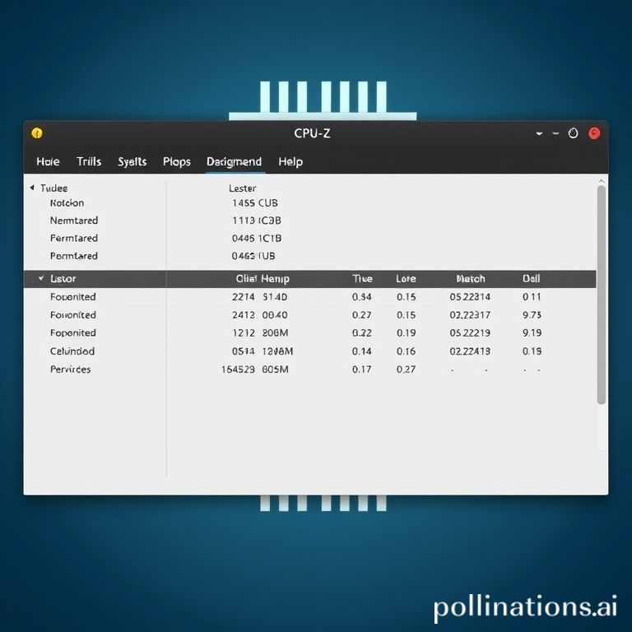
CPU-Z: System Information Utility
• Current Version: 2.15, released March 2025.
• Developed by CPUID, accessible via cpuid.com.
• Official Web Page: cpuid.com/softwares/cpu-z.html.
• Validation and Hall of Fame available at valid.x86.fr.

Slide 2
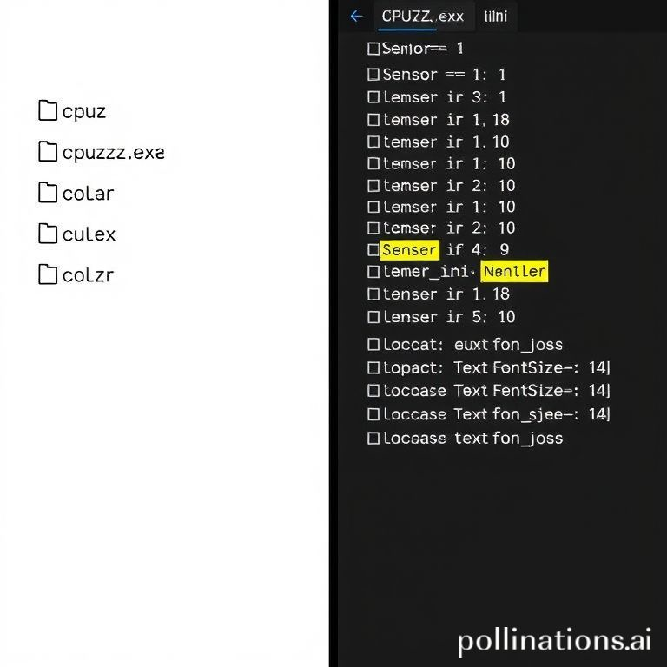
Configuring CPU-Z: The cpuz.ini File
• The `cpuz.ini` file must be in the same directory as `cpuz.exe`.
• Customize display settings: `TextFontName`, `TextFontSize`, `TextFontColor`.
• Enable/disable data collection for `Sensor`, `PCI`, `DMI`, `SMBus`, `SPD` information.
• `XOC` (eXtreme Overclock Mode) for minimal system load.
• `CheckUpdates` controls the new version checker at startup.

Slide 3
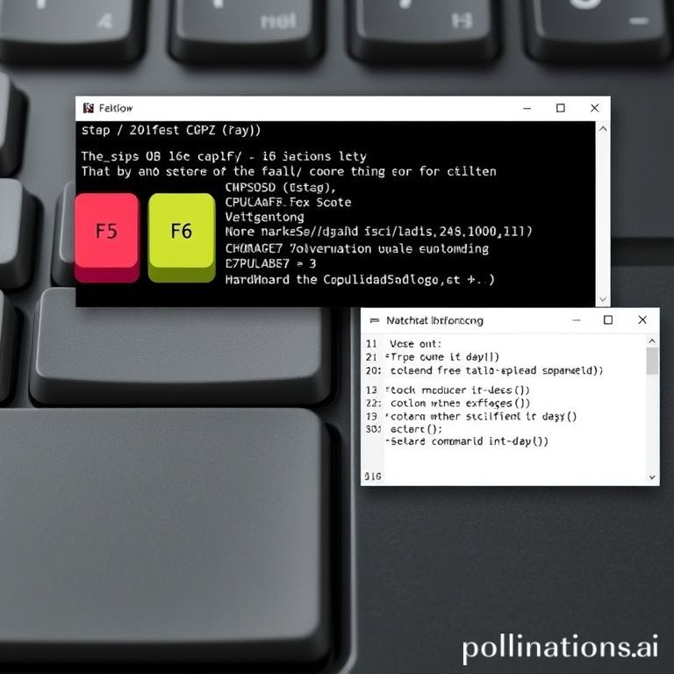
CPU-Z Productivity: Command-Line & Hotkeys
• Generate reports in 'ghost mode' without interface: `-txt=filename` or `-html=filename`.
• Display specific core clock speed: `-core=id` (e.g., `-core=0`).
• Run benchmark automatically and save results: `-bench`.
• Quick actions with hotkeys: F5 (save tab as BMP), F6 (copy tab to clipboard), F7 (save CVF file).

Slide 4

CPU-Z Version 2.15: Latest Hardware Support
• Improved support for Intel Arrow Lake-H processors and various AMD Ryzen series (AI Max+, Kraken Point, EPYC).
• Added support for NVIDIA RTX 5070 Ti/5070 and AMD Radeon RX 9070 series GPUs.
• New reporting feature for GPU compute units in the Graphics tab.
• Introduced a new Validation Statistics page (valid.x86.fr/statistics.html).

