Slide 1
Logic flow discuss
Mengting Jiang
AOT

Slide 2
Equipment
Scan-lab
Function generator: Tektronix - AFG31252
Beam_shutter: https://www.thorlabs.com/thorproduct.cfm?partnumber=SH1/M
CCD camera: Andor zyla 5.5 RollingShutter and global shutter sCMOS Camera (USB3.0) (series number:VSC-08735)
Motor stage: H117P1N4, proScanIII control https://www.prior.com/download-category/software

Slide 3
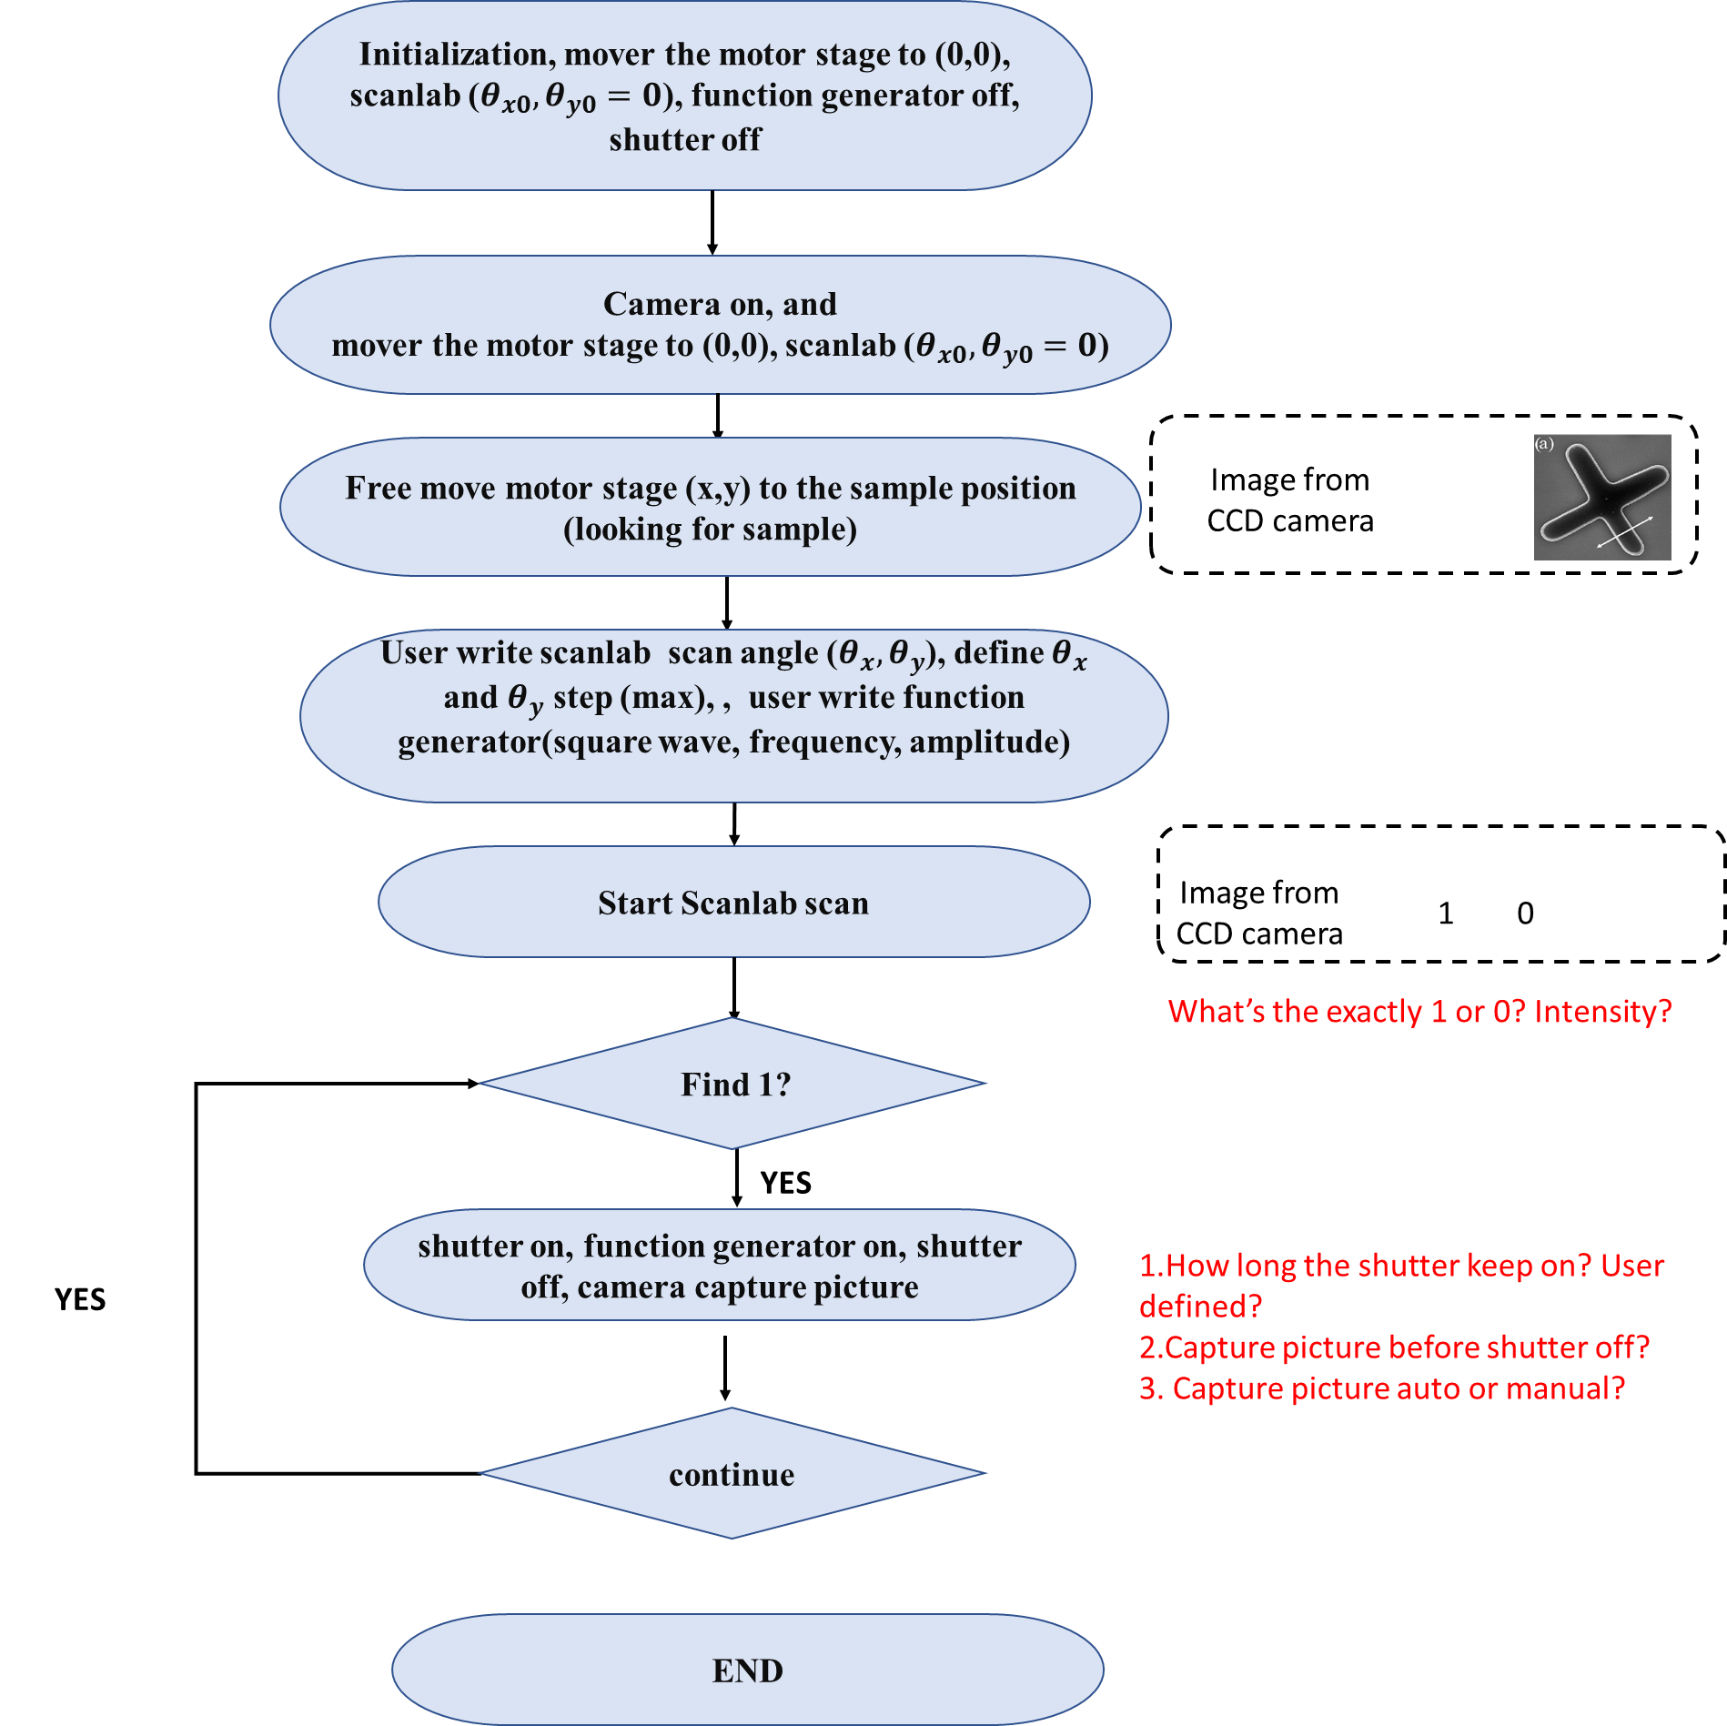
Logic flow
Additional request:
Each equipment has the on, pause, continue, off botton

Slide 4
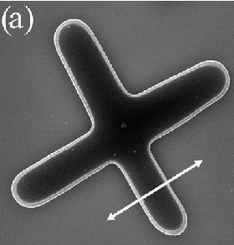
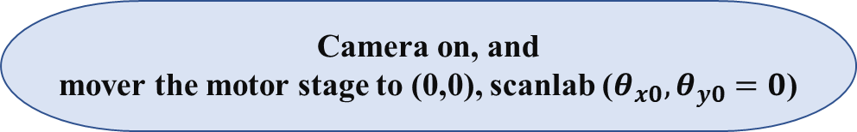
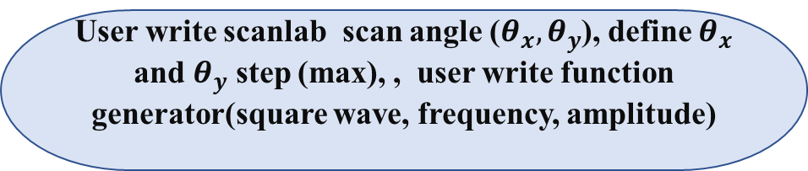
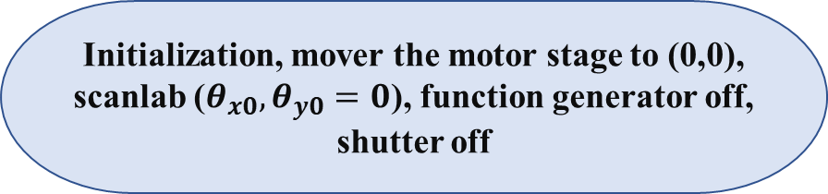
Initialization, mover the motor stage to (0,0), scanlab ($θ_{x0},θ_{y0}=0$), function generator off, shutter off
Camera on, and
mover the motor stage to (0,0), scanlab ($θ_{x0},θ_{y0}=0$)
Free move motor stage (x,y) to the sample position (looking for sample)
Image from CCD camera
User write scanlab scan angle ($θ_{x},θ_{y}$), define $θ_{x}$ and $θ_{y}$ step (max), , user write function generator(square wave, frequency, amplitude)
Start Scanlab scan
Image from CCD camera
1
0
What’s the exactly 1 or 0? Intensity?
Find 1?
YES
shutter on, function generator on, shutter off, camera capture picture
1.How long the shutter keep on? User defined?
2.Capture picture before shutter off? 3. Capture picture auto or manual?
YES
continue
END

