Slide 1

Putting Probability
Lei Shi, Shalima Zalsha

Slide 2

I. Introduction: Putting Probability
Putting
Putting is gently hitting a golf ball into the hole across the green.
It is arguably one of the most important aspects in the game of golf.
Motivation
Limitation of the current PGA Tour putting model, in which only distance is used for predicting the probability.
Objective
Predict the probability that a PGA golfer will successfully make a putt based on a variety of factors.
Photo credit: http://www.appliedgreens.com/golf-course/golf-putting-green/

Slide 3
I. Introduction: Questions of Interest
How does a player’s intention of putting, measured by score, influence the probability of putting?
Does the putting capability of players change throughout the day?
How does a player’s ranking in a tournament affect his/her probability of successful putting?
Do some players, in whom the client is interested, putt better than the others?
What other variables could affect the putting probability?

Slide 4
II. Method: Data
ShotLink® data
Every shot from PGA Tour tournaments between 2014 and 2018.
Excluding shots that are not putt, for example, shots that drive the ball across the course.
Excluding match plays, in which players compete with each other by hole rather than round.
Final data consist of 2,339,569 records and 43 variables.

Slide 5
II. Method: Variables
Variables addressing key questions
Score - a categorical variable indicating the intention of a putting shot:
a birdie or better, par, bogey, and double bogey or worse;
Hole Sequence - indicating the player’s progress in a day;
Rank - a player’s rank in the tournament before he/she takes the shot;
Player – indicator for specific players selected by the client, and all others are grouped as ‘other’;
Other variables
Distance – the distance from the ball to the hole;
Slope – the slope of the ball’s travelling path: level, uphill, or downhill;
Par Value – a pre-determined number of strokes that an average player needs to play a hole.

Slide 6
II. Method: Model Building
Model
A logistic regression model is used to describe how putting probability is affected by a variety of factors. Backward selection is used to reach the final model.
Considerations
A distance² term is included, as we suspect there exists an optimal distance for putting.
Two separate models are fitted for round 1-3 and round 4, because only better players can enter the 4th round, making it a different population.
We also suspect there is an interaction between distance (also distance²) and slope.

Slide 7
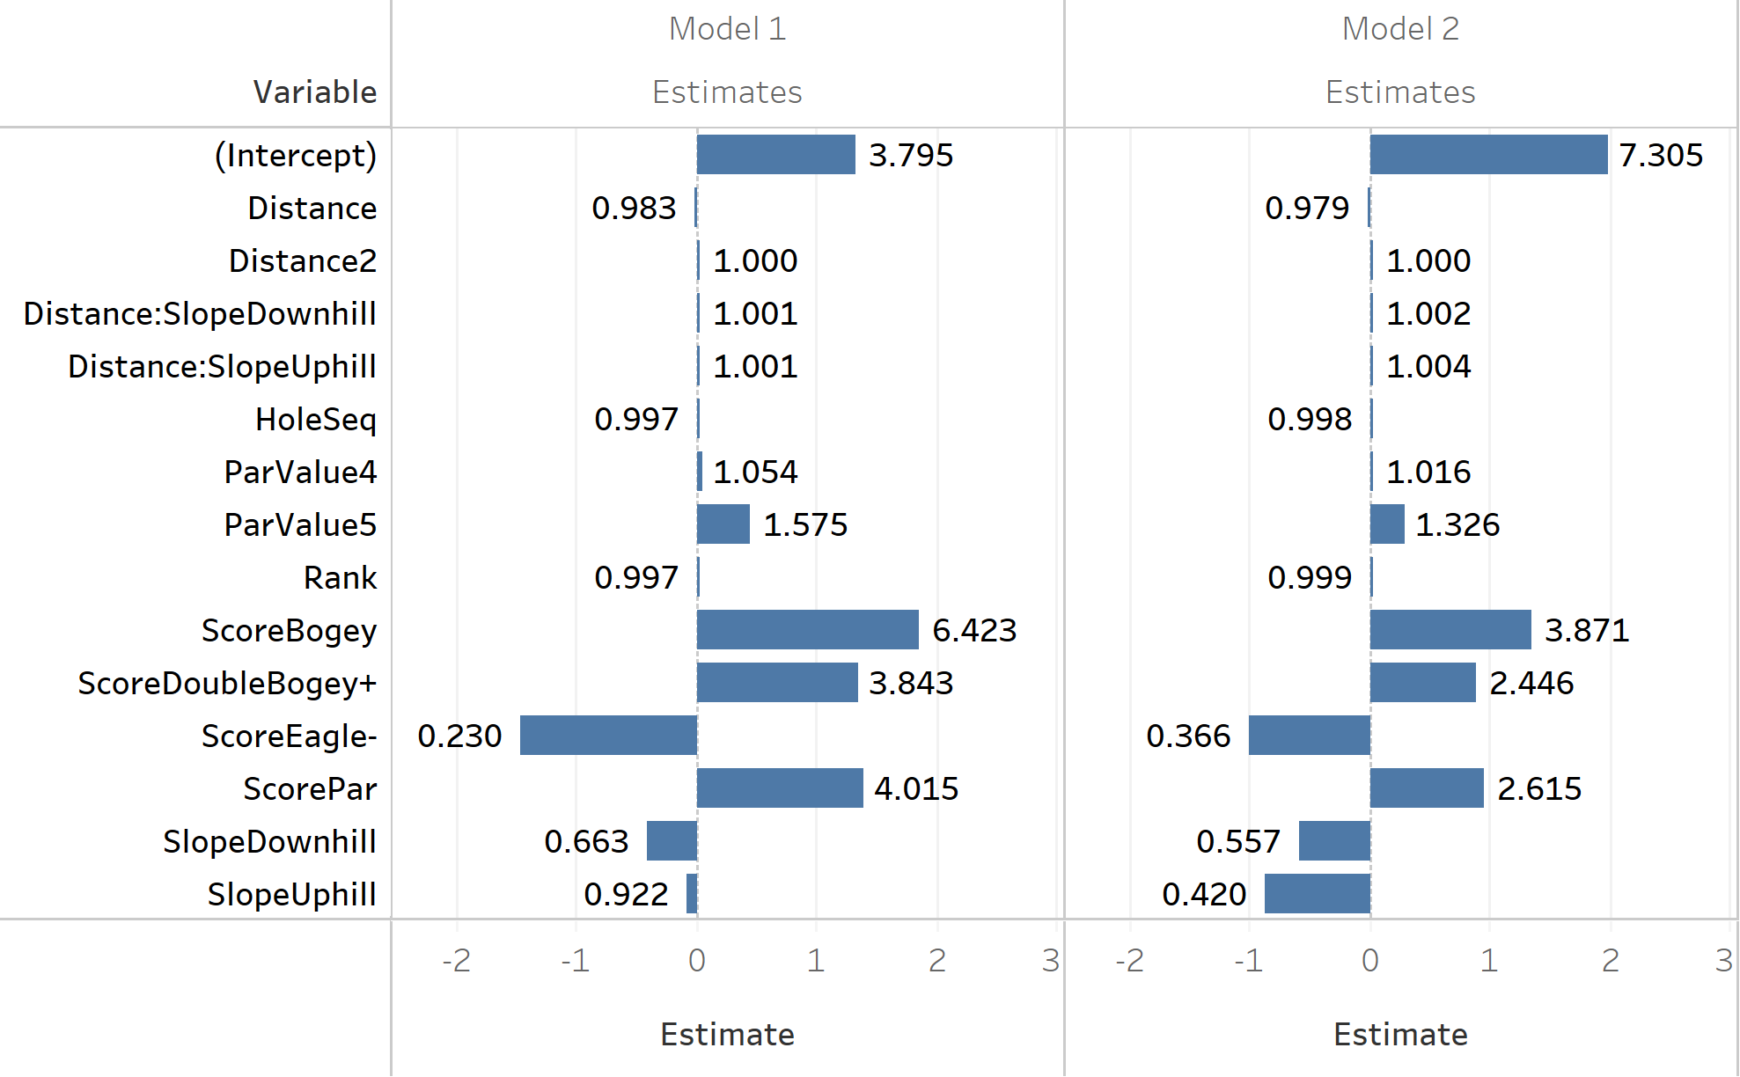
III. Result: Answering Questions
Score
The lower (better) score attempts are less likely to succeed.
Ranking
Higher ranks are less likely to succeed, by slight magnitude.
Distance
Further distance is less likely to succeed.
Slope
Putting on a level path is the more likely to be successful than on an uphill or downhill.
Effects are expressed in terms of its odds ratio $(e^{β})$

Slide 8
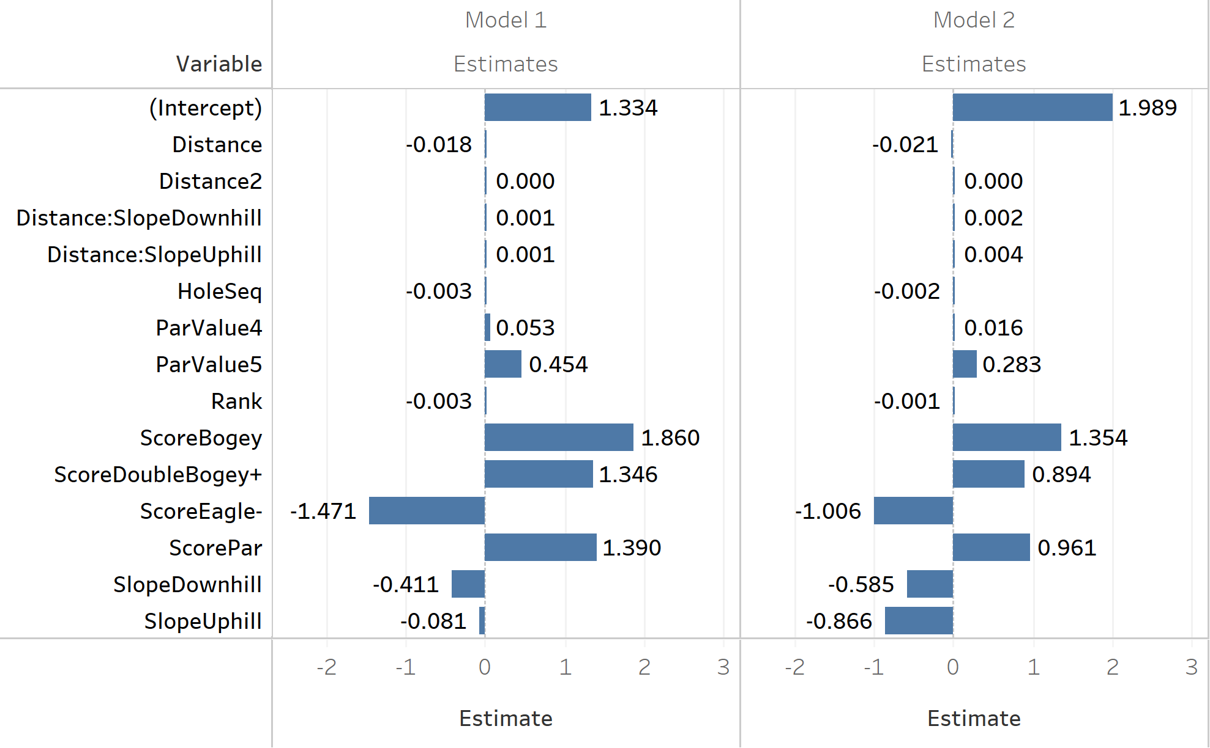
III. Result: Answering Questions
Score
The lower (better) score attempts are less likely to succeed.
Ranking
Higher ranks are less likely to succeed, by slight magnitude.
Distance
Further distance is less likely to succeed.
Slope
Level path is the more likely to succeed than uphill or downhill.

Slide 9
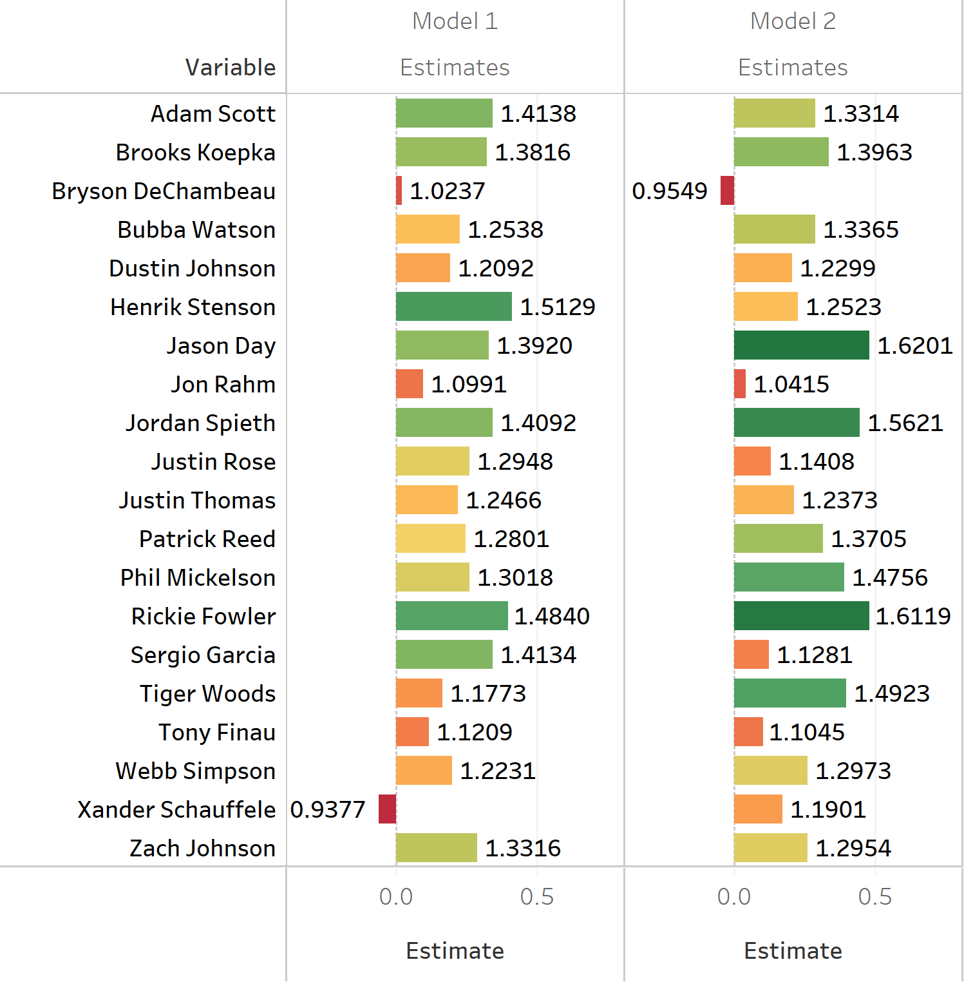
III. Result : Players effect (odds ratio)
Effects are expressed in terms of its odds ratio $(e^{β})$
Client is interested in several players.
Other players not in the list is the baseline for estimated effect.
Some of the players putt better than others:
Rickie Fowler, Jason Day and Jordan Spieth
Some players are not different from the other players, or even worse.
Bryson Dechambeau and Xander Schaeuffele

Slide 10
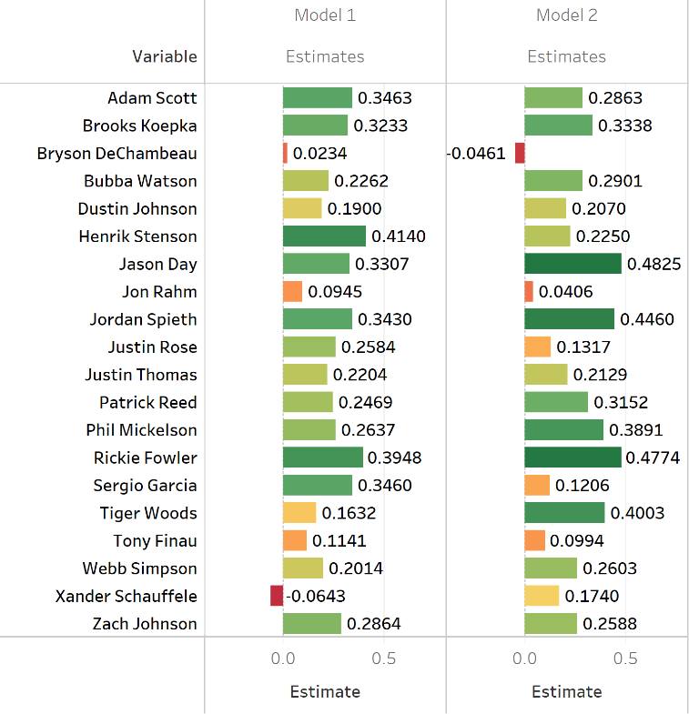
III. Result : Players effect
Client is interested in several players.
Other players not in the list is the baseline for estimated effect.
Some of the players putt better than others:
Rickie Fowler, Jason Day and Jordan Spieth
Some players are not different from the other players, or even worse.
Bryson Dechambeau and Xander Schaeuffele

Slide 11
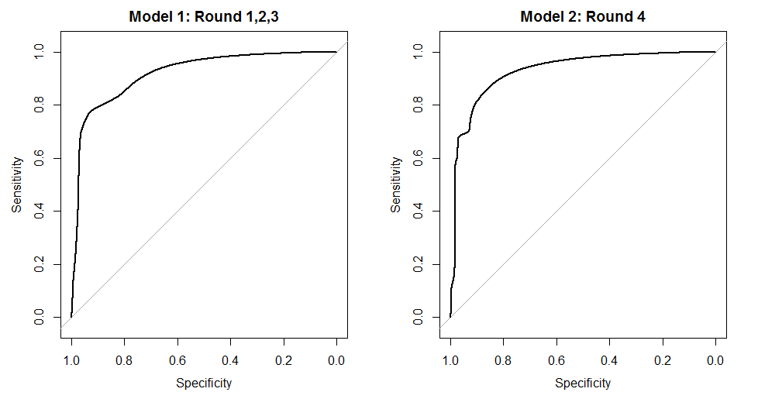
III. Result: ROC Curves

Slide 12
IV. Discussion
Weather Information
Not available in ShotLink® data set.
Future analysis for putting probability could consider using weather information from GIS record and associate it with golf tournaments by time and coordinates.
Model Scope
The model was built using PGA Tour players data which lack of new or rising players.

Slide 13
V. Conclusion
Objective
Predict the probability that a PGA golfer will successfully make a putt given a variety of factors.
Address questions of interest
Score, ranking, distance, slope, players
Methodology
Logistic Regression
Discussion and limitations
Weather and model scope
Notes:
Difficulties: LeaderBoard, Large Data

Slide 14
References
Agresti, A. (2014). Categorical Data Analysis. Hoboken: Wiley.
Gelman, A. and Nolan, D. (2002), A Probability Model for Golf Putting. Teaching Statistics, 24: 93-95. doi:10.1111/1467-9639.00097
Introduction to SAS. UCLA: Statistical Consulting Group. (n.d.). Retrieved November 25, 2018, from https://stats.idre.ucla.edu/other/mult-pkg/faq/general/faq-how-do-i-interpret-odds-ratios-in-logistic-regression/

Slide 15
Questions?
Thank you!

