Slide 1
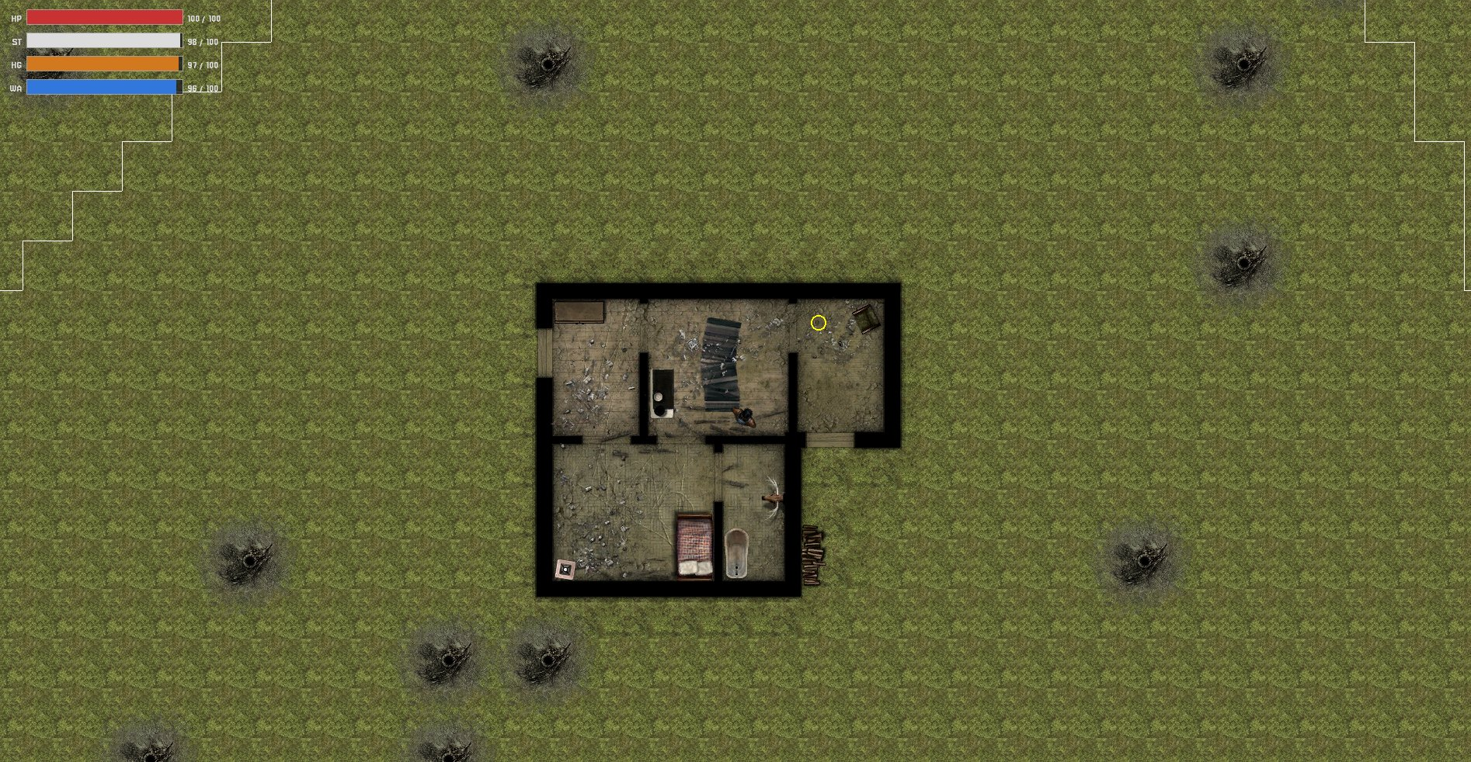
THORNS
Project Progress Update

Slide 2
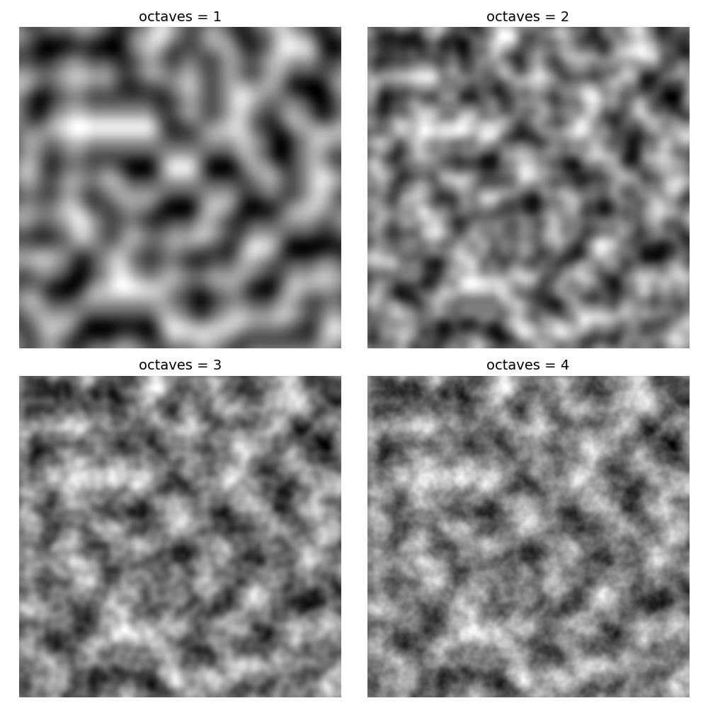
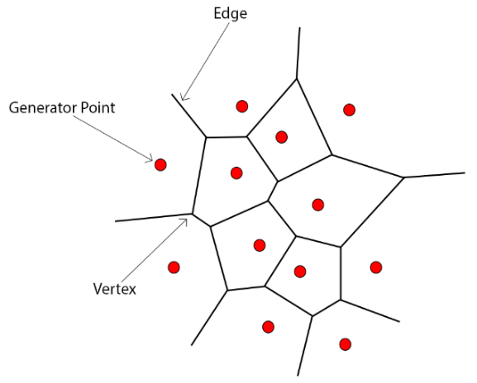
CONTEXT POINTS: VORONOI AND PERLIN NOISE
Voronoi Regionalization
Perlin Noise
What is it?
Imagine dropping seeds onto the map. Every tile simply asks, “which seed am I closest to?” That seed claims the tile. Regions separated into different areas.
In THORNS:
Each seed is a map site. POIs like farms and villages are placed at those sites, so they are always spaced out and never clump together.
What is it?
Pure random noise looks like TV static. Perlin Noise is randomness that flows smoothly, like rolling hills or drifting clouds. Each value blends gently into the next. (Octaves are used to perform multiple layers of noise)
In THORNS: Used to scatter world objects (rocks, roots, stumps) across the terrain in natural-looking clusters, rather than totally random or evenly spaced patterns.

Slide 3
COMPLETED MILESTONES
Game Loop & State Machine
Input Abstraction Layer
Procedural Map Generation
Fixed 60 frame per second, push/pop state transitions (Menu, Playing, Paused, Settings)
Keyboard + gamepad support, rebindable keys, device detection at runtime
Voronoi regionalization via Poisson disk sampling, spatial grid O(k) lookups
POI System
Player & Camera
UI Framework
Farms placed at Voronoi sites, TMX collision templates
State machine (Idle/Walk/Sprint/Inventory), mouse-facing rotation, camera clamp
Main, Pause & Settings menus with key rebinding, inventory grid (10 slots), HUD bars

Slide 4
REMAINING MILESTONES
Inventory
Items & Use
Making “Inventory” items such as Food, Water, Health Packs,
Week 10 (Current week)
AI & Enemies
Using the Voronoi Spatial Sites for enemy updating delegation and isolation.
Either FSM or dynamic class pointer swapping
Easter Break
Weapons
System
Different tiers of weapons to find and collect within the world.
Range and Melee (knifes, axe, gun, etc)
Easter Break
POI & World
Finalization
Fixing any final generation issues and adding in the rest of the world objects and POI sites
Week 11
Priority ordered: Inventory -> AI → Weapons -> World Finalization

Slide 5
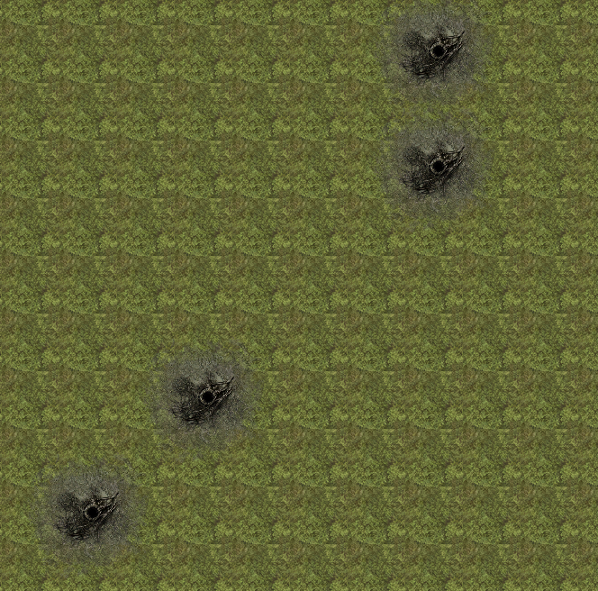
PERLIN NOISE: WORLD OBJECT PLACEMENT
What It Does
Generates organic, natural looking clusters for world object placement (tree stumps, roots, rocks – note these will be added in final week) across the map terrain.
How It Works
Each tile's world position is sampled through multi-octave(passes) Perlin noise. Values the threshold trigger a valid placement.
Performance
Shared flyweight atlas for the objects to point to, frustrum culling to only render on screen objects and skips every 2nd tile for generation.
Reproducible
Using Perlin allows for the map to have deterministic seed generation, so its reproducible but still adheres to random generation.

Slide 6
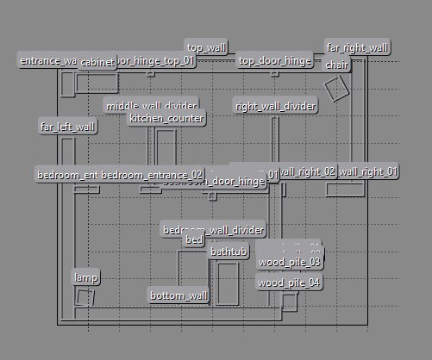
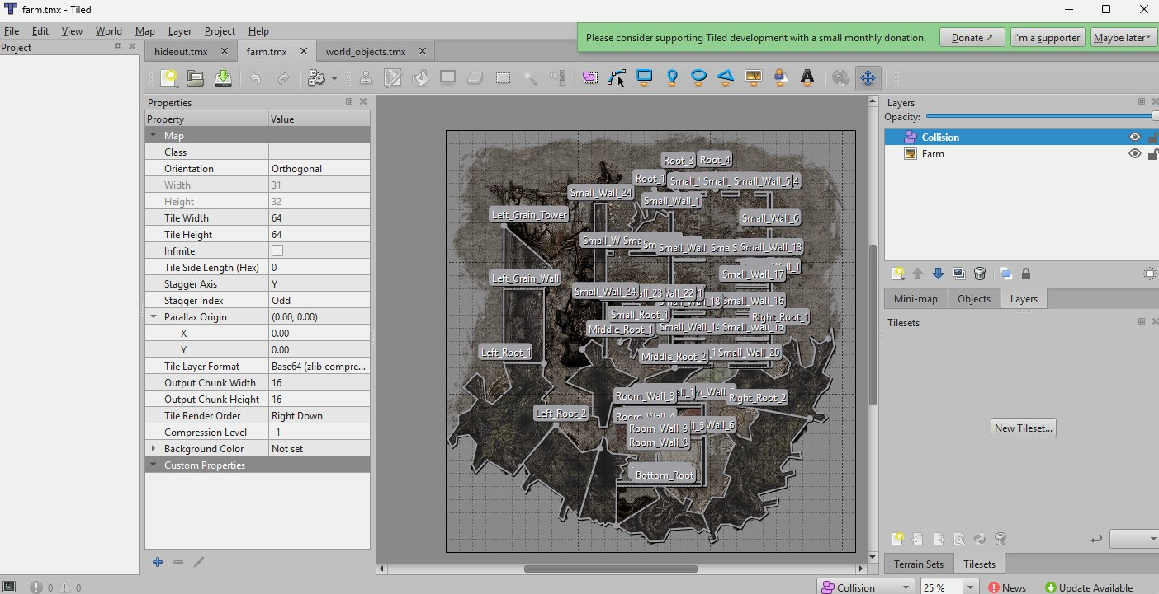
TILED & TMX: COLLISION SYSTEM
Hideout TMX file
Farm TMX file
Tiled Map Editor
tmxlite Library
SAT Collision
Flyweight Pattern
TMX files define named collision shapes for each POI and world object.
Parses .tmx XML at compile time, extracting polygons & rectangles.
CollisionManager uses Separating Axis Theorem (SAT). “Does this vector overlap this one?”.
Multiple objects reference the same data table for collision, not given individual ones.

Slide 7
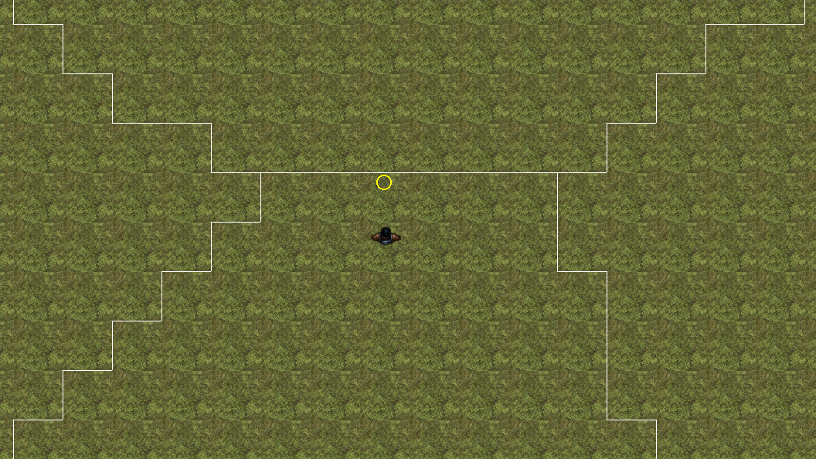
VORONOI: UPDATED GENERATION
Auto Site Spacing
Sites will now auto space the distance needed between them. i.e (Map is X big and to use 5 sites, divide into 5 sections accordingly.)
Full Map Coverage
Sites used to only cover small, unscaled, sections of the map, now more tiles are assigned to a site region. (I.e 2 sites split map into 2 sections now)
POIs Spawn Far From Player
Voronoi sites are sorted by distance from the hideout before POI assignment — Villages and Farms spawn at furthest possible points.

Slide 8
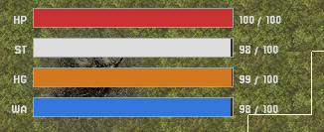
HUD SYSTEM — PLAYER STATS
Health
HP
Health component manages the damage, gains and total health values
Stamina
ST
Note: Rest use a generic “StatComponent”
Drains when the player sprints and recharge when walking
Hunger
HG
Drains over time at a medium rate, when inventory items are added will be able to regain hunger.
Water
WA
Drains also over time but at a faster rate, will be an inventory item to collect and manage.

Slide 9
NEXT: INVENTORY SYSTEM & COLLECTABLES
IMPLEMENTATION PLAN
1
Item Data Classes
Framework Setup
ItemBase with type enum (Food, Water, Weapon, Material), stats payload, stack limit
10-slot inventory grid (2×5) with hover detection
SpriteComponent-backed item rendering with quantity display
addItem/ removeItem / clearSlot templates
World Pickup Component
Trigger zone on map, player overlap adds item to inventory, removes world object
Needs to be worked on
Item types: food, water, weapons, materials
World pickups: collision/trigger zones on map objects
Use actions: Equip from inventory to use an item
Inventory Use Actions
Right-click slot, context actions such as “equip” or “use”
4
HUD Integration
Active item shown in HUD. Consumable items trigger stat changes and removed from slot

Slide 10
NEXT: AI ENEMIES & WEAPONS SYSTEM
PRIORITY 2
AI ENEMY BEHAVIOURS
WEAPONS SYSTEM
Idle State
Weapon Types
Enemy stands at post
Melee (knife, axe) and ranged (gun or throwing weapons)
Patrol State
Attack Input
Moves between waypoints or along a fixed path (A* or flowfield patterns)
Hold left click to ready the attack, right click to initiate
Alert State
Damage System
Player detected within range, using raycast
Weapon damage applied via HealthComponent.takeDamage() on both enemies and player
Chase State
Inventory Integration
Moves toward player position, might try add collision avoidance with raycasts using LOS class
Weapons equippable from inventory slots, active weapon shown in HUD slot
Attack State
Collision Detection
In melee/ranged range, triggers attack damage
Collision manager to be updated to account for weapons and hitboxes of entities.

Slide 11
WORLD FINALIZATION & NEW POI AREAS
New POI: Village & Landmarks
Terrain Variety
More POI areas for the player to explore and see
Different types of terrain to generate on the ground and world object placement layers
Priority note^

Slide 12
THORNS
Suggestion and feedback.

